Slide 1
CS 341: Algorithms
Lecture 11: graph algorithms II – finishing BFS, depth first search
Readings: see website
Trevor Brown
https://student.cs.uwaterloo.ca/~cs341
trevor.brown@uwaterloo.ca

Slide 2
BFS Application: testing whether a graph is bipartite

Slide 3
(Undirected) Bipartite graphs and BFS
A graph is bipartite if the nodes can be partitioned into sets $R$ and $B$ such that each edge has one endpoint in $R$ and one endpoint in $B$
7
7
8
7
8
8
3
5
3
5
3
5
6
6
6
1
1
1
2
4
2
2
4
4
$$G$$
$$R$$
$$B$$

Slide 4
Crucial property: no odd cycles
Claim: a graph is bipartite if and only if it does not contain an odd length cycle
Edge with both endpoints in $B$!
7
7
8
7
8
What happens if I create an odd length cycle?
8
3
5
3
5
3
5
6
6
6
1
1
1
2
4
2
2
4
4
$$G$$
$$R$$
$$B$$

Slide 5
Proof Part 1: odd cycle $⇒$ not bipartite
Suppose there is an odd length cycle $v_{1},v_{2},…,v_{2k+1},v_{1}$
$$v_{7}$$
…
until $v_{2k}∈B$
$$v_{7}$$
$$v_{2k}$$
$$v_{2k}$$
$$v_{6}$$
$$v_{6}$$
$$v_{2k+1}$$
$${ v}_{2k+1}$$
And finally $v_{2k+1}∈R$ !!
And so on,
alternating…
Both endpoints in $R$! Contradiction!
$$v_{5}$$
$$v_{5}$$
$$v_{1}$$
$$v_{1}$$
WLOG let $v_{1}∈R$
$$v_{4}$$
$$v_{4}$$
$$v_{2}$$
$$v_{2}$$
Then we must have $v_{2}∈B$
$$v_{3}$$
And $v_{4}∈B$
$$v_{3}$$
(or there will be an edge $(v_{1},v_{2})$ with two endpoints in $R$)
And $v_{3}∈R$

Slide 6
Proof Part 2: all cycles have even length $⇒$ bipartite
Let $v_{i}$ be any node, and $d(v)$ be the distance from $v_{i}$ to $v$
Partition nodes by even vs odd distances
$$d\left(v_{i}\right)=0$$
$$d=1$$
8
$$v_{i}$$
$$v_{i}$$
$$v_{i}$$
8
8
3
5
$$d=1$$
$$d=2$$
$$d=3$$
$$G$$
3
3
5
5
6
6
6
1
$$d=2$$
$$d=3$$
$$d=4$$
1
1
2
2
4
4
2
4
WTP: no edge between red nodes
no edge between blue nodes
$R=$ odd $d(v)$
$B=$ even $d\left(v\right)$

Slide 7
Bad edges mean odd cycles
Claim: if there were an edge between red nodes, or between blue nodes, there would be an odd length cycle
WLOG suppose for contradiction $\left(u,v\right)∈E$ where $u,v∈R$
Since $u,v∈R$, distances $d(u)$ and $d(v)$ from $v_{i}$ are both odd
Recall $d(u)$ = length of shortest path $v_{i}→…→u$
…
$$u$$
$d(u)=$odd
The combined path
$$v_{i}→…→u→v→…→v_{i}$$
forms a cycle
$$v_{i}$$
And its length is
$d\left(u\right)+1+d\left(v\right)$ which is odd!
…
$$v$$
$d(v)=$odd
…and $d(v)$the shortest path $v_{i}→…→v$
So there is no edge $\left(u,v\right)$where $u,v∈R$ (case $B$ is similar)
Notes:
Claim: If there were an edge between red nodes, or between blue nodes, there would be an odd length cycle!
Proof: WLOG suppose for contra there is an edge between u,v \in R. Both have odd distance from v_i. Path u->…->v_i->…->v->u has length d(u)+d(v)+1 which is odd!
Consider the cycle $u→…→v_{i}→…→v→u$

Slide 8
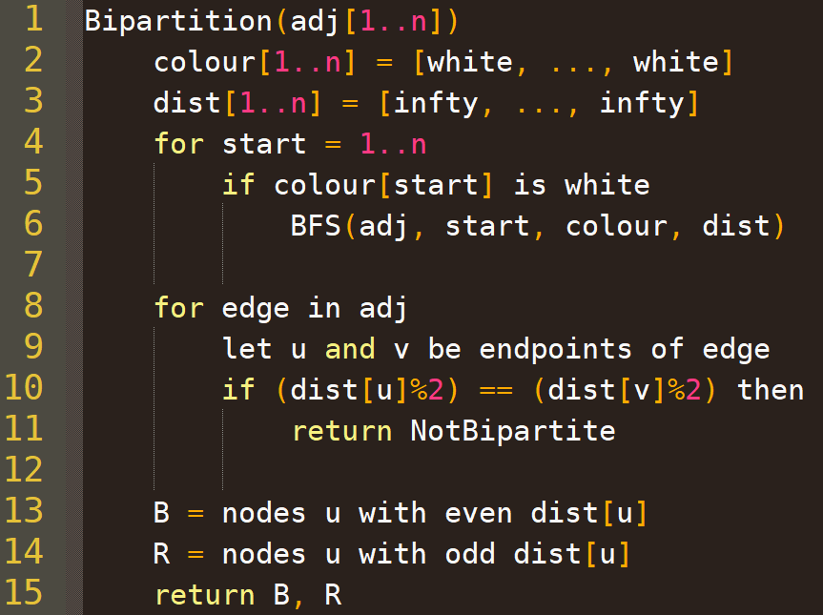
Algorithm for testing Bipartiteness
Call BFS on each component to calculate distances for each node
Modified BFS that reuses the same colour array
and same dist array
If both even or both odd
Runtime complexity?
Return an actual bipartition
Can be done in $O(n+m)$

Slide 9
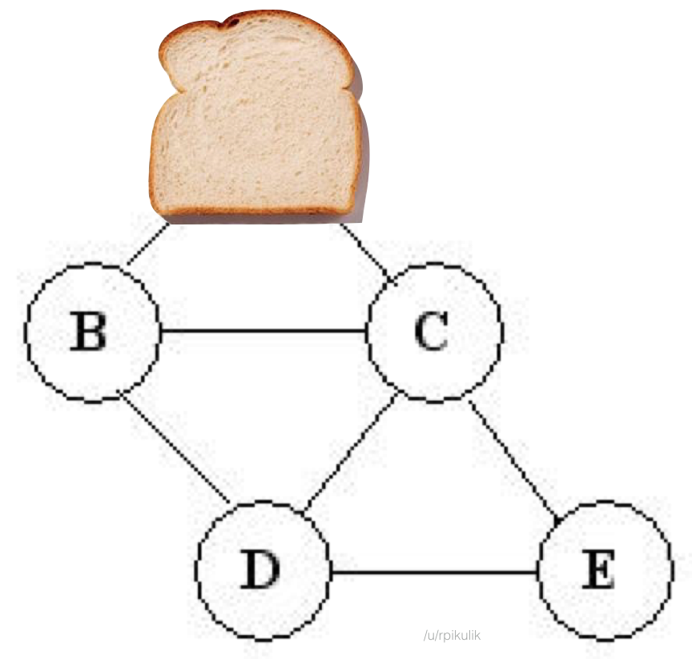
Depth first search
Bread first
search
Depp first
search

Slide 10
Depth-first search of a directed graph

Slide 11
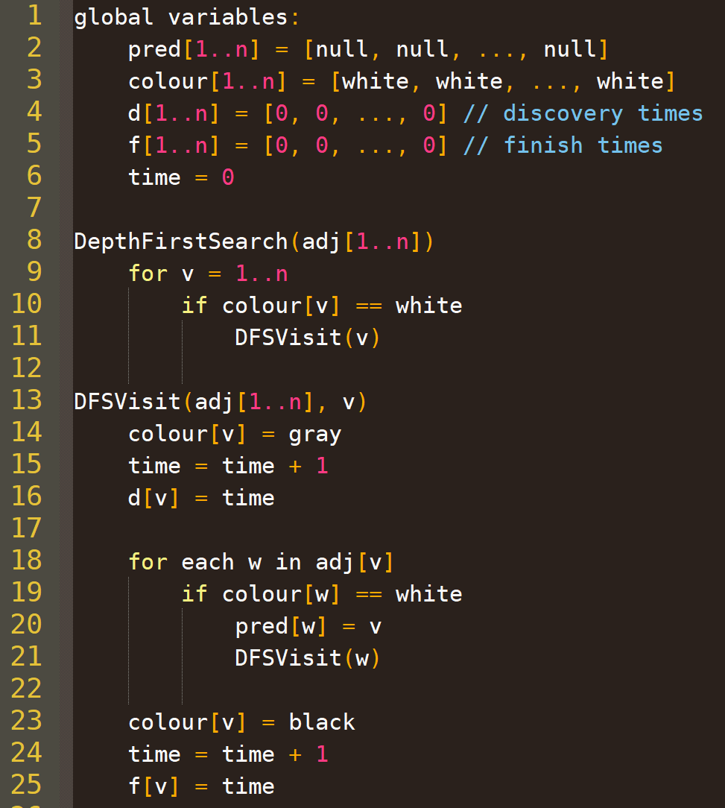
Depth first search Algorithm
Example execution starting at node 1
time = 0
time = 1
time = 2
time = 3
time = 4
time = 5
time = 6
time = 7
time = 8
time = 9
time = 10
time = 11
time = 12
not white
not white
3
3
3
5
5
5
6
6
6
not white
d[3]=3
d[5]=7
d[6]=11
f[3]=4
f[5]=8
f[6]=12
not white
1
1
1
2
2
2
4
4
4
d[1]=1
d[2]=2
d[4]=5
f[1]=10
f[2]=9
f[4]=6
DFSVisit(1)
DFSVisit(6)

Slide 12
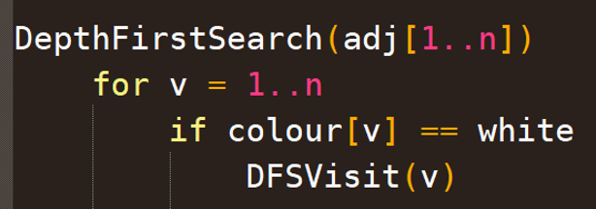
DFS tree / forest
Could draw BFS forest this way also…
As in breadth first search, $pred[]$ array induces a forest
Let’s match the graph’s edge directions (opposite from pred)
Graph
DFS forest
3
3
3
5
5
5
6
6
6
1
6
d[3]=3
d[5]=7
d[6]=11
f[3]=4
f[5]=8
f[6]=12
tree 2
1
1
1
2
2
2
4
4
4
2
d[1]=1
d[2]=2
d[4]=5
f[1]=10
f[2]=9
f[4]=6
3
4
5
tree 1
Each top level DFSVisit call is the root of a tree
Recall: DFSVisit(1), DFSVisit(6)

Slide 13
Basic DFS Properties to remember
Also gets a discovery time $d[v]$ at this point
Nodes start white
A node $v$ turns gray when it is discovered, which is when the first call to $DFSVisit(v)$ happens
After $v$ is turned gray, we recurse on its neighbours
After recursing on all neighbours, we turn $v$ black
Recursive calls on neighbours end before $DFSVisit(v)$ does, so the neighbours of $v$ turn black before $v$
Also gets a finish time $f[v]$ at this point

Slide 14
Runtime Complexity of DFS (for Adj. lists)
$$O(n)$$
Home exercise: complexity with adjacency matrix?
Only called on a white node, and immediately colours the node gray
So called once per node!
Each call iterates over the neighbours. Effectively: “for each node, for each neighbour, do O(1) work + recurse.”
Total O(n+m) iterations over all recursive calls. Total O(n+m) runtime!

Slide 15
Classifying edge in DFS
$$u$$
$$v$$
If $pred\left[v\right]=u$, then: $(u,v)$ is a tree edge
Else if $v$ is a descendent of $u$ in the DFS forest: forward edge
Else if $v$ is an ancestor of $u$ in the DFS forest: back edge
Else: $(u,v)$ is a cross edge
DFS forest
Graph
1
6
3
3
3
5
5
5
6
6
6
d[3]=3
d[5]=7
d[6]=11
2
f[3]=4
f[5]=8
f[6]=12
1
1
1
2
2
2
4
4
4
d[1]=1
d[2]=2
d[4]=5
3
4
5
f[1]=10
f[2]=9
f[4]=6
Can we classify edges without inspecting the DFS forest? Perhaps using $d[…]$, $f\left[…\right]$, $colour[…]$?

Slide 16
Definitions
Definition: we use $I_{u}$ to denote (𝑑[𝑢],𝑓[𝑢]), which we call the interval of 𝒖
Definition: $v$ is white-reachable from $u$ if there is a path from $u$ to $v$ containing only white nodes (excluding $u$)
2
3
12
7
$$u$$
4
9
11
13
6
1
8
10
5

Slide 17
Exploring d[], f[] and colour[]
Observe: every node $v$ that is white-reachable from $u$ when we first call $DFSVisit(u)$ becomes gray after $u$ and black before $u$ (so $I_{v}$ is nested inside $I_{u}$)
Consider the tree of recursive calls rooted at $DFSVisit(u)$.
Start $DFSVisit(u)$, colour $u$ grey, and set $u$’s discovery time
$v$ is discovered by a call in this tree iff $I_{v}$ is nested inside $I_{u}$
Perform $DFSVisit$ calls recursively…
d=9
iff $v$ is a descendent of $u$ in the DFS forest
f=12
$$u$$
$$u$$
$$u$$
Colour $u$ black, set $u$’s finish time and return from $DFSVisit(u)$
iff $v$ turns grey after $u$ and black before $u$
d=7
d=10
f=14
f=11
iff $v$ is white-reachable from $u$ when $DFSVisit(u)$ is called
d=8
f=13

Slide 18
Summarizing in a theorem
Theorem: Let $u,v$ be any nodes. The following statements are all equivalent.
($v$ is white-reachable from $u$ when we call $DFSVisit(u)$)
($v$ turns grey after $u$ and black before $u$)
(discovery/finish time interval $I_{v}$ is nested inside $I_{u}$)
($v$ is discovered during $DFSVisit(u)$)
($v$ is a descendant of $u$ in the DFS forest)

Slide 19
Classifying edge types in DFS
DFS inspects every edge in the graph.
When DFS inspects an edge $\{u,v\}$, the colour of $v$ and relationship between the intervals of $u$ and $v$ determine the edge type.
$v$ discovered during $DFSVisit(u)$
but not directly from $u$ (or $\{u,v\}$ would be a tree edge)
So when DFSVisit(u) inspects $\{u,v\}$, $v$ cannot be white
$$u$$
$$v$$
$v$ is a child of $u$
in the DFS tree
$v$ is already discovered!
Q1?
Q2?
Q4?
Q3?
$v$ is a descendent of $u$
Q6?
Q5?
$v$ is an ancestor of $u$
Q8?
Q7?
$v$ is not a descendent, and not an ancestor
Recall: ($v$ is discovered during $DFSVisit(u)$)
$⇔$ ($v$ is white-reachable from $u$ when we call $DFSVisit(u)$)
$⇔$ ($v$ is a descendant of $u$ in the DFS forest)
$⇔$ ($v$ turns grey after $u$ and black before $u$)
$⇔$ ($I_{v}$ nested inside $I_{u}$)
… by another recursive call that $DFSVisit(u)$ makes when it inspects a previous edge
That call terminates before $DFSVisit(u)$ inspects $\{u,v\}$
And it colors $v$ black!
Notes:
Break up this slide?

Slide 20
useful fact: Parenthesis theorem
Theorem: for each pair of nodes $u,v$ the intervals of $u$ and $v$ are either disjoint or nested
Proof: Suppose the intervals are not disjoint.
Then either $d\left[v\right]∈I_{u}$ or $d[u]∈I_{v}$
WLOG suppose $d\left[v\right]∈I_{u}$
Then $v$ is discovered during $DFSVisit(u)$
So, $v$ must turn gray after $u$and black before $u$
So $f\left[v\right]<f[u]$
So the intervals are nested. QED
$$d[u]$$
$$DFSVisit(u)$$
$$f[u]$$
$$∈$$
$$d[v]$$
$$f[v]$$
$$f[v]$$

Slide 21
Classifying edge types in DFS
So, $I_{v}$ must be earlier.
DFS inspects every edge in the graph.
When DFS inspects an edge $\{u,v\}$, the colour of $v$ and relationship between the intervals of $u$ and $v$ determine the edge type.
If $I_{u}$ were earlier, then $v$ would be discovered before $u$ finishes (because of edge $\{u,v\}$), so intervals would not be disjoint!
$$u$$
$$v$$
Intervals $I_{u}$ and $I_{v}$ must be disjoint. But which is earlier?
Q8?
Q7?
$v$ is not a descendent, and not an ancestor
Recall: ($v$ is discovered during $DFSVisit(u)$)
$⇔$ ($v$ is white-reachable from $u$ when we call $DFSVisit(u)$)
$⇔$ ($v$ is a descendant of $u$ in the DFS forest)
$⇔$ ($v$ turns grey after $u$ and black before $u$)
$⇔$ ($I_{v}$ nested inside $I_{u}$)
Notes:
Break up this slide?

Slide 22
Classifying edge types in DFS
So, $I_{v}$ must be earlier.
DFS inspects every edge in the graph.
When DFS inspects an edge $\{u,v\}$, the colour of $v$ and relationship between the intervals of $u$ and $v$ determine the edge type.
If $I_{u}$ were earlier, then $v$ would be discovered before $u$ finishes (because of edge $\{u,v\}$), so intervals would not be disjoint!
$$u$$
$$v$$
Intervals $I_{u}$ and $I_{v}$ must be disjoint. But which is earlier?
$v$ is not a descendent, and not an ancestor
Recall: ($v$ is discovered during $DFSVisit(u)$)
$⇔$ ($v$ is white-reachable from $u$ when we call $DFSVisit(u)$)
$⇔$ ($v$ is a descendant of $u$ in the DFS forest)
$⇔$ ($v$ turns grey after $u$ and black before $u$)
$⇔$ ($I_{v}$ nested inside $I_{u}$)
Notes:
Break up this slide?

Slide 23
Application of DFS (or BFS): Strong connectedness
Testing existence of all-to-all paths

Slide 24
Strong connectedness
In a directed graph,
$v$ is reachable from $w$ if there is a path from $w$ to $v$
we denote such a path $w\text{⇝}v$
A graph G is strongly connected iff every node is reachable from every other node
More formally: $∀_{w,v} ∃$ $w\text{⇝}v$
$$w$$
…
$$v$$
Compare: we use $w→v$ to denote an edge from $w$ to $v$

Slide 25
Strong connectedness
Is this graph strongly connected?
How about this one?
a
b
c
No path from c to other nodes.
d
Yes. One big cycle.
a
b
c
d

Slide 26
Strong connectedness
c
How about this graph?
How about this one?
a
b
f
Yes. Multiple intersecting cycles.
g
d
e
No. Two cycles with only a one-directional path between them.
f
a
b
c
d
e
g

Slide 27
Other Applications of checking strong connectedness
You gain some symmetry from knowing a graph is strongly connected
For example, you can start a graph traversal at any node, and know the traversal will reach every node
Without strong connectedness, if you want to run a graph traversal that reaches every node in a single pass, you would have to do additional processing to determine an appropriate starting node

Slide 28
Other Applications of checking strong connectedness
Useful as a sanity check!
Suppose you want to run an algorithm that requires strong connectedness, and you believe your input graph is strongly connected
Validate your input by testing whether this is true!
Subtle, difficult-to-detect bugs often result if such an algorithm is run only on one component of a graph
[More concrete applications once we generalize and talk about strongly connected components…]

Slide 29
A useful lemma
Proof: $(⇒)$ Suppose G is strongly connected. Then for all $u,v$ we have $u\text{⇝}v$. Fix any $s$. Node $s$ is reachable from all nodes, and vice versa.
Lemma: a graph is strongly connected
iff for any node $s$,
all nodes are reachable from $s$, and $s$ is reachable from all nodes
$(⇐)$ Suppose some $s$ is reachable from all nodes and vice versa.
For any $u,v$, we have $u\text{⇝}s\text{⇝}v$, and $v\text{⇝}s\text{⇝}u$. So G is strongly conn.
$$s$$
$$s$$

Slide 30
Creating an algorithm
DFS from $s$ and see if every node turns black
How to use DFS to determine whether every node is reachable from a given node $s$?
How to use DFS to determine whether s is reachable from every node?
What if we first reverse the direction of every edge?
Then $s\text{⇝}v$ in this new graph IFF $v\text{⇝}s$ in the original graph
DFS from $s$
$$s$$
$$s$$

Slide 31
The Algorithm
$IsStronglyConnected(G=\{V,E\})$where $V=v_{1},v_{2},…,v_{n}$
$(colour,d,f)≔DFSVisit(v_{1},G)$
$for i≔1..n$
$if colour\left[v_{i}\right]≠black then return$ $false$
Construct graph $H$ by reversing all edges in $G$
$(colour,d,f)≔DFSVisit(v_{1},H)$
$for i≔1..n$
$if colour\left[v_{i}\right]≠black then return$ $false$
$return true$
How?

Slide 32
Example execution 1
f
$DFSVisit(a)$ in $G$ ($a$ is arbitrary)
f
f
c
c
b
c
b
a
b
a
a
Every node is black. Next step!
d
d
d
e
e
e
g
g
g

Slide 33
Example execution 1
f
$DFSVisit(a)$ in $G$ ($a$ is arbitrary)
f
f
c
c
b
c
b
a
b
a
a
Every node is black. Next step!
d
d
d
e
e
e
g
g
g
construct graph $H$
$DFSVisit(a)$ in $H$
f
f
f
c
c
b
c
b
a
b
a
a
Every node is black. So $G$ is strongly connected!
d
d
d
e
e
e
g
g
g

Slide 34
Example execution 2
f
$DFSVisit(a)$ in $G$ ($a$ is arbitrary)
f
f
c
c
b
c
b
a
b
a
a
Every node is black. Next step!
d
d
d
e
e
e
g
g
g
Could the result change if we started at a different node?
construct graph $H$
$DFSVisit(a)$ in $H$
f
c
c
b
c
b
a
b
a
a
Some nodes are not black
d
d
d
e
g
No path from those nodes to $a$
So $G$ is not strongly connected!

Slide 35
Reversing edges: adjacency matrix
target
a | b | c | d | e | f | g
a
b
c
d
e
f
g
 |  |  | 1
 |  | 1
1 |  |  |  | 1
 | 1
 |  |  |  |  | 1
 |  |  |  |  |  | 1
 |  |  |  | 1
f
a
b
c
source
d
e
g
reverse all edges
a | b | c | d | e | f | g
a
b
c
d
e
f
g
f
a
b
c
d
e
g

Slide 36
Reversing edges: adjacency matrix
target
a | b | c | d | e | f | g
a
b
c
d
e
f
g
 |  |  | 1
 |  | 1
1 |  |  |  | 1
 | 1
 |  |  |  |  | 1
 |  |  |  |  |  | 1
 |  |  |  | 1
f
a
b
c
source
d
e
g
reverse all edges
a | b | c | d | e | f | g
a
b
c
d
e
f
g
 |  | 1
f
a
b
c
d
e
g

Slide 37
Reversing edges: adjacency matrix
target
a | b | c | d | e | f | g
a
b
c
d
e
f
g
 |  |  | 1
 |  | 1
1 |  |  |  | 1
 | 1
 |  |  |  |  | 1
 |  |  |  |  |  | 1
 |  |  |  | 1
f
a
b
c
source
d
e
g
reverse all edges
a | b | c | d | e | f | g
a
b
c
d
e
f
g
 |  | 1
 | 1
f
a
b
c
d
e
g

Slide 38
Reversing edges: adjacency matrix
target
a | b | c | d | e | f | g
a
b
c
d
e
f
g
 |  |  | 1
 |  | 1
1 |  |  |  | 1
 | 1
 |  |  |  |  | 1
 |  |  |  |  |  | 1
 |  |  |  | 1
f
a
b
c
source
d
e
g
reverse all edges
a | b | c | d | e | f | g
a
b
c
d
e
f
g
 |  | 1
 | 1
1
f
a
b
c
d
e
g

Slide 39
Reversing edges: adjacency matrix
target
a | b | c | d | e | f | g
a
b
c
d
e
f
g
 |  |  | 1
 |  | 1
1 |  |  |  | 1
 | 1
 |  |  |  |  | 1
 |  |  |  |  |  | 1
 |  |  |  | 1
f
a
b
c
source
d
e
g
reverse all edges
a | b | c | d | e | f | g
a
b
c
d
e
f
g
 |  | 1
 |  |  | 1
 | 1
1
f
a
b
c
d
e
g

Slide 40
Reversing edges: adjacency matrix
target
a | b | c | d | e | f | g
a
b
c
d
e
f
g
 |  |  | 1
 |  | 1
1 |  |  |  | 1
 | 1
 |  |  |  |  | 1
 |  |  |  |  |  | 1
 |  |  |  | 1
f
a
b
c
source
d
e
g
reverse all edges
a | b | c | d | e | f | g
a
b
c
d
e
f
g
 |  | 1
 |  |  | 1
 | 1
1
 |  | 1
f
a
b
c
d
e
g

Slide 41
Reversing edges: adjacency matrix
target
a | b | c | d | e | f | g
a
b
c
d
e
f
g
 |  |  | 1
 |  | 1
1 |  |  |  | 1
 | 1
 |  |  |  |  | 1
 |  |  |  |  |  | 1
 |  |  |  | 1
f
a
b
c
source
d
e
g
reverse all edges
a | b | c | d | e | f | g
a
b
c
d
e
f
g
 |  | 1
 |  |  | 1
 | 1
1
 |  | 1
 |  |  |  | 1
f
a
b
c
d
e
g

Slide 42
Reversing edges: adjacency matrix
target
a | b | c | d | e | f | g
a
b
c
d
e
f
g
 |  |  | 1
 |  | 1
1 |  |  |  | 1
 | 1
 |  |  |  |  | 1
 |  |  |  |  |  | 1
 |  |  |  | 1
f
a
b
c
source
d
e
g
reverse all edges
a | b | c | d | e | f | g
a
b
c
d
e
f
g
 |  | 1
 |  |  | 1
 | 1
1
 |  | 1 |  |  |  | 1
 |  |  |  | 1
f
a
b
c
d
e
g

Slide 43
Reversing edges: adjacency matrix
target
a | b | c | d | e | f | g
a
b
c
d
e
f
g
 |  |  | 1
 |  | 1
1 |  |  |  | 1
 | 1
 |  |  |  |  | 1
 |  |  |  |  |  | 1
 |  |  |  | 1
f
a
b
c
source
d
e
g
reverse all edges
a | b | c | d | e | f | g
a
b
c
d
e
f
g
 |  | 1
 |  |  | 1
 | 1
1
 |  | 1 |  |  |  | 1
 |  |  |  | 1
 |  |  |  |  | 1
f
a
b
c
d
e
g

Slide 44
Reversing edges: adjacency matrix
target
a | b | c | d | e | f | g
a
b
c
d
e
f
g
 |  |  | 1
 |  | 1
1 |  |  |  | 1
 | 1
 |  |  |  |  | 1
 |  |  |  |  |  | 1
 |  |  |  | 1
Can do matrix transpose, or can just treat rows as columns and vice versa in your code
f
a
b
c
$$M_{E}$$
source
d
e
g
Complexity?
reverse all edges
a | b | c | d | e | f | g
a
b
c
d
e
f
g
 |  | 1
 |  |  | 1
 | 1
1
 |  | 1 |  |  |  | 1
 |  |  |  | 1
 |  |  |  |  | 1
f
$${\left(M_{E}\right)}^{T}$$
a
b
c
d
e
g

Slide 45
Reversing edges: adjacency Lists
a
b
c
d
e
f
g
d
target
c
f
a
b
c
a
e
source
b
d
f
e
g
g
e
Complexity?
reverse edges
a
b
c
d
e
f
g
c
d
b
f
a
a
b
c
c
g
e
d
e
g
f

Slide 46
Runtime Complexity for adjacency list representation?
$IsStronglyConnected(G=\{V,E\})$where $V=v_{1},v_{2},…,v_{n}$
$(colour,d,f)≔DFSVisit(v_{1},G)$
$for i≔1..n$
$if colour\left[v_{i}\right]≠black then return$ $false$
Construct graph $H$ by reversing all edges in $G$
$(colour,d,f)≔DFSVisit(v_{1},H)$
$for i≔1..n$
$if colour\left[v_{i}\right]≠black then return$ $false$
$return true$
$$O(n+m)$$

