Slide 1
CS 341: Algorithms
Lecture 13: graph algorithms IV – minimum spanning trees
Readings: see website
Trevor Brown
https://student.cs.uwaterloo.ca/~cs341
trevor.brown@uwaterloo.ca

Slide 2
Weighted undirected graph
Problem can also be defined for directed graphs…
Consider an undirected graph in which each edge has a weight (or cost)
l
18
19
6
a
7
14
h
5
j
f
8
c
10
4
k
b
16
12
2
3
1
15
9
d
e
i
20
g
11
17
13

Slide 3
Minimum spanning tree (MST)
A tree (connected acyclic graph) that includes every node, and minimizes the total sum of edge weights
l
l
18
19
6
a
a
7
h
14
h
5
j
f
j
f
4
k
c
10
k
b
8
c
b
16
12
2
3
1
15
9
i
d
i
d
e
e
20
g
g
11
17
13
Problem can also be defined for minimum spanning forest. Algorithm taught here works.

Slide 4
Application: internet backbone planning
Want to connect n cities with internet backbone links
Direct links possible between each pair of cities
Each link has a certain dollar cost (excavation, materials, distance & time, legal costs…)
Want to minimize total cost
Notes:
Also works for planning highways, water pipes, electrical grid, …

Slide 5
Application: Image segmentation [paper]
Segments are easier for a machine learning algorithm to understand.
break image into regions by colour similarity
via other techniques
turn regions into nodes, and add edges between them with weights = “dissimilarity,” then build MST
break MST into large, highly similar segments, and assign the dominant colour to each segment
Just for fun, don’t need to know this

Slide 6
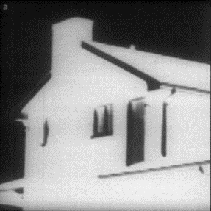
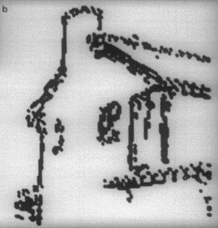
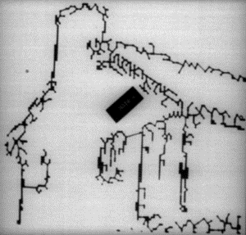
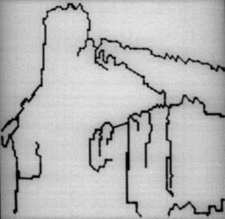
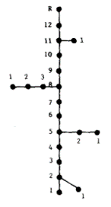
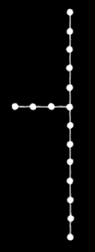
Application: Curvilinear feature extraction
Want a machine to recognize this object
Edge
detection
algorithm
MST
[Paper]
Input to image recognition alg.
“Hair”
removal
Final
result
Just for fun, don’t need to know this

Slide 7
Useful tree facts
l
a
a
d
c
h
f
j
c
k
b
b
redrawing as a tree
d
e
i
g
e
f
h
If you add an edge $e$ to a tree and this creates a cycle $C$, then removing any other edge $e^{′}∈C$ will break the cycle and produce a tree.
j
i
k
g
l
Notes:
Last bullet point means: if you add edge e to a tree and create a cycle C, then removing any other edge e’ in C will break the cycle and produce a tree.

Slide 8
A Cut of a graph
Definition: a cut in a graph G = (V,E) is a partition of V into two non-empty subsets S and V \ S
l
V\S
S
18
19
6
a
7
14
h
5
j
f
8
c
10
4
k
b
16
12
2
3
1
15
9
d
e
i
20
11
17
g
21
13

Slide 9
The cutset of a cut
Edges in the cutset are also said to “cross the cut”
Definition: given a cut (S, V\S), the cutset is the set of edges with one endpoint in S and the other in V\S
l
V\S
S
18
19
6
a
7
14
h
5
j
f
8
c
10
4
k
b
16
12
2
3
1
15
9
d
e
i
20
11
17
g
21
13

Slide 10
The cut property
The minimum weight edge is also called the “lightest edge”
Theorem: for any cut (S, V\S) of a graph G, the minimum weight edge in the cutset is in every MST for G
l
V\S
S
18
19
6
a
7
14
h
5
j
f
8
c
10
4
k
b
16
12
2
3
1
15
9
d
e
i
20
11
17
g
21
13
In every MST
This can also be referred to as the lightest edge crossing the cut

Slide 11
Proof of The cut property
V\S
l
19
6
S
a
18
7
h
5
14
$$u$$
j
8
c
10
4
k
b
16
12
2
3
1
15
9
d
11
$$v$$
i
20
17
g
21
13
Let $e=(u,v)$ be the lightest edge crossing the cut (u in S, v in V\S)
Let $T$ be an MST and suppose $e∉T$ for contradiction
l
a
h
j
$$u$$
b
c
k
d
$$v$$
i
g

Slide 12
Proof of The cut property
V\S
l
$T$ = white edges
19
6
S
a
18
14
h
5
j
$$u$$
8
c
10
4
k
b
16
12
2
3
1
15
9
$$u^{′}$$
i
d
11
$$v$$
20
17
$$v^{′}$$
g
21
13
We construct spanning $T′$ s.t. $w\left(T^{′}\right)<w(T)$ for contra.
T is spanning, so exists path $u⇝v$
Path starts in S and ends in V\S so contains an edge $e^{′}=\left(u^{′},v^{′}\right)$ with $u^{′}∈S,v^{′}∈V\backslash S$
Let $T^{′}=T−\left\{e^{′}\right\}+\{e\}$
This edge crosses the cut
Exchanging edges that cross the cut

Slide 13
Proof of The cut property
V\S
l
$T$ = white edges
19
6
S
a
18
14
h
5
j
$$u$$
8
c
10
4
k
b
16
12
2
3
1
15
9
$$u^{′}$$
i
d
11
$$v$$
20
17
$$v^{′}$$
g
21
13
l
Let $T^{′}=T−\left\{e^{′}\right\}+\{e\}$
19
6
a
18
14
h
5
j
$$u$$
8
c
10
4
k
b
16
12
2
3
1
15
9
$$u^{′}$$
i
d
11
$$v$$
20
17
$$v^{′}$$
g
21
13

Slide 14
Proof of The cut property
V\S
l
$T$ = white edges
19
6
S
a
18
14
h
5
j
$$u$$
8
c
10
4
k
b
16
12
2
3
1
15
9
$$u^{′}$$
i
d
11
$$v$$
20
17
$$v^{′}$$
g
21
13
Adding $e$ would create a cycle with $e^{′}$
l
Let $T^{′}=T−\left\{e^{′}\right\}+\{e\}$
19
6
a
18
But removing $e^{′}$ breaks that cycle and results in a tree
14
h
5
j
$$u$$
8
c
10
4
k
b
And a tree contains all-to-all paths
16
12
2
3
1
15
9
$$u^{′}$$
i
d
11
$$v$$
20
17
$$v^{′}$$
g
21
13

Slide 15
Proof of The cut property
l
19
6
a
18
14
h
5
j
$$T$$
$$u$$
8
c
10
4
k
b
16
12
2
3
1
15
9
d
11
$$v$$
i
20
17
g
21
13
l
$$T^{′}=T−\left\{e^{′}\right\}+\{e\}$$
6
So $T^{′}$ is still a spanning tree
18
19
a
14
h
5
j
$$u$$
And $w\left(T^{′}\right)=w\left(T\right)−w\left(e^{′}\right)+w(e)$
8
c
10
4
k
b
16
12
2
But $e$ and $e′$ both cross the cut, and $e$ is the lightest edge crossing the cut!
3
9
1
15
d
$$v$$
i
20
11
17
So $w\left(e\right)<w\left(e^{′}\right)$, which means $w\left(T^{′}\right)<w(T)$
g
13
21
So $T$ cannot be an MST if it doesn’t contain $e$

Slide 16
Recap: The cut property
Theorem: for any cut (S, V\S) of a graph G, the minimum weight (lighest) edge in the cutset (crossing the cut) is in every MST for G
l
V\S
S
18
19
6
a
7
14
h
5
j
f
8
c
10
4
k
b
16
12
2
3
1
15
9
d
e
i
20
11
17
g
21
13

Slide 17
building an MST
Kruskal’s algorithm [introduced in this 3-page paper from 1955]
Greedy
Sort edges from lightest to heaviest
For each edge e in this order
Add e to T if it does not create a cycle

Slide 18
Example execution
How can we test for cycles as we go?
Increasing edge weights: 1, 2, 3, 4, 5, 6, 7, 8, 9, 10, 11, 12, 13, 14, 15, 16, 17, 18, 19, 20
8 would create a cycle: a, c, b, d, a
11 would create a cycle: d, e, b, d
14 would create a cycle: c, f, e, b, d, a, c
l
l
18
19
6
a
a
7
h
14
h
5
j
f
j
f
4
k
c
10
k
b
8
c
b
16
12
2
3
1
15
9
i
d
i
d
e
e
20
g
g
11
17
13
15 would create a cycle: g, f, h, j, I, g
16 would create a cycle…
17 would create a cycle…
18 would create a cycle…
19 would create a cycle…
20 would create a cycle…
Done!

Slide 19
Proof
Let $T$ be partial spanning tree just before adding $e=(u,v)$, the lightest edge that does not create a cycle
Let $S$ be the connected component of $T$ that contains $u$
l
l
18
19
6
a
a
7
h
14
h
5
j
f
j
f
4
k
c
10
k
$$u$$
8
c
b
$$S$$
16
12
2
3
1
15
9
i
d
i
d
$$e$$
$$v$$
e
20
g
g
11
17
13

Slide 20
Proof
Note $e=(u,v)$ crosses the cut $(S,V\backslash S)$ or it would create a cycle
Out of all edges crossing the cut, $e$ is considered first, so it is the lightest of these edges
l
So the cut property implies $e$ is in every MST of the graph
l
18
19
6
a
a
7
h
14
h
5
j
f
j
f
4
k
c
10
k
$$u$$
8
c
b
$$S$$
16
12
2
3
1
15
9
i
d
i
d
$$e$$
$$v$$
e
20
g
g
11
17
13
So every edge chosen by Kruskal’s is in every MST

Slide 21
Implementing Kruskal’s
Sort edges from lightest to heaviest
For each edge e in this order
Add e to T if it does not create a cycle
How can we determine whether adding e would create a cycle?

Slide 22
Union find
To avoid strange/long names, keep one of the original set names
$$S_{1}∪S_{2}$$
$$S_{2}$$
Represents a partition of set $S=\left\{e_{1},…,e_{n}\right\}$ into disjoint subsets
Initially $n$ disjoint subsets $S_{i}=\left\{e_{i}\right\}$
Operations
$Union(S_{i},S_{j})$ replaces $S_{i}$ and $S_{j}$ by their union $S_{i}∪S_{j}$
$Find(e_{i})$ returns the label of the set containing $e_{i}$
$$e_{1},e_{2}$$
$$S_{1}$$
$$S_{2}$$
$$S_{3}$$
$$S_{4}$$
$$e_{1}$$
$$e_{2}$$
$$e_{3}$$
$$e_{4}$$
$$Union\left(S_{1},S_{2}\right)$$
$$Find\left(e_{3}\right)→S_{3}$$
$$Find\left(e_{2}\right)→S_{2}$$
$$Find\left(e_{1}\right)→S_{2}$$

Slide 23
Kruskal’s using Union-Find
Each graph node is initially in its own subset
Add an edge → union two subsets
An edge creates a cycle IFF its endpoints are in the same subset
Graph:
Union-find:
a
$$a,b$$
$$a,b,d$$
$$a,b,c,d$$
a
7
c
d
8
c
b
2
$$a$$
$$b$$
$$c$$
$$d$$
3
b
d
Both endpoints already in same set! Do not add.

Slide 24
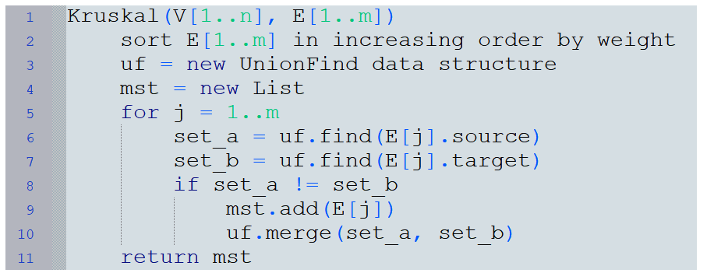
Pseudocode for Kruskal’s using Union-find

Slide 25
Time complexity?
Need to know runtime for union find…
For an efficient union-find algorithm (with union by rank and path compression), we get a total running time for Kruskal’s algorithm of $O\left(α\left(m+n\right)\left(m+n\right)\right)$, where $α(x)$ is the inverse Ackermann function.
For all practical x, $α\left(x\right)≤5$, so this is pseudo-linear.
A simpler implementation with union-by-rank only yields $O\left(m\log{n}\right)$

Slide 26
Other Notable MST algorithms
Prim’s algorithm
Incrementally extend a tree T into an MST, by:
Initializing T to contain any arbitrary node in G
Repeatedly selecting the lightest edge that crosses cut (T, V\T)
Visualization: https://www.cs.usfca.edu/~galles/visualization/Prim.html
Borůvka’s algorithm
Like Kruskal (merging components), but with phases
In each phase, select an outgoing edge for every component, and add all edges found in the phase
Use priority queue to store outgoing edges from T (and repeatedly extract the minimum weight one)
There is also a fast parallel hybrid of Prim and Borůvka

Slide 27
A fun Application: maze building
Create grid graph with
edges up/down/left/right
Randomize edge weights then run Kruskal’s
[video clip]

Slide 28
Visualizing Kruskal’s (without path compression)
https://www.cs.usfca.edu/~galles/visualization/Kruskal.html

Slide 29
Bonus slides
- Kruskal’s proof via exchange argument instead
- Implementing union-find efficiently

Slide 30
Proof via exchange
K: output of Kruskal
Let $f_{j}=$ first edge not in O
G: input graph
$$f_{1}$$
$$f_{n−1}$$
$$f_{2}$$
$$f_{j}$$
$$f_{3}$$
Suppose K is not an MST, for contradiction.
Let O be an (optimal) MST. Note O $≠$ K.
Label edges so $w\left(f_{1}\right)<w\left(f_{2}\right)<…<w(f_{n−1})$.
(we prove this for distinct weights)
Adding $f_{j}$ to O would create cycle C
O:
$$e^{′}$$
C:
Let $e^{′}=$ smallest edge in C $∖$ K
$$e^{′}$$
$$f_{j}$$
(exists since no cycles in K)
$$f_{j}$$
Kruskal considers $e^{′}$ before $f_{j}$, and rejects $e′$ despite taking $f_{1},…,f_{j−1}$
Note $w\left(O^{′}\right)=w\left(O\right)+w(f_{j})−w(e^{′})$
Let $O^{′}$ be same as $O$ but with $e′$ and $f_{j}$ swapped
$w\left(O^{′}\right)≥w\left(O\right)$ since O is optimal
So, $f_{1},…,f_{j−1},e^{′}$ contains a cycle $C^{′}$
So $w(f_{j})−w(e^{′})≥0$, so $w(f_{j})>w\left(e^{′}\right)$
But $f_{1},…,f_{j−1},e^{′}∈O$. Contradiction!

Slide 31
Union Find Implementation
Union-find forest (physical):
$$parent$$
1 | 2 | 3 | 4
2 | 2 | 3 | 4
2 | 4 | 3 | 4
2 | 4 | 4 | 4
$$1$$
$$2$$
$$3$$
$$4$$
Suppose we are partitioning set $\left\{1,…,n\right\}$ into subsets $S_{1},…,S_{n}$
Represent the partition as a forest of trees
Initially one single-node tree per subset
Each node has a parent pointer
$Find\left(i\right)$ returns the root of the tree containing element $i$
$Union\left(i,j\right)$ makes one root the parent of the other
Union-find forest (logical):
1
2
3
4
1
2
3
1
Let’s union the sets containing elements 1 and 2
$find\left(1\right)$ → $1$, $find(2)$ → $2$
$Union(1,2)$: $parent\left[1\right]=2$
How about elements 4 and 1?
$find\left(4\right)$ → $4$, $find(1)$ → $2$
$$Union\left(4, 2\right): parent\left[2\right]=4$$
How about elements 3 and 1?
$find\left(3\right)$ → $3,$ $find(1)$ → $4$
$$Union\left(3, 4\right): parent\left[3\right]=4$$

Slide 32
Problem: Slow find()
4
2
3
1
Long paths → slow find()
Find runtime could be O(number of unions performed)

Slide 33
Union-find with Union by Rank
Keep track of heights of trees
Make root with greater height be the parent
Union of two trees with height $h$ has height $h+1$
Union of tree with height $h$ and tree with height $<h$ has height $h$
Runtime with union by rank?
Union-find forest:
1
2
3
4
1
4
Let’s union the sets containing elements 1 and 2
$find\left(1\right)$ → $1$, $find(2)$ → $2$
$Union(1,2)$: same height → $parent\left[1\right]=2$
How about elements 4 and 1?
$find\left(4\right)$ → $4$, $find(1)$ → $2$
$Union\left(4, 2\right):$ 2’s height is greater → $parent\left[4\right]=2$

Slide 34
Runtime of union by rank
Can prove the following lemma by induction:
Each tree of height $h$ contains at least $2^{h}$ nodes
Case 1: trees of different height
height $h$
By I.H., left tree already has $≥2^{h}$ nodes.
So result has height $h$ and $≥2^{h}$ nodes
height $<h$

Slide 35
Runtime of union by rank
Can prove the following lemma by induction:
Each tree of height $h$ contains at least $2^{h}$ nodes
Case 2: trees of same height
height $h$
By I.H., each tree has $≥2^{h}$ nodes.
Result has height $h+1$ and $≥2^{h}+2^{h}$ nodes
height $h$
And $2^{h}+2^{h}=2^{h+1}$. QED

Slide 36
Runtime of union by rank
How does the lemma help?
Each tree of height $h$ contains at least $2^{h}$ nodes
There are only $n$ nodes in the graph
So height is at most $\log{n}$
(Lemma: a tree of height $\log{n}$ contains at least $2^{\log{n}}$ nodes and $2^{\log{n}}=n$)
So the longest path in the union-find forest is $\log{n}$
So all union-find operations run in $Θ\left(\log{n}\right)$ time!

Slide 37
Time complexity using Union by rank
$$O\left(m\log{m}\right)$$
$$O\left(n\right)$$
$$O\left(1\right)$$
$$O\left(\log{n}\right)$$
$$O\left(\log{n}\right)$$
$$O\left(m log{n}\right)$$
$$O\left(\log{n}\right)$$
$$O\left(1\right)$$
$$O\left(1\right)$$
$$O\left(\log{n}\right)$$
Total $O\left(m\log{n}+m\log{m}\right)$
So runtime is in $O\left(m\log{n}\right)$
Trick: $log m≤\log{n^{2}}=2\log{n}∈O(\log{n})$

Slide 38
Making this even faster
In addition to union by rank, union-find can be implemented with path compression
This variant is introduced in this paper
Using both union by rank and path compression, we get a total running time for Kruskal’s algorithm of $O\left(α\left(m+n\right)\left(m+n\right)\right)$, where $α(x)$ is the inverse Ackermann function.
For all practical x, $α\left(x\right)≤5$, so this is pseudo-linear.

Slide 39
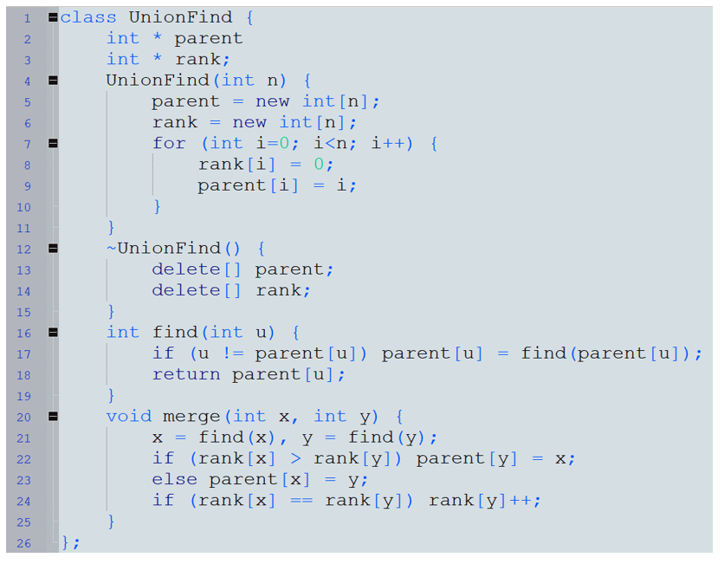
efficient union-find
Initialization
Free memory at end
Path compression
Union by rank

