Slide 1
CS 341: Algorithms
Lecture 22: intractability V – More NPC transformations
Readings: see website
Trevor Brown
https://student.cs.uwaterloo.ca/~cs341
trevor.brown@uwaterloo.ca

Slide 2
Last time
Polynomial transformations
Poly transformation from Clique to Vertex Cover
NP Completeness
SAT is NP complete (NPC)
Got part way through showing 3SAT is NPC
Did poly transformation from SAT to 3SAT
Need to also show 3SAT is in NP

Slide 3
Let’s do a Brief review
of NPC, poly transformations, and showing a problem is in NP

Slide 4
Complexity Class NP-Complete (NPC)
Mechanics of proving $Π∈NPC$
Show $Π$ is in NP
Show a poly transformation from some NPC problem to $Π$

Slide 5
Mechanics of showing a problem is in NP
How to show $Π∈NP$
Define a yes-certificate
Design a poly-time $verify(I,C)$ algorithm
Correctness proof
Case 1: Let $I$ be any yes-instance; Find $C$ such that $verify\left(I,C\right)=true$
Case 2: Let $I$ be any no-instance, and $C$ be any certificate; Prove $verify\left(I,C\right)=false$

Slide 6
Polynomial transformation for proving $Π_{2}$ is in NPC
Let $Π_{1}$ and $Π_{2}$ be decision problems
$Π_{1}≤_{P}Π_{2}$ iff there exists $f :ℐ\left(Π_{1}\right)→ℐ(Π_{2})$ such that:
$f(I)$ is computable in poly-time, for all $I∈ℐ(Π_{1})$
If $I∈ℐ_{yes}(Π_{1})$ then $f\left(I\right)∈ℐ_{yes}(Π_{2})$
If $f(I)∈𝓘_{yes}(Π_{2})$ then $I∈𝓘_{yes}(Π_{1})$
Known NPC problem
Problem you want show is NPC

Slide 7
Let’s Finish showing 3SAT $∈$ NPC
- Already poly transformed SAT to 3SAT
- Need to show 3SAT in NP

Slide 8
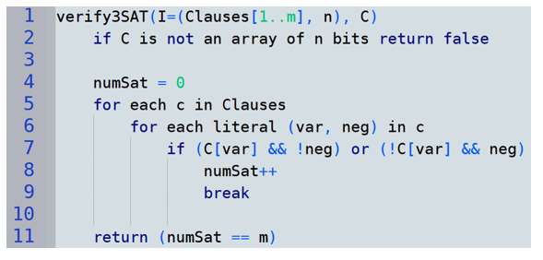
Proving 3SAT is in NP
3SAT input $I=(Clauses[1..m], n)$: a list of $m$clauses, and the number $n$of variables.
Each clause contains literals. Each literal is a pair (var, neg): a variable $∈\{1..n\}$ & a negation bit
Define desired YES-certificate
Design a poly-time $verify(I,C)$ algorithm
Correctness proof
Case 1: Let $I$ be any yes-instance; Find $C$ such that $verify\left(I,C\right)=true$
Case 2: Let $I$ be any no-instance, and $C$ be any certificate; Prove $verify\left(I,C\right)=false$
Contrapositive of case 2: Suppose $verify\left(I,C\right)=true$; Prove $I$ is a yes-instance
YES-certificate $C$ = array with one bit per variable in $\{1..n\}$ representing a satisfying assignment
This takes $O(\left|Clauses\right|)$ time, which is polynomial in $Size(I)$

Slide 9
Mechanics of showing a problem is in NP
Define desired YES-certificate
Design a poly-time $verify(I,C)$ algorithm
Correctness proof
Case 1: Let $I$ be any yes-instance; Find $C$ such that $verify\left(I,C\right)=true$
Case 2: Let $I$ be any no-instance, and $C$ be any certificate; Prove $verify\left(I,C\right)=false$
Contrapositive of case 2: Suppose $verify\left(I,C\right)=true$; Prove $I$ is a yes-instance
Let $I$ be a yes-instance of 3SAT. Then it has a satisfying assignment $A_{s}$. And, $verify(I,A_{s})$ will see that each clause contains a literal satisfied by this assignment, so $verify$ will see $numSat=|Clauses|$ and return true.
Suppose $verify(I,C)$ returns true.
Then $numSat=|Clauses|$, so $numSat$ was incremented in each iteration of the loop over clauses, so each clause contains a satisfied literal, so the 3SAT formula in $I$ is satisfied by $C$, so $I$ is a yes-instance.
It follows that 3SAT is in NP.
Since we have already shown SAT $≤_{P}$ 3SAT, we now know that 3SAT is NP-COMPLETE.

Slide 10
Every problem in NP
SAT
can be poly transformed to
can be poly transformed to
3-SAT
Since SAT is NP-complete, so is 3-SAT!
Today and next time let’s start filling out a hierarchy of reductions that prove several problems are NP complete
But first, since you need to know NP hardness for your assignment…

Slide 11
NP-Hardness
Intuitively: problems that are at least as hard as NP-complete (but are not necessarily decision problems)

Slide 12
TSP-Optimal Value is also NP-hard (and not in NP)
This version returns the total weight of an optimal Hamiltonian cycle
Reduction from lecture 19/20
TSP-Decision $≤_{P}^{T}$ TSP-Optimization
Returns an optimal Hamiltonian cycle

Slide 13
Comparing NPC and NP Hard
$Π∈NPC$
Must be a decision problem
Must poly transform some NPC problem to $Π$
Must show $Π$ in NP
$Π∈NPHard$
Does not need to be a decision problem
Can use either poly transform or poly Turing reduction
Does not need to be in NP (and can’t be if not decision)

Slide 14
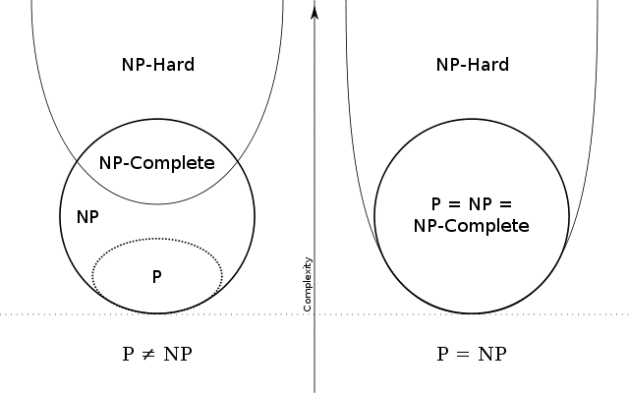
Two possible realities…

Slide 15
Some problems in each
TSP optimization
SAT, TSP-Decision
We think some stuff may exist here, called NP intermediate problems… but we’re not sure
BFS

Slide 16
Establishing another NPC problem
… by Transforming 3-SAT to Clique
(Proving 3-SAT $≤_{P}$ Clique)

Slide 17
Showing 3-SAT $≤_{P}$ Clique
Let $I$ be an instance of 3-SAT with $n$ variables $x_{1}…x_{n}$ and $m$ clauses $C_{1}…C_{m}$
E.g., $\left(x_{1}∨\overline{x_{2}}∨\overline{x_{3}}\right)∧\left(\overline{x_{1}}∨x_{2}∨x_{3}\right)∧\left(\overline{x_{2}}∨x_{3}∨x_{5}\right)∧(\overline{x_{3}}∨x_{4}∨\overline{x_{5}})$ [$n=5,m=4$]
We construct Clique input $f\left(I\right)=(G,k)$ :
Node $v_{ℓ}^{c}$ for each literal $1≤ℓ≤3$ in each clause $1≤c≤m$ (so $\left|V\right|=3m$)
Edges between all non-contradictory pairs of nodes (no $x_{i}∧\overline{x_{i}}$) in different clauses
$k=m$ (can we find an $m$-clique?)
Must prove this is a polynomial transformation
$C_{1}$:
$$v_{1}^{1}$$
$$x_{1}$$
$$v_{2}^{1}$$
$$\overline{x_{2}}$$
$$v_{3}^{1}$$
$$\overline{x_{3}}$$
$C_{2}$:
$$v_{1}^{2}$$
$$\overline{x_{1}}$$
$$v_{2}^{2}$$
$$x_{2}$$
$$v_{3}^{2}$$
$$x_{3}$$
$$v_{1}^{3}$$
$$\overline{x_{2}}$$
$$v_{2}^{3}$$
$$x_{3}$$
$$v_{3}^{3}$$
$$x_{5}$$
$$v_{1}^{4}$$
$$\overline{x_{3}}$$
$$v_{2}^{4}$$
$$x_{4}$$
$$v_{3}^{4}$$
$$\overline{x_{5}}$$
Reasonable 3-SAT representation:$array[1..m]$ of clauses <$l_{1},l_{2},l_{3}$> of literals <$v,neg$> where $v∈\{1..n\}$.
Runtime: create $3m$ nodes, $O(m^{2})$ edges, at $O(1)$ time each
Note $O\left(m\right)⊆O\left(Size\left(I\right)\right)$,
So runtime $O\left(m^{2}\right)⊆O(Size{\left(I\right)}^{2})$ ➔ polytime!

Slide 18
Showing 3-SAT $≤_{P}$ Clique
Let $I$ be an instance of 3-SAT with $n$ variables $x_{1}…x_{n}$ and $m$ clauses $C_{1}…C_{m}$
E.g., $\left(x_{1}∨\overline{x_{2}}∨\overline{x_{3}}\right)∧\left(\overline{x_{1}}∨x_{2}∨x_{3}\right)∧\left(\overline{x_{2}}∨x_{3}∨x_{5}\right)∧(\overline{x_{3}}∨x_{4}∨\overline{x_{5}})$
Case 1: Suppose $I$ is a yes-instance of 3-SAT, and show $f\left(I\right)$ is a yes-instance of $m$-clique
Since $I$ is a yes-instance, $∃$ a satisfying assignment
E.g., $x_{1}=1, x_{2}=1, x_{3}=1, x_{4}=0, x_{5}=0$
For each clause $C_{i}$, let $s_{i}$be a satisfied literal in $C_{i}$
E.g., $s_{1}=x_{1}, s_{2}=x_{2}, s_{3}=x_{3}, s_{4}=\overline{x_{5}}$
Claim: the corresponding nodes form an $m$-clique
There are $m$ of these nodes, each in a different clause
None of them represent contradictory truth assignments
So, there are edges between all pairs of them → they form an $m$-clique
$$v_{1}^{1}$$
$$v_{1}^{1}$$
$$x_{1}$$
$$v_{2}^{1}$$
$$\overline{x_{2}}$$
$$v_{3}^{1}$$
$$\overline{x_{3}}$$
$$x_{1}$$
$$x_{1}$$
$$v_{1}^{2}$$
$$v_{2}^{2}$$
$$\overline{x_{1}}$$
$$v_{2}^{2}$$
$$x_{2}$$
$$v_{3}^{2}$$
$$x_{3}$$
$$x_{2}$$
$$x_{2}$$
$$v_{1}^{3}$$
$$v_{2}^{3}$$
$$\overline{x_{2}}$$
$$v_{2}^{3}$$
$$x_{3}$$
$$v_{3}^{3}$$
$$x_{5}$$
$$x_{3}$$
$$x_{3}$$
$$v_{1}^{4}$$
$$v_{2}^{4}$$
$$v_{3}^{4}$$
$$\overline{x_{3}}$$
$$x_{4}$$
$$v_{3}^{4}$$
$$\overline{x_{5}}$$
$$\overline{x_{5}}$$
$$\overline{x_{5}}$$

Slide 19
Showing 3-SAT $≤_{P}$ Clique
Let $I$ be an instance of 3-SAT with $n$ variables $x_{1}…x_{n}$ and $m$ clauses $C_{1}…C_{m}$
E.g., $\left(x_{1}∨\overline{x_{2}}∨\overline{x_{3}}\right)∧\left(\overline{x_{1}}∨x_{2}∨x_{3}\right)∧\left(\overline{x_{2}}∨x_{3}∨x_{5}\right)∧(\overline{x_{3}}∨x_{4}∨\overline{x_{5}})$
Case 2: Suppose $f(I)$ is a yes-instance of $m$-clique, and show $I$ is a yes-instance of 3-SAT
Since $f(I)$ is a yes-instance, it contains an $m$-clique
Clique contains edges between all pairs of nodes
There are no edges between nodes in same clause, so clique contains one node from each clause
Set the corresponding literals to be satisfied
Clique contains no edges between contradictory literals (i.e., no edge connects $x_{i}$ and $\overline{x_{i}}$ for any $i$)
So, truth assignment is consistent and satisfies each clause (and the formula)
$$v_{1}^{1}$$
$$v_{1}^{1}$$
$$x_{1}$$
$$v_{2}^{1}$$
$$\overline{x_{2}}$$
$$v_{3}^{1}$$
$$\overline{x_{3}}$$
$$x_{1}$$
$$x_{1}$$
$$v_{1}^{2}$$
$$v_{2}^{2}$$
$$\overline{x_{1}}$$
$$v_{2}^{2}$$
$$x_{2}$$
$$v_{3}^{2}$$
$$x_{3}$$
$$x_{2}$$
$$x_{2}$$
$$v_{1}^{3}$$
$$v_{2}^{3}$$
$$\overline{x_{2}}$$
$$v_{2}^{3}$$
$$x_{3}$$
$$v_{3}^{3}$$
$$x_{5}$$
$$x_{3}$$
$$x_{3}$$
$$v_{1}^{4}$$
$$v_{2}^{4}$$
$$v_{3}^{4}$$
$$\overline{x_{3}}$$
$$x_{4}$$
$$v_{3}^{4}$$
$$\overline{x_{5}}$$
$$\overline{x_{5}}$$
$$\overline{x_{5}}$$

Slide 20
Last step: Show CLIQUE is in NP
YES-certificate: array of k nodes forming a clique
Verify(I,C):
Check certificate is array of length k, containing vertex IDs
Check all-to-all edges to verify these vertices form a clique
$O\left(k^{2}\right)⊆O({|V|}^{2})$ runtime → polytime
Correctness: exercise! Need to prove:
if I is a yes instance, verify returns yes, and
if verify returns yes then I is a yes instance

Slide 21
Every problem in NP
SAT
can be poly transformed to
3-SAT

Slide 22
Every problem in NP
SAT
can be poly transformed to
3-SAT
This additional poly transformation was proved last class (CL to VC)!
We also need to show Vertex Cover is in NP. Exercise. ☺

Slide 23
Reducing Vertex-Cover to Subset-Sum
(Proving Vertex-Cover $≤_{P}$ Subset-Sum)
(if we have time)

Slide 24
Subset-Sum (slightly different from before)
Earlier, we defined Subset-Sum with a target sum of 0
Here we add a target sum T and take positive integers as input
$$W$$
$$W$$
Goal: transform instance $I$ of VC into instance $f\left(I\right)$ of SS (in poly time) such that $I$ is a yes-instance of VC iff $f(I)$ is a yes-instance of SS
Idea: turn nodes and edges into a list of integers and a target sum W. Sum W should be achievable IFF there is a k-vertex cover.
Somehow want the array of integers to encode which edges are covered by various nodes, and target sum to encode that every edge is covered if W is achieved

Slide 25
Input to Vertex Cover
Sort of like an adjacency matrix, but instead of storing which node-pairs are adjacent, store which edges are incident to each node
$c_{ij}=$ is edge j covered by node i?

Slide 26
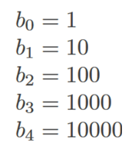
ints
Each edge becomes a unique integer in the array:
edge $e_{j}$ becomes ${10}^{j}$
E.g.,

Slide 27
Each node becomes a integer in the array: ${10}^{m}+$the integers for all edges incident to the node
ints
Each edge becomes a unique integer in the array:
edge $e_{j}$ becomes ${10}^{j}$
$+{10}^{m}$ means the integer for a node is at least one digit longer than the integers for all edges
E.g.,

Slide 28
Why twice? If both endpoints of $e_{j}$ are in the vertex cover, it is counted twice. Otherwise once, and can add $b_{j}$.
Each node becomes a integer in the array: ${10}^{m}+$the integers for all edges incident to the node
ints
Each edge becomes a unique integer in the array:
edge $e_{j}$ becomes ${10}^{j}$
This target weight asks for $k$ nodes and for all edges to be included twice

Slide 29
Example
All 5 edges counted twice
Looking for 2 nodes
Edge $e_{0}$
Edge $e_{4}$
edge
Is there a 2-VC? Use subset sum to search for $W=222222$
Node $v_{1}$
Subset sum looks for a subset of $\left\{a_{1},a_{2},a_{3},a_{4},a_{5},b_{0},b_{1},b_{2},b_{3},b_{4}\right\}$ that sums to $W$
node
Sum of edge sizes incident to $v_{1}$, plus ${10}^{m}$
Node $v_{5}$
$$=$$
It finds $W=a_{2}+a_{3}+b_{0}+b_{1}+b_{3}+b_{4}$
Note: no “carrying” can occur even if we sum everything
$$a_{2}+a_{3}=211211$$
Most significant digit(s) of $W$ accurately capture # of nodes
Edge $e_{2}$ counted twice, other edges once. Sum uses $b_{0},b_{1},b_{3},b_{4}$ to get all to be counted twice.
Other digits are in $[0,3]$. An edge is definitely covered by a node if its digit is 2.
Notes:
explain one endpoint vs both endpoints in VC

Slide 30
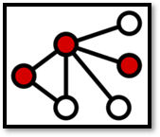
Case 1: Suppose $I$ is a yes-instance of Vertex-Cover.
one endpoint in $V^{′}$
both endpoints in $V^{′}$
Contains node ints
Contains edge ints
ints
$e_{j}$ has one endpoint in $V^{′}$, so nodes in $V^{′}$ contribute $1×10^{j}$ to $W$
$e_{j}$ has both endpoints in $V^{′}$, so nodes in $V^{′}$ contribute $2×10^{j}$ to $W$
ints
Add another $1×^{j}$ to $W$ for each $e_{j}$ with one endpoint in $V^{′}$
ints
To get $2×{10}^{j}$ for all $e_{j}$, plus ${10}^{m}$ for each node
Notes:
In future it would be nice to rename A’ -> N’, B’ -> E’, or *something* more memorable than A and B. something that encodes the fact that A’ contains node sizes, and B’ contains edge sizes.

Slide 31
Case 2: Suppose $f(I)$ is a yes-instance of Subset Sum.
We show $I$ is a yes-instance of Vertex-Cover
Since $f(I)$ is a yes-instance, there exists $A^{′}∪B^{′}$ that sums to $W$
where $A′$ contains node ints and $B′$ contains edge ints
Define $V^{′}=\left\{v_{i} :a_{i}∈A^{′}\right\}$. We claim $V′$ is a vertex cover of size $k$.
We must have $\left|V^{′}\right|=k$ for the coefficient of ${10}^{m}$ to be $k$ (no carrying)
Suppose (for contra.) $V′$ does not cover some edge $e_{j}=(u,v)$
Then the coefficient of ${10}^{j}$ is zero for every $a_{i}∈A^{′}$
But the coefficient of ${10}^{j}$ is 2, so a subset of $B′$ must sum to $2×{10}^{j}$
But this is impossible (so $e_{j}$ is covered, so all edges are covered)

Slide 32
Complexity of the transformation:
Easy! Included for your notes.
Assume adjacency matrix and unit cost model for simplicity
Compute $C$ with trivial algorithm in $O(nm)$ time
Compute $a_{i}$ by visiting all incident edges. Trivial algorithm yields $O(m)$ time for each $a_{i}$, totaling $O(nm)$ over all $i$
Trivial to compute all $b_{j}$ in $O(m)$ time
Trivial to compute $W$ in $O(m)$ time
Total $O(nm)$ time. This is polynomial in the input graph size!

Slide 33
Every problem in NP
can be poly transformed to
can be poly transformed to
Technically need to also show SubsetSum with target T is in NP (exercise) to know it is in NPC

Slide 34
Is 2-SAT also hard? (if we have time – very unlikely)

Slide 35
2-SAT examples
Logical refresher:
$p⇒q$ is equivalent to
$¬p∨q$.
$\left(p∨q\right)∧\left(¬p∨r\right)∧\left(¬r∨¬p\right)$
Satisfiable: $p=0,q=1,r∈\{0,1\}$
$\left(p∨q\right)∧\left(¬p∨r\right)∧\left(¬r∨¬p\right)∧\left(p∨¬q\right)$
Therefore, $p∨q$ is equivalent to $¬p⇒q$ and equivalent to $¬q⇒p$
Edges (implications of clauses)…
$$q$$
$$p$$
$$q$$
$$q$$
$$p$$
$$p$$
$$r$$
$$¬p⇒q$$
$$p⇒r$$
$$r⇒¬p$$
$$¬p⇒¬q$$
$$¬q⇒p$$
$$¬r⇒¬p$$
$$p⇒¬r$$
$$q⇒p$$
$q⇒p⇒¬r⇒¬p⇒¬q$ … so $q$ cannot be $true$
$$¬q$$
$$¬p$$
$$¬q$$
$$¬q$$
$$¬p$$
$$¬p$$
$$¬r$$
$$¬r$$
$$¬r$$
$¬q⇒p⇒¬r⇒¬p⇒q$ … so $q$ cannot be $false$
Therefore the formula cannot be satisfied!

Slide 36
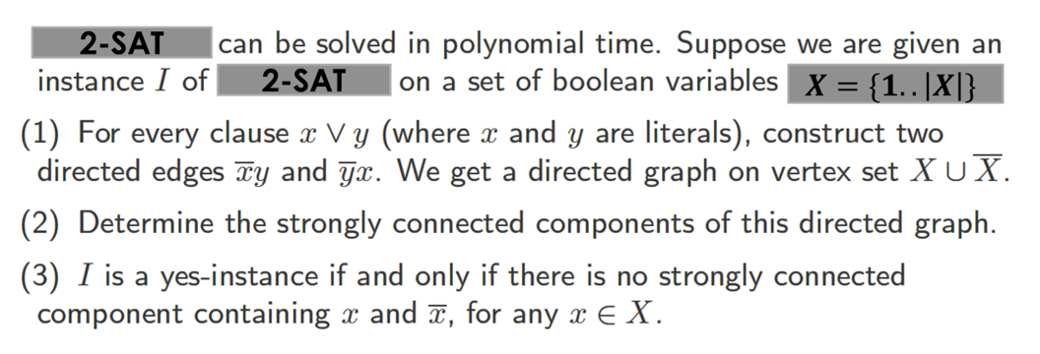
(variable names are integers in 1..|X|)
2-SAT
2-SAT
$$X=\{1..\left|X\right|\}$$
Suppose no variable $x$ is in the same SCC as $\overline{x}$, then to get a satisfying assignment do the following:
For each $x$, if $∃$ path from $x$ to $\overline{x}$, then set $x=false$ else set $x=true$.

Slide 37
Bonus slides

Slide 38
Summary of complexity classes
See this slide’s notes
P (Poly-time)
Decision problems that can be solved by algorithms with runtime poly(input size)
NP (Non-deterministic poly-time)
Decision problems for which certificates can be verified in time poly(input size)
Equivalently: decision problems that can be solved in poly-time if you have access to a non-deterministic oracle that returns a yes-certificate if one exists
NPC (NP-complete)
Decision problems $Π∈NP$ s.t. every $Π^{′}∈NP$ can be transformed to $Π$ in poly-time
NP-hard (at least as hard as NPC)
problems $Π$ s.t. every $Π^{′}∈NP$ can be reduced to $Π$ in poly-time
Note: P, NP and NPC problems are decidable
E.g., (decision problem variants of:) BFS, Dijkstra’s, some DP algorithms
All of P, and e.g.,, vertex cover, clique, SAT, subset sum
E.g., vertex cover, clique, SAT, subset sum, TSP-decision
All of NPC, and e.g., TSP-optimization, TSP-optimal value
Notes:
Note: problems can be NP-hard even if they are NOT decision problems. (And in that case they are, of course, not in NP.)
P is a subset of NP. NPC is a subset of NP. NPC is a subset of NP-hard. Other relationships and other complexity classes can be studied in a complexity theory course. :)

Slide 39
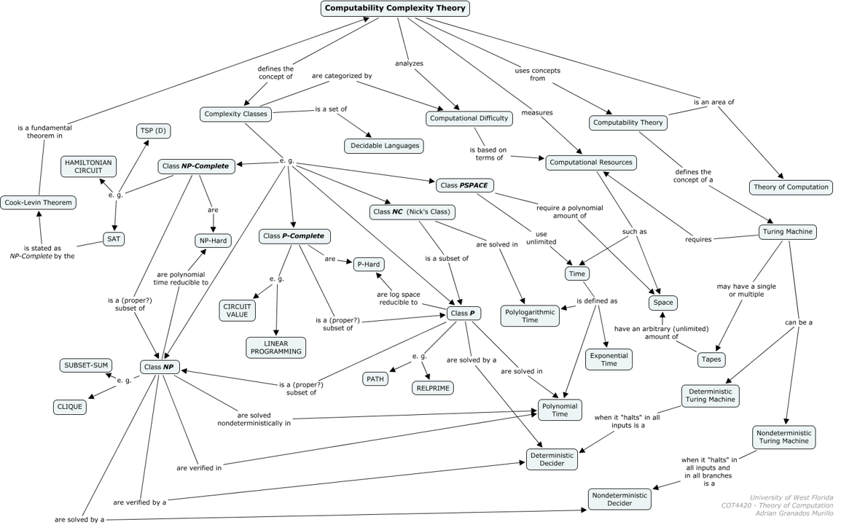
Found this neat image online

