Slide 1
CS 341: Algorithms
Lecture 4: divide & conquer III
Readings: see website
Trevor Brown
https://student.cs.uwaterloo.ca/~cs341
trevor.brown@uwaterloo.ca

Slide 2
The selection problem

Slide 3
The Selection problem
Input: An array A containing n distinct integer values, and an integer k between 1 and n
Output: The k-th smallest integer in A
Minimum is a special case where $k=1$
Median is a special case where $k=\frac{n}{2}$
Maximum is a special case where $k=n$
Simple algorithm for solving selection?

Slide 4
$$y$$
$$A$$
12 | 4 | 6 | 27 | 23 | 17 | 40 | 9
12 | 4 | 6 | 27 | 23 | 17 | 40 | 9
$$Restructure(A,y)$$
12 | 4 | 6 | 17 | 9 | 23 | 27 | 40
$$y$$
$$A$$
12 | 4 | 6 | 27 | 23 | 17 | 40 | 9
Number of elements on each side depend on the value $y$…
12 | 4 | 6 | 27 | 23 | 17 | 40 | 9
$$Restructure(A,y)$$
4 | 6 | 12 | 27 | 23 | 17 | 40 | 9

Slide 5
$A$ after
$$Restructure\left(A,y\right)$$
$$1 2 3 … i_{y} … n$$
12 | 4 | 6 | 17 | 9 | 23 | 27 | 40
$$A_{L}$$
$$y$$
$$A_{R}$$
Number of elements in this range = $i_{y}$
What’s the $k$-th smallest element of $A$?
If $k=i_{y}$ then $y$
If $k<i_{y}$ then the $k$th smallest in $A_{L}$
If $k>i_{y}$ then the $(k−i_{y})$th smallest in $A_{R}$
Recursive calls
Recursive calls

Slide 6
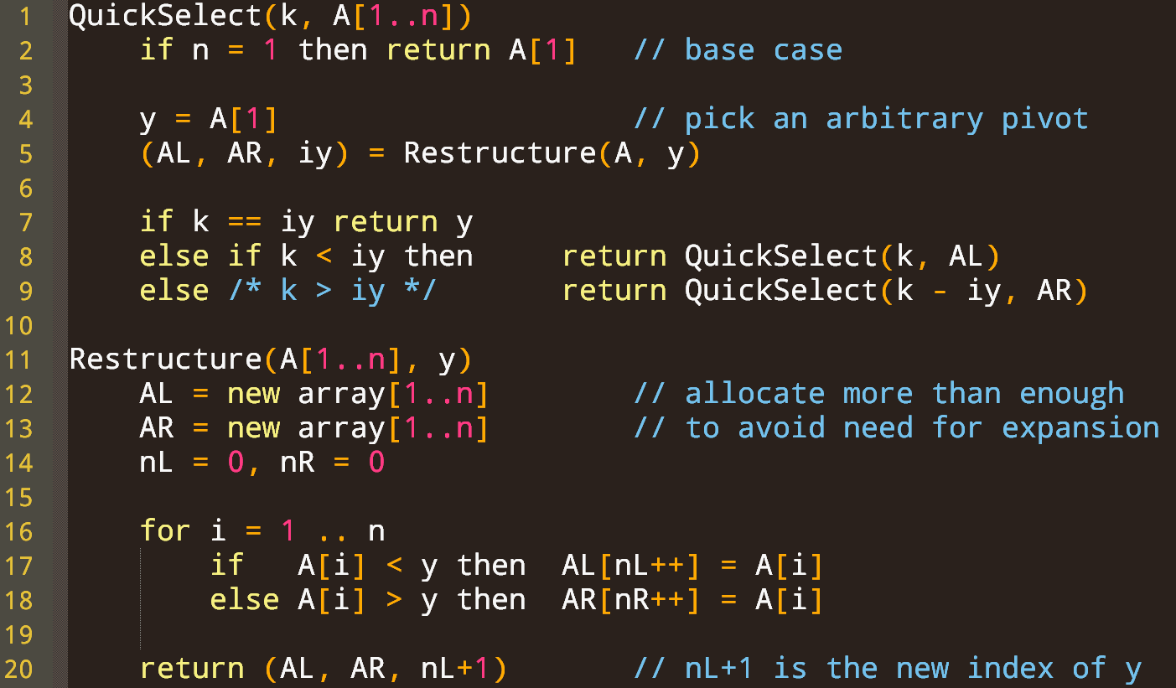
Precondition: $1≤k≤n$

Slide 7
Overly optimistic analysis ☺
$A$ after
$$Restructure\left(A,y\right)$$
12 | 4 | 6 | 17 | 9 | 23 | 27 | 40
$$A_{L}$$
$$y$$
$$A_{R}$$
If $i_{y}=\frac{n}{2}$, then we recurse on $\sim \frac{n}{2}$ elements,
If we could always recurse on $\frac{n}{2}$ elements then
We would get $T\left(n\right)=T\left(\frac{n}{2}\right)+Θ\left(n\right)$
Which would yield $a=1,b=2,y=1,x=\log_{2}{1}=0$, $y>x$ and $T\left(n\right)∈Θ\left(n^{y}\right)=Θ(n)$ by the Master theorem.
But we don’t always recurse on $\frac{n}{2}$ elements!

Slide 8
Worst-case analysis
$A$ after
$$Restructure\left(A,y\right)$$
12 | 4 | 6 | 17 | 9 | 23 | 27 | 40
$$A_{L}$$
$$y$$
$$A_{R}$$
If we always get $i_{y}=1$ and recurse on the right, then
We get $T\left(n\right)=T\left(n−1\right)+Θ(n)$
By the substitution method this is $Θ(n^{2})$
So, sometimes the pivot is good, sometimes it’s bad…
What about the average case?

Slide 9
Average-case analysis
Definition: we say a pivot $y$is good if $i_{y}∈\left(\frac{n}{4},\frac{3n}{4}\right)$
For any good pivot we recurse on at most $\frac{3n}{4}$ elements
Probability of an arbitrary pivot being good?
$$\frac{n}{4}$$
$$\frac{3n}{4}$$
$$1$$
$$n$$
… | … | … | … | … | $$y$$
$\sim \frac{n}{4}$ elements
$\sim \frac{n}{2}$ elements
$\sim \frac{n}{4}$ elements
 |  |  |  |  | $$y$$ | … | …
… | … | … | … | … | … | … | …
Reducing the size of the subproblem by at least 1/4
p = 1/2

Slide 10
Proof Sketch
Since probability of a good pivot is ½,
on average, every two recursive calls, we will encounter a good pivot
Encountering a good pivot reduces problem size to at most $\frac{3n}{4}$
So, problem size is reduced to $\frac{3n}{4}$ after expected linear work
Average case recurrence: $T\left(n\right)=T\left(\frac{3n}{4}\right)+Θ(n)$
$T\left(n\right)∈Θ(n)$

Slide 11
This is just for your notes, in case you want to know how you’d do this analysis formally

Slide 12
Taking selection further
We just showed:
QuickSelect with average case runtime in $O(n)$
Next up:
Median-of-medians QuickSelect (MOMQuickSelect)
worst case runtime in $O(n)$
Relies on getting a good pivot within $O(1)$ recursive calls on average
Must get a good pivot within $O(1)$ recursive calls always
The algorithm we will see picks a good pivot in every recursive call

Slide 13
High level algorithm
Similar to QuickSelect
Choose a pivot
Move smaller elements to the left of the pivot, and larger elements to the right of the pivot
Recursively call MOMQuickSelect on one subarray
Only difference is how we choose the pivot
Always want to pick a good pivot

Slide 14
Always Picking a good pivot
Example input A[1...50]:
11, 38, 6, 21, 20, 17, 14, 9, 7, 5, 8, 34, 49, 47, 28, 18, 44, 31, 46, 48, 27, 4, 2, 50, 23, 45, 3, 13, 43, 22, 10, 32, 35, 41, 24, 1, 30, 12, 15, 26, 16, 19, 36, 33, 37, 39, 25, 40, 29, 42
Group into rows of 5
Find median of each row
Build array of medians
11 38 6 21 20
17 14 9 7 5
8 34 49 47 28
18 44 31 46 48
27 4 2 50 23
45 3 13 43 22
10 32 35 41 24
1 30 12 15 26
16 19 36 33 37
39 25 40 29 42
11 38 6 21 20
17 14 9 7 5
8 34 49 47 28
18 44 31 46 48
27 4 2 50 23
45 3 13 43 22
10 32 35 41 24
1 30 12 15 26
16 19 36 33 37
39 25 40 29 42
20, 9, 34, 44, 23, 22, 32, 15, 33, 39
Time complexity?
Recursively find the median of these medians: 23
Time complexity for this step?
Time complexity for this step?
Recursive problem size?

Slide 15
How good is the pivot 23?
# elements $≤23$ is at least $3(5)$.
This is at least 3/10ths of our 50-element input, or $3n/10$.
Recall: median of each row
Imagine sorting each row:
11 38 6 21 20
17 14 9 7 5
8 34 49 47 28
18 44 31 46 48
27 4 2 50 23
45 3 13 43 22
10 32 35 41 24
1 30 12 15 26
16 19 36 33 37
39 25 40 29 42
6 11 20 21 38
5 7 9 14 17
8 28 34 47 49
18 31 44 46 48
2 4 23 27 50
3 13 22 43 45
10 24 32 35 41
1 12 15 26 30
16 19 33 36 37
25 29 39 40 42
Then ordering rows by medians:
5 7 9 14 17
1 12 15 26 30
6 11 20 21 38
3 13 22 43 45
2 4 23 27 50
10 24 32 35 41
16 19 33 36 37
8 28 34 47 49
25 29 39 40 42
18 31 44 46 48
# elements $≥23$ is at least $3(6)$.
This is > 3/10ths of our 50-element input.
So, after restructuring, pivot 23 must have at least $3n/10$ elements before and after it
This is a good pivot!
We recurse on $A_{L}$ or $A_{R}$, and both have size at most $7n/10$

Slide 16
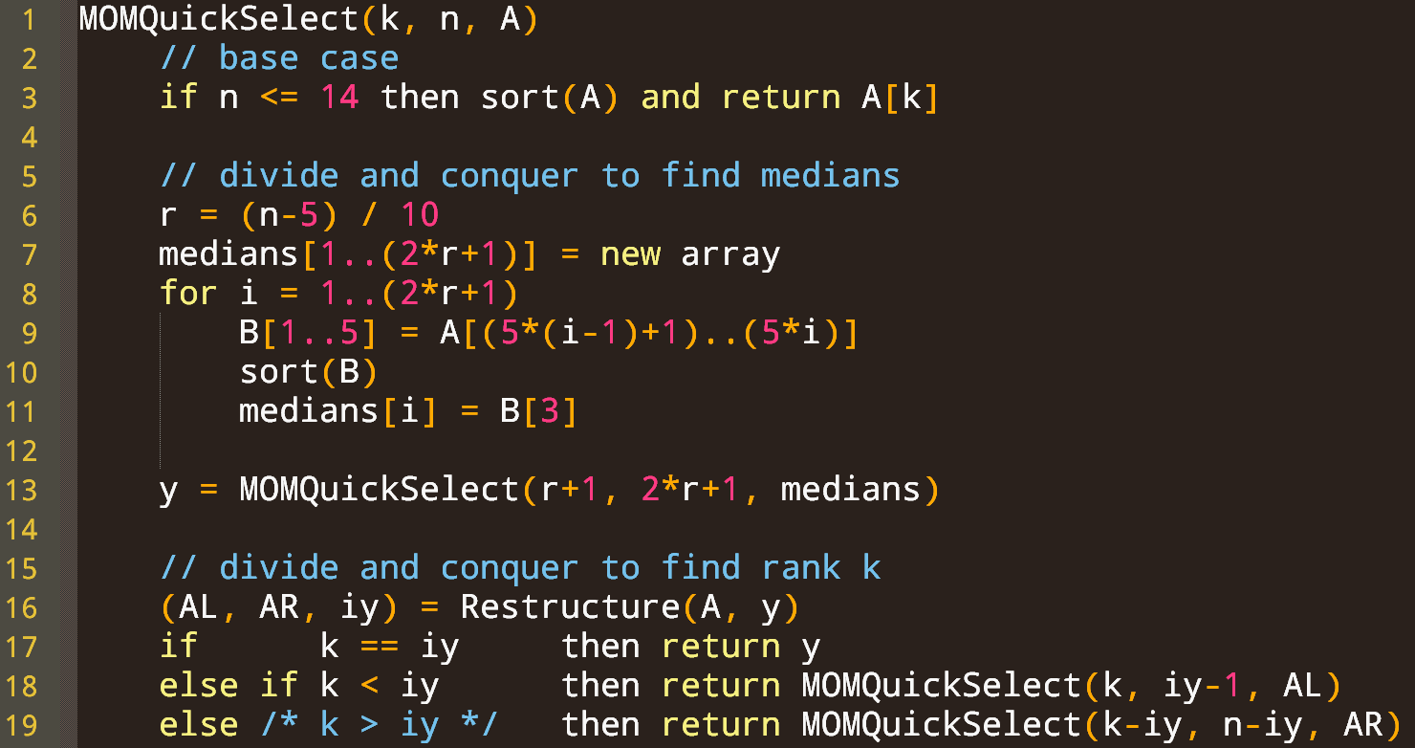
$$MOMQuickSelect(k=11,n=14,A)$$
$$11, 38, 6, 21, 20, 17, 14, 9, 7, 5, 8, 34, 49, 47$$
$$5, 6, 7, 9, 7, 11, 14, 17, 20, 21, 34, 38, 47, 49$$

Slide 17
$$MOMQuickSelect(k=11,n=21,A)$$
$$11, 38, 6, 21, 20, 17, 14, 9, 7, 5, 8, 34, 49, 47, 28, 18, 44, 31, 46, 48, 27$$
$$r=\left\lfloor \frac{21−5}{10}\right\rfloor =1$$
Not considering at most 9 elements
$$B$$
11 38 6 21 20
$$sort(B)$$
6 11 20 21 38
17 14 9 7 5
5 7 9 14 17
8 34 49 47 28
8 28 34 47 49
$$medians$$
$$20, 9, 34$$
$$y=MOMQuickSelect\left(2,3,\left[20,9,34\right]\right)⇒20$$

Slide 18
$$MOMQuickSelect(k=11,n=21,A)$$
$$11, 38, 6, 21, 20, 17, 14, 9, 7, 5, 8, 34, 49, 47, 28, 18, 44, 31, 46, 48, 27$$
$$Restructure\left(A,y=20\right)⇒$$
$$A_{L}=[11, 6, 17, 14, 9, 7, 5, 8, 18]$$
$$A_{R}=[38, 21, 34, 49, 47, 28, 44, 31, 46, 48, 27]$$
$$i_{y}=\left|A_{L}\right|+1=10$$
$$k=11 > i_{y}=10$$
$$k−i_{y}=1 n−i_{y}=10$$
$$MOMQuickSelect\left(1,10,A_{R}\right)⇒21$$

Slide 19
Runtime? (unit cost)
Rows $B$ ordered by medians
$$Θ(1)$$
5 7 9 14 17
1 12 15 26 30
… … …
2 4 y 27 50
… … …
25 29 39 40 42
18 31 44 46 48
$$≤y$$
$$r+1$$
$$≥y$$
$$Θ(n)$$
$$r+1$$
$Θ(n)$ iterations
$$Θ(1)$$
$$3$$
$$Θ(1)$$
$$Θ(1)$$
$$3$$
$$T\left(\frac{n}{5}\right)$$
$3\left(r+1\right)$ elements $≤y$
$3\left(r+1\right)$ elements $≥y$
$$Θ(n)$$
So problem size shrinks by at least $3(r+1)$
$$T(?)$$
$$T(?)$$
$$Θ(1)$$
Observe $n=10r+5$

Slide 20
How much does the problem shrink?
Shrinks by at least $3(r+1)$
Problem size ~$=n=10r+5$
Subproblem size $≤n−Shrink=n−3\left(r+1\right)$
$=10r+5−3r−3=7r+2$
Express in terms of $n$ using $r=\left\lfloor \frac{n−5}{10}\right\rfloor$
Subproblem size $≤7\left\lfloor \frac{n−5}{10}\right\rfloor +2≤7\frac{n−5}{10}+2$
$=\frac{7n}{10}−7\left(\frac{5}{10}\right)+2=\frac{7n}{10}−\frac{3}{2}≤\frac{7n}{10}$

Slide 21
Time complexity
$$Θ(1)$$
$$Θ(n)$$
$Θ(n)$ iterations
$$Θ(1)$$
$$Θ(1)$$
$$Θ(1)$$
$$T\left(\frac{n}{5}\right)$$
$$Θ(n)$$
$$Θ(1)$$
$$T\left(\frac{7n}{10}\right)$$
$$T\left(\frac{7n}{10}\right)$$
$T\left(n\right)∈O\left(n\right)+T\left(n/5\right)+T(7n/10)$ if $n≥15$
$T\left(n\right)∈O(1)$ if $n≤14$

Slide 22
$T\left(n\right)∈O\left(n\right)+T\left(n/5\right)+T(7n/10)$ if $n≥15$
$T\left(n\right)∈O(1)$ if $n≤14$
9/10

Slide 23
Guess & check
$$T(n)=cn$$
Let $T\left(n\right)=c^{′}n+T\left(\frac{n}{5}\right)+T\left(\frac{7n}{10}\right)$ where $c^{′}>0$
Want to prove: $T\left(n\right)=cn$ for some $c>0$
Note $c$ and $c′$ are independent constants
$c′$ comes from the work at each level of recursion being $O(n)$
$c$ is a positive constant we are trying to show exists
I.H.: Suppose $∃c>0 :T\left(n′\right)=cn′$ for $15≤n′<n$
$T\left(n\right)=c′n+c\frac{n}{5}+c\frac{7n}{10}$ (by inductive hypoth.)
$T\left(n\right)=cn$ (want this to be true)
$⇔ c^{′}n+c\frac{n}{5}+c\frac{7n}{10}=cn$ (equivalently)
$⇔c^{′}+c\frac{1}{5}+c\frac{7}{10}=c$ $⇔c=10c′$ (by algebra)

