Slide 1
CS 341: Algorithms
Lecture 5: finishing D&C, greedy algorithms I
Readings: see website
Trevor Brown
https://student.cs.uwaterloo.ca/~cs341
trevor.brown@uwaterloo.ca

Slide 2
The closest pair problem
overworked student
When someone near you
You
classroom

Slide 3
The Closest Pair Problem
Input: Set P of n 2D points
Output: pair p and q s.t. dist(p, q) minimum over all pairs
Break ties arbitrarily

Slide 4
Can we Divide & Conquer?
Like non-dominated points: sort by x-axis & divide in half
p₂
p₁
p₄
p₇
p₆
p₅
p₈
p₃
L
R
Claim that doesn’t require a proof: closest pair (p, q):
(p, q) both in L or
(p, q) both in R or
One of (p,q) in L and one of (p,q) in R
We call this a spanning pair

Slide 5
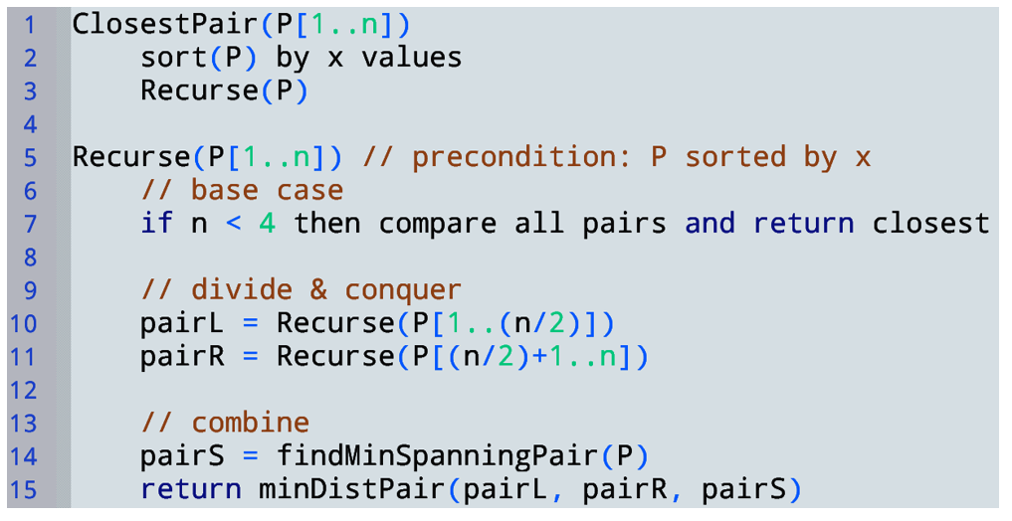
How to efficiently compute the minimum spanning pair?

Slide 6
Observation 1
Let δ = min (dist(pair_{L}), dist(pair_{R}))
δ
δ
←L
R→
Then pair_{s} (if closest globally) lies in the above 2δ-wide green strip
Q: Why?

Slide 7
Example for Observation 1
δ
δ
p
←L
R→
Q: Can p be part of a globally closest spanning pair_{s}?
A: No. Everything in R has dist > δ to p.
And we already have a solution with dist = δ.

Slide 8
Observation 2
Say, p (the lowest y valued point in strip) is in pair_{s}
δ
δ
Has to be on the opposite side & can’t be > δ higher than p on y axis.
δ
p
δ
←L
R→
Q: Why?
Then the other point can only lie in this δxδ square.

Slide 9
Core Idea For Finding Spanning Pair
Start from lowest y valued point in the strip
Search the δxδ square points on the opposite side
Repeat 1 & 2 for the next lowest y-valued point
So on and so forth…
δ
δ
←L
R→

Slide 10
Core Idea For Finding Spanning Pair
Start from lowest y valued point in the strip
Search the δxδ square points on the opposite side
Repeat 1 & 2 for the next lowest y-valued point
So on and so forth…
δ
δ
←L
R→

Slide 11
Core Idea For Finding Spanning Pair
Start from lowest y valued point in the strip
Search the δxδ square points on the opposite side
Repeat 1 & 2 for the next lowest y-valued point
So on and so forth…
δ
δ
←L
R→

Slide 12
Core Idea For Finding Spanning Pair
Start from lowest y valued point in the strip
Search the δxδ square points on the opposite side
Repeat 1 & 2 for the next lowest y-valued point
So on and so forth…
δ
δ
←L
R→

Slide 13
Core Idea For Finding Spanning Pair
Start from lowest y valued point in the strip
Search the δxδ square points on the opposite side
Repeat 1 & 2 for the next lowest y-valued point
So on and so forth…
Switching sides might complicate code…
Turns out it’s not needed to get good time complexity.
δ
δ
←L
R→

Slide 14
A More Practical Idea
Don’t differentiate between same and opposite side
Just search the 2δxδ above rectangle each time
δ
δ
←L
R→

Slide 15
A More Practical Idea
Don’t differentiate between same and opposite side
Just search the 2δxδ above rectangle each time
δ
δ
←L
R→

Slide 16
A More Practical Idea
Don’t differentiate between same and opposite side
Just search the 2δxδ above rectangle each time
δ
δ
←L
R→

Slide 17
A More Practical Idea
Don’t differentiate between same and opposite side
Just search the 2δxδ above rectangle each time
δ
δ
←L
R→

Slide 18
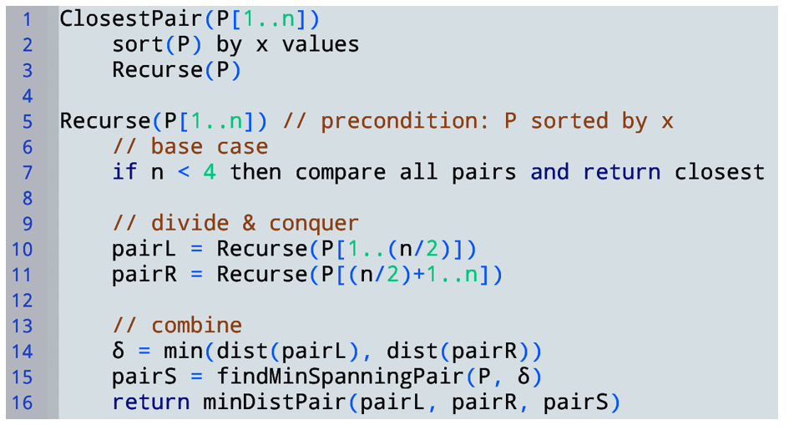

Slide 19
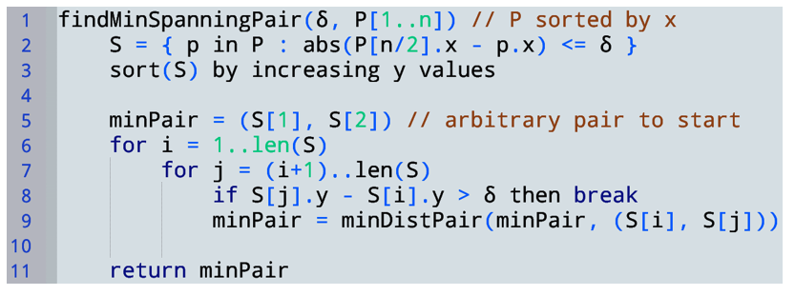
Time complexity?
$$Θ(n)$$
$$Θ(n\log{n})$$
δ
δ
if |S| < 2 return $\left(−∞,−∞\right),(∞,∞)$
$$Θ(1)$$
$$???$$
S₄
S₃
S₂
$$Θ(1)$$
$$Θ(1)$$
S₁
Points in S
Claim: inner loop performs O(1) iterations!

Slide 20
For a particular $i$, how many $j$ iterations occur?
Obs: as many as there are points in the 2δ x δ rectangle.
Q: How many points can be in a 2δ x δ rectangle?
A: As many as in the left δ x δ square + right δ x δ square.
δ
δ
δ
$$S[i]$$
←L
R→

Slide 21
Points in a $δ×δ$ square
Recall $δ$ is the smallest distance between any pair of points that are both in $L$ or both in $R$
Note this square is entirely in $L$ or entirely in $R$
So, δ is the smallest distance between any pair of points in this square!
δ
A point in the middle would rule out any other points
So, most efficient packing of points puts one in each corner (4 total)
δ

Slide 22
For a particular $i$, how many $j$ iterations occur?
Obs: as many as there are points in the 2δ x δ rectangle.
Q: How many points can be in a 2δ x δ rectangle?
A: As many as in the left δ x δ square + right δ x δ square.
δ
δ
Can only contain eight points! (technically six)
δ
$$S[i]$$
←L
R→

Slide 23
Time complexity (unit cost)
δ
δ
$$Θ(n)$$
$$Θ(n\log{n})$$
S₄
if |S| < 2 return $\left(−∞,−∞\right),(∞,∞)$
$$Θ(1)$$
S₃
$$???$$
S₂
S₁
$$Θ(1)$$
$$Θ(1)$$
Points in S
j-loop performs at most eight iterations
Each does $Θ\left(1\right)$ work, so entire j-loop does $Θ(1)$ work!
So entire i-loop does $Θ(n)$ work
So, findMinSpanningPair does $Θ(n\log{n})$ work

Slide 24
Time complexity (unit cost)
$T^{′}\left(n\right)$: $ClosestPair(P\left[1..n\right])$
$T\left(n\right)$: $Recurse(P\left[1..n\right])$
$T^{′}\left(n\right)=Θ\left(n\log{n}\right)+T(n)$
$T\left(n\right)=2T\left(\frac{n}{2}\right)+Θ(n\log{n})$
Lec2 notes using recursion trees showed
$T\left(n\right)∈Θ(n\log^{2}{n})$
$T^{′}\left(n\right)∈Θ\left(n\log{n}\right)+Θ\left(n\log^{2}{n}\right)$
So $T^{′}\left(n\right)∈Θ(n\log^{2}{n})$
$$Θ(n\log{n})$$
$$T(n)$$
$$Θ(1)$$
$$Θ\left(n\right)+T\left(\frac{n}{2}\right)$$
$$Θ\left(n\right)+T\left(\frac{n}{2}\right)$$
$$Θ(1)$$
$$Θ(n\log{n})$$
$$Θ(1)$$

Slide 25
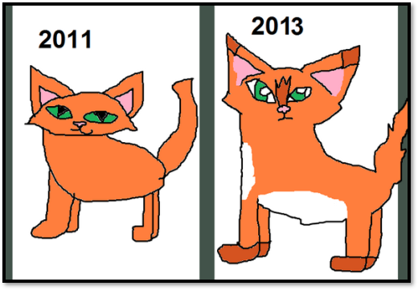
Improving this result Further

Slide 26
Improving the previous algorithm
Sorting by $y$-values causes findMinSpanningPair to take $O(n log⁡n)$ time instead of $O(n)$ time
This happens in each recursive call, and dominates the running time
Avoid sorting $P$ over and over by creating another copy of $P$ that is pre-sorted by $y$-values
Assume for simplicity that x coordinates are unique

Slide 27
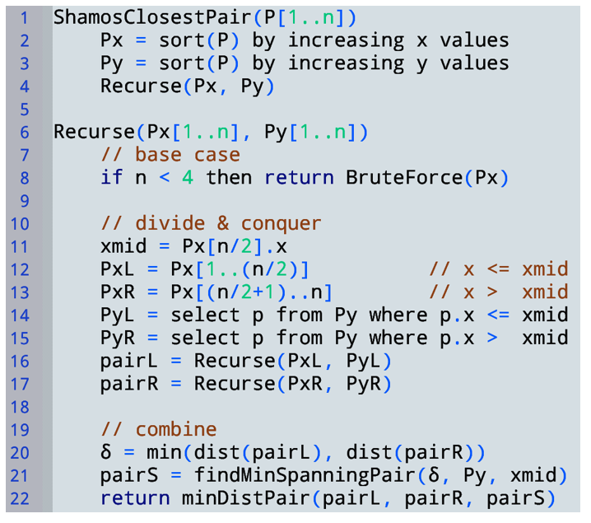
Shamos’ algorithm (1975)
This selection step preserves the y-sort order
x-coord uniqueness used
Observe PxL and PyL contain the same points
(specifically the points with x <= xmid)
Moreover PxL is sorted by x
while PyL is sorted by y
And similarly for PxR, PyR…
No need to sort in Recurse!

Slide 28
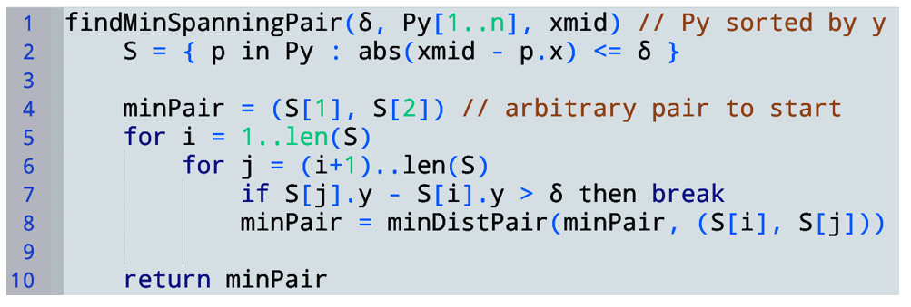
$Θ(n)$ and preserves the y-sort order
if |S| < 2 return $\left(−∞,−∞\right),(∞,∞)$
$$Θ(n)$$
Total $Θ(n)$ for this function

Slide 29
Time complexity
$$Θ(n log n)$$
$$T\left(n\right)=2T\left(\frac{n}{2}\right)+Θ\left(n\right)$$
Merge sort recurrence…
$$T\left(n\right)∈Θ(n\log{n})$$
$$Θ(n)$$
So runtime for Shamos’ algorithm is in $Θ(n\log{n})$
$$T\left(\frac{n}{2}\right)$$
$$T\left(\frac{n}{2}\right)$$
$$Θ(1)$$
$$Θ(n)$$
$$Θ(1)$$

Slide 30
Greedy Algorithms

Slide 31
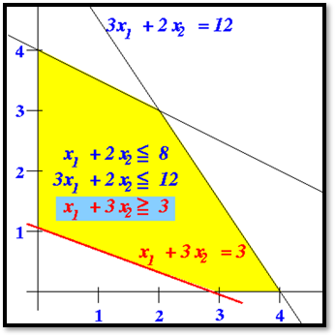
f(this point) = $720

Slide 32
Solving optimization problems
Lots of techniques
We will study greedy approaches first
Later, dynamic programming
Sort of like divide and conquer but can sometimes be much more efficient than D&C
Greedy algorithms are usually
Very fast, but hard to prove optimality for
Structured as follows…

Slide 34
Local evaluation means we cannot consider future choices when deciding whether to include y in our solution.
We irrevocably decide to include y (or not). We do not reconsider.
We choose the next element to include greedily by taking the y that gives the maximum local improvement.
This may or may not be a good idea…

Slide 35
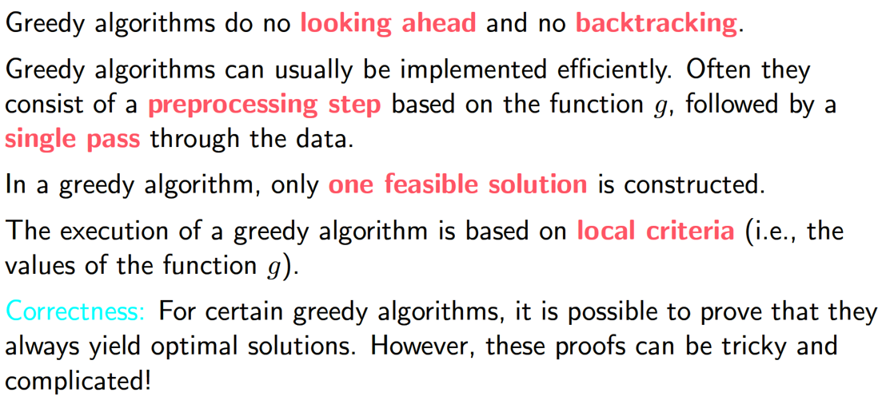
Core Characteristics of Greedy algorithms
Cannot consider how your current choice affects future choices
Cannot undo / change your choice

Slide 36
Problem: Interval Selection

Slide 37
Problem: Interval selection
Where $si$ and $fi$ are positive integers
Input: a set $A = \{A1, …, An\}$ of time intervals
Each interval $Ai$ has a start time $si$ and a finish time $fi$
Feasible solution: a subset $X$ of $A$ containing pairwise disjoint intervals
Output: a feasible solution of maximum size
I.e., one that maximizes $|X|$
Chosen
Bad solution. Not optimal!
Rejected

Slide 38
Possible greedy strategies
Partial solutions
$X=[x_{1},x_{2},…,x_{i}]$ where each $x_{i}$ is an interval for the output
Choices
$𝒳=A$ (i.e., all intervals)
$Choice\left(X\right)=\{ y∈𝒳 :\left[x_{1},…,x_{i},y\right]$ respects all constraints$\}$
i.e., where $y∉X$ and $∀_{x∈X} disjoint(y, x)$
Local evaluation function
$g\left(y\right)=s_{j}$ where $y=A[j]$
(i.e., $g\left(y\right)=$ start time of interval $y$)

Slide 39
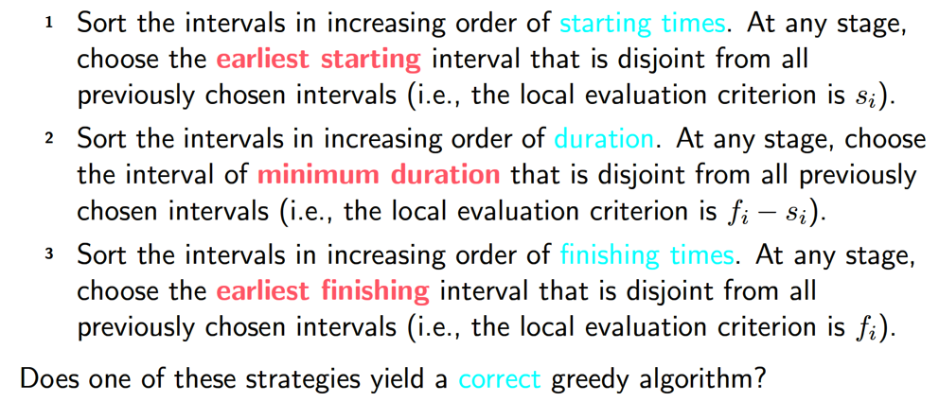
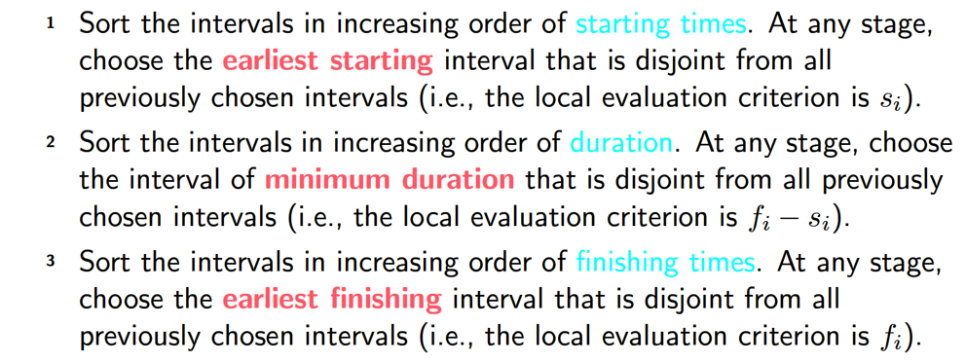
Possible greedy strategies for Interval Selection

Slide 40
Strategy 1: Proving incorrectness
Idea: find one input for which the algorithm gives a non-optimal solution or an infeasible solution
Strategy 1
Consider input:
c | h | o | s | e | n
0
2
4
6
8
10
x-axis

Slide 41
How about strategy 2?
Strategy 2
Consider input:
0
2
4
6
8
10
x-axis

Slide 42
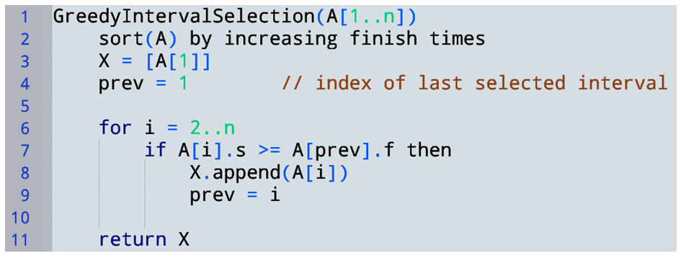
Strategy 3
$$A[3]$$
$$A[1]$$
$$A[2]$$
0
2
4
6
8
10
x-axis
Where is our local evaluation function $g$ in this code?
$$A[1]$$
$$A[3]$$
$$A[2]$$
0
2
4
6
8
10
x-axis

Slide 43
Strategy 3
Time complexity:
Sort + one pass $$∈Θ(n log⁡n)$$
How to prove this is correct? (I.e., how can we show the returned solution is both feasible and optimal?)
Feasibility? Easy! We always choose an interval that starts after all other chosen intervals end
Optimality? Harder…

Slide 45
Greedy Correctness proofs
Want to prove: greedy solution $X$ is correct (feasible & optimal)
Usually show feasibility directly and optimality by contradiction:
Suppose solution $O$ is better than $X$
Show this necessarily leads to a contradiction
Two broad strategies for deriving this contradiction:
Greedy stays ahead: show every choice in $X$ is “at least as good” as the corresponding choice in $O$
Exchange: show $O$ can be improved by replacing some choice in $O$ with a choice in $X$
Let’s demonstrate approach #1 (next time)

