Slide 1
CS 341: Algorithms
Lecture 7: dynamic programming I
Readings: see website
Trevor Brown
https://student.cs.uwaterloo.ca/~cs341
trevor.brown@uwaterloo.ca

Slide 2
Finishing up greedy

Slide 3
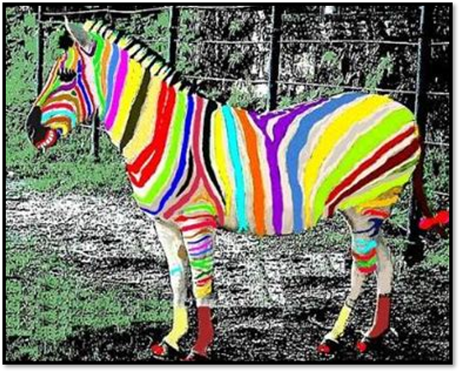
Interval Colouring

Slide 4
Problem: Interval colouring
Example
7 intervals, 7 colours.
Feasible, but not optimal

Slide 5
More examples
Same color, but not disjoint…
Example
Not feasible!
Example
7 intervals, 6 colours.
Feasible, but not optimal
Same color, but disjoint. OK!
Same color, but disjoint. OK!
Example
7 intervals, 2 colours.
Optimal

Slide 7
Example: order matters!
A₁
A₂
A₃
A₄
A₅
A₆
A₇
A₈
A₉
A₁₀
Consider intervals in the order they are given in the input: $A1…A10$
0
2
4
6
8
10
12
14
16
18
20
x-axis

Slide 8
Example: order matters!
A₁ | 1
A₂ |  |  |  |  |  |  |  |  | 1
A₃ |  |  |  |  |  |  |  |  |  |  |  |  |  |  | 1
A₄ |  |  |  | 2
A₅
A₆
A₇
A₈
A₉
A₁₀
0
2
4
6
8
10
12
14
16
18
20
x-axis

Slide 9
Example: order matters!
A₁ | 1
A₂ |  |  |  |  |  |  |  |  | 1
A₃ |  |  |  |  |  |  |  |  |  |  |  |  |  |  | 1
A₄ |  |  |  | 2
A₅
A₆
A₇
A₈
A₉
A₁₀
0
2
4
6
8
10
12
14
16
18
20
x-axis

Slide 10
Example: order matters!
A₁ | 1
A₂ |  |  |  |  |  |  |  |  | 1
A₃ |  |  |  |  |  |  |  |  |  |  |  |  |  |  | 1
A₄ |  |  |  | 2
A₅
A₆
A₇
A₈
A₉
A₁₀
0
2
4
6
8
10
12
14
16
18
20
x-axis

Slide 11
Example: order matters!
A₁ | 1
A₂ |  |  |  |  |  |  |  |  | 1
A₃ |  |  |  |  |  |  |  |  |  |  |  |  |  |  | 1
A₄ |  |  |  | 2
A₅
A₆
A₇
A₈
A₉
A₁₀
0
2
4
6
8
10
12
14
16
18
20
x-axis

Slide 12
Example: order matters!
A₁ | 1
A₂ |  |  |  |  |  |  |  |  | 1
A₃ |  |  |  |  |  |  |  |  |  |  |  |  |  |  | 1
A₄ |  |  |  | 2
A₅ |  |  |  |  |  |  |  |  |  |  |  |  |  |  |  |  | 2
A₆
A₇
A₈
A₉
A₁₀
0
2
4
6
8
10
12
14
16
18
20
x-axis

Slide 13
Example: order matters!
A₁ | 1
A₂ |  |  |  |  |  |  |  |  | 1
A₃ |  |  |  |  |  |  |  |  |  |  |  |  |  |  | 1
A₄ |  |  |  | 2
A₅ |  |  |  |  |  |  |  |  |  |  |  |  |  |  |  |  | 2
A₆ |  |  |  |  |  |  | 3
A₇
A₈
A₉
A₁₀
0
2
4
6
8
10
12
14
16
18
20
x-axis

Slide 14
Example: order matters!
A₁ | 1
A₂ |  |  |  |  |  |  |  |  | 1
A₃ |  |  |  |  |  |  |  |  |  |  |  |  |  |  | 1
A₄ |  |  |  | 2
A₅ |  |  |  |  |  |  |  |  |  |  |  |  |  |  |  |  | 2
A₆ |  |  |  |  |  |  | 3
A₇ |  |  |  |  |  |  |  |  |  |  | 2
A₈
A₉
A₁₀
0
2
4
6
8
10
12
14
16
18
20
x-axis

Slide 15
Example: order matters!
A₁ | 1
A₂ |  |  |  |  |  |  |  |  | 1
A₃ |  |  |  |  |  |  |  |  |  |  |  |  |  |  | 1
A₄ |  |  |  | 2
A₅ |  |  |  |  |  |  |  |  |  |  |  |  |  |  |  |  | 2
A₆ |  |  |  |  |  |  | 3
A₇ |  |  |  |  |  |  |  |  |  |  | 2
A₈ | 4
A₉
A₁₀
0
2
4
6
8
10
12
14
16
18
20
x-axis

Slide 16
Example: order matters!
A₁ | 1
A₂ |  |  |  |  |  |  |  |  | 1
A₃ |  |  |  |  |  |  |  |  |  |  |  |  |  |  | 1
A₄ |  |  |  | 2
A₅ |  |  |  |  |  |  |  |  |  |  |  |  |  |  |  |  | 2
A₆ |  |  |  |  |  |  | 3
A₇ |  |  |  |  |  |  |  |  |  |  | 2
A₈ | 4
A₉ |  |  |  |  |  |  |  |  |  |  |  |  | 4
A₁₀
0
2
4
6
8
10
12
14
16
18
20
x-axis

Slide 17
Example: order matters!
A₁ | 1
A₂ |  |  |  |  |  |  |  |  | 1
A₃ |  |  |  |  |  |  |  |  |  |  |  |  |  |  | 1
A₄ |  |  |  | 2
A₅ |  |  |  |  |  |  |  |  |  |  |  |  |  |  |  |  | 2
A₆ |  |  |  |  |  |  | 3
A₇ |  |  |  |  |  |  |  |  |  |  | 2
A₈ | 4
A₉ |  |  |  |  |  |  |  |  |  |  |  |  | 4
A₁₀ | 3
Used 4 colours
Can we do better?
0
2
4
6
8
10
12
14
16
18
20
x-axis

Slide 18
Example: order matters!
A₁
A₂
A₃
A₄
A₅
A₆
A₇
A₈
A₉
A₁₀
Pre-sort intervals by increasing start time!
0
2
4
6
8
10
12
14
16
18
20
x-axis

Slide 19
Example: order matters!
A₁
A₂
A₃
A₄
A₅
A₆
A₇
A₈
A₉
A₁₀
Pre-sort intervals by increasing start time!
0
2
4
6
8
10
12
14
16
18
20
x-axis

Slide 20
Example: order matters!
A₁ | 1
A₂
A₃
A₄
A₅
A₆
A₇
A₈
A₉
A₁₀
0
2
4
6
8
10
12
14
16
18
20
x-axis

Slide 21
Example: order matters!
A₁ | 1
A₂ | 2
A₃
A₄
A₅
A₆
A₇
A₈
A₉
A₁₀
0
2
4
6
8
10
12
14
16
18
20
x-axis

Slide 22
Example: order matters!
A₁ | 1
A₂ | 2
A₃ | 3
A₄
A₅
A₆
A₇
A₈
A₉
A₁₀
0
2
4
6
8
10
12
14
16
18
20
x-axis

Slide 23
Example: order matters!
A₁ | 1
A₂ | 2
A₃ | 3
A₄
A₅
A₆
A₇
A₈
A₉
A₁₀
0
2
4
6
8
10
12
14
16
18
20
x-axis

Slide 24
Example: order matters!
A₁ | 1
A₂ | 2
A₃ | 3
A₄
A₅
A₆
A₇
A₈
A₉
A₁₀
0
2
4
6
8
10
12
14
16
18
20
x-axis

Slide 25
Example: order matters!
A₁ | 1
A₂ | 2
A₃ | 3
A₄
A₅
A₆
A₇
A₈
A₉
A₁₀
0
2
4
6
8
10
12
14
16
18
20
x-axis

Slide 26
Example: order matters!
A₁ | 1
A₂ | 2
A₃ | 3
A₄
A₅
A₆
A₇
A₈
A₉
A₁₀
0
2
4
6
8
10
12
14
16
18
20
x-axis

Slide 27
Example: order matters!
A₁ | 1
A₂ | 2
A₃ | 3
A₄
A₅
A₆
A₇
A₈
A₉
A₁₀
0
2
4
6
8
10
12
14
16
18
20
x-axis

Slide 28
Example: order matters!
A₁ | 1
A₂ | 2
A₃ | 3
A₄
A₅
A₆
A₇
A₈
A₉
A₁₀
0
2
4
6
8
10
12
14
16
18
20
x-axis

Slide 29
Example: order matters!
A₁ | 1
A₂ | 2
A₃ | 3
A₄
A₅
A₆
A₇
A₈
A₉
A₁₀
Used 3 colours
0
2
4
6
8
10
12
14
16
18
20
Turns out to be optimal…
x-axis

Slide 30
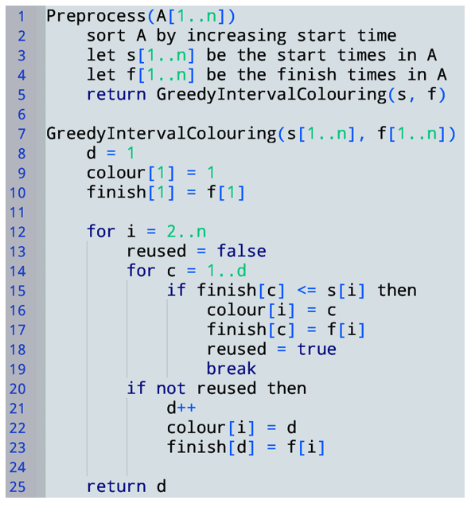
$d$ = # of colours used so far
$finish[c] =$ finish time of last interval to receive colour $c$
Interval 1 gets colour 1
For each interval $A_{i}$, search for an appropriate colour c
Check if we can reuse any colour c in 1..d
Consider interval $A_{i}=\left(s_{i},f_{i}\right).$
If $s_{i}≥finish[c]$, then we can give $A_{i}$ colour $c$ without breaking feasibility
we reused a colour
If we didn’t reuse a colour, use a new colour

Slide 31
Example: running greedy
Initial state
A₁
A₂
A₃
A₄
A₅
A₆
A₇
A₈
A₉
A₁₀
0
2
4
6
8
10
12
14
16
18
20
x-axis

Slide 32
Example: running greedy
i=1
d=1
finish[1]=
Code before the loop: just assign colour 1
A₁ | 1
A₂
A₃
A₄
A₅
A₆
A₇
A₈
A₉
A₁₀
0
2
4
6
8
10
12
14
16
18
20
x-axis

Slide 33
Example: running greedy
Is $finish\left[1\right]≤s2$?
i=2
d=1
finish[1]=
d=2
No. We cannot reuse colour 1.
While loop over c.
Check if we can reuse a color in 1..d
A₁ | 1
A₂
A₃
A₄
A₅
A₆
A₇
A₈
A₉
A₁₀
Cannot reuse any colour. Create a new one!
0
2
4
6
8
10
12
14
16
18
20
x-axis

Slide 34
Example: running greedy
Is $finish\left[1\right]≤s2$?
i=2
d=2
finish[1]=
finish[2]=
No. We cannot reuse colour 1.
While loop over c.
Check if we can reuse a color in 1..d
A₁ | 1
A₂ | 2
A₃
A₄
A₅
A₆
A₇
A₈
A₉
A₁₀
Cannot reuse any colour. Create a new one!
0
2
4
6
8
10
12
14
16
18
20
x-axis

Slide 35
Example: running greedy
Is $finish\left[1\right]≤s3$?
i=3
d=2
finish[1]=
finish[2]=
No. We cannot reuse colour 1.
While loop over c.
Check if we can reuse a color in 1..d
A₁ | 1
A₂ | 2
A₃
A₄
A₅
A₆
A₇
A₈
A₉
A₁₀
Is $finish\left[2\right]≤s3$?
No. We cannot reuse colour 2.
Cannot reuse any colour. Create new one.
0
2
4
6
8
10
12
14
16
18
20
x-axis

Slide 36
Example: running greedy
Is $finish\left[1\right]≤s3$?
i=3
d=3
finish[1]=
finish[2]=
finish[3]=
No. We cannot reuse colour 1.
While loop over c.
Check if we can reuse a color in 1..d
A₁ | 1
A₂ | 2
A₃ | 3
A₄
A₅
A₆
A₇
A₈
A₉
A₁₀
Is $finish\left[2\right]≤s3$?
No. We cannot reuse colour 2.
Cannot reuse any colour. Create new one.
0
2
4
6
8
10
12
14
16
18
20
x-axis

Slide 37
Example: running greedy
Is $finish\left[1\right]≤s4$?
i=4
d=3
finish[1]=
finish[2]=
finish[3]=
Yes. We can reuse colour 1.
While loop over c.
Check if we can reuse a color in 1..d
A₁ | 1
A₂ | 2
A₃ | 3
A₄
A₅
A₆
A₇
A₈
A₉
A₁₀
0
2
4
6
8
10
12
14
16
18
20
x-axis

Slide 38
Example: running greedy
Is $finish\left[1\right]≤s4$?
i=4
d=3
finish[1]=
finish[2]=
finish[3]=
Yes. We can reuse colour 1.
While loop over c.
Check if we can reuse a color in 1..d
A₁ | 1
A₂ | 2
A₃ | 3
A₄
A₅
A₆
A₇
A₈
A₉
A₁₀
0
2
4
6
8
10
12
14
16
18
20
x-axis

Slide 39
Example: running greedy
Is $finish\left[1\right]≤s5$?
i=5
d=3
finish[1]=
finish[2]=
finish[3]=
No. We cannot reuse colour 1.
While loop over c.
Check if we can reuse a color in 1..d
A₁ | 1
A₂ | 2
A₃ | 3
A₄
A₅
A₆
A₇
A₈
A₉
A₁₀
Is $finish\left[2\right]≤s5$?
No. We cannot reuse colour 2.
Is $finish\left[3\right]≤s5$?
Yes. We can reuse colour 3.
0
2
4
6
8
10
12
14
16
18
20
x-axis

Slide 40
Example: running greedy
Is $finish\left[1\right]≤s5$?
i=5
d=3
finish[1]=
finish[2]=
finish[3]=
No. We cannot reuse colour 1.
While loop over c.
Check if we can reuse a color in 1..d
A₁ | 1
A₂ | 2
A₃ | 3
A₄
A₅
A₆
A₇
A₈
A₉
A₁₀
Is $finish\left[2\right]≤s5$?
No. We cannot reuse colour 2.
Is $finish\left[3\right]≤s5$?
Yes. We can reuse colour 3.
And so on, and so forth…
0
2
4
6
8
10
12
14
16
18
20
x-axis

Slide 42
Let $F_{D}$ be the first interval that has colour $D$
$$F_{D}$$
 |  |  |  |  |  |  |  |  |  |  |  |  |  |  |  |  | D
x-axis
0
2
4
6
8
10
12
14
16
18
20

Slide 43
Let $F_{D}$ be the first interval that has colour $D$
We prove $F_{D}$ overlaps D-1 other intervals at a single point in time
$$F_{D}$$
 |  |  |  |  |  |  |  |  |  |  |  |  |  |  |  |  | D
x-axis
0
2
4
6
8
10
12
14
16
18
20

Slide 44
Let $F_{D}$ be the first interval that has colour $D$
Let’s argue $L_{1}$ overlaps $F_{D}$
Let $L_{c}$ be the last interval that has colour $c$ and starts before $F_{D}$
Note $L_{1}$ must exist (otherwise greedy would just use colour 1 for $F_{D}$)
We prove $F_{D}$ overlaps every interval $L_{c}$ for all $c<D$
And $finish[L_{1}]$ must be after $F_{D}$ starts (same reason)
$$L_{1}$$
$$L_{2}$$
$$L_{3}$$
$$L_{4}$$
$$L_{5}$$
…
…
…
$$L_{D−1}$$
$$F_{D}$$
 | 1
 | 2
 |  |  | 3
 |  |  |  | 4
 |  |  |  | 5
 |  |  |  |  |  |  |  |  | …
 |  |  |  |  |  |  |  |  |  |  | …
 |  |  |  |  |  |  |  |  |  |  |  |  | …
 |  |  |  |  |  |  |  |  |  |  |  |  |  |  | D-1
 |  |  |  |  |  |  |  |  |  |  |  |  |  |  |  |  | D
Same argument applies to $L_{2},…,L_{D−1}$
So, $F_{D}$ overlaps $D−1$ intervals!
Moreover, every interval in $\{L_{1},…,L_{D−1}\}$ contains the starting time of $F_{D}$
x-axis
0
2
4
6
8
10
12
14
16
18
20
So, we must use $D$ colours!

Slide 45
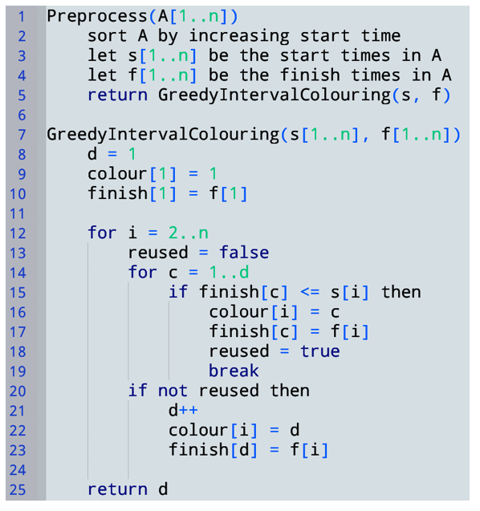
Time Complexity?
$$O(n\log{n)}$$
Total $O(n log n+ nd)$
Could be $O(n log n)$ if only a constant number of colours are needed (or even $\log{n}$ colours!)
$O(n)$ iterations
Could be $O(n^{2})$ if $n$ colours are needed
$O(d)$ iterations…
Most accurate complexity statement is $Θ(n log n+nD)$ where $D$ is # colours used
What inefficiencies exist in this algorithm? Could we make it faster with clever data structure usage?

Slide 46
Improving this algorithm
Current greedy algorithm:
For each interval $Ai$, compare its start time $si$ with the $finish[c]$ times of all colours introduced so-far
Why? Looking for some $finish[c]$ time that is earlier than $si$
We are doing linear search… Can we do better?
Use a priority queue to keep track of the earliest $finish[c]$ at all times in the algorithm
Then we only need to look at minimum element

Slide 47
Example: Heap-based algorithm
Initial state
A₁
A₂
A₃
A₄
A₅
A₆
A₇
A₈
A₉
A₁₀
Min element: NULL
Heap
0
2
4
6
8
10
12
14
16
18
20
x-axis

Slide 48
Example: Heap-based algorithm
Iteration i=1
Check heap minimum
Empty, so a new colour is needed
A₁
A₂
A₃
A₄
A₅
A₆
A₇
A₈
A₉
A₁₀
Min element: NULL
Heap
0
2
4
6
8
10
12
14
16
18
20
x-axis

Slide 49
Example: Heap-based algorithm
Iteration i=1
Check heap minimum
Empty, so a new colour is needed
A₁ | 1
A₂
A₃
A₄
A₅
A₆
A₇
A₈
A₉
A₁₀
Min element: NULL
finish at time 3
Heap
finish at time 3
0
2
4
6
8
10
12
14
16
18
20
x-axis

Slide 50
Example: Heap-based algorithm
Iteration i=2
Check heap minimum
Check if finish time 3 is before $s_{2}$
No. New colour!
A₁ | 1
A₂
A₃
A₄
A₅
A₆
A₇
A₈
A₉
A₁₀
Min element: NULL
finish at time 3
Heap
finish at time 3
0
2
4
6
8
10
12
14
16
18
20
x-axis

Slide 51
Example: Heap-based algorithm
Iteration i=2
Check heap minimum
Check if finish time 3 is before $s_{2}$
No. New colour!
A₁ | 1
A₂ | 2
A₃
A₄
A₅
A₆
A₇
A₈
A₉
A₁₀
Min element: NULL
finish at time 3
Heap
finish at time 3
finish at time 7
0
2
4
6
8
10
12
14
16
18
20
x-axis

Slide 52
Example: Heap-based algorithm
Iteration i=3
Check heap minimum
Check if finish time 3 is before $s_{3}$
No. New colour!
A₁ | 1
A₂ | 2
A₃
A₄
A₅
A₆
A₇
A₈
A₉
A₁₀
Min element: NULL
finish at time 3
Heap
finish at time 3
finish at time 7
0
2
4
6
8
10
12
14
16
18
20
x-axis

Slide 53
Example: Heap-based algorithm
Iteration i=3
Check heap minimum
Check if finish time 3 is before $s_{3}$
No. New colour!
A₁ | 1
A₂ | 2
A₃ | 3
A₄
A₅
A₆
A₇
A₈
A₉
A₁₀
Min element: NULL
finish at time 3
Heap
finish at time 3
finish at time 7
finish at time 5
0
2
4
6
8
10
12
14
16
18
20
x-axis

Slide 54
Example: Heap-based algorithm
Iteration i=4
Check heap minimum
Check if finish time 3 is before $s_{4}$
Yes. Reuse colour, deleteMin and insert new finish time into heap!
A₁ | 1
A₂ | 2
A₃ | 3
A₄
A₅
A₆
A₇
A₈
A₉
A₁₀
Min element: NULL
finish at time 3
Heap
finish at time 3
finish at time 7
finish at time 5
0
2
4
6
8
10
12
14
16
18
20
x-axis

Slide 55
Example: Heap-based algorithm
Iteration i=4
Check heap minimum
Check if finish time 3 is before $s_{4}$
Yes. Reuse colour, deleteMin and insert new finish time into heap!
A₁ | 1
A₂ | 2
A₃ | 3
A₄
A₅
A₆
A₇
A₈
A₉
A₁₀
Min element: NULL
finish at time 5
Heap
finish at time 7
finish at time 5
0
2
4
6
8
10
12
14
16
18
20
x-axis

Slide 56
Example: Heap-based algorithm
Iteration i=4
Check heap minimum
Check if finish time 3 is before $s_{4}$
Yes. Reuse colour, deleteMin and insert new finish time into heap!
A₁ | 1
A₂ | 2
A₃ | 3
A₄
A₅
A₆
A₇
A₈
A₉
A₁₀
Min element: NULL
finish at time 5
Heap
finish at time 9
finish at time 7
finish at time 5
0
2
4
6
8
10
12
14
16
18
20
x-axis

Slide 57
Example: Heap-based algorithm
Iteration i=5
Check heap minimum
Check if finish time 5 is before $s_{5}$
Yes. Reuse colour, deleteMin and insert new finish time into heap!
A₁ | 1
A₂ | 2
A₃ | 3
A₄
A₅
A₆
A₇
A₈
A₉
A₁₀
Min element: NULL
finish at time 5
Heap
finish at time 9
finish at time 7
finish at time 5
0
2
4
6
8
10
12
14
16
18
20
x-axis

Slide 58
Example: Heap-based algorithm
Iteration i=5
Check heap minimum
Check if finish time 5 is before $s_{5}$
Yes. Reuse colour, deleteMin and insert new finish time into heap!
A₁ | 1
A₂ | 2
A₃ | 3
A₄
A₅
A₆
A₇
A₈
A₉
A₁₀
Min element: NULL
finish at time 7
Heap
finish at time 9
And so on, and so forth…
finish at time 7
finish at time 13
0
2
4
6
8
10
12
14
16
18
20
x-axis

Slide 59
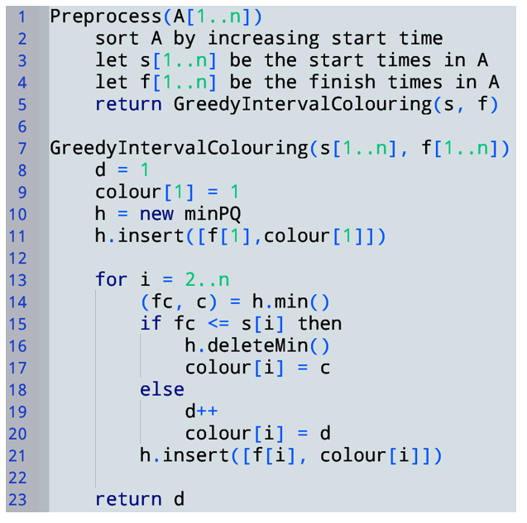
$O(log⁡S)$ where $S=$ size(priority queue)
$$O(1)$$
$$O(1)$$
$$O(log⁡D)$$
Total $Θ\left(n\log{n}\right)+Θ(n\log{D})$
Since $n≥D$, $Θ(n\log{n})$
$$O(log⁡D)$$

Slide 60
Dynamic Programming
What?

Slide 61
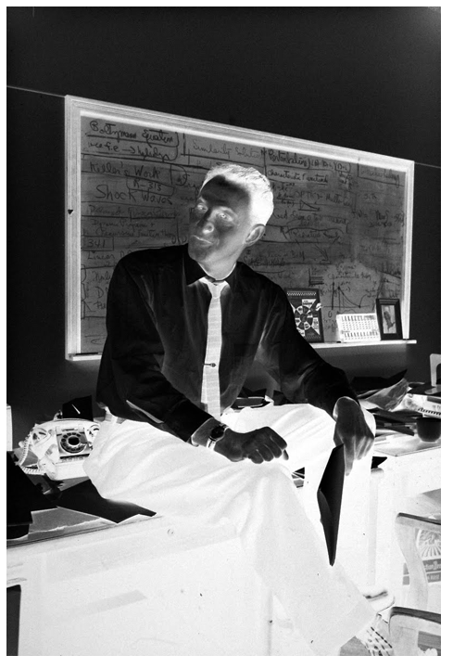
— Richard Bellman, Eye of the Hurricane: An Autobiography (1984, excerpts from page 159)
“Bottom-up recursion” might also a reasonable name, as we’ll see…
Where did the name, dynamic programming, come from? The 1950s were not good years for mathematical research.
We had a very interesting gentleman in Washington named Wilson. He was Secretary of Defense, and he actually had a pathological fear and hatred of the word "research”… He would turn red, and he would get violent if people used the term research in his presence. You can imagine how he felt, then, about the term mathematical.
I felt I had to do something to shield Wilson … from the fact that I was really doing mathematics… What title, what name, could I choose? In the first place I was interested in planning, in decision making, in thinking. But planning, is not a good word for various reasons. I decided therefore to use the word "programming." I wanted to get across the idea that this was “dynamic,” this was multistage, this was time-varying. I thought, let's kill two birds with one stone.
I thought dynamic programming was a good name. It was something not even a Congressman could object to.
Notes:
I spent the Fall quarter (of 1950) at RAND. My first task was to find a name for multistage decision processes. An interesting question is, "Where did the name, dynamic programming, come from?" The 1950s were not good years for mathematical research. We had a very interesting gentleman in Washington named Wilson. He was Secretary of Defense, and he actually had a pathological fear and hatred of the word "research". I'm not using the term lightly; I'm using it precisely. His face would suffuse, he would turn red, and he would get violent if people used the term research in his presence. You can imagine how he felt, then, about the term mathematical. The RAND Corporation was employed by the Air Force, and the Air Force had Wilson as its boss, essentially. Hence, I felt I had to do something to shield Wilson and the Air Force from the fact that I was really doing mathematics inside the RAND Corporation. What title, what name, could I choose? In the first place I was interested in planning, in decision making, in thinking. But planning, is not a good word for various reasons. I decided therefore to use the word "programming". I wanted to get across the idea that this was dynamic, this was multistage, this was time-varying. I thought, let's kill two birds with one stone. Let's take a word that has an absolutely precise meaning, namely dynamic, in the classical physical sense. It also has a very interesting property as an adjective, and that is it's impossible to use the word dynamic in a pejorative sense. Try thinking of some combination that will possibly give it a pejorative meaning. It's impossible. Thus, I thought dynamic programming was a good name. It was something not even a Congressman could object to. So I used it as an umbrella for my activities.
— Richard Bellman, Eye of the Hurricane: An Autobiography (1984, page 159)

Slide 62
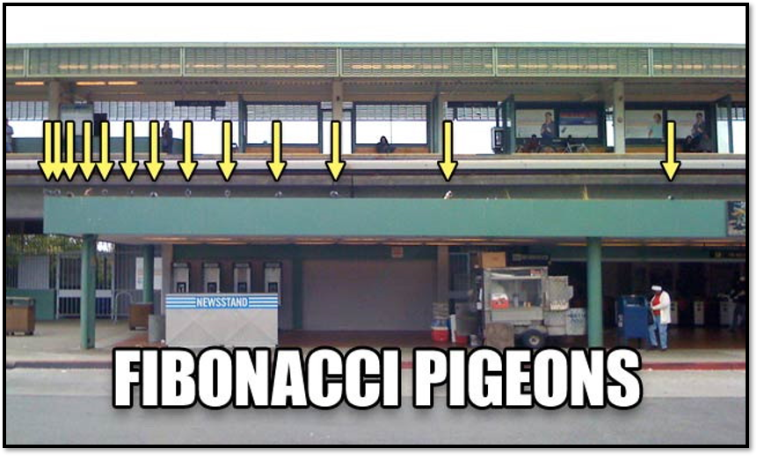
Computing Fibonacci numbers inefficiently A Toy example to compare D&C to dynamic programming

Slide 63
Runtime
In unit cost model
(UNREALISTIC!)
$T\left(n\right)=T\left(n−1\right)+T\left(n−2\right)+O(1)$
$T\left(n\right)≥2T\left(n−2\right)+O\left(1\right)$
$T\left(n\right)≤2T\left(n−1\right)+O(1)$
n/2 levels of recursion for the first expression
n levels for the second expression
Work doubles at each level
$T(n)$ is certainly in $Ω(2^{n/2})$ and $O(2^{n})$
This O(1) would change in the bit complexity model

Slide 64
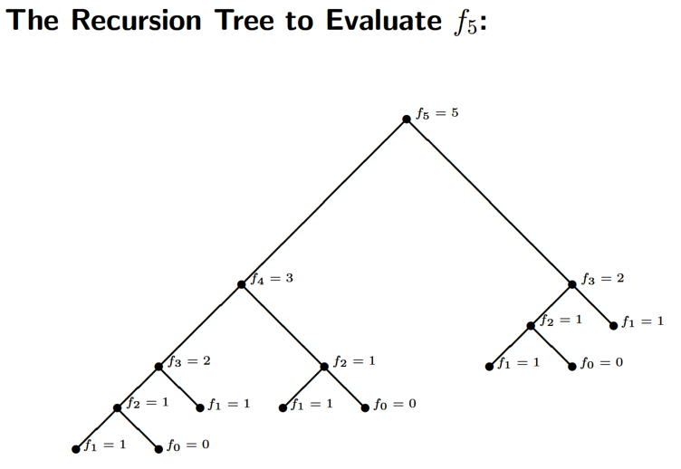
Why is this SO slow?
Subproblems have LOTS of overlap!
Every subtree on the right appears on the left
… recursively …
Each subtree is computed exponentially often in its depth
This overlap suggests dynamic programming may be able to help!

Slide 65
(Optimal) Recursive Structure

Slide 67
Solving Fib using Dynamic Programming
(Optimal) Recursive Structure
Solution to $n$-th Fibonacci number $f(n)$ can be expressed as the addition of smaller Fibonacci numbers
No notion of optimality for this particular problem
Define Subproblems
The set subproblems that will be combined to obtain $Fib(n)$ is $\{Fib\left(n−1\right),Fib\left(n−2\right)\}$
$S\left(I\right)=\{Fib\left(0\right), Fib\left(1\right), …, Fib\left(n\right)\}$
Recurrence Relation
Computing (Optimal) Solutions
Create table f[1..n] and compute its entries “bottom-up”
$$f\left(n\right)=\left\{\begin{aligned}f\left(n−1\right)+f\left(n−2\right) :i≥2 \\ 1 :i=1 \\ 0 :i=0\end{aligned}\right.$$

Slide 68
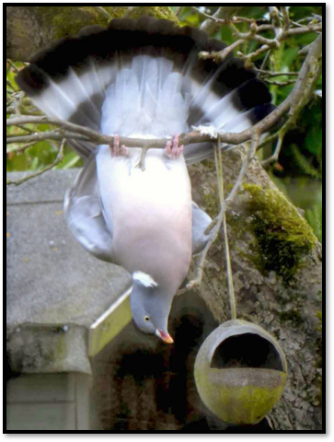
Filling the table “Bottom-up”
Key idea:
When computing a table entry
Must have already computed the entries it depends on!
Dependencies
Extract directly from recurrence
Entry n depends on n-1 and n-2
Computing entries in order 1..n guarantees n-1 and n-2 are already computed when we compute n

Slide 69
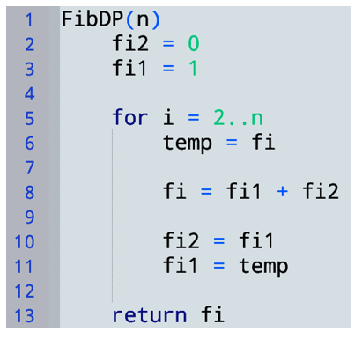
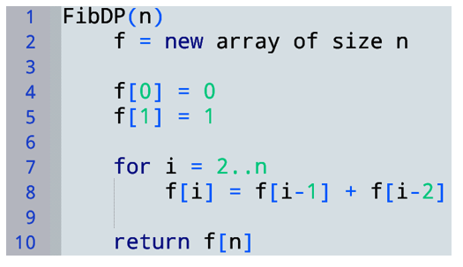
DP Solution
represents f[i-2]
represents f[i-1]
Save f[i] before overwriting it (so its value can be stored in f[i-1] later)
Space saving optimization:
We never look at f[i-3] or earlier
Can make do with a few variables instead of a table
Contains f[n]
This is still considered to be dynamic programming… We’ve just optimized out the table.

Slide 70
Correctness
Order 0..n means i-1 and i-2 are already computed when we compute i
Step 1
Prove that when computing a table entry, dependent entries are already computed
Suppose f[i-1] and f[i-2] are the (i-1)th and (i-2)th Fib #s
Then prove f[i] = the n-th Fib #
Step 2 (similar to D&C)
Suppose subproblems are solved correctly (optimally)
Prove these (optimal) subsolutions are combined into a(n optimal) solution

Slide 71
Model of computation for runtime
Unit cost model is not very realistic for this problem, because Fibonacci numbers grow quickly
F[10]=55
F[100]=354224848179261915075
F[300]=222232244629420445529739893461909967206666939096499764990979600
Value of F[n] is exponential in n: $f_{n}∈Θ\left(φ^{n}\right)$ where $φ≅1.6$
$φ^{n}$ needs $\log\left(φ^{n}\right)$ bits to store it
So F[n] needs $Θ\left(n\right)$ bits to store!
But let’s use unit cost anyway for simplicity

Slide 72
Running time (unit cost)
$T\left(n\right)∈Θ\left(n\right)$

Slide 73
A brief Aside
Express T(n) as a function of the input size S (in bits)
Is this linear runtime?
NO! This is “a linear function of n”
When we say “linear runtime” we mean “a linear function of the input size”
What is the input size $S$?
The input is the number $n$.
How many bits does it take to store n? $O(\log{n)}$
So $S=\log{n}$ bits
$$T\left(n\right)∈Θ\left(n\right)$$
$$2^{S}=2^{\log{n}}=n$$
So $T\left(n\right)∈Θ\left(2^{S}\right)$
This algorithm is exponential in the input size!
… but still exponentially faster than $2^{n/2}$

Slide 74
Rod cutting A “real” Dynamic Programming example
Input:
$n$: length of rod
$p_{1},…,p_{n}$: $p_{i}=$ price of a rod of length $i$
Output:
Max income possible by cutting the rod of length $n$ into any number of integer pieces (maybe no cuts)
$$n=4$$
All ways of cutting a rod of length 4
Example output: 10

Slide 75
Dynamic programming approach
High level idea (can just think recursively to start)
Given a rod of length n
Either make no cuts, or make a cut and recurse on the remaining parts
Where should we cut?
$$Income p_{n}$$
$$Income\left(Left\right)+Income(Right)$$

Slide 76
Dynamic programming approach
Try all ways of making that cut
I.e., try a cut at positions $1, 2, …, n−1$
In each case, recurse on two rods $[0,i]$ and $[i,n]$
Take the max income over all possibilities (each $i$ / no cut)
$$i=1$$
Optimal substructure:
Max income from two rods w/sizes $i$ and $n−i$
$$i=2$$
$$i=3$$
…
… is max income we can get from the rod size $i$
$$i=n−1$$
+ max income we can get from the rod size $n−i$

Slide 77
We stopped here

Slide 78
Recurrence relation
Critical step! Must define what M(k) means, semantically!
Define $M(k)=$ maximum income for rod of length $k$
If we do not cut the rod, max income is $p_{k}$
If we do cut a rod at $i$
max income is $M\left(i\right)+M(k−i)$
Want to maximize this over all $i$
$max_{i}\left\{M\left(i\right)+M\left(k−i\right)\right\}$ (for $0<i<k$)
$M\left(k\right)=\max\left\{p_{k}, max_{1≤i≤k−1}\left\{M\left(i\right)+M\left(k−i\right)\right\}\right\}$
$$i$$
$$k$$
Length $i$
Length $k−i$

Slide 79
Computing solutions bottom-up
Recurrence: $M\left(k\right)=\max\left\{p_{k}, max_{1≤i≤k−1}\left\{M\left(i\right)+M\left(k−i\right)\right\}\right\}$
Compute table of solutions: $M[1..n]$
Dependencies: entry $k$ depends on
$M[i]$ → $M[1..\left(k−1\right)]$
$M[k−i]$ → $M[1..\left(k−1\right)]$
All of these dependencies are $<k$
So we can fill in the table entries in order $1..n$
$$M$$
$$1$$
$$k$$
$$n$$

Slide 80
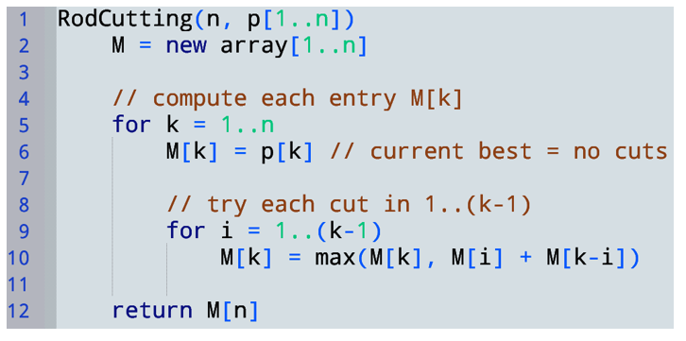
Recall, semantically, $M(k)=$ maximum income for rod of length $k$
Recurrence:$M\left(k\right)=\max\left\{p_{k}, max_{1≤i≤k−1}\left\{M\left(i\right)+M\left(k−i\right)\right\}\right\}$
Time complexity (unit cost)?
$$Θ\left(n^{2}\right)$$
Is this a “quadratic time” algorithm?

Slide 81
miscellaneous tips
Building a table of results bottom-up is what makes an algorithm DP
There is a similar concept called memoization
But, for the purposes of this course, we want to see bottom-up table filling!
Base cases are critical
They often completely determine the answer
Try setting f[0]=f[1]=0 in FibDP…

