Slide 1
CS 341: Algorithms
Lecture 8: dynamic programming II
Readings: see website
Trevor Brown
https://student.cs.uwaterloo.ca/~cs341
trevor.brown@uwaterloo.ca

Slide 2
Rod cutting A “real” Dynamic Programming example
Input:
$n$: length of rod
$p_{1},…,p_{n}$: $p_{i}=$ price of a rod of length $i$
Output:
Max income possible by cutting the rod of length $n$ into any number of integer pieces (maybe no cuts)
$$n=4$$
All ways of cutting a rod of length 4
Example output: 10

Slide 3
Dynamic programming approach
High level idea (can just think recursively to start)
Given a rod of length n
Either make no cuts, or make a cut and recurse on the remaining parts
Where should we cut?
$$Income p_{n}$$
$$Income\left(Left\right)+Income(Right)$$

Slide 4
Dynamic programming approach
Try all ways of making that cut
I.e., try a cut at positions $1, 2, …, n−1$
In each case, recurse on two rods $[0,i]$ and $[i,n]$
Take the max income over all possibilities (each $i$ / no cut)
$$i=1$$
Optimal substructure:
Max income from two rods w/sizes $i$ and $n−i$
$$i=2$$
$$i=3$$
…
… is max income we can get from the rod size $i$
$$i=n−1$$
+ max income we can get from the rod size $n−i$

Slide 5
Recurrence relation
Critical step! Must define what M(k) means, semantically!
Define $M(k)=$ maximum income for rod of length $k$
If we do not cut the rod, max income is $p_{k}$
If we do cut a rod at $i$
max income is $M\left(i\right)+M(k−i)$
Want to maximize this over all $i$
$max_{i}\left\{M\left(i\right)+M\left(k−i\right)\right\}$ (for $0<i<k$)
$M\left(k\right)=\max\left\{p_{k}, max_{1≤i≤k−1}\left\{M\left(i\right)+M\left(k−i\right)\right\}\right\}$
$$i$$
$$k$$
Length $i$
Length $k−i$

Slide 6
Computing solutions bottom-up
Recurrence: $M\left(k\right)=\max\left\{p_{k}, max_{1≤i≤k−1}\left\{M\left(i\right)+M\left(k−i\right)\right\}\right\}$
Compute table of solutions: $M[1..n]$
Dependencies: entry $k$ depends on
$M[i]$ → $M[1..\left(k−1\right)]$
$M[k−i]$ → $M[1..\left(k−1\right)]$
All of these dependencies are $<k$
So we can fill in the table entries in order $1..n$
$$M$$
$$1$$
$$k$$
$$n$$

Slide 7
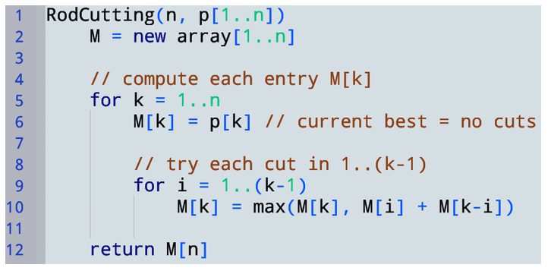
Recall, semantically, $M(k)=$ maximum income for rod of length $k$
Recurrence:$M\left(k\right)=\max\left\{p_{k}, max_{1≤i≤k−1}\left\{M\left(i\right)+M\left(k−i\right)\right\}\right\}$
Time complexity (unit cost)?
$$Θ\left(n^{2}\right)$$

Slide 8
miscellaneous tips
Building a table of results bottom-up is what makes an algorithm DP
There is a similar concept called memoization
But, for the purposes of this course, we want to see bottom-up table filling!
Base cases are critical
They often completely determine the answer
Try setting f[0]=f[1]=0 in FibDP…

Slide 9
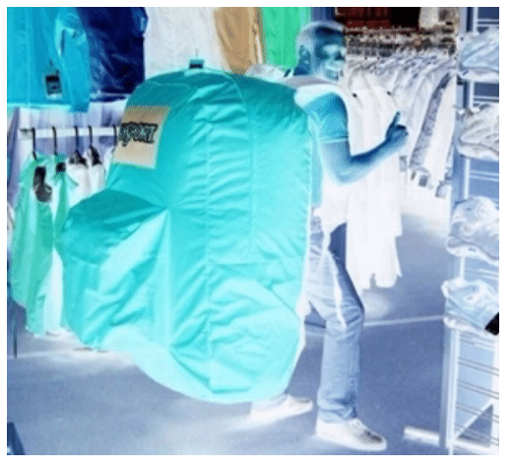
DP solution to 0-1 Knapsack

Slide 10
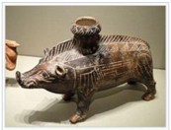
Problem: output maximum value one can get from taking ≤ 7kg, out of these four items.
Item 4
Suppose the optimal solution O does not include this
Subproblem: output max value for ≤ 7kg out of these three items
This is a smaller subproblem: reduced # of items
Item 3
Then with the O must achieve the best possible value using only items 1-3.
Item 2
Goal: create recurrence relation to describe optimal solution in terms of subproblems
Let P[i, m] = maximum profit using any subset of the items 1..i, with weight limit m
Note: P[n, M] (= P[4, 7]) is the optimal profit
Item 1
If O does not include the camera, then P[4, 7] = best we can do with the first three items and weight limit 7kg
What if the camera IS included in O?
That is, P[4, 7] = P[3, 7]

Slide 11
Problem: output maximum value one can get from taking ≤ 7kg, out of these four items.
Item 4
Suppose the optimal solution O includes this
Item 3
Subproblem: output max value for ≤ 6kg out of these three items
This is a smaller subproblem: reduced weight
and # of items
Then with the remaining 7kg – w₄ = 6kg, and items 1-3, O must achieve the best possible value.
Item 2
Recall: $P\left[i, m\right]=$ maximum profit using any subset of the items $1..i$, with weight limit $m$
If O includes the camera, then $P[4, 7]=p4$ + best we can do with the first three items and weight limit 7kg – w₄ = 6kg
Item 1
How to evaluate both possibilities: in & not in O?
That is, $P[4, 7]=p4 + P[3, 6]$

Slide 12
Recall: $P[i, m]=$maximum profit using any subset of the items $1..i$, with weight limit $m$
In general:
If O does not include the camera, then $P[4, 7]=$ best we can do with the first three items and weight limit 7kg
$$P[4, 7]=P[3, 7]$$
$$P[i, m]=P[i−1, m]$$
If O includes the camera, then $P[4, 7]=p4+$ best we can do with the first three items and weight limit 7kg – w₄ = 6kg
$$P[4, 7]=p4+P[3, 7−w4]$$
$$P[i, m]=pi+P[i−1, m−wi]$$
Try both and take the better result! (How?)
$$P\left[4, 7\right]=max⁡\{$$
$P\left[3, 7\right],$
$p_{4}+P[3, 7−w_{4}]\}$
$$P[i, m]=max⁡\{$$
$P[i−1, m],$
$pi + P[i−1, m−wi]\}$
Note that $max⁡\{P[i−1, m], pi + P[i−1, m−wi]\}$ is only valid if $i≥2$ and $m≥w_{i}$
What to do when $i=1$ or $m<w_{i}$? These are special cases.

Slide 13
General case: $i≥2$ and $m≥w_{i}$
Special case 1: $i≥2$ and $m<w_{i}$
Since $m≥w_{i}$, we can carry item i.
$$P\left[i,m\right]=\max\left\{P\left[i−1,m\right], p_{i}+P\left[i−1,m−w_{i}\right]\right\}$$
Since $m<w_{i}$, we cannot carry item i.
So, $P\left[i,m\right]=P\left[i−1,m\right].$
Special case 2: $i=1$ and $m≥w_{i}$
Special case 3: $i=1$ and $m<w_{i}$
Since $i≤1$, we can only use item 1.
Since $m≥w_{i}$, we can carry item 1.
So, $P\left[i,m\right]=p_{i}.$
Since $i≤1$, we can only use item 1.
Since $m<w_{i}$, we cannot carry item 1.
So, $P\left[i,m\right]=0.$

Slide 14
Filling the array:
No data dependencies on any other array cells.
$i$-axis
(can use
items in $1..i$)
Suppose item 1 does not fit until this $m$ value $(m=w_{1})$
…
1
3
5
n
$$w_{1}$$
…
0
2
4
M
$m$-axis (remaining weight limit)

Slide 15
Filling the array:
Suppose $m < w_{2}$ from here
… to here
0 | 0 | 0 | 0 | 0 | .. | .. | .. | 0 | p₁ | p₁ | p₁ | p₁ | p₁ | p₁ | p₁ | p₁ | p₁ | p₁ | p₁ | p₁
$i$-axis
(can use
items in $1..i$)
Data dependency: need cell above to be computed already
…
1
3
5
n
$$w_{1}$$
$$w_{2}$$
…
0
2
4
M
$m$-axis (remaining weight limit)

Slide 16
Filling the array:
Entry $[i−1,m]$
0 | 0 | 0 | 0 | 0 | .. | .. | .. | 0 | p₁ | p₁ | p₁ | p₁ | p₁ | p₁ | p₁ | p₁ | p₁ | p₁ | p₁ | p₁
0 | 0 | 0 | 0 | 0 | .. | .. | .. | 0 | p₁ | p₁ | p₁ | p₁
Consider this entry
where $m≥w_{2}$
$i$-axis
(can use
items in $1..i$)
Data dependency: need this to be computed already
Where is slot $[i−1,m−w_{i}]$?
…
1
3
5
n
So, what value should be stored in this entry?
$$max⁡\{p_{1},p_{2}+0\}$$
$$w_{2}$$
…
0
2
4
M
$m$-axis (remaining weight limit)

Slide 17
Filling the array:
0 | 0 | 0 | 0 | 0 | .. | .. | .. | 0 | p₁ | p₁ | p₁ | p₁ | p₁ | p₁ | p₁ | p₁ | p₁ | p₁ | p₁ | p₁
0 | 0 | 0 | 0 | 0 | .. | .. | .. | 0 | p₁ | p₁ | p₁ | p₁
$$max⁡\{p_{1},p_{2}+0\}$$
$$max⁡\{p_{1},p_{2}+0\}$$
$i$-axis
(can use
items in $1..i$)
We only ever look at the previous row!
$$max⁡\{p_{1},p_{2}+0\}$$
$$max⁡\{p_{1},p_{2}+0\}$$
…
1
3
5
n
Depending how many zeros we have in the top row, and how far back we’re looking, might start to get cells containing $max⁡\{p_{1},p_{2}+p_{1}\}$
To satisfy data dependencies, we can fill entries in the order: for ($i=1..n$), for ($m=0..M$)
…
0
2
4
M
Would the following fill-order work?
for ($i=1..n$), for ($m=M..0$)
$m$-axis (remaining weight limit)

Slide 18
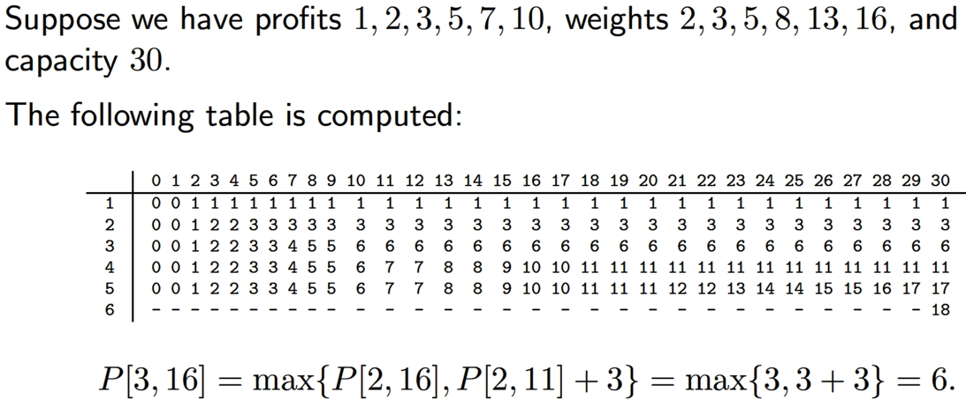
exercise
$m$-axis
(weight)
$i$-axis
(items)
?
? What do you think ?

Slide 19
exercise
$m$-axis
(weight)
$i$-axis
(items)

Slide 20
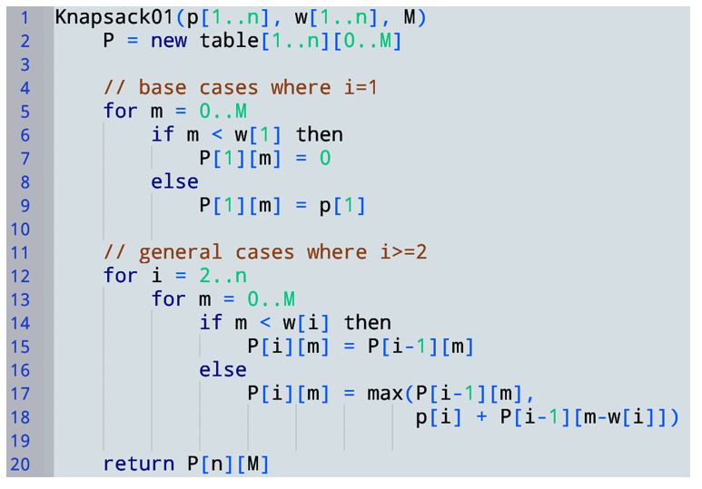
Recall: To satisfy data dependencies, we can fill entries in the order: for ($i=1..n$), for ($m=0..M$)
Read & return optimal profit
How about the optimal items?

Slide 21
outputting contents of the optimal knapsack O
? ? ?
weight limit remaining
Items you can take
8 > 6 so O must take item 4
Same profit using items 1..4 or 1..5. So, there exists an optimal solution O that does not use item 5! Consider O.
Best profit for remaining items + weight
18 > 17, so any optimal solution must take item 6
Start at optimal profit
remaining weight = 14
Exercise: continue, and determine which other items are in O

Slide 22
outputting contents of the optimal knapsack O
weight limit remaining
Items you can take

Slide 23
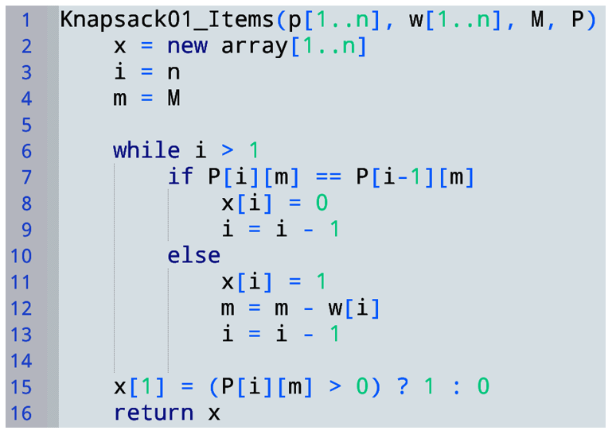
Runtime given $P?$
$$Θ(n)$$
Is this linear time?
More on this soon…

Slide 24
So the DP alg is faster when there are many item types, but small weight limit
Huge n is fine, but M should be in poly(n) to get an asymptotic improvement
DP takes $Θ\left(nM\right)$ time, which could be $Θ\left(n2^{n}\right)$ for huge M
n must be very small
A recursive algorithm would take $\sim Θ\left(2^{n}\right)$ time

Slide 25
Simplifying base cases
$$P\left[i,m\right]=\left\{\begin{aligned}\max\left\{P\left[i−1,m\right],p_{i}+P\left[i−1,m−w_{i}\right]\right\} if i≥1,m≥w_{i} \\ P\left[i−1,m\right] if i≥1,m<w_{i} \\ 0 if i=0 \end{aligned}\right.$$
0
0 | 0 | 0 | 0 | 0 | 0 | 0 | 0 | 0
2
$i$-axis
(can use
items in $1..i$)
…
For $i=1$,$m<w_{i},$
we have $P\left[i−1,m\right]$
which is 0
…
1
3
n
For $i=1$,$m≥w_{i},$
we have $p_{i}+P\left[i−1,m−w_{i}\right]$
which is $p_{i}+0$
n
…
…
0
2
4
M
0
2
4
M
$m$-axis (remaining weight limit)

Slide 26
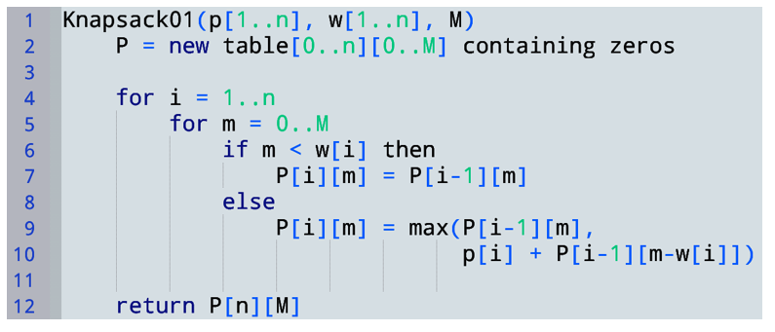
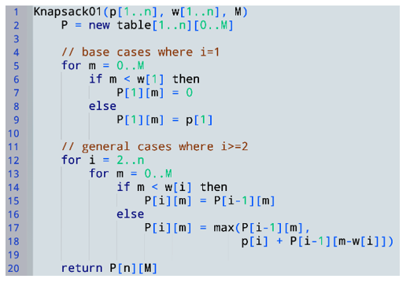
We get much simpler code!
Compare:

Slide 27
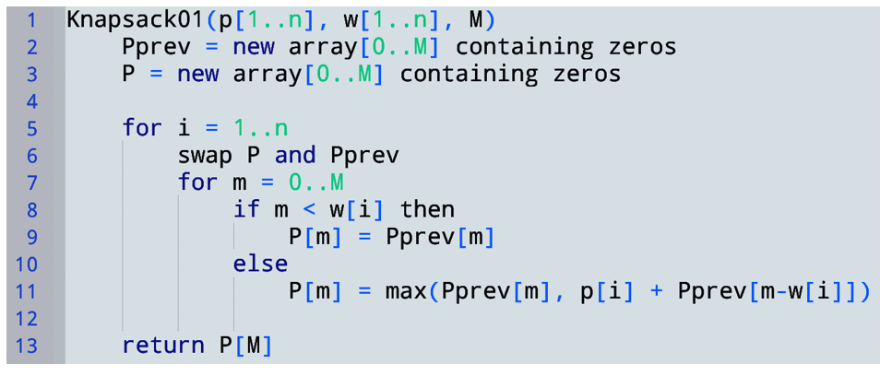
Saving space
We never look at P[i-2][…].
Just keep two arrays representing P[i] and P[i-1]
Space complexity changes from $O(mn)$ to $O(m)$

Slide 28
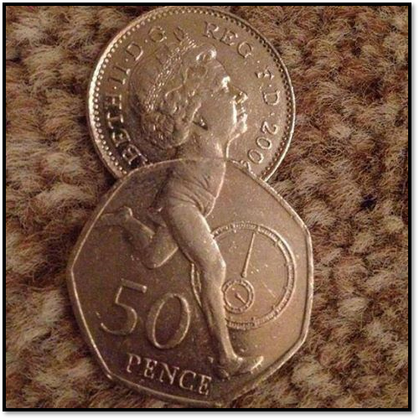
Coin changing

Slide 29
There is a denomination with unit value!
In 0-1 knapsack, we only considered two subproblems in our recurrence: taking an item, or not.
Here we can do more than use a coin denomination or not.

Slide 30
Exploring: some sensible base case(s)?
General case:
What are the different ways we could use coin denomination $di$?
What subproblems / solutions should we use?
Final recurrence relation
OR $t=0$

Slide 31
Also $N[i,0]=0$ for all $i$
General case:
What are the different ways we could use coin denomination $di$?
What subproblems / solutions should we use?
Final recurrence relation
OR $t=0$

Slide 32
Also $N[i,0]=0$ for all $i$
OR $t=0$

Slide 33
Filling the array $N[1…n,0…T]$:
OR $t=0$
No data dependencies on any other array cells.
$i$-axis
(coin type)
(recall: $N[i,t]$ uses coin types $1..i$)
…
1
3
5
n
…
0
2
4
T
$t$-axis (target sum remaining)
Notes:
Note to self for next time: make more concrete, with numbers I can fill in completely

Slide 34
Filling the array $N[1…n,0…T]$:
OR $t=0$
No data dependencies on any other array cells.
0 | 1 | 2 | 3 | 4 | 5 | 6 | … |  |  |  |  |  |  |  |  |  |  |  |  | T
0
0
0
0
…
0
$i$-axis
(coin type)
(recall: $N[i,t]$ uses coin types $1..i$)
…
1
3
5
n
…
0
2
4
T
$t$-axis (target sum remaining)

Slide 35
Filling the array $N[1…n,0…T]$:
OR $t=0$
0 | 1 | 2 | 3 | 4 | 5 | 6 | … |  |  |  |  |  |  |  |  |  |  |  |  | T
0
0
0
0
…
0
$$N[i−1,t−2⋅d_{i}]$$
$$N[i−1,t−1⋅d_{i}]$$
$$N[i−1,t−0⋅d_{i}]$$
$i$-axis
(coin type)
(recall: $N[i,t]$ uses coin types $1..i$)
…
…
1
3
5
n
Consider cell$N[i,t]$
$$di$$
It is sufficient to fill:
row i=1 (base case), then for ($i=2…n$), for ($t=0…T$)
We only look at the previous $i$-row!
…
0
2
4
T
$t$-axis (target sum remaining)

Slide 36
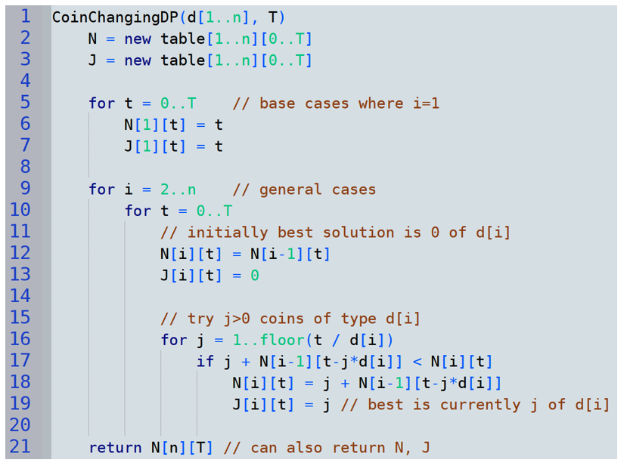
i.e., using coin $d_{1}=1$
$J\left[i,t\right]=$ # of coins of type $di$ used in $N[i,t]$
using other coin types
Compute min{…} over $j = 0 …\left\lfloor t/d_{i}\right\rfloor$

Slide 37
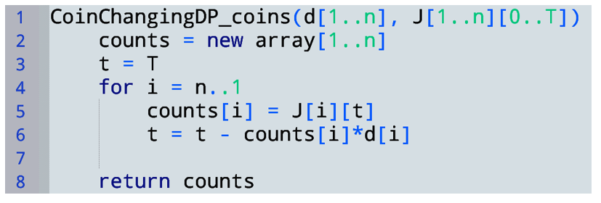
outputting Optimal Set of Coins
Recall $J\left[i,t\right]=$ # of coins of type $di$ used in $N[i,t]$
We start at $J\left[n\right]\left[T\right]=$ # of coins of type $d_{n}$ used in the optimal solution
Exercise for later:
compute the correct output without using $J\left[i,t\right]$ (i.e., using only $N$, $d$, $T$)

Slide 38
Time complexity?
Unit cost computational model is reasonable here
Consider instance $I=(d,T)$
Runtime $R\left(I\right)∈O\left(\sum_{i=2}^{n}{\sum_{t=0}^{T}{\left\lfloor \frac{t}{d_{i}}\right\rfloor }}\right)$
$$R\left(I\right)∈O\left(\sum_{i=2}^{n}{\frac{1}{d_{i}}}\sum_{t=0}^{T}{t}\right)$$
$$R\left(I\right)∈O\left(\sum_{i=2}^{n}{\frac{1}{d_{i}}}\left(\frac{T\left(T+1\right)}{2}\right)\right)$$
$$R\left(I\right)∈O\left(DT^{2}\right)$$
where $D=\sum_{i=2}^{n}{\frac{1}{d_{i}}}<n$.
If T is small, this is much better than brute force

Slide 39
Polynomial time
An algorithm runs in (worst case) polynomial time IFF its runtime $R\left(I\right)$ on every input is upper bounded by a polynomial in the input size S
I.e., $R\left(I\right)∈O\left(c_{0}+c_{1}S+c_{2}S^{2}+c_{3}S^{3}+…+c_{k}S^{k}\right)$ for constants $k$ and $c_{0},…,c_{k}$
… so is $O(nT^{2})$ polynomial in our input size $S$?

Slide 40
Input size
$S=bits\left(T\right)+bits\left(d_{1}\right)+…+bits\left(d_{n}\right)$
It takes $⌈\log_{2}{T}⌉$ bits to store $T$
It takes $\left\lceil \log_{2}{d_{i}}\right\rceil$ bits to store each $d_{i}$
Assume $d_{i}≤T$ (otherwise $d_{i}$ cannot be used at all, and should be omitted from the input)
Then we have $\left\lceil \log_{2}{d_{i}}\right\rceil ∈O(log T)$
So, $S∈O(n\log{T})$

Slide 41
Comparing $T(I)$ to $S$
Recall $R\left(I\right)∈O(nT^{2})$ and $S∈O\left(n log{T}\right)$
As an example, if $n$ is fixed at 10 and $T$ is allowed to vary, then $S∈O\left(\log{T}\right)$ and $R\left(I\right)∈O\left(T^{2}\right)$
In this case, $R(I)$ is exponential in $S$
However, if $T$ is fixed at 10 and $n$ is allowed to vary, then $S∈O(n)$ and $R\left(I\right)∈O(n)$
In this case, $R(I)$ is linear in $S$
So, large $n$ and small $T$ is where this DP solution shines!

Slide 42
A bit more analysis
Recall $R\left(I\right)∈O(nT^{2})$ and $S∈O\left(n log{T}\right)$
If $T∈O(n)$, then $S∈O(n\log{n})$ and $R\left(I\right)∈O(n^{3})$
Note $O(n^{3})$ is a smaller runtime than $O\left(S^{3}\right)=O(n^{3}\log{n})$
And $S^{3}$ is polynomial in $S$, so $O\left(n^{3}\right)$ is a polynomial runtime
So, for some inputs with relatively small T, we can get polynomial runtimes!
In particular, for $T∈O(n^{k})$ where $k$ is constant, $R\left(I\right)∈O\left(n{\left(n^{k}\right)}^{2}\right)=O(n^{2k+1})$ and $S∈O\left(n\log{n^{k}}\right)=O\left(n\log{n}\right)$
And $R\left(I\right)∈O\left(n^{2k+1}\right)⊆O\left({\left(n\log{n}\right)}^{2k+1}\right)=O(S^{2k+1})$

