Slide 1
CS 341: Algorithms
Lecture 15: graph algorithms VI – all pairs shortest paths
Readings: see website
Trevor Brown
https://student.cs.uwaterloo.ca/~cs341
trevor.brown@uwaterloo.ca

Slide 2
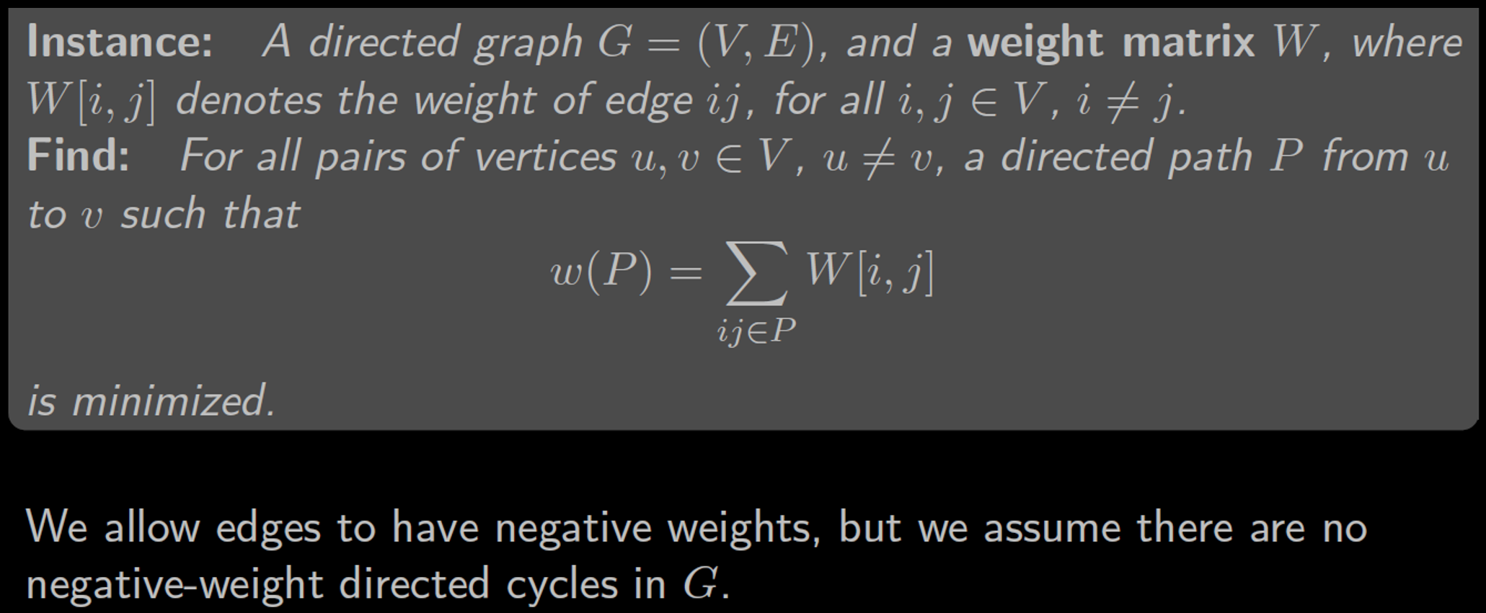
All pairs shortest paths (APSP) Problem

Slide 3
$$a$$
3
$$b$$
from:
$$a$$
$$b$$
$$c$$
$$d$$
to: $a b c d$
4
$$W\left[i,j\right]=\left[\begin{matrix}\begin{matrix}0 & \\ & 0\end{matrix} & \begin{matrix} & \\ & \end{matrix} \\ \begin{matrix} & \\ & \end{matrix} & \begin{matrix}0 & \\ & 0\end{matrix}\end{matrix}\right]$$
$$W\left[i,j\right]=\left[\begin{matrix}\begin{matrix}0 & 3 \\ & 0\end{matrix} & \begin{matrix} & \\ & \end{matrix} \\ \begin{matrix} & \\ & \end{matrix} & \begin{matrix}0 & \\ & 0\end{matrix}\end{matrix}\right]$$
$$W\left[i,j\right]=\left[\begin{matrix}\begin{matrix}0 & 3 \\ & 0\end{matrix} & \begin{matrix}∞ & ∞ \\ & \end{matrix} \\ \begin{matrix} & \\ & \end{matrix} & \begin{matrix}0 & \\ & 0\end{matrix}\end{matrix}\right]$$
$$W\left[i,j\right]=\left[\begin{matrix}\begin{matrix}0 & 3 \\ & 0\end{matrix} & \begin{matrix}∞ & ∞ \\ 12 & 5\end{matrix} \\ \begin{matrix} & \\ & \end{matrix} & \begin{matrix}0 & \\ & 0\end{matrix}\end{matrix}\right]$$
$$W\left[i,j\right]=\left[\begin{matrix}\begin{matrix}0 & 3 \\ ∞ & 0\end{matrix} & \begin{matrix}∞ & ∞ \\ 12 & 5\end{matrix} \\ \begin{matrix} & \\ & \end{matrix} & \begin{matrix}0 & \\ & 0\end{matrix}\end{matrix}\right]$$
$$W\left[i,j\right]=\left[\begin{matrix}\begin{matrix}0 & 3 \\ ∞ & 0\end{matrix} & \begin{matrix}∞ & ∞ \\ 12 & 5\end{matrix} \\ \begin{matrix}4 & \\ & \end{matrix} & \begin{matrix}0 & −1 \\ & 0\end{matrix}\end{matrix}\right]$$
$$W\left[i,j\right]=\left[\begin{matrix}\begin{matrix}0 & 3 \\ ∞ & 0\end{matrix} & \begin{matrix}∞ & ∞ \\ 12 & 5\end{matrix} \\ \begin{matrix}4 & ∞ \\ & \end{matrix} & \begin{matrix}0 & −1 \\ & 0\end{matrix}\end{matrix}\right]$$
$$W\left[i,j\right]=\left[\begin{matrix}\begin{matrix}0 & 3 \\ ∞ & 0\end{matrix} & \begin{matrix}∞ & ∞ \\ 12 & 5\end{matrix} \\ \begin{matrix}4 & ∞ \\ 2 & −4\end{matrix} & \begin{matrix}0 & −1 \\ & 0\end{matrix}\end{matrix}\right]$$
2
$$W\left[i,j\right]=\left[\begin{matrix}\begin{matrix}0 & 3 \\ ∞ & 0\end{matrix} & \begin{matrix}∞ & ∞ \\ 12 & 5\end{matrix} \\ \begin{matrix}4 & ∞ \\ 2 & −4\end{matrix} & \begin{matrix}0 & −1 \\ ∞ & 0\end{matrix}\end{matrix}\right]$$
-4
5
12
$$d$$
$$c$$
-1

Slide 4
Easy solution
Run Bellman-Ford $n$ times, once for each possible source
$$D_{aa}=0$$
$$D_{ab}=3$$
$$D_{ba}=7$$
$$D_{bb}=0$$
$$D_{ca}=1$$
$$D_{cb}=−5$$
$$D_{da}=2$$
$$D_{db}=−4$$
$$a$$
3
3
$$s$$
$$a$$
3
$$b$$
$$a$$
3
$$b$$
$$s$$
$$b$$
$$a$$
$$b$$
4
4
4
4
2
2
2
-4
2
-4
-4
-4
5
12
5
12
5
12
5
12
$$d$$
$$d$$
$$s$$
$$s$$
$$c$$
$$d$$
$$c$$
$$d$$
$$c$$
$$c$$
-1
-1
-1
-1
$$D_{ad}=8$$
$$D_{ac}=15$$
$$D_{bd}=5$$
$$D_{bc}=12$$
$$D_{cd}=−1$$
$$D_{cc}=0$$
$$D_{dd}=0$$
$$D_{dc}=8$$
Complexity $O(n^{2}m)$. (Could be $O(n^{4})$.)
Output:
Matrix $D$ of shortest path
lengths
from:
$$a$$
$$b$$
$$c$$
$$d$$
to: $a b c d$
$$D\left[i,j\right]=\left[\begin{matrix}\begin{matrix}0 & 3 \\ 7 & 0\end{matrix} & \begin{matrix}15 & 8 \\ 12 & 5\end{matrix} \\ \begin{matrix}1 & −5 \\ 2 & −4\end{matrix} & \begin{matrix}0 & −1 \\ 8 & 0\end{matrix}\end{matrix}\right]$$
Can we do better?

Slide 5
Arguing optimal substructure
Let $P=$ minimum weight
$\left(i,j\right)$-path with $≤m$ edges
$$P$$
$$j$$
$$i$$
Base case: $L_{1}=W$
General case: How to express solution in terms of optimal solutions to subproblems?
$$w\left(P\right)=L_{m}[i,j]$$
Let $k$ be the predecessor of $j$
on path P
Express shortest path with m edges in terms of shortest path(s) with < m edges?
$$j$$
$$i$$
$$k$$
$$w\left(P′\right)=L_{m−1}[i,k]$$
$$P′$$
$$L_{1}[k,j]$$
Problem: we don’t know the predecessor of j on the optimal path P
Then $P^{′}=$ minimum weight
$\left(i,k\right)$-path with $≤m−1$ edges
Try all possible predecessors $k$
(or could shrink $w(P)$; contra!)

Slide 6
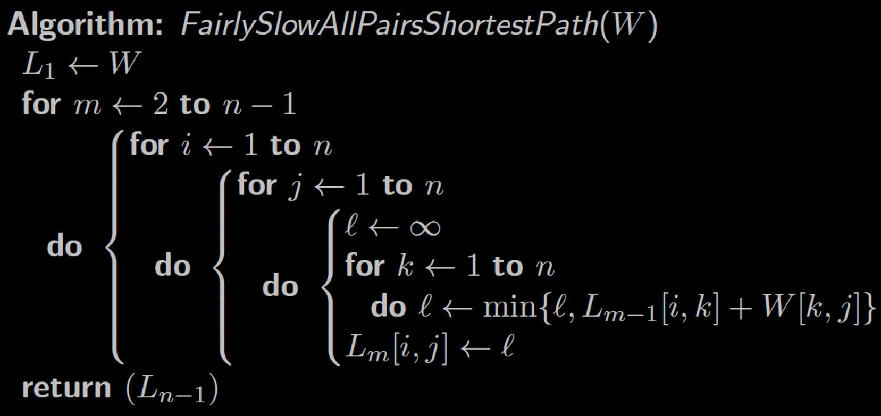
Time complexity?
$$O(n^{4})$$
Space complexity is a bit subtle…
To compute $L_{m}$, only need $W$ and $L_{m−1}$. No need to keep $L_{2},…,L_{m−2}$.
So space is $O\left(\left|W\right|+\left|L_{m}\right|+\left|L_{m−1}\right|\right)=O\left(\left|L_{m}\right|\right)=O(n^{2})$
Home exercise: do we need to keep both $L_{m}$ and $L_{m−1}$? Or can we reuse $L_{m−1}$ directly as our $L_{m}$ array, and modify it in-place?
Note: this is asymptotically the same as input size for dense graphs where $\left|E\right|∈Θ({\left|V\right|}^{2})$

Slide 7
Better solution: successive doubling
Arguing optimal substructure
Let $P=$ minimum weight
$\left(i,j\right)$-path with $≤2m$ edges
and $k=$ midpoint node of $P$
$$P_{2}$$
$$j$$
$$j$$
$$i$$
$$P_{1}$$
$$k$$
$$P$$
$$i$$
$≤m$ edges
$≤m$ edges
$P_{1}$ is the minimum weight $\left(i,k\right)$-path with $≤m$ edges and
(or else we could improve P by improving P1 or P2)
Then $P=$ $P_{1}∪P_{2}$ where:
$P_{2}$ is the minimum weight $\left(k,j\right)$-path with $≤m$ edges
Don’t know which node is midpoint of P, so try all k…

Slide 8
Complexity analysis
$O(n^{3}\log{n})$ runtime
$O(n^{2})$ space

Slide 9
Summary & what’s next
First solution: sub-problem is a path to the predecessor node
Optimality: try all possible predecessor nodes $k$
Second solution: sub-problems are paths to/from the midpoint node
Optimality: try all possible midpoint nodes $k$
Third solution: sub-problems are paths in which all interior nodes are in $\{1..k−1\}$
I.e., we restrict paths to using a prefix of all nodes
Optimality: try all ways to use new node $k$ as an interior node
$$j$$
$$i$$
$$k$$
~half path
~half path
$$i$$
$$j$$
$$k$$
interior nodes are all in $\{1..k−1\}$
$$i$$
$$j$$
$$k$$

Slide 10
Third solution: Floyd-Warshall
Optimal solution:
interior nodes are all in $\left\{1,…,k\right\}$
Let $D_{k}[i,j]$ denote the length of the minimum-weight path $i⇝j$ in which all interior nodes are in the set $\{1,…,k\}$.
We want to compute $D_{n}$.
$$\left\{1,…,k\right\}$$
$$i$$
$$P$$
$$j$$
Let $P$ be a min-weight $\left(i,j\right)$-path in which all interior nodes are in $\{1,…,k\}$
Case 1: $k$ is not used in $P$
Case 2: $k$ is used in $P$
interior nodes are all in $\left\{1,…,k−1\right\}$
interior nodes
are all in $\left\{1,…,k−1\right\}$
How can we argue k is not in either P1 or P2?
$$P$$
$$j$$
$$P_{2}$$
$$j$$
Because P would then contain a cycle, and the cycle cannot make P shorter
$$i$$
$$i$$
$$P_{1}$$
$$k$$
So there must be an equivalent or better $P$ without a cycle
Then $D_{k}\left[i,j\right]=D_{k−1}[i,j]$
Then $D_{k}[i,j] =D_{k−1}\left[i,k\right]+D_{k−1}\left[k,j\right]$
more formal proof in bonus slides
Notes:
If every minimum weight (i,j)-path with all interior nodes in {1…m} visits m twice or more, then there is a negative weight cycle. Clearly there is a cycle in any such path. If the cycle has non-negative weight, then we can remove the cycle and leave the path weight unchanged, or even improve it. So, there should be another optimal path without such a cycle. Removing such a cycle also removes any extra copies of m on the path, so m appears exactly once among the interior nodes of the path. The only way that removing a cycle containing m will eliminate the optimality of the path is if traversing the cycle actually improves the weight of the path, which can only happen if the cycle has negative weight, which is impossible, since we have assumed there are no negative cycles (for all-pairs shortest paths to be solvable).

Slide 11
Floyd-Warshall algorithm
Let $D_{k}[i,j]$ denote the length of the minimum-weight $(i,j)$-path in which all interior nodes are in the set of nodes $\{1…k\}$.
Base case: $D_{0}=W$
Recurrence: $D_{k}\left[i,j\right]=min⁡\{D_{k−1}\left[i,j\right], D_{k−1}\left[i,k\right]+D_{k−1}[k,j]\}$
copy of weight matrix $W$
Time complexity?
Space complexity?
This returns distances. Can reconstruct paths from this.
Dlast

Slide 12
Example
$$a$$
3
$$b$$
4
2
-4
5
12
$$d$$
$$c$$
-1

Slide 13
Stable matching problem (solved with a greedy graph algorithm)

Slide 14
X
Y
x₁
5→
←2
y₁
3→
x₂
←1
y₂
x₃
y₃

Slide 17
Keeps track of current matches
Termination is not so obvious…
Propose to most desired $y$
Unmatched $yj$ accepts any proposal
Matched $yj$ considers upgrading

Slide 18
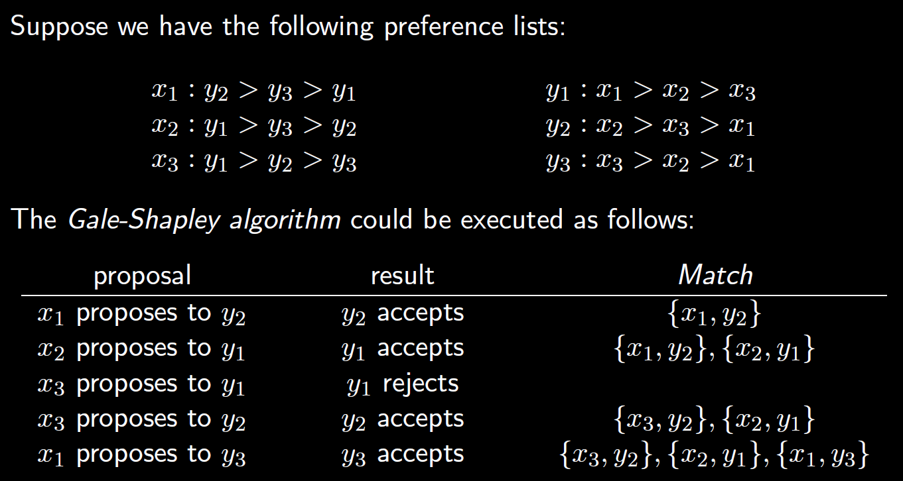
Example:

Slide 19
So the algorithm terminates, and each $xi$ is matched with some $yj$
Need to argue the matching is stable (i.e., optimal)
That is, no $xi$ and $yj$ prefer each other more than their current partners

Slide 20
Observe: $x_{i}$ proposes to $y_{ℓ}$ before proposing to $y_{j}$
Implies $y_{ℓ}$ already matched with someone better than $x_{i}$
And $y_{ℓ}$ can only change to even better partners, so $y_{ℓ}$’s current partner is better than $x_{i}$
Then $y_{ℓ}$ should end up matched with $x_{i}$. Contradiction!
Other proposal must be to someone better. Contradiction!
Contradicts our assumption that this instability exists!
All three cases are impossible, so assumption is wrong. There cannot be an instability!

Slide 21
Complexity
But how much time does it take per iteration?

Slide 22
Depends on how we implement the algorithm…
Maintain a queue of unmatched $x$ elements
Simple list of preferences
Want to know who $y_{j}$ is matched with
Want to know who $y_{j}$ is matched with
Maintain arrays of matches.
If $x_{i}$ and $y_{j}$ are matched then $M_{x}\left[i\right]=j$ and $M_{y}\left[j\right]=i$
(Initially $M_{x}\left[i\right],M_{y}\left[i\right]=0$)
Want to quickly look up $y_{j}$’s rank for $x_{i}$ and $x_{k}$
Construct an array $R\left[j,i\right]$ containing the rank of $x_{i}$ in $y_{j}$’s preference list
I.e., want $R\left[j,i\right]=k$ if $x_{i}$ is $y_{j}$’s $k$-th favourite partner
So, we get $O\left(1\right)$ time per iteration, and $O(n^{2})$ time in total
$O(n^{2})$ preprocessing
Allows comparing two ranks in $O(1)$ time!
Exercise: try writing pseudocode for this implementation

Slide 23
Formulating Graph Problems

Slide 26
For each input point (x,y): add vertices (x,0), (x,h), (x,y) to V
For all pairs of vertices u, v in V: if dist(u,v) < d, add edge uv
Also add edges between all vertices on each canyon wall
y=h
< d
d
y=0
Bear cannot get through the canyon if North and South walls are connected
Test connectivity using BFS from any point on the North wall, and checking if any point on the South wall is visited.
Exercise: what if each tree had radius $r$?

Slide 27
0.8
e
Reliability of path a->b->c->d: 0.5 * 0.9 * 0.75 = 0.3375
0.9
c
b
0.75
0.5
1.0
0.9
a
0.8
d
Higher reliability via path a->b->d: 0.5 * 0.8 = 0.4

Slide 28
Can we turn this into a shortest path problem?
Shortest path minimizes a sum of weights $\sum{w}$
Problem 1: need product of weights not sum
Problem 2: want to maximize the product
Use logs to turn product of weights into a sum.
A path $P$ has maximum $\prod{w}$ IFF it has maximum $\log{\prod{w}}$ IFF it has minimum $log\prod{\frac{1}{w}}$
Recall: $\log{xy}=\log{x}+\log{y}$. So $log\prod{w}=\sum{log w}$.
$$log\prod{\frac{1}{w}}=\log{\frac{1}{\prod{w}}=\log{1}−\log{\prod{w}}=−\log{\prod{w}}}$$
$=−\sum{\log{w}}=\sum{\left(−\log{w}\right)}$. ← Want to minimize this!
Solution: create a new graph where each weight $w$ is replaced with weight $\left(−log w\right)$
=~0.155
…
0.8
e
$$−log⁡0.9$$
$$−log⁡0.8$$
e
0.9
c
c
b
=1
b
$$−log⁡0.75$$
0.75
0.5
0.7
$$−log⁡0.5$$
$$−log⁡0.9$$
$$−log⁡0.7$$
0.9
a
0.8
d
a
d
$$−log⁡0.8$$
=~0.322
if $w≤1$ then $\log{w}≤0$
so $(−log w)≥0$
So we can use Dijkstra!

Slide 29
Bonus slides

Slide 30
A More formal optimality argument For your notes
By induction: suppose $D_{m−1}\left[i,j\right]$ is correct for all $i,j$. We show $D_{m}[i,j]$ is correct.
(Base case $D_{0}\left[i,j\right]$ is left as an exercise)
Let $P$ be a min-weight $\left(i,j\right)$-path in which all interior nodes are in $\{1…m\}$
Case 1: $m$ is not used in $P$
Case 2: $m$ is used in $P$
interior nodes are all in $\left\{1…m−1\right\}$
interior nodes
are all in $\left\{1…m\right\}$
Reduce $P_{1},P_{2}$ to subproblems
all interior nodes in $\left\{1…m−1\right\}$
but what if $m∈P_{1},P_{2}$?
$$P$$
$$j$$
$$P_{2}$$
$$P_{2}′$$
$$j$$
$$i$$
$$i$$
$$j$$
$$i$$
$$P_{1}′$$
$$m$$
$$P_{1}$$
$$m$$
Consider $P′$
Then $w(P)=D_{m−1}[i,j]$ by I.H., and $D_{m}\left[i,j\right]=D_{m−1}[i,j]$
Claim: $∃$ optimal path $P^{′}=P_{1}^{′},m,P_{2}^{′}$ such that $P_{1}^{′}$ and $P_{2}^{′}$ have all interior nodes in $\{1…m−1\}$
By I.H., $w(P_{1}^{′})=D_{m−1}\left[i,m\right]$
and$w\left(P_{2}^{′}\right)=D_{m−1}[m,j]$
And $w\left(P_{1}^{′}\right)+w\left(P_{2}^{′}\right)=D_{m−1}\left[i,m\right]+D_{m−1}\left[m,j\right]=D_{m}[i,j]$
(details in slide notes)
(If $m$ appears twice in $P$, it creates a cycle which can be removed to get $P^{′}$ with same or better weight)
Notes:
If every minimum weight (i,j)-path with all interior nodes in {1…m} visits m twice or more, then there is a negative weight cycle. Clearly there is a cycle in any such path. If the cycle has non-negative weight, then we can remove the cycle and leave the path weight unchanged, or even improve it. So, there should be another optimal path without such a cycle. Removing such a cycle also removes any extra copies of m on the path, so m appears exactly once among the interior nodes of the path. The only way that removing a cycle containing m will eliminate the optimality of the path is if traversing the cycle actually improves the weight of the path, which can only happen if the cycle has negative weight, which is impossible, since we have assumed there are no negative cycles (for all-pairs shortest paths to be solvable).

