Slide 1
CS 341: Algorithms
Lecture 19: intractability I
Readings: see website
Trevor Brown
https://student.cs.uwaterloo.ca/~cs341
trevor.brown@uwaterloo.ca

Slide 2
This time
Intractability (hardness of problems)
Decision problems
Complexity class P
Polynomial-time Turing reductions
Introductory reductions
Three flavours of the traveling salesman problem

Slide 3
Intractability
Studying the hardness of problems

Slide 6
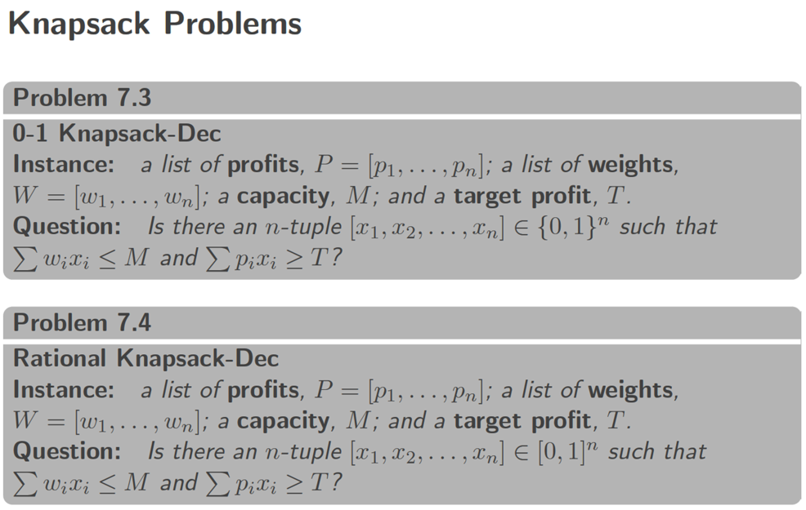
Relative problem hardness?

Slide 7
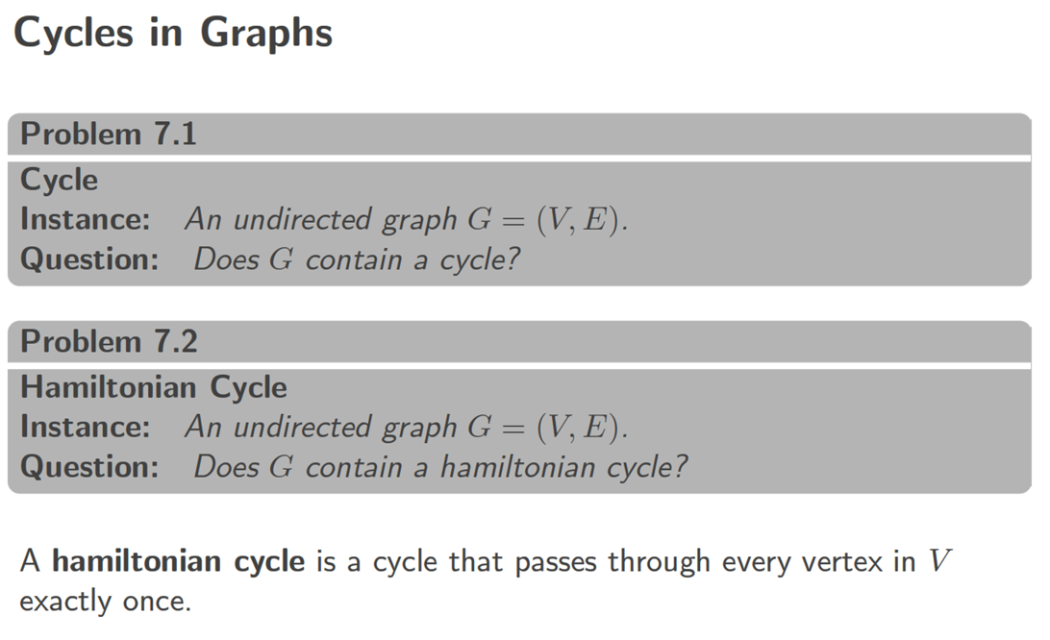
Relative hardness?

Slide 8
Example: all-pairs-shortest-paths easily reduces to single-source-shortest-path
A reduction typically: 1. transforms the larger problem’s input so it can be fed to the oracle, and
2. transforms the oracle’s output into a solution to the larger problem.

Slide 9
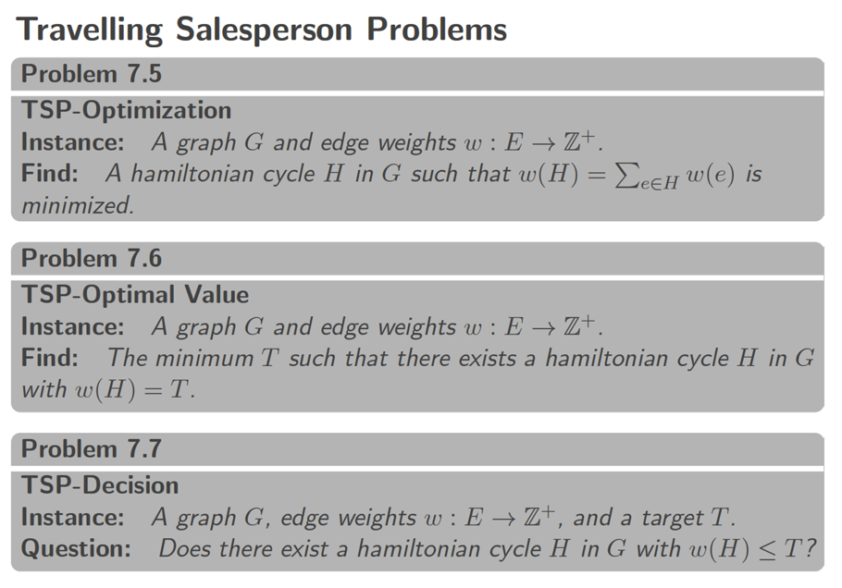
Positive edge weights
Return type “a path/cycle H”
Is TSP-Dec $≤_{P}^{T}$ TSP-Optimal Value?
Return type “a positive integer T”
Is TSP-Dec $≤_{P}^{T}$ TSP-Optimization?
Return type “yes/no”

Slide 10
We already know
TSP-Dec $≤_{P}^{T}$ TSP-Optimal Value
TSP-Dec $≤_{P}^{T}$ TSP-Optimization
We show
TSP-Optimal Value $≤_{P}^{T}$ TSP-Dec
TSP-Optimization $≤_{P}^{T}$ TSP-Dec

Slide 11
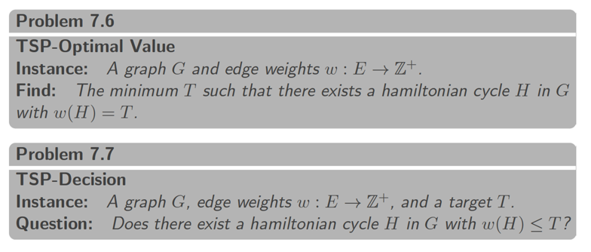
TSP-Optimal Value input: G, w
3
3
1
4
2
1
5
1
TSP-Dec() also needs a target T
What if we try TSP-Dec(G, w, 100)?
It returns true. But we don’t learn optimal value… just that it’s $≤$100
How can we learn the exact optimal value by making such calls?

Slide 12
Use binary search! How to define the starting range (lo, hi) to search?
Largest possible cycle could include every edge
0 is smallest possible weight for any cycle
Maybe there is no Hamiltonian cycle, at all
Is this a “poly-time reduction?”
I.e., if we assume TSP-Dec-Solver runs in O(1) time, is the runtime a polynomial in the input size?
Questions: (1) What’s the input size? (2) What’s the runtime?

Slide 13
What’s the size of the input $I=\left(G,w\right)$?
$$Size\left(I\right)=Size\left(G\right)+Size\left(w\right)$$
But wait… G and w could be represented in many different ways. Could the choice of representation affect our complexity result?
Only for very inefficient representations (that are exponentially larger than optimal).
For example if we store weights in unary
We rule out such inefficient representations for the purpose of proving polynomial runtime
Polynomial differences in size do not matter.
Exercise: $if T∈poly\left(Size{\left(I\right)}^{40}\right) then T∈poly\left(Size\left(I\right)\right)$

Slide 14
What’s the size of the input $I=(G,w)$?
$$Size\left(I\right)=Size\left(G\right)+Size\left(w\right)$$
So, suppose $G$ is represented as an array of adjacency lists (one list for each vertex), with each list containing edges to neighbouring vertices, and an edge is represented by a weight and the name of the target vertex
Bits to store weight of the edge (storing $w(e)$ takes $\log{w\left(e\right)}+1$ bits)
Bits to store the name of the target vertex (in 1..|V|)
$$Size\left(I\right)=|V|+\sum_{e∈E}{\left(log w\left(e\right)+1+log\left|V\right|+1\right)}$$
Array of empty lists for all vertices $v$
For all edges
Let’s relate this to runtime… what’s the runtime?

Slide 15
Let’s assume $O(1)$ time for operations on weights
Later we’ll see this isn’t needed to show polytime
Runtime $T\left(I\right)∈O\left(\left|E\right|+\log{\sum_{e∈E}{w(e)}}\right)$
$$O(\left|E\right|)$$
$$O(1)$$
$O(1)$ for the oracle
# iterations: $O\left(\log\left(hi−lo\right)\right)$
$=\log{\sum_{e∈E}{w\left(e\right)}}$
$$O(1)$$

Slide 16
Comparing $T(I)$ and $Size(I)$
$T\left(I\right)$ $∈O\left(\left|E\right|+\log{\sum_{e∈E}{w(e)}}\right)$
$Size\left(I\right)$ $=|V|+\sum_{e∈E}{\left(log w\left(e\right)+1+log\left|V\right|+1\right)}$
$=\left|V\right|+Σ_{e∈E}\left(\log{w\left(e\right)}+1\right)+Σ_{e∈E}\left(\log\left|V\right|+1\right)$
$=\left|V\right|+Σ_{e∈E}\left(\log{w\left(e\right)}+1\right)+Σ_{e∈E}\left(\log\left|V\right|\right)+|E|$
Want to show $T\left(I\right)∈O\left(Size{\left(I\right)}^{c}\right)$ for some constant $c$ (we show c=1)
$O\left(\left|E\right|+\log{\sum_{e∈E}{w\left(e\right)}}\right)$ $⊆^{?}$ $O\left(\left|V\right|+Σ_{e∈E}(\log{w\left(e\right)+1)}+Σ_{e∈E}\log\left|V\right|+\left|E\right|\right)$
$⇔$ $O\left(\log{\sum_{e∈E}{w\left(e\right)}}\right)$ $⊆^{?}$ $O\left(\left|V\right|+Σ_{e∈E}\left(\log{w\left(e\right)}+1\right)+Σ_{e∈E}\log\left|V\right|\right)$
How to compare $\log{\sum_{e∈E}{w(e)}}$ and $Σ_{e∈E}\left(\log{w\left(e\right)}+1\right)$?

Slide 17
Comparing $T(I)$ and $Size(I)$
How to compare $\log{\sum_{e∈E}{w(e)}}$ and $Σ_{e∈E}\left(\log{w\left(e\right)}+1\right)$?
$Σ_{e∈E}\left(\log{w\left(e\right)}+1\right)=\left(\log{w\left(e_{1}\right)}+1\right)+\left(\log{w\left(e_{2}\right)}+1\right)+…+\left(\log\left(w\left(e_{\left|E\right|}\right)\right)+1\right)$
Can we combine these terms into one log using $\log{x}+\log{y}=\log{xy}$?
$Σ_{e∈E}\left(\log{w\left(e\right)}+1\right) =\left(\log{w\left(e_{1}\right)}+\log{2}\right)++…+\left(\log\left(w\left(e_{\left|E\right|}\right)\right)+\log{2}\right)$
$Σ_{e∈E}\left(\log{w\left(e\right)}+1\right) =\log{2w\left(e_{1}\right) 2w\left(e_{2}\right) … 2w\left(e_{\left|E\right|}\right)}=\log{\prod_{e∈E}{2w\left(e\right)}}$
So how to compare $\log{\prod_{e∈E}{2w\left(e\right)}}$ and $\log{\sum_{e∈E}{w(e)}}$?
All $w\left(e\right)$ are positive integers, so $\prod_{e∈E}{2w\left(e\right)}≥$ $\sum_{e∈E}{w(e)}$
Since log is increasing on ℤ⁺, $\log{\prod_{e∈E}{2w\left(e\right)}}≥$ $\log{\sum_{e∈E}{w(e)}}$

Slide 18
Comparing $T(I)$ and $Size(I)$
We in fact show $T\left(I\right)∈O(Size\left(I\right))$
$O\left(\log{\sum_{e∈E}{w\left(e\right)}}\right)$ $⊆^{?}$ $O\left(\left|V\right|+Σ_{e∈E}\left(\log{w\left(e\right)}+1\right)+Σ_{e∈E}\log\left|V\right|\right)$
How to compare $\log{\sum_{e∈E}{w(e)}}$ and $Σ_{e∈E}\left(\log{w\left(e\right)}+1\right)$?
We just saw $Σ_{e∈E}\left(\log{w\left(e\right)}+1\right)=\log{\prod_{e∈E}{2w\left(e\right)}}≥\log{\sum_{e∈E}{w(e)}}$
So $T\left(I\right)∈O\left(Size{\left(I\right)}^{c}\right)$ where $c=1$
So this reduction has runtime that is polynomial in the input size!

Slide 19
Exercise: show the variant of this reduction where linear search is used instead of binary search is not $poly(Size(I))$

Slide 20
Reached this point
(but will recap the comparison of T(I) and Size(I) next time)

Slide 21
So TSP-OptimalValue-Solver is polytime… But is it a correct reduction from TSP-Optimal Value to TSP-Dec?
Need to prove: TSP-OptimalValue-Solver(G,w) returns the weight $W$ of the shortest Hamiltonian Cycle (HC) in G
Sketch: We return $∞$ iff there is no HC.
Loop invariant: $W∈[lo,hi]$.
So, at termination when $hi=lo$, we return exactly $hi=W$.

Slide 22
So, TSP-OptimalValue-Solver is polytime, and is a correct reduction.
We have therefore shown:
TSP-Optimal Value is polytime reducible to TSP-Dec
So, if an $O\left(1\right)$ implementation of TSP-Dec-Solver exists, then we have a polytime implementation of TSP-Optimal-Value-Solver!
In fact, TSP-OptimalValue-Solver remains polytime even if the implementation of the oracle runs in polytime instead of O(1)!

Slide 23
TSP-OptimalValue-Solver remains polytime even if the oracle runs in polytime instead of O(1)!
The key idea is: Consider polynomials $P_{R}(s)$ and $P_{O}\left(s\right)$ representing the runtime of a reduction and its oracle, respectively, on an input of size $s$.
Worst possible runtime happens if every step in the reduction is a call to the oracle. This is $P_{R}\left(s\right)P_{O}(s)$ --- multiplication of polynomials.
But multiplying polynomials of degrees $d_{1},d_{2}$ results in a polynomial of degree $≤d_{1}+d_{2}$. Example:
$$P_{1}\left(x\right)=5x^{2}+10x+100$$
$$P_{2}\left(x\right)=20x^{3}+20$$
$$P_{1}\left(x\right)P_{2}(x)=(5x^{2}+10x+100)(20x^{3}+20)$$
$$=100x^{5}+200x^{4}+2000x^{3}+100x^{2}+200x+2000$$

Slide 24
Proving reductions correct
In more complex reductions where we transform the input before calling the oracle, we will need a more complex proof:
(A) If there is a(n optimal) solution in the input, our transformation will preserve that solution so the oracle can find it, and
(B) Our transformation doesn’t introduce new solutions that are not present in the original input
(i.e., if we find a solution in the transformed input, there was a corresponding solution in the original input)
More on this later…

Slide 25
Input size cheat sheet
Exponentially larger than optimal representation!
Input $I$ | Perfectly fine choices of $Size(I)$
int $x$ | $1$ or $⌊\log\left(x\right)⌋+1$ (can simplify to $\log\left(x\right)+1$ or $\log{x}$)
Graph $\left(V,E\right)$ with weights $W$: | $|V|$ or $|E|$ or ${\left|V\right|}^{2}$ or $\left|V\right|+|E|$ or $\sum_{e∈E}{(\log\left(w\left(e\right)\right)+1)}$ or $\sum_{u,v∈V}{(log\left(w\left(u,v\right)\right)+1)}$ or any sum of terms above
$A[1..n]$ of int | $n$ or $\sum_{i}{(\log\left(A\left[i\right]\right)+1})$
$n$ x $n$ matrix $m$ | $n^{2}$ or $\sum_{i,j}{(log\left(m_{ij}\right)+1})$
Input $I$ | Examples of BAD choices of $Size(I)$
int $x$ | $x$
Graph $\left(V,E\right)$ | $2^{|V|}$ or ${\left|V\right|}^{|E|}$ or $\sum_{e∈E}{w(e)}$
$A[1..n]$ of int | $2^{n}$ or $\sum_{i}{A[i]}$
To write down x=1, need log(1)+1=1 bit.
For x=2 this is 2 bits.
For x=4, 3 bits.
Pick any expression that makes your analysis easy
Pseudo-polynomial ~= no exponentiation of non-constant terms
Technically any pseudo-polynomial combination of these terms is fine. For example, the following is fine: $\left({\left|E\right|}^{100}+{\left|V\right|}^{2}\right)⋅\sum_{e∈E}{(\log\left(w\left(e\right)\right)+1)}$

Slide 26
Bonus slides
efficient vs inefficient input representations

Slide 27
What’s the size of the input $I$?
$$Size\left(I\right)=Size\left(G\right)+Size\left(w\right)$$
But wait… G and w could be represented in many different ways. Could the choice of representation affect our complexity result?
Representation 1: What if the entire graph is simply represented as a weight matrix $W$ which contains a weight $w_{uv}$ for each $u,v∈V$ ($∞$ if an edge does not exist)
Consider weight $w_{uv}$. It takes $Θ(log{w_{uv})}$ bits ($\log\left(w_{uv}\right)+1$) to store this weight.
We would then have:
$$Size\left(R_{1}\right)=\sum_{u∈V}{\sum_{v∈V}{\log\left(w_{uv}\right)+1}}$$
What would it mean to have a runtime $T$ that is polynomial in $Size\left(R_{1}\right)$?
We say $T$ is polynomial in $Size\left(R_{1}\right)$ (denoted $T∈poly\left(Size\left(R_{1}\right)\right)$) iff:
$∃$constant $c$ s.t. for all $I,$ we have $T∈O\left({Size\left(R_{1}\right)}^{c}\right)$

Slide 28
Representation 2: What if the graph were represented as an array of adjacency lists (one list for each vertex), with each list containing edges to neighbouring vertices, where an edge is represented by a weight and the name of the target vertex?
$$Size\left(R_{2}\right)=\left|V\right|+\sum_{(u,v)∈E}{(log\left(w_{uv}\right)+1+\log{|V|}+1})$$
We would then have:
Array with one list per vertex $v$
Weight of the edge
Name of the target vertex
Compare with representation 1:
$$Size\left(R_{1}\right)=\sum_{u∈V}{\sum_{v∈V}{log \left(w_{uv}\right)}}+1$$

Slide 29
Representation 3: What if we were to represent the graph as a weight matrix $W$ but write all weights in unary, instead of binary (so it takes $w_{uv}$ bits to store weight $w_{uv}$).
For this (very stupid) representation, we would then have:
$$Size\left(R_{3}\right)=\sum_{u∈V}{\sum_{v∈V}{(w_{uv}) }}$$
This can be exponentially larger than $Size(R_{1})$!
Compare with representation 1:
$$Size\left(R_{1}\right)=\sum_{u∈V}{\sum_{v∈V}{\left(log w_{uv}\right)+1 }}$$
For example, in a graph where there are $O(1)$ nodes and all edges have weight $w$: $Size\left(R_{1}\right)=Θ\left(\log_{2}{w}\right)$ and $Size\left(R_{3}\right)=Θ(w)$.
So, some algorithms could be polynomial in $Size\left(R_{3}\right)$ but exponential in $Size(R_{1})$
In this case, $Size\left(R_{3}\right)∈Θ\left(2^{Size\left(R_{1}\right)}\right)$
We should rule out this highly inefficient representation for the purpose of proving polynomial runtime
Problem: it’s not clear what the optimal representation is…
Idea: determine whether runtime is polynomial in the size of the optimal representation of the input
What if we can argue the runtime is polynomial in some lower bound on the size of the input?

Slide 30
Lower bounding $Size(I)$
The following are valid choices of $L\left(I\right)$ for various input types:
To prove that a reduction’s runtime $T(I)$ on input $I$ is polynomial in the size of $I$:
Define a lower bound $L(I)$ on the size of $I$
For every possible representation $I_{R}$ of $I$, $L\left(I\right)≤Size(I_{R})$ should hold
Can be proved with information theory, or ad-hoc; outside the scope of the course
In this course, we can be a bit sloppy, and just use the table of valid choices here to obtain a term for each variable in $I$
Then, if we can show $T\left(I\right)≤poly\left(L\left(I\right)\right)$, we have actually shown $T\left(I\right)≤poly\left(size\left(I\right)\right)$
Input $I$ | $$L(I)$$
int $x$ | $1$ or $\log\left(x\right)+1$
Graph $\left(V,E\right)$ possibly with weights $W$ | $1$ or $|V|$ or $|E|$ or $\left|V\right|+|E|$ or $\sum_{e∈E}{(\log\left(w\left(e\right)\right)}+1)$
$A[1..n]$ of int | $n$ or $\sum_{i}{(log\left(A\left[i\right]\right)+1})$
$n$ x $n$ matrix $m$ | $n^{2}$ or $\sum_{i,j}{(log\left(m_{ij}\right)+1})$
Justifying sloppy analysis:
Polynomial differences in choices of $L(I)$, such as $|V|$ vs ${\left|V\right|}^{2}$ vs $(\left|E\right|+{\left|V\right|)}^{40}$ don’t matter.
Such differences cannot change whether a runtime $T\left(I\right)$ is in $poly\left(L\left(I\right)\right)$ or not
Exercise: $T\left(I\right)∈poly\left(L{\left(I\right)}^{40}\right) iff T\left(I\right)∈poly\left(L\left(I\right)\right)$

Slide 31
So what’s a valid $L(I)$ for an input $I$ to TSP-OptimalValue-Solver?
Input is a graph G with weight matrix w.
From the table of valid $L\left(I\right)$ choices, we let $L\left(I\right)=\left|E\right|+\sum_{e∈E}{(\log\left(w\left(e\right)\right)+1)}$.
$$O(\left|E\right|)$$
What’s the relationship between the reduction’s runtime $T(I)$ and $L(I)$?
$$O(1)$$
$O(1)$ for the oracle
# iterations: $O\left(\log\left(hi−lo\right)\right)$
$T\left(I\right)=O\left(\left|E\right|+\log{\sum_{e∈E}{w\left(e\right)}}\right)$
$=\log{\sum_{e∈E}{w\left(e\right)}}$
and $L\left(I\right)=O\left(\left|E\right|+\sum_{e∈E}{(\log\left(w\left(e\right)\right)+1)}\right)$
Loop body: $O(1)$
As we argued earlier, $$T\left(I\right)∈poly(L\left(I\right))$$
And thus $T\left(I\right)∈poly\left(Size\left(I\right)\right)$
So this reduction has runtime that is polynomial in the input size!

