Slide 1
CS 341: Algorithms
Lecture 2: divide & conquer I
Readings: see website
Trevor Brown
https://student.cs.uwaterloo.ca/~cs341
trevor.brown@uwaterloo.ca

Slide 2
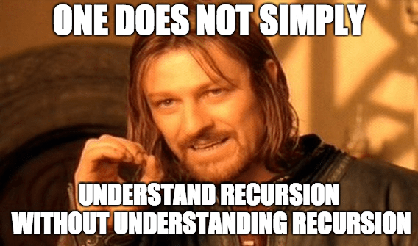
Divide and conquer
Notable algorithms: mergesort, quicksort, binary search, …

Slide 3
Divide-and-Conquer Design Strategy
divide: Given a problem instance $I$, construct one or more smaller problem instances $I1, …, Ia$
These are called subproblems
Usually, want subproblems to be small compared to the size of $I$ (e.g., half the size)
conquer: For $1 ≤ j ≤ a$, solve instance $Ij$ recursively, obtaining solutions $S1, …, Sa$
combine: Given solutions $S1, …, Sa$, use an appropriate combining function to find the solution $S$ to the problem instance $I$
i.e., $S =$ Combine$(S1, …, Sa)$.

Slide 4
D&C proto-algorithm

Slide 5
Correctness
Prove base cases are correct
Inductively assume subproblems are solved correctly
Show they are correctly assembled into a solution

Slide 6
Runtime/space complexity?
Techniques covered in this lecture
Model complexities using recurrence relations
Solve with substitution, master theorem, etc.

Slide 7
Worked Example: Design of Mergesort

Slide 8
divide
105 | 7 | 13 | 8 | 14 | 1 | 19 | 11 | 4 | 10 | 98 | 16 | 31 | 5 | 21 | 12
105 | 7 | 13 | 8 | 14 | 1 | 19 | 11
4 | 10 | 98 | 16 | 31 | 5 | 21 | 12
105 | 7 | 13 | 8
14 | 1 | 19 | 11
4 | 10 | 98 | 16
31 | 5 | 21 | 12
105 | 7
13 | 8
14 | 1
19 | 11
4 | 10
98 | 16
31 | 5
21 | 12
105
7
13
8
14
1
19
11
4
10
98
16
31
5
21
12

Slide 9
Merge: Conquer and combine
1 | 4 | 5 | 7 | 8 | 10 | 11 | 12 | 13 | 14 | 19 | 21 | 31 | 96 | 98 | 105
1 | 7 | 8 | 11 | 13 | 14 | 19 | 105
4 | 5 | 10 | 12 | 21 | 31 | 96 | 98
7 | 8 | 13 | 105
1 | 11 | 14 | 19
4 | 10 | 96 | 98
5 | 12 | 21 | 31
7 | 105
8 | 13
1 | 14
11 | 19
4 | 10
16 | 98
5 | 31
12 | 21
105
7
13
8
14
1
19
11
4
10
98
16
31
5
21
12

Slide 10
Merge simulation
L
R
4 | 10 | 96 | 98
5 | 12 | 21 | 31
O
4 | 5 | 10
4
4 | 5 | 10 | 12
4 | 5 | 10 | 12 | 21
4 | 5 | 10 | 12 | 21 | 31 | 96 | 98
4 | 5
4 | 5 | 10 | 12 | 21 | 31
4 | 5 | 10 | 12 | 21 | 31 | 96

Slide 11
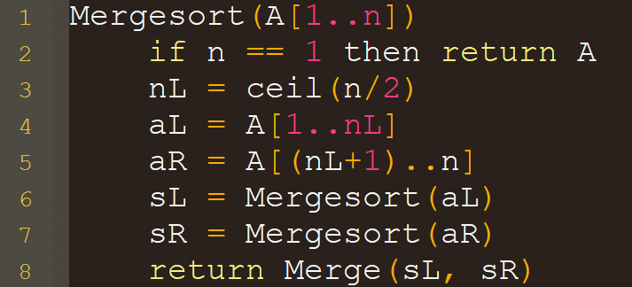
Pseudocode for mergesort

Slide 12
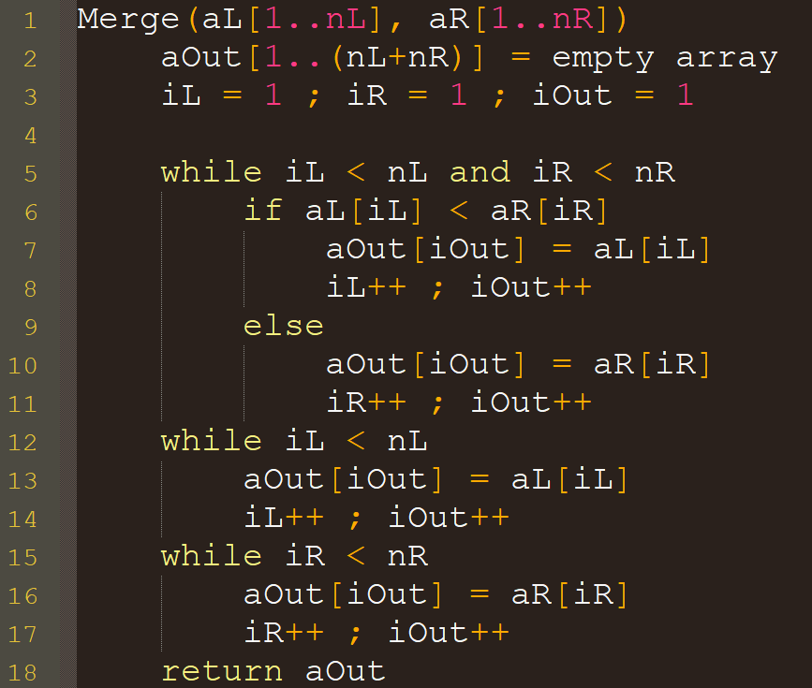
Pseudocode for merge
There are still elements left in both arrays
aL
aR
4 | 10 | 96 | 98
5 | 12 | 21 | 31
iL < nL
iR < nR
aOut
4
Right array is out of elements
aL
aR
4 | 10 | 96 | 98
5 | 12 | 21 | 31
iL < nL
iR $≥$ nR
aOut
4 | 5 | 10 | 12 | 21 | 31
Left array is out of elements

Slide 13
Analysis of mergesort
So, MergeSort(A) takes O(n) time, plus the time for its two recursive calls!
O(1)
O(1)
How can we analyze this recursive program structure?
O(n) or O(1)
O(n) or O(1)
???
???
O(n)

Slide 14
Recurrence relations
$$Hulk(n) =Face – Chin + Hulk(n−1)$$
A crucial analysis tool for recursive algorithms

Slide 15
Recurrence Relations

Slide 16
mathematically Expressing the complexity of mergesort
$$Θ\left(1\right)$$
$T(n)$ is a function of $T(…)$ so $T$ is a recurrence relation
How can we compute/solve for $T(n)$?
To make this easier, assume $n=2^{k}$, which lets us ignore floors/ceilings

Slide 17
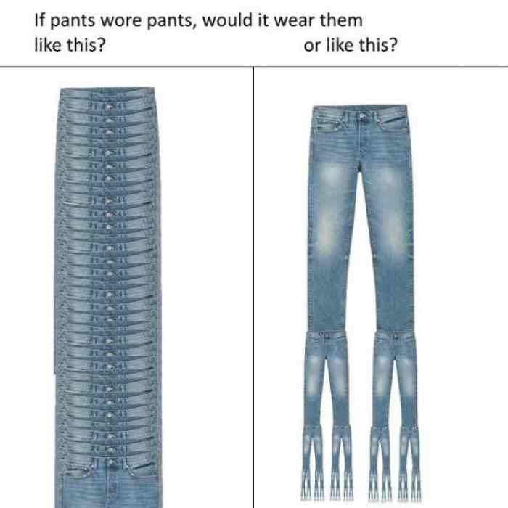
Recursion tree method
Compare vs:
$$T(n)$$
Recursion tree
$$T(n−1)$$
$$T(n)$$
$$T(n−2)$$
$$…$$
$$T(n/2)$$
$$T(n/2)$$
Evaluating recurrences with $T(n/c)$ terms
$$T(n/4)$$
$$…$$
$$T(n/4)$$
$$T(n/8)$$
$$…$$
$$T(n/8)$$

Slide 18
Recursion tree method
msort(n)
cn
= cn
msort(n/2)
msort(n/2)
2(cn/2)
= cn
= cn
msort(n/4)
msort(n/4)
msort(n/4)
msort(n/4)
4(cn/4)
…
…
…
msort(1)
msort(1)
msort(1)
msort(1)
n(c)
= cn
Level | # of nodes | runtime per node | total runtime for level
$$0$$ | $$1$$ | $$cn$$ | $$cn$$
$$1$$ | $$2$$ | $$c(n/2)$$ | $$2c\left(n/2\right)=cn$$
$$2$$ | $$4$$ | $$c(n/4)$$ | $$4c\left(n/4\right)=cn$$
… | … | … | …
$$log⁡n$$ | $$n$$ | $$c\left(n/n\right)=c$$ | $$nc\left(n/n\right)=cn$$
Total $= cn ∗$ #levels
Total $= cn log2(n)$
So, mergesort has runtime $O(n log n)$
Can also compute using a table…

Slide 19
Recursion tree method formalized
Sample recurrence for two recursive calls on problem size $n/2$
Step 1
Step 2
Step 3
Step 4

Slide 20
Guess-and-check Method
Suppose we have the following recurrence
$T\left(0\right)=4$ ; $T\left(n\right)=T\left(n−1\right)+6n−5$
Guess the form of the solution any way you like
My approach: the substitution method
Recursively substitute the formula into itself
Try to identify patterns to guess the final closed form
Prove that the guess was correct

Slide 21
Substitution method: Worked example
Recurrence: $T\left(0\right)=4$ ; $T\left(n\right)=T\left(n−1\right)+6n−5$
$T\left(n−1\right)=T\left(\left(n−1\right)−1\right)+6(n−1)−5$
$T\left(n\right)=\left(T\left(n−2\right)+6\left(n−1\right)−5\right)+6n−5$ (substitute)
$=T\left(n−2\right)+2\left(6n−5\right)−6$ (try to preserve structure)
$=\left(T\left(n−3\right)+6\left(n−2\right)−5\right)+2\left(6n−5\right)−6$ (substitute)
$=T\left(n−3\right)+3\left(6n−5\right)−6(1+2)$
… identify patterns and guess what happens in the limit
$=T\left(0\right)+n\left(6n−5\right)−6\left(1+2+3+…+\left(n−1\right)\right)=guess(n)$
Compare: new terms? +(6n-5) -6
new terms? +(6n-5) -2(6)

Slide 22
$guess\left(n\right)=T\left(0\right)+n\left(6n−5\right)−6\left(1+2+3+…+\left(n−1\right)\right)$
Use $1+2+…+\left(n−1\right)=\frac{n\left(n−1\right)}{2}$
$guess\left(n\right)=4+6n^{2}−5n−6n(n−1)/2$ (simplify)
$=3n^{2}−2n+4$
Are we done?
The form of $guess\left(n\right)$ was an educated guess.
To be sure, we must prove it correct using induction

Slide 23
Proof
Recall: $T\left(0\right)=4$ ; $T\left(n\right)=T\left(n−1\right)+6n−5$ ; $guess\left(n\right)=3n^{2}−2n+4$
Want to prove: $guess\left(n\right)=T\left(n\right)$ for all $n$
Base case: $guess\left(0\right)=3{\left(0\right)}^{2}−2\left(0\right)+4=T\left(0\right)$

Slide 24
Proof
Recall: $T\left(0\right)=4$ ; $T\left(n\right)=T\left(n−1\right)+6n−5$ ; $guess\left(n\right)=3n^{2}−2n+4$
Want to prove: $guess\left(n\right)=T\left(n\right)$ for all $n$
Inductive case: suppose $guess\left(n\right)=T\left(n\right)$ for $n≥0$, show $guess\left(n+1\right)=T\left(n+1\right)$.
$T\left(n+1\right)$ $=T\left(n\right)+6(n+1)−5$ (by definition)
$=guess\left(n\right)+6\left(n+1\right)−5$ (by inductive hypothesis)
$=3n^{2}−2n+4$ $+6\left(n+1\right)−5$ (substitute)
$=3n^{2}+4n+5$ (simplify)
$guess\left(n+1\right)$ $=3{\left(n+1\right)}^{2}−2\left(n+1\right)+4$ (by definition)
$=3n^{2}+4n+5=T\left(n+1\right)$ (simplify)

Slide 25
Another approach
Suppose you look for a while at the previous recurrence:
$T\left(0\right)=4$ ; $T\left(n\right)=T\left(n−1\right)+6n−5$
With some experience, you might just guess it’s quadratic
If you’re right, it should have the form:
$an^{2}+bn+c$ for some unknown constants a, b, c
So, just carry the unknown constants into the proof!
You can then determine what the constants must be for the proof to work out

Slide 26
$T\left(0\right)=4$ ; $T\left(n\right)=T\left(n−1\right)+6n−5$ ; $guess\left(n\right)=an^{2}+bn+c$
Want to prove: $guess\left(n\right)=T\left(n\right)$ for all $n$
Base case: $guess\left(0\right)=a{\left(0\right)}^{2}+b\left(0\right)+c=T\left(0\right)=4$
this holds iff $c=4$ ($a,b$ are not constrained)
Inductive case: suppose $guess\left(n\right)=T\left(n\right)$ for $n≥0$, show $guess\left(n+1\right)=T\left(n+1\right)$.
$T\left(n+1\right)$ $=T\left(n\right)+6(n+1)−5$ (by definition)
$=guess\left(n\right)+6\left(n+1\right)−5$ (by inductive hypothesis)
$=an^{2}+bn+4+6\left(n+1\right)−5$ (substitute)
$=an^{2}+\left(b+6\right)n+5$ (simplify)

Slide 27
Recall: $guess\left(n\right)=an^{2}+bn+c$ where $c=4$
Inductive case: suppose $guess\left(n\right)=T\left(n\right)$ for $n≥0$, show $guess\left(n+1\right)=T\left(n+1\right)$.
$T\left(n+1\right)$ $=an^{2}+\left(b+6\right)n+5$ (continue previous slide)
$guess\left(n+1\right)$ $=a{\left(n+1\right)}^{2}+b\left(n+1\right)+4$ (by definition and $c=4$)
$=a\left(n^{2}+2n+1\right)+bn+b+4$ (simplify, and…)
$=an^{2}+\left(2a+b\right)n+(a+b+4)$ (rearrange polynomial)
We want this to be equal to $T(n+1)$
$an^{2}+\left(2a+b\right)n+\left(a+b+4\right)=an^{2}+\left(b+6\right)n+5$
equivalent to $\left(2a+b\right)=\left(b+6\right)$ and $\left(a+b+4\right)=$ $5$
first implies $a=3$ plug a into second to get $b=5−4−3=−2$
So, inductive hypothesis is correct for $a=3,b=−2,c=4$

Slide 28
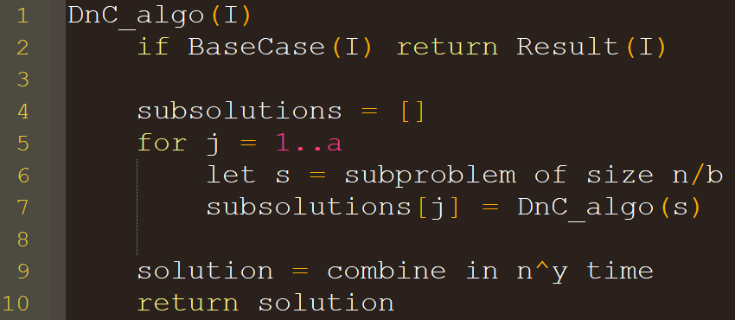
Master theorem for recurrences
Provides a formula for solving many recurrence relations
We start with a simplified version
Consider recurrence: $T\left(1\right)=d ; T\left(n\right)=aT\left(\frac{n}{b}\right)+Θ\left(n^{y}\right)$ where $a≥1, b≥2$ and $n$ is a power of $b$ (i.e., $n=b^{j}$ for integer $j$)
Example corresponding algorithm
Simplified Master Theorem
where $x=\log_{b}{a}$.
Notes:
Show what kind of function this expression represents, and show the recursion tree now to give intuition for x term (and reuse tree for proof)

Slide 29
Deriving the simplified Master theorem
$T\left(1\right)=d ; T\left(n\right)=aT\left(\frac{n}{b}\right)+Θ\left(n^{y}\right)$ where $a≥1, b≥2$ and $n=b^{j}$
$1$ node
Problem size $n$
$$cn^{y}$$
Lvl 0 $=1cn^{y}$
$a$ nodes problem size $\frac{n}{b}$
$$c{\left(\frac{n}{b}\right)}^{y}$$
$$c{\left(\frac{n}{b}\right)}^{y}$$
$$c{\left(\frac{n}{b}\right)}^{y}$$
…
$$c{\left(\frac{n}{b}\right)}^{y}$$
Lvl 1$=ac{\left(\frac{n}{b}\right)}^{y}$
…
$a^{2}$ nodes
Problem size $\frac{n}{b^{2}}$
$$c{\left(\frac{n}{b^{2}}\right)}^{y}$$
…
$$c{\left(\frac{n}{b^{2}}\right)}^{y}$$
$$c{\left(\frac{n}{b^{2}}\right)}^{y}$$
…
$$c{\left(\frac{n}{b^{2}}\right)}^{y}$$
$$c{\left(\frac{n}{b^{2}}\right)}^{y}$$
…
$$c{\left(\frac{n}{b^{2}}\right)}^{y}$$
Lvl 2$=a^{2}c{\left(\frac{n}{b^{2}}\right)}^{y}$
…
…
…
…
…
…
Lvl $i=a^{i}c{\left(\frac{n}{b^{i}}\right)}^{y}$
$a^{j}$ nodes prob size $\frac{n}{b^{j}}=1$
…
$$d$$
$$d$$
$$d$$
$$d$$
$$d$$
$$d$$
$$d$$
Lvl $j=a^{j}d$
Sum over all levels we get $T\left(n\right)=da^{j}+\sum_{i=0}^{j−1}{ca^{i}{\left(\frac{n}{b^{i}}\right)}^{y}}$
Let’s rearrange this into a geometric sequence and solve
Notes:
Show what kind of function this expression represents, and show the recursion tree now to give intuition for x term (and reuse tree for proof)

Slide 30
Rearranging
$T\left(n\right)=da^{j}+\sum_{i=0}^{j−1}{ca^{i}{\left(\frac{n}{b^{i}}\right)}^{y}}$
$=da^{j}+\sum_{i=0}^{j−1}{ca^{i}\frac{n^{y}}{{\left(b^{i}\right)}^{y}}}$
$=da^{j}+\sum_{i=0}^{j−1}{ca^{i}\frac{n^{y}}{{\left(b^{y}\right)}^{i}}}$
$=$ $da^{j}+\sum_{i=0}^{j−1}{cn^{y}\frac{a^{i}}{{\left(b^{y}\right)}^{i}}}$
$=$ $da^{j}+\sum_{i=0}^{j−1}{cn^{y}{\left(\frac{a}{b^{y}}\right)}^{i}}$
$= da^{j}+cn^{y}\sum_{i=0}^{j−1}{{\left(\frac{a}{b^{y}}\right)}^{i}}$
Let $x=\log_{b}{a}$
$x$ relates # of subproblems to their size
Rearranging we have $b^{x}=a$
So $T\left(n\right)= da^{j}+cn^{y} \sum_{i=0}^{j−1}{{\left(\frac{b^{x}}{b^{y}}\right)}^{i}}$
$= da^{j}+cn^{y} \sum_{i=0}^{j−1}{{\left(b^{x−y}\right)}^{i}}$
Also $da^{j}=d{\left(b^{x}\right)}^{j}=d{\left(b^{j}\right)}^{x}$
Since $n=b^{j}$ this is just $dn^{x}$
So $T\left(n\right)=dn^{x}+cn^{y}\sum_{i=0}^{j−1}{{\left(b^{x−y}\right)}^{i}}$
and we can simplify: let $r=b^{x−y}$

Slide 31
Solving the geometric Seq
$T\left(n\right)=dn^{x}+cn^{y}\sum_{i=0}^{j−1}{r^{i}}$ where $r=b^{x−y}$
Geo. Seq. formula: $\sum_{i=0}^{j−1}{ar^{i}}=\left\{\begin{aligned}a\frac{r^{j}−1}{r−1}∈Θ\left(r^{j}\right) if r>1 \\ ja∈Θ\left(j\right) if r=1 \\ a\frac{1−r^{j}}{1−r}∈Θ\left(1\right) if 0<r<1\end{aligned}\right.$
So different solutions depending on $r$
Case 1: $r=b^{x−y}>1$ $⇔$ $x−y>0$ $⇔$ $x>y$
Case 2: $r=b^{x−y}=1$ $⇔$ $x−y=0$ $⇔$ $x=y$
Case 3: $0<r=b^{x−y}<1$ $⇔$ $x−y<0$ $⇔$ $x<y$

Slide 32
Solving the geometric Seq
Formula: $\sum_{i=0}^{j−1}{ar^{i}}=\left\{\begin{aligned}a\frac{r^{j}−1}{r−1}∈Θ\left(r^{j}\right) if r>1 \\ ja∈Θ\left(j\right) if r=1 \\ a\frac{1−r^{j}}{1−r}∈Θ\left(1\right) if 0<r<1\end{aligned}\right.$
Case 1: $r=b^{x−y}>1$ $⇔$ $x−y>0$ $⇔$ $x>y$
$T\left(n\right)=dn^{x}+cn^{y}\sum_{i=0}^{j−1}{r^{i}}∈dn^{x}+cn^{y}Θ\left(r^{j}\right)$
$T\left(n\right)∈Θ\left(n^{x}+n^{y}r^{j}\right)=Θ\left(n^{x}+n^{y}{\left(b^{x−y}\right)}^{j}\right)=Θ\left(n^{x}+n^{y}{\left(b^{j}\right)}^{x−y}\right)$
Recall $b^{j}=n$, so $T\left(n\right)∈Θ\left(n^{x}+n^{y}n^{x−y}\right)=Θ\left(n^{x}+n^{y+x−y}\right)$
So $T\left(n\right)∈Θ\left(n^{x}\right)$

Slide 33
Solving the geometric Seq
Formula: $\sum_{i=0}^{j−1}{ar^{i}}=\left\{\begin{aligned}a\frac{r^{j}−1}{r−1}∈Θ\left(r^{j}\right) if r>1 \\ ja∈Θ\left(j\right) if r=1 \\ a\frac{1−r^{j}}{1−r}∈Θ\left(1\right) if 0<r<1\end{aligned}\right.$
Case 2: $r=b^{x−y}=1$ $⇔$ $x−y=0$ $⇔$ $x=y$
$T\left(n\right)=dn^{x}+cn^{y}\sum_{i=0}^{j−1}{r^{i}}∈dn^{x}+cn^{y}Θ\left(j\right)$
$T\left(n\right)∈Θ\left(n^{x}+{jn}^{y}\right)=Θ(n^{x}+jn^{x})$ since $x=y$
Recall $b^{j}=n$, so $\log_{b}{b^{j}}=\log_{b}{n}$. This means $j∈Θ(\log{n})$.
So $T\left(n\right)=Θ\left(n^{x}+n^{x}\log{n}\right)=Θ\left(n^{x}\log{n}\right)$

Slide 34
Solving the geometric Seq
Formula: $\sum_{i=0}^{j−1}{ar^{i}}=\left\{\begin{aligned}a\frac{r^{j}−1}{r−1}∈Θ\left(r^{j}\right) if r>1 \\ ja∈Θ\left(j\right) if r=1 \\ a\frac{1−r^{j}}{1−r}∈Θ\left(1\right) if 0<r<1\end{aligned}\right.$
Case 3: $0<r=b^{x−y}<1$ $⇔$ $x−y<0$ $⇔$ $x<y$
$T\left(n\right)=dn^{x}+cn^{y}\sum_{i=0}^{j−1}{r^{i}}∈dn^{x}+cn^{y}Θ\left(1\right)$
$T\left(n\right)∈Θ\left(n^{x}+n^{y}\right)$
Since $x<y$, we simply have $T\left(n\right)∈Θ\left(n^{y}\right)$

Slide 35
Master theorem for recurrences
Simplified version
Consider recurrence:
$T\left(n\right)=aT\left(\frac{n}{b}\right)+Θ\left(n^{y}\right)$ where $a≥1, b≥2$ and $n=b^{j}$
And let $x=\log_{b}{a}$.

Slide 36
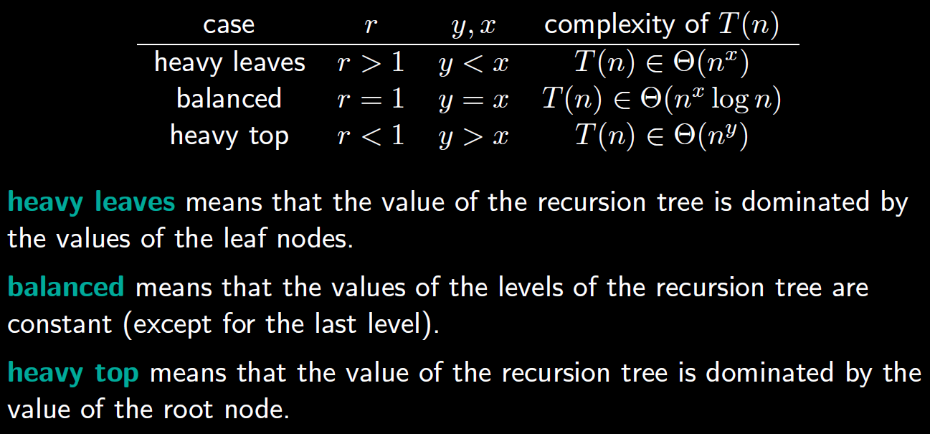
Some Bonus Intuition for r cases
Recall: $T\left(n\right)=dn^{x}+cn^{y}\sum_{i=0}^{j−1}{r^{i}}$ where $r=b^{x−y}$
$x=\log_{b}{a}$ i.e. $\log_{subproblem size}{|subproblems|}$

Slide 37
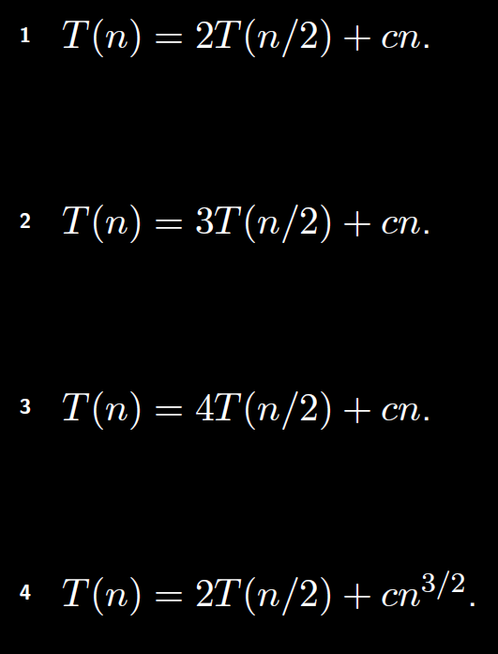
Worked Examples
a=2;
b=2;
y=1;
x=1
Recall: simplified master theorem
$$Θ\left(n^{x}\log{n}\right)$$
$$=Θ\left(n\log{n}\right)$$
a=3;
b=2;
y=1;
x=log₂ 3
$$Θ\left(n^{x}\right)$$
$$=Θ\left(n^{\log_{2}{3}}\right)$$
a=4;
b=2;
y=1;
x=log₂ 4
$$Θ\left(n^{x}\right)$$
$$=Θ\left(n^{2}\right)$$
Questions: a=? b=? y=? x=?
which $Θ$ function?
a=2;
b=2;
y=3/2;
x=1
$$Θ\left(n^{y}\right)$$
$$=Θ\left(n^{3/2}\right)$$

Slide 38
Master theorem when $b^{j−1}<n<b^{j}$
Bonus slide, for you at home
$n/b$ is not always an integer!
floors/ceilings are hard
not a geometric sequence
Suppose we get a big-O bound for $b^{j−1}<n<b^{j}$ by instead considering the larger problem size $b^{j}$
So $T\left(n\right)≤T\left(b^{j}\right)∈\left\{\begin{aligned}Θ\left({\left(b^{j}\right)}^{x}\right) if y<x \\ Θ\left({\left(b^{j}\right)}^{x}\log{b^{j}}\right) if y=x \\ Θ\left({\left(b^{j}\right)}^{y}\right) if y>x\end{aligned}\right.$

Slide 39
Master theorem when $b^{j−1}<n<b^{j}$
Bonus slide, for you at home
$T\left(n\right)≤T\left(b^{j}\right)∈\left\{\begin{aligned}Θ\left({\left(b^{j}\right)}^{x}\right) if y<x \\ Θ\left({\left(b^{j}\right)}^{x}\log{b^{j}}\right) if y=x \\ Θ\left({\left(b^{j}\right)}^{y}\right) if y>x\end{aligned}\right.$
Observation: $b^{j}<bn$ since $n$ is between $b^{j−1}$ and $b^{j}$
So $T\left(n\right)≤T\left(b^{j}\right)∈\left\{\begin{aligned}Θ\left({\left(bn\right)}^{x}\right) if y<x \\ Θ\left({\left(bn\right)}^{x}\log{bn}\right) if y=x \\ Θ\left({\left(bn\right)}^{y}\right) if y>x\end{aligned}\right.$

Slide 40
Master theorem when $b^{j−1}<n<b^{j}$
Bonus slide, for you at home
$T\left(n\right)∈\left\{\begin{aligned}Θ\left({\left(bn\right)}^{x}\right) if y<x \\ Θ\left({\left(bn\right)}^{x}\log{bn}\right) if y=x \\ Θ\left({\left(bn\right)}^{y}\right) if y>x\end{aligned}\right.$
Case 1 $(y<x)$: ${\left(bn\right)}^{x}=b^{x}n^{x}$ and $b^{x}$ is a constant
So $T\left(n\right)∈O(n^{x})$
Case 2 $(y=x)$: ${\left(bn\right)}^{x}\log{bn}=b^{x}n^{x}\left(\log{b}+\log{n}\right)$
$T\left(bn\right)∈Θ\left(b^{x}n^{x}\log{b}+b^{x}n^{x}\log{n}\right)=Θ\left(n^{x}+n^{x}\log{n}\right)$
So $T\left(n\right)∈O(n^{x}\log{n)}$
Case 3 $(y>x)$: ${\left(bn\right)}^{y}=b^{y}n^{y}$
So $T\left(n\right)∈O(n^{y})$
Can tackle $Ω$ similarly to get $θ$

Slide 41
General master theorem
Example recurrence:
Arbitrary function of $n$
(not just $cn^{y}$)
Must reason about relationship between $f(n)$ and $n^{x}$

Slide 42
Revisiting the recursion tree method
Some recurrences with complex f(n) functions (such as f(n) = log n) can still be solved “by hand”
Example: Let $n=2^{j} ; T\left(1\right)=1 ; T\left(n\right)=2T\left(\frac{n}{2}\right)+n log n$
Note
$$\log_{2}{n}=j$$
So
$$j2^{j}=n\log_{2}{n}$$
And
$$\left(j−1\right)2^{j−1}=\frac{n}{2}\log{\frac{n}{2}}$$

Slide 43
Revisiting the recursion tree method
Recall: $n=2^{j} ; T\left(1\right)=1 ; T\left(n\right)=2T\left(\frac{n}{2}\right)+n log n$

