Slide 1
CS 341: Algorithms
Lecture 22: intractability IV – poly transformations, NP completeness
Readings: see website
Trevor Brown
https://student.cs.uwaterloo.ca/~cs341
trevor.brown@uwaterloo.ca

Slide 2
Polynomial transformations
commonly used for NP-completeness and impossibility results

Slide 3
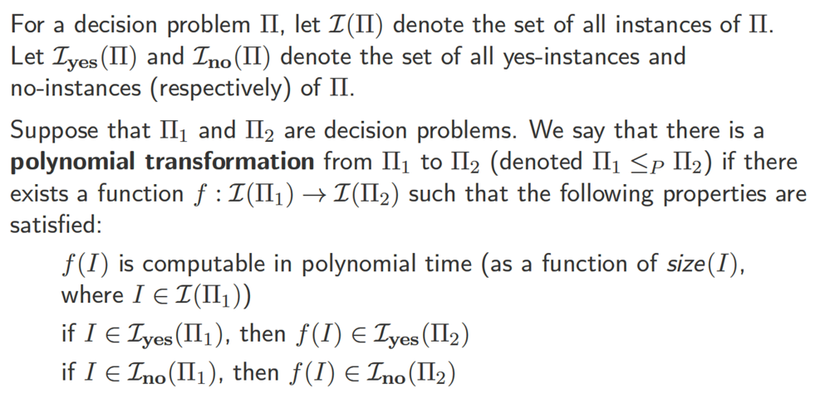
Polynomial transformations
[Mechanics] to give a polynomial transformation, you must:
1. specify $f(I)$, 2. show it runs in poly-time, and 3. show $I$ is a yes-instance of $Π_{1}$ IFF $f(I)$ is a yes-instance of $Π_{2}$.

Slide 4
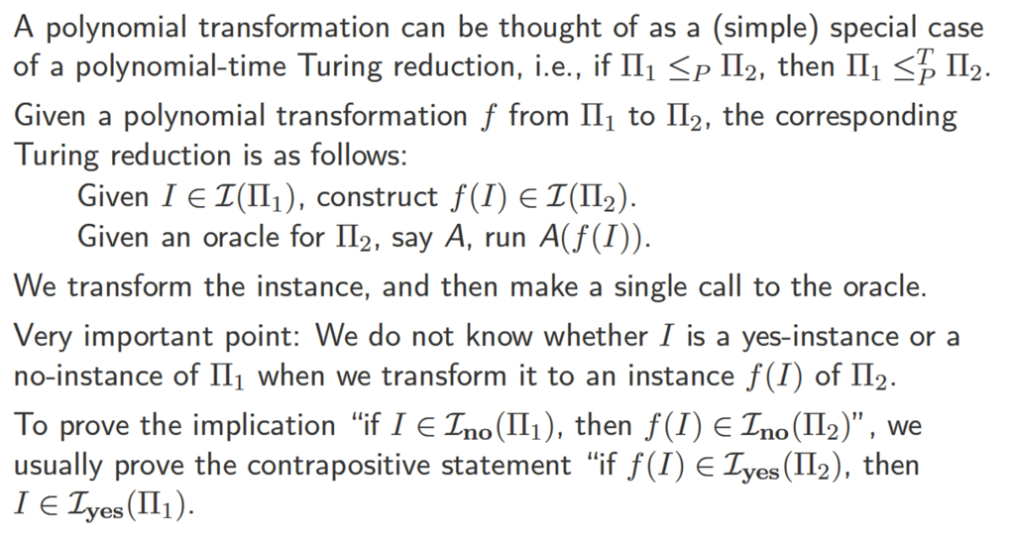
Polynomial transformations (cont.)
Also known as Karp reductions and many-one reductions
We saw one instance where a contrapositive was easier to prove when we discussed Hamiltonian cycles
The contrapositive can help when it is hard to precisely characterize certificates for no-instances (or when such certificates don’t prove much)

Slide 5
Summarizing the More convenient definition
Let $Π_{1}$ and $Π_{2}$ be decision problems
$Π_{1}≤_{P}Π_{2}$ iff there exists $f :ℐ\left(Π_{1}\right)→ℐ(Π_{2})$ such that:
$f(I)$ is computable in poly-time, for all $I∈ℐ(Π_{1})$
If $I∈ℐ_{yes}(Π_{1})$ then $f\left(I\right)∈ℐ_{yes}(Π_{2})$
If $f(I)∈𝓘_{yes}(Π_{2})$ then $I∈𝓘_{yes}(Π_{1})$
Note: this is the same as saying
$$(I∈𝓘_{yes}\left(Π_{1}\right))⇔(f\left(I\right)∈𝓘_{yes}\left(Π_{2}\right))$$
This property justifies correctness for the following generic poly-time Karp reduction:
P1toP2KarpReduction(I)
fI = f(I)
return OracleForP2(fI)
This is the contrapositive. Was previously (2 slides ago): If $I∈ℐ_{no}(Π_{1})$ then $f\left(I\right)∈ℐ_{no}\left(Π_{2}\right)$

Slide 6
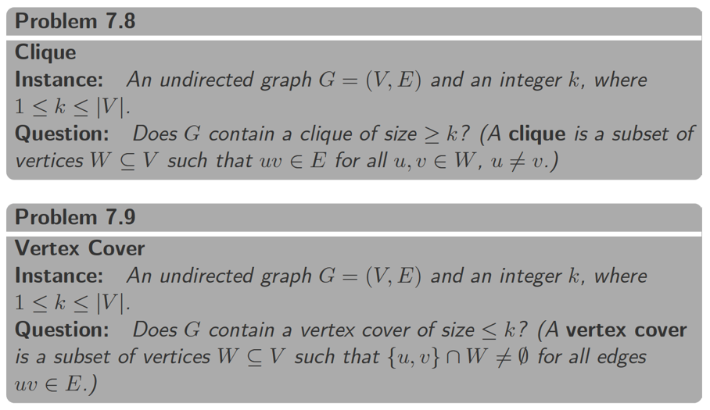
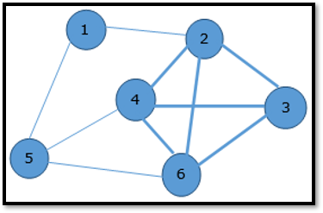
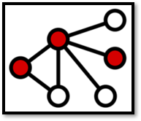
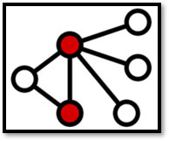
Example polynomial transformation
4-clique
3-vertex cover
2-vertex cover

Slide 7
Clique $≤_{P}$Vertex-Cover
Suppose $I=(G,k)$ is an instance of Clique where $G=\left(V,E\right)$, $V=\{v_{1},…, v_{n}\}$ and $1≤k≤n$
Construct instance $f\left(I\right)=(\overline{G},n−k)$ of Vertex-Cover, where $H=(V,\overline{E})$ and $v_{i}v_{j}∈\overline{E}⇔v_{i}v_{j}∉E$
Want to solve
$$Clique(G, k)$$
Claim: there is a $k$-clique in $G$ iff there is an $\left(n−k\right)$ Vertex-Cover in $\overline{G}$
Consider the complement graph $\overline{G}$ of $G$
Idea: reduce to
$$VertexCover(\overline{G}, n−k)$$
Every edge of $G$ is a non-edge of $\overline{G}$.
Every non-edge of $G$ is an edge of $\overline{G}$.
Given an adjacency matrix for $G$, get $\overline{G}$by flipping 0’s and 1’s.

Slide 8
Proving this is a Polynomial transformation
We denote Clique by $CL$ and Vertex-Cover by $VC$
$CL≤_{P}VC$ iff there exists $f :ℐ\left(CL\right)→ℐ(VC)$ such that:
$f(I)$ is computable in poly-time, for all $I∈𝓘(CL)$
If $I∈ℐ_{yes}(CL)$ then $f\left(I\right)∈ℐ_{yes}(VC)$
If $f(I)∈ℐ_{yes}(VC)$ then $I∈ℐ_{yes}(CL)$
First let’s show this

Slide 9
Complexity of the transformation
Assuming adjacency matrix,
$$Size\left(I\right)=Θ(n^{2}+\log_{2}{k})$$
Suppose $I=(G,k)$ is an instance of Clique where $G=\left(V,E\right)$, $V=\{v_{1},…, v_{n}\}$ and $1≤k≤n$
Construct instance $f\left(I\right)=(\overline{G},n−k)$ of Vertex-Cover, where $\overline{G}=(V,\overline{E})$ and $v_{i}v_{j}∈\overline{E}⇔v_{i}v_{j}∉E$
Time to compute $f(I)$?
Constructing $\overline{G}$ takes $O(n^{2})$ time, and computing $n−k$ takes $O(\log{n})$ time.
Want to solve
$$Clique(G, k)$$
So computing $f(I)$ takes $O(n^{2})$ time, which is polynomial in $Size\left(I\right)$.
Idea: reduce to
$$VertexCover(\overline{G}, n−k)$$

Slide 10
Proving this is a Polynomial transformation
We denote Clique by $CL$ and Vertex-Cover by $VC$
$CL≤_{P}VC$ iff there exists $f :ℐ\left(CL\right)→ℐ(VC)$ such that:
$f(I)$ is computable in poly-time, for all $I∈ℐ(CL)$
If $I∈𝓘_{yes}(CL)$ then $f\left(I\right)∈𝓘_{yes}(VC)$
If $f(I)∈ℐ_{yes}(VC)$ then $I∈ℐ_{yes}(CL)$
Now let’s show this, i.e., if $G$ contains a $k$-clique then $\overline{G}$ contains an $\left(n−k\right)$ vertex cover.

Slide 11
Proving: $I∈ℐ_{yes}\left(CL\right)⇒f(I)∈ℐ_{yes}(VC)$
Graph $G$
Suppose $I=(G,k)$ is a yes-instance of Clique
Then there is a set $W$ of $k$ vertices in a clique (with all-to-all edges)
Define $\overline{W}=V∖W$. Clearly $\left|\overline{W}\right|=n−k$.
We claim $\overline{W}$ is a vertex cover of $\overline{G}$
Consider any edge $\left(u,v\right)∈\overline{G}$
If either $u$ or $v$ is in $\overline{W}$, then we are done, so assume $u,v∉\overline{W}$ to obtain a contradiction
Then $u,v∈W$, and $W$ is a clique in $G$, so $\left(u,v\right)∈G$
But $\left(u,v\right)∈\overline{G}$ implies $\left(u,v\right)∉G$. Contradiction!
Example:
$$Clique(G, 4)$$
$$W$$
Graph $\overline{G}$
$$\overline{W}$$

Slide 12
Proving this is a Polynomial transformation
We denote Clique by $CL$ and Vertex-Cover by $VC$
$CL≤_{P}VC$ iff there exists $f :ℐ\left(CL\right)→ℐ(VC)$ such that:
$f(I)$ is computable in poly-time, for all $I∈ℐ(CL)$
If $I∈ℐ_{yes}(CL)$ then $f\left(I\right)∈ℐ_{yes}(VC)$
If $f(I)∈𝓘_{yes}(VC)$ then $I∈𝓘_{yes}(CL)$
Now let’s show this, i.e., if $\overline{G}$ contains an $\left(n−k\right)$ vertex cover, then $G$ contains a $k$-clique

Slide 13
Proving: $f(I)∈ℐ_{yes}\left(VC\right)⇒I∈ℐ_{yes}(CL)$
Graph $\overline{G}$
Suppose $f(I)=(\overline{G},n−k)$ is a yes-instance of $VC$
Then there is a set of $n−k$ vertices $\overline{W}$ that is a vertex cover of $\overline{G}$
Define $W=V∖\overline{W}$. Clearly $\left|W\right|=k$.
We claim $W$ is a clique in $G$
Since $\overline{W}$ is a vertex cover of $\overline{G}$, every edge in $\overline{G}$ has at least one endpoint in $\overline{W}$
Therefore, no edge in $\overline{G}$ has two endpoints in $W$
So, in $G$, there are edges between all pairs of nodes in $W$. So, $W$ is a clique in $G$.
$$\overline{W}$$
Graph $G$
$$W$$
So, we have demonstrated a polynomial transformation from CLIQUE to VERTEX-COVER

Slide 14
Complexity class NP-Complete

Slide 15
Complexity Class NP-Complete (NPC)

Slide 16
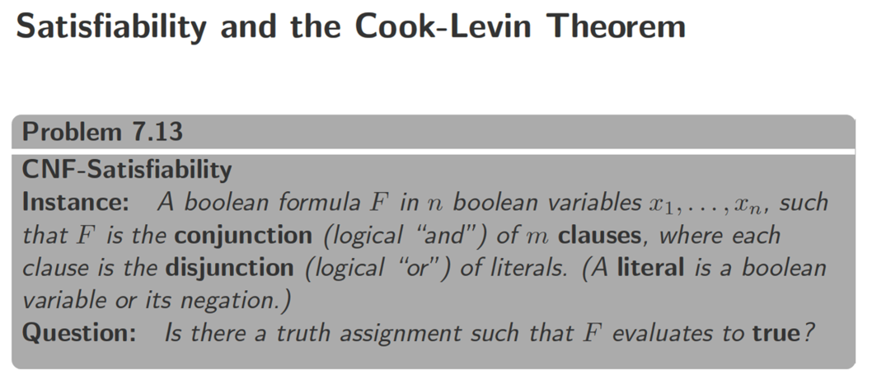
Challenging and powerful result! How to prove any NP problem anyone will ever come up with is solved by a reduction to SAT?
We will just call it the SAT problem
Example: $\left(p∨q\right)∧\left(¬p∨r\right)∧\left(¬r∨¬p∨s∨¬s\right)$
Variable: $p,q$ Literal: $p,¬q$
Clause: $(p∨q)$
Real-world problem people care about! For example, used extensively to argue correctness for new processor designs.
SAT

Slide 17
Now that we have one NP-complete problem…
Every $Π∈NP$ can be polynomially transformed to $Π_{1}$
And $Π_{1}$ can be polynomially transformed to $Π_{2}$
So, every $Π∈NP$ can be polynomially transformed to $Π_{2}$
(Everything in NP can be poly-transformed to $Π_{2}$) + ($Π_{2}$ in NP) = definition of NPC

Slide 18
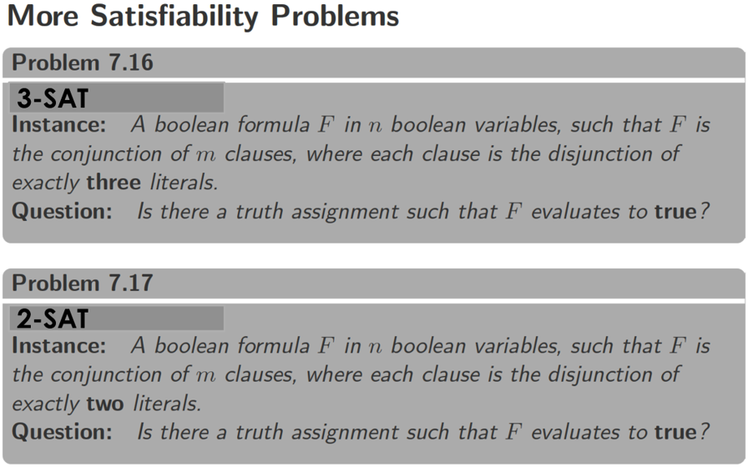
Example: $\left(p∨q∨r\right)∧\left(¬p∨r∨q\right)∧\left(¬r∨¬p∨s\right)$
3-SAT
Example: $\left(p∨q\right)∧\left(¬p∨r\right)∧\left(¬r∨¬p\right)$
2-SAT
Satisfiable: $p=0,q=1,r∈\{0,1\}$

Slide 19
Is sat harder than 3-sat? Only polynomially…
Satisfying all 4 clauses is possible IFF $z=true$
Same trick, but padding the clause with two new variables
We add a new variable c as padding
To satisfy both of these clauses, one of $z_{1},z_{2}$ must be true!
$\left(z_{1}∨z_{2}∨c\right)∧(z_{1}∨z_{2}∨¬c)$ is satisfiable IFF $(z_{1}∨z_{2})$ is satisfiable!
So, the new clauses, together, are “equivalent” to the old one
New variables $d_{1}…d_{k−3}$ “link” the clauses
Here it gets trickier, because we aren’t just “padding,” but “linking” many clauses
Key idea: satisfying all clauses is possible IFF some $z_{i}=true$
Let’s prove this is a correct polynomial transformation

Slide 20
Correctness
Sketch: let $L$ be the number of literals in input $I$. In our transformed input, we construct at most $4L$ clauses. Clearly this can be done in time $poly(4L)$, which is in $poly(L)$, which is in $poly(Size(I))$.
Want to prove: $SAT≤_{P}3SAT$
I.e., our transformation function $f$ satisfies:
$f(I)$ is computable in poly-time, for all $I∈ℐ(Π_{1})$
If $I∈ℐ_{yes}(SAT)$ then $f\left(I\right)∈ℐ_{yes}(3SAT)$
If $f(I)∈𝓘_{yes}(3SAT)$ then $I∈𝓘_{yes}(SAT)$
Let’s do this direction

Slide 21
SAT
3-SAT

Slide 22
Correctness
Want to prove: $SAT≤_{P}3SAT$
I.e., our transformation function $f$ satisfies:
$f(I)$ is computable in poly-time, for all $I∈ℐ(Π_{1})$
If $I∈ℐ_{yes}(SAT)$ then $f\left(I\right)∈ℐ_{yes}(3SAT)$
If $f(I)∈𝓘_{yes}(3SAT)$ then $I∈𝓘_{yes}(SAT)$
We just showed this
Now let’s show this

Slide 23
Consider each clause $C$ in the SAT input $I$. We identify a corresponding set $S$ of clauses in $f(I)$, and we show $C$ must be satisfied because of the clauses in $S$.

Slide 24
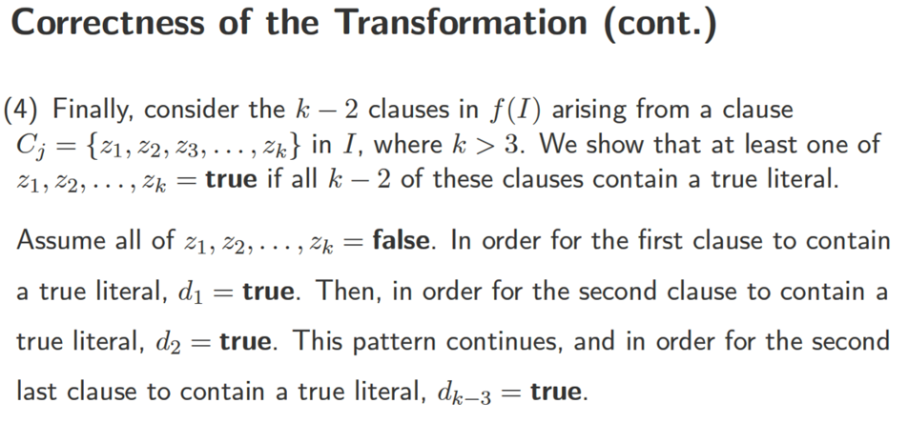
So, we have given a correct polynomial transformation from SAT to 3SAT.
So, if a problem $Π$ can be transformed into SAT in polytime, it can also be transformed into 3SAT in polytime.
But wait… SAT is NP-COMPLETE.
Have we shown 3SAT is NP-COMPLETE?
So every problem in NP can be transformed into 3SAT in polytime!
Still need to show 3SAT $∈$ NP!

Slide 25
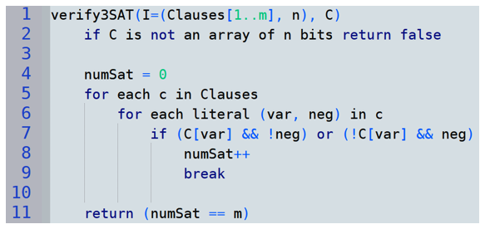
Proving 3SAT is in NP
3SAT input $I=(Clauses[1..m], n)$: a list of $m$clauses, and the number $n$of variables.
Each clause contains literals. Each literal is a pair (var, neg): a variable $∈\{1..n\}$ & a negation bit
Define desired YES-certificate
Design a poly-time $verify(I,C)$ algorithm
Correctness proof
Case 1: Let $I$ be any yes-instance; Find $C$ such that $verify\left(I,C\right)=true$
Case 2: Let $I$ be any no-instance, and $C$ be any certificate; Prove $verify\left(I,C\right)=false$
Contrapositive of case 2: Suppose $verify\left(I,C\right)=true$; Prove $I$ is a yes-instance
YES-certificate $C$ = array with one bit per variable in $\{1..n\}$ representing a satisfying assignment
This takes $O(\left|Clauses\right|)$ time, which is polynomial in $Size(I)$

Slide 26
Mechanics of showing a problem is in NP
Define desired YES-certificate
Design a poly-time $verify(I,C)$ algorithm
Correctness proof
Case 1: Let $I$ be any yes-instance; Find $C$ such that $verify\left(I,C\right)=true$
Case 2: Let $I$ be any no-instance, and $C$ be any certificate; Prove $verify\left(I,C\right)=false$
Contrapositive of case 2: Suppose $verify\left(I,C\right)=true$; Prove $I$ is a yes-instance
Let $I$ be a yes-instance of 3SAT. Then it has a satisfying assignment $A_{s}$. And, $verify(I,A_{s})$ will see that each clause contains a literal satisfied by this assignment, so $verify$ will see $numSat=|Clauses|$ and return true.
Suppose $verify(I,C)$ returns true.
Then $numSat=|Clauses|$, so $numSat$ was incremented in each iteration of the loop over clauses, so each clause contains a satisfied literal, so the 3SAT formula in $I$ is satisfied by $C$, so $I$ is a yes-instance.
It follows that 3SAT is in NP.
Since we have already shown SAT $≤_{P}$ 3SAT, we now know that 3SAT is NP-COMPLETE.

Slide 27
Recap
To prove a problem $Π$ is NP-COMPLETE
Show $Π$ is in NP, and
Give a polynomial transformation from some NP-COMPLETE problem to $Π$
This involves an IFF correctness argument, and a polytime complexity argument
When showing a problem is in NP, or proving correctness for a polynomial transformation,
Instead of proving statements about no-instances, it is usually easier to prove the contrapositive

Slide 28
Is 2-SAT also hard?

Slide 29
2-SAT examples
Logical refresher:
$p⇒q$ is equivalent to
$¬p∨q$.
$\left(p∨q\right)∧\left(¬p∨r\right)∧\left(¬r∨¬p\right)$
Satisfiable: $p=0,q=1,r∈\{0,1\}$
$\left(p∨q\right)∧\left(¬p∨r\right)∧\left(¬r∨¬p\right)∧\left(p∨¬q\right)$
Therefore, $p∨q$ is equivalent to $¬p⇒q$ and equivalent to $¬q⇒p$
Edges (implications of clauses)…
$$q$$
$$p$$
$$q$$
$$q$$
$$p$$
$$p$$
$$r$$
$$¬p⇒q$$
$$p⇒r$$
$$r⇒¬p$$
$$¬p⇒¬q$$
$$¬q⇒p$$
$$¬r⇒¬p$$
$$p⇒¬r$$
$$q⇒p$$
$q⇒p⇒¬r⇒¬p⇒¬q$ … so $q$ cannot be $true$
$$¬q$$
$$¬p$$
$$¬q$$
$$¬q$$
$$¬p$$
$$¬p$$
$$¬r$$
$$¬r$$
$$¬r$$
$¬q⇒p⇒¬r⇒¬p⇒q$ … so $q$ cannot be $false$
Therefore the formula cannot be satisfied!

Slide 30
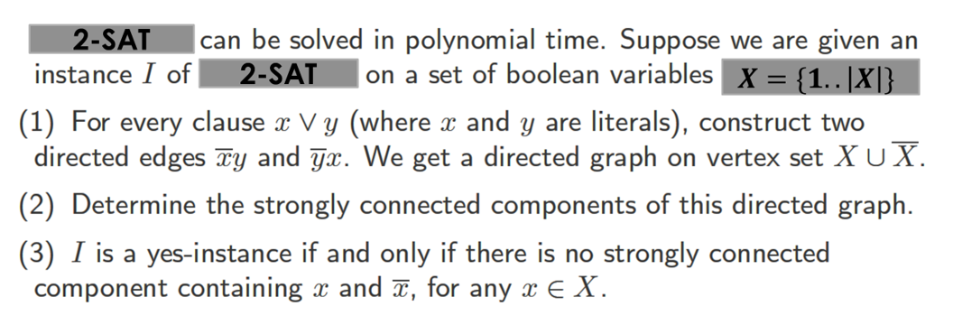
(variable names are integers in 1..|X|)
2-SAT
2-SAT
$$X=\{1..\left|X\right|\}$$
Suppose no variable $x$ is in the same SCC as $\overline{x}$, then to get a satisfying assignment do the following:
For each $x$, if $∃$ path from $x$ to $\overline{x}$, then set $x=false$ else set $x=true$.

Slide 31
Homework slides

Slide 32
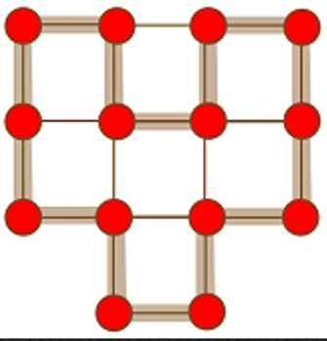
Returning to another familiar problem
Turns out Hamiltonian Cycle is NP complete as well
Compare to Euler tour/circuit: a cycle that passes through each edge exactly once can be found in polytime!

Slide 33
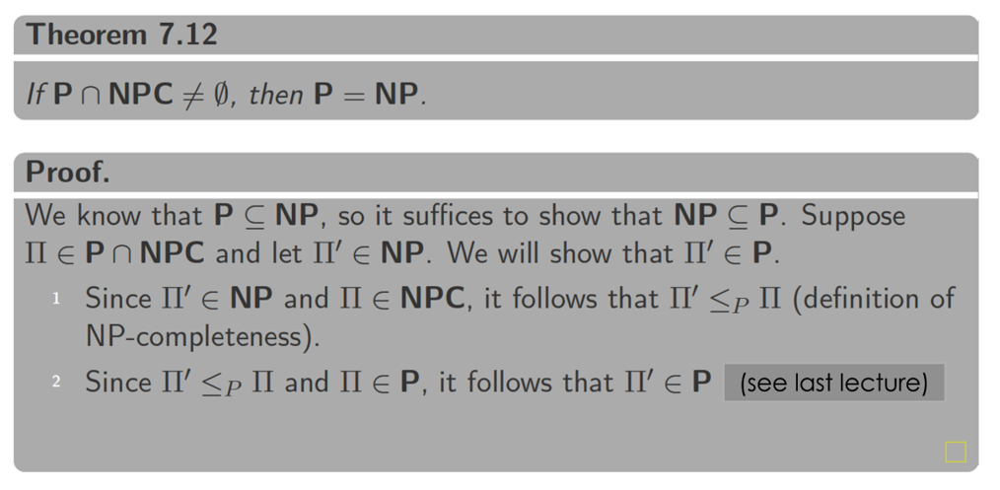
The P=NP question
So, to win $1,000,000 just need to find one problem in $NPC$ that can be reduced to a problem in $P$
(see last lecture)

Slide 34
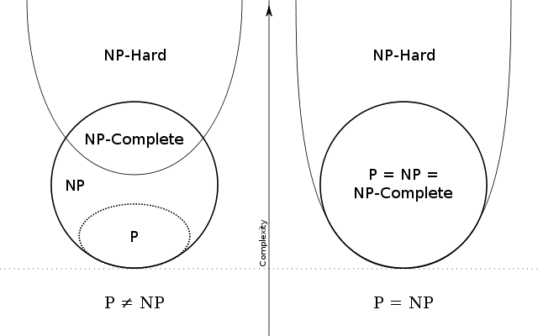
Two possible realities…

Slide 35
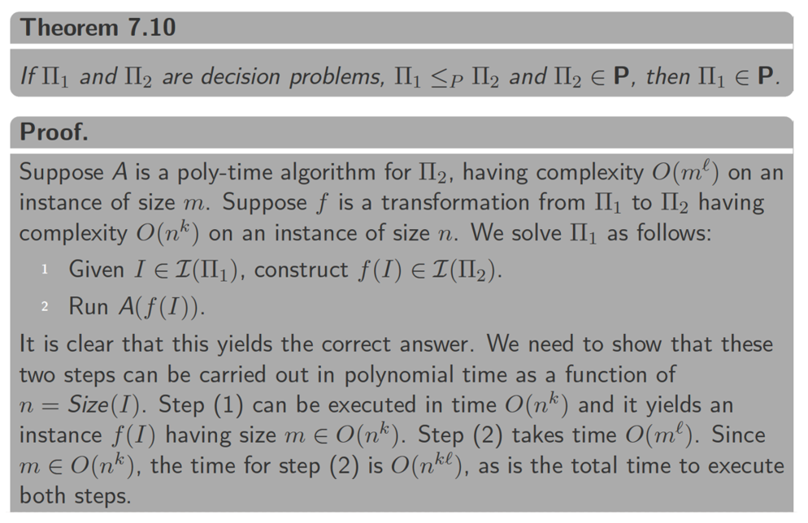
Properties of polynomial transformations

Slide 36
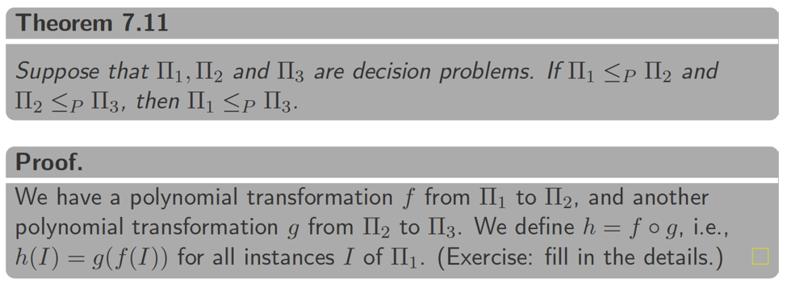
Properties of polynomial transformations

