Slide 1
CS 341: Algorithms
Lecture 6: greedy algorithms II
Readings: see website
Trevor Brown
https://student.cs.uwaterloo.ca/~cs341
trevor.brown@uwaterloo.ca

Slide 2
Optimality proof
for greedy interval selection

Slide 3
Goal: choose as many disjoint intervals as possible, (i.e., without any overlap)
Algorithm:
$$A[3]$$
$$A[1]$$
$$A[3]$$
$$A[1]$$
$$A[2]$$
$$A[2]$$
0
2
4
6
8
10
x-axis
0
2
4
6
8
10
x-axis

Slide 4
Proving Optimality
Consider an input A[1..n]
Let G be the greedy solution
Let O be an optimal solution
“Greedy stays ahead” argument
Intuition: out of the a given set of intervals, greedy picks as many as optimal

Slide 5
Visual Example
Input
G₁
G₂
G
G₃
G₄
G₅
O₅
O
O₄
O₂
O₁
O₃
How to compare G and O?
Imagine reordering O to match G!

Slide 6
CRUCIAL: We are NOT assuming the optimal algorithm uses the same sort order!
We are merely imagining reordering the intervals chosen by the optimal algorithm so we can easily compare their finish times to intervals in G

Slide 7
Reordering O by increasing finish time
O₅
O
O₄
O₂
O₁
O₃
O’₂
O’
O’₁
O’₃
O’₄
O’₅
Now O’ and G are both ordered by increasing finish time
This ordering helps us leverage what we know about G in our comparison with O’.
Argue for a prefix of the intervals sorted this way, G chooses as many as O’

Slide 8
Comparing O’ with G
$$f({O′}_{i})$$
O’₂
O’
O’₁
O’₃
O’₄
O’₅
$$s({O′}_{1})$$
$$f({O′}_{1})$$
G₁
G₂
G
$$s(G_{1})$$
$$f(G_{1})$$
G₃
G₄
G₅
Looks like $f(G_{1})≤{f(O′}_{1})$
and $f(G_{2})≤{f(O′}_{2})$ …
Is ${f(G}_{i})≤f(O_{i}^{′})$ for all $i$?
If this trend holds in general, then
out of the intervals with finish time $≤f\left(O_{i}^{′}\right)$
G chooses as many intervals as O!

Slide 9
Proving Lemma: ${f(G}_{i})≤f(O_{i}^{′})$ for all $i$
O’
$$O_{1}^{′}$$
$$O_{2}^{′}$$
…
$$O_{i−1}^{′}$$
$$O_{i}^{′}$$
G
$$G_{1}$$
$$G_{2}$$
…
$$G_{i−1}$$
Base case: $f\left(G_{1}\right)≤f(O_{1}^{′})$ since G chooses the interval with the earliest finish time first.

Slide 10
Proving Lemma: ${f(G}_{i})≤f(O_{i}^{′})$ for all $i$
$$≤$$
O’
$$O_{1}^{′}$$
$$O_{2}^{′}$$
…
$$O_{i−1}^{′}$$
$$O_{i}^{′}$$
$$≤$$
$$≤$$
G
$$G_{1}$$
$$G_{2}$$
…
$$G_{i−1}$$
Inductive step: assume $f\left(G_{i−1}\right)≤f(O_{i−1}^{′})$.
Show $f\left(G_{i}\right)≤f\left(O_{i}^{′}\right)$.
Since O’ is feasible, $f\left(O_{i−1}^{′}\right)≤s\left(O_{i}^{′}\right)$
So $f\left(G_{i−1}\right)≤s(O_{i}^{′})$
So $G$ can choose $O_{i}^{′}$ if it has the smallest finish time
So $f\left(G_{i}\right)≤f\left(O_{i}^{′}\right)$

Slide 11
Using this lemma
O’
$$O_{1}^{′}$$
$$O_{2}^{′}$$
…
$$O_{k}^{′}$$
$$O_{k+1}^{′}$$
G
$$G_{1}$$
$$G_{2}$$
…
$$G_{k}$$
Suppose $\left|O^{′}\right|>|G|$ to obtain a contradiction
So if $G$ chooses $k$ intervals, $O^{′}$ chooses at least $k+1$
By the lemma, $f\left(G_{k}\right)≤f\left(O_{k}\right)$
Since $O^{′}$ is feasible, $f\left(O_{k}^{′}\right)≤s\left(O_{k+1}^{′}\right)$
But then $G$ can, and would, pick $O_{k+1}^{′}$.
Contradiction!
So assumption $\left|O^{′}\right|>|G|$ is wrong!
So $G$ is optimal

Slide 12
A different proof
“Slick” ad-hoc approaches are sometimes possible…

Slide 13
$$X$$
No interval finishes strictly to the left
No interval starts strictly to the right
Would be chosen by greedy! (contradiction)
No interval in is strictly between these points!
So, in addition to the intervals in $X$, only the following types of intervals are possible
Contains $f_{i_{1}}$
Contains $f_{i_{2}}$
Contains $f_{i_{1}}$ and $f_{i_{2}}$
Thus, every interval contains some finishing time in $F$
So, there must be as many finishing times in $F$ as there are intervals in $O$. QED
And, two intervals in $O$ cannot contain the same element of $F$

Slide 14
Knapsack problems

Slide 15
Gotta respect the weight limit M…

Slide 16
0-1 Knapsack: NP Hard.
Probably requires exponential time to solve...
Rational knapsack: Can be solved in polynomial time by a greedy alg!
Lets discuss this now… other one later

Slide 17
Possible Greedy Strategies for Knapsack Problems
Strategy 1: consider items in decreasing order of profit (i.e., we maximize the local evaluation criterion $p_{i}$)
Let’s try an example input
Profits $P=\left[20,50,100\right]$
Weights $W=[10,20,10]$
Weight limit $M=10$
Algorithm selects last item for 100 profit
Looks optimal in this example

Slide 18
Possible Greedy Strategies for Knapsack Problems
Strategy 1: consider items in decreasing order of profit (i.e., we maximize the local evaluation criterion $p_{i}$)
How about a second example input
Profits $P=\left[20,50,100\right]$
Weights $W=[10,20,100]$
Weight limit $M=10$
Algorithm selects last item for 10 profit
Not optimal!

Slide 19
Possible Greedy Strategies for Knapsack Problems
Strategy 2: consider items in increasing order of weight (i.e., we minimize the local evaluation criterion $w_{i}$)
Counterexample
Profits $P=\left[20,50,100\right]$
Weights $W=[10,20,100]$
Weight limit $M=10$
Algorithm selects first item for 20 profit
It could select half of second item, for 25 profit!

Slide 20
Possible Greedy Strategies for Knapsack Problems
Strategy 3: consider items in decreasing order of profit divided by weight (i.e., we maximize local evaluation criterion $p_{i}/w_{i}$)
Let’s try our first example input
Profits $P=\left[20,50,100\right]$
Weights $W=[10,20,10]$
Weight limit $M=10$
Profit divided by weight
$P/W=[2, 2.5, 10]$
Algorithm selects last item for 100 profit (optimal)

Slide 21
Possible Greedy Strategies for Knapsack Problems
Strategy 3: consider items in decreasing order of profit divided by weight (i.e., we maximize local evaluation criterion $p_{i}/w_{i}$)
Let’s try our second example input
Profits $P=\left[20,50,100\right]$
Weights $W=[10,20,100]$
Weight limit $M=10$
Profit divided by weight
$P/W=[2, 2.5, 1]$
Algorithm selects second item for 25 profit (optimal)
It turns out strategy #3 is optimal…

Slide 22
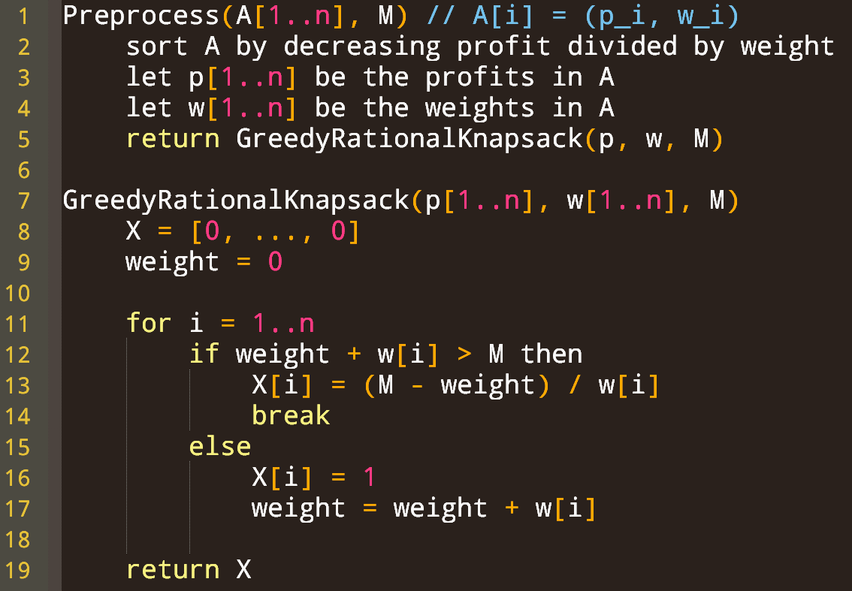
No items are chosen yet
Current weight of knapsack
For all items
If we cannot fit the entire item
Put in as much of the item as you can, to exactly fill the knapsack
Otherwise take the entire item
Either X=(1,1,…,1,0,…,0) or X=(1,1,…,1,$x_{i}$,0,…,0) where $x_{i}∈(0,1)$

Slide 23
Running time complexity?
Can do preprocessing in $Θ(n\log{n})$
Create array in $Θ(n)$ time
$Θ(n)$ iterations each doing $Θ(1)$ work
Total $Θ(n\log{n})$
(or $Θ(n)$ if input is already sorted)

Slide 24
Informal feasibility argument (Should be good enough to show feasibility on assessments)
Feasibility: all $x_{i}$ are in $[0,1]$ and total weight is $≤M$
Either everything fits in the knapsack, or:
When we exit the loop, weight is exactly M
Every time we write to $x_{i}$ it’s either 0, 1 or $(M−weight)/w_{i}$ where $weight+w\left[i\right]>M$
Rearranging the latter we get $(M−weight)/w_{i}<1$
And $weight≤M$, so $(M−weight)/w_{i}≥0$
So, we have $x_{i}∈[0,1]$

Slide 25
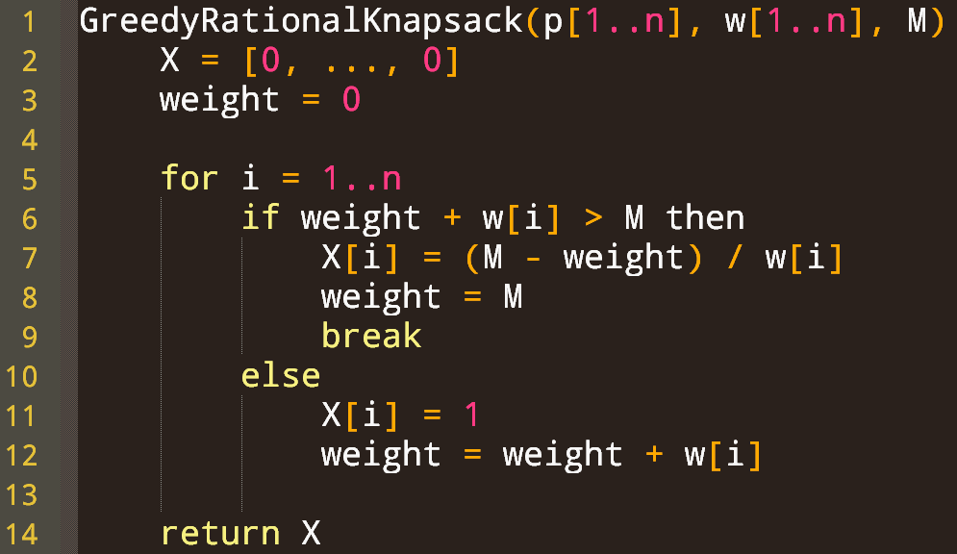
Minor modification to facilitate formal proof
Optional slide, just for your notes
Does NOT change behaviour of the algorithm at all!

Slide 26
Formal Feasibility Arg
Loop invariant: $∀_{i} :x_{i}∈\left[0,1\right]$
and $weight=\sum_{i=1}^{n}{w_{i}x_{i}}≤M$
Base case. Initially weight = 0 and $∀_{i} :x_{i}=0$.
So $0=weight=\sum_{i=1}^{n}{w_{i}⋅0}=\sum_{i=1}^{n}{w_{i}x_{i}}≤M$
Inductive step.
Suppose invariant holds at start of iteration $i$
Let $weight^{′},x_{i}′$ denote values of $weight, x_{i}$ at end of iteration $i$
Prove invariant holds at end of iteration $i$
i.e., $∀_{i} :x_{i}^{′}∈\left[0,1\right]$ and $weight′=\sum_{i=1}^{n}{w_{i}{x′}_{i}}≤M$
Optional slide, just for your notes

Slide 27
Formal Feasibility Arg
WTP: $∀_{i} :x_{i}^{′}∈\left[0,1\right]$ and $weight′=\sum_{i=1}^{n}{w_{i}{x′}_{i}}≤M$
Case 1: $weight+w_{i}≤M$
$x_{i}^{′}=1$ which is in $[0,1]$ (by line 11)
$weight^{′}=weight+w_{i}$ (by line 12) and this is $≤M$ by the case
$weight^{′}=\sum_{k=1}^{n}{x_{k}w_{k}}+w_{i}$ (by invariant)
$weight^{′}=\sum_{k=1}^{n}{x_{k}w_{k}}+x_{i}^{′}w_{i}$ (since $x_{i}^{′}=1$)
And $x_{k}^{′}=x_{k}$ for all $k≠i$ and $x_{i}=0$ so $\sum_{k=1}^{n}{x_{k}^{′}w_{k}}=$ $x_{i}^{′}w_{i}+\sum_{k=1}^{n}{x_{k}w_{k}}$
Rearrange to get $\sum_{k=1}^{n}{x_{k}w_{k}}=\left(\sum_{k=1}^{n}{x_{k}^{′}w_{k}}−x_{i}^{′}w_{i}\right)$
So $weight^{′}=\left(\sum_{k=1}^{n}{x_{k}^{′}w_{k}}−x_{i}^{′}w_{i}\right)+x_{i}^{′}w_{i}=\sum_{k=1}^{n}{x_{k}^{′}w_{k}}$
Optional slide, just for your notes

Slide 28
Formal Feasibility Arg
WTP: $∀_{i} :x_{i}^{′}∈\left[0,1\right]$ and $weight′=\sum_{i=1}^{n}{w_{i}{x′}_{i}}≤M$
Case 2: $weight+w_{i}>M$
We have $w_{i}>M−weight$ (by case) and $M−weight≥0$ (by invariant)
So $0≤\frac{M−weight}{w_{i}}<1$ which means $x_{i}^{′}∈[0,1)$
$weight^{′}=M=weight+(M−weight)$ (by line 8)
$weight^{′}=\sum_{k=1}^{n}{x_{k}w_{k}}+\left(M−weight\right)$ (by invariant)
But $x_{k}^{′}=x_{k}$ for all $k≠i$ and $x_{i}=0$ so $\sum_{k=1}^{n}{x_{k}^{′}w_{k}}=$ $x_{i}^{′}w_{i}+\sum_{k=1}^{n}{x_{k}w_{k}}$
Rearrange to get $\sum_{k=1}^{n}{x_{k}w_{k}}=\left(\sum_{k=1}^{n}{x_{k}^{′}w_{k}}−x_{i}^{′}w_{i}\right)$
So $weight^{′}=\left(\sum_{k=1}^{n}{x_{k}^{′}w_{k}}−x_{i}^{′}w_{i}\right)+\left(M−weight\right)$
And $M−weight=x_{i}^{′}w_{i}$ so $weight^{′}=\sum_{k=1}^{n}{x_{k}^{′}w_{k}}$
Optional slide, just for your notes

Slide 29
Exchange argument
for proving optimality

Slide 30
Optimality – An exchange arugment
To obtain a contradiction
$X$ and $Y$ are identical up to $x_{j}$ and $y_{j}$, respectively

Slide 31
j = first index where the solutions differ
Greedy solution X
Optimal solution Y
1
1
x₁
x₂
x_{j-1}
y₁
y₂
y_{j-1}
y_{j} $≠$ x_{j}
fraction of item in knapsack
…
…
x_{j}
0
0
Item 1
Item j
Item n
Item 1
Item j
Item n
Item 2
Item 2
What’s the relationship between $x_{j}$ and $y_{j}$?

Slide 32
j = first index where the solutions differ
Greedy solution X
Optimal solution Y
1
1
Can we have y_{j} > x_{j}?
x₁
x₂
x_{j-1}
y₁
y₂
y_{j-1}
fraction of item in knapsack
…
…
y_{j}
x_{j}
No! Greedy would take more of item j if it could.
0
0
Item 1
Item j
Item n
Item 1
Item j
Item n
Item 2
Item 2

Slide 33
j = first index where the solutions differ
Greedy solution X
Optimal solution Y
1
1
x₁
x₂
x_{j-1}
y₁
y₂
y_{j-1}
(x_{j} – y_{j})
fraction of item in knapsack
…
…
x_{j}
Must have
y_{j} < x_{j}
y_{j}
0
0
Item 1
Item j
Item n
Item 1
Item j
Item n
Item 2
Item 2

Slide 34
j = first index where the solutions differ
Greedy solution X
Optimal solution Y
1
1
x₁
x₂
x_{j-1}
y₁
y₂
y_{j-1}
fraction of item in knapsack
…
…
x_{j}
y_{j}
0
0
Item 1
Item j
Item n
Item 1
Item j
Item n
Item 2
Item 2
No! It would be worth less than X
Can Y be all zeros after y_{j}?

Slide 35
j = first index where the solutions differ
Greedy solution X
Optimal solution Y
1
1
x₁
x₂
x_{j-1}
y₁
y₂
y_{j-1}
fraction of item in knapsack
…
…
x_{j}
y_{k}
y_{j}
0
0
Item 1
Item j
Item n
Item 1
Item j
Item k
Item n
Item 2
Item 2
Must exist k > j such that y_{k} > 0
But, by our sort order, item j is worth more (per unit of weight) than item k!
Remove some of item k and replace it with some of item j?
How much of item k should we remove?

Slide 36
j = first index where the solutions differ
Greedy solution X
Optimal solution Y
1
1
x₁
x₂
x_{j-1}
y₁
y₂
y_{j-1}
fraction of item in knapsack
…
…
x_{j}
y_{k}
y_{j}
0
0
Item 1
Item j
Item n
Item 1
Item j
Item k
Item n
Item 2
Item 2
Since item j is worth more per unit weight, replacing even a tiny amount of item k with item j will improve the solution
So, we remove an infinitesimal $δ>0$ of weight of item k, and add $δ$ weight of item j

Slide 37
j = first index where the solutions differ
Greedy solution X
To move $δ$ weight from item k to item j…
Optimal solution Y
What fraction of item j are we adding?
What fraction of item k are we removing?
1
1
x₁
x₂
x_{j-1}
y₁
y₂
y_{j-1}
fraction of item in knapsack
…
…
$$\frac{δ}{w_{j}}$$
x_{j}
$$\frac{δ}{w_{k}}$$
y_{k}
y_{j}
0
0
Item 1
Item j
Item n
Item 1
Item j
Item k
Item n
Item 2
Item 2
1
$$y_{j}^{′}=y_{j}+\frac{δ}{w_{j}}$$
$$y_{k}^{′}=y_{k}−\frac{δ}{w_{k}}$$
y₁
y₂
y_{j-1}
Modified optimal solution Y’
…
y_{j}’
y_{k}’
0

Slide 38
1
$$y_{j}^{′}=y_{j}+\frac{δ}{w_{j}}$$
$$y_{k}^{′}=y_{k}−\frac{δ}{w_{k}}$$
y₁
y₂
y_{j-1}
Modified optimal solution Y’
…
y_{j}’
y_{k}’
0
To show $Y^{′}$ is feasible, we show $y_{k}^{′}≥0, y_{j}^{′}≤1$ and $weight\left(Y^{′}\right)≤M$

Slide 39
Feasibility of $Y′$
To show $Y^{′}$ is feasible, we show $y_{k}^{′}≥0, y_{j}^{′}≤1$ and $weight\left(Y^{′}\right)≤M$
Let’s show $y_{k}^{′}≥0$
By definition, $y_{k}^{′}=y_{k}−\frac{δ}{w_{k}}$
So, $y_{k}^{′}≥0$ iff $y_{k}−\frac{δ}{w_{k}}≥0$ iff $δ≤y_{k}w_{k}$
And we know $y_{k}$ and $w_{k}$ are both positive
So, this constrains $δ$ to be smaller than this positive number
Therefore, it is possible to choose positive $δ$ s.t. $y_{k}^{′}≥0$
Existence proof, but a non-constructive one

Slide 40
Feasibility of $Y′$
To show $Y^{′}$ is feasible, we show $y_{k}^{′}≥0, y_{j}^{′}≤1$ and $weight\left(Y^{′}\right)≤M$
Now let’s show $y_{j}^{′}≤1$
By definition, $y_{j}^{′}=y_{j}+\frac{δ}{w_{j}}$
So, $y_{j}^{′}≤1$ iff $y_{j}+\frac{δ}{w_{j}}≤1$ iff $δ≤\left(1−y_{j}\right)w_{j}$
Recall $y_{j}<x_{j}$, so $y_{j}<1$, which means $\left(1−y_{j}\right)>0$
So, this constrains $δ$ to be smaller than some positive number

Slide 41
Feasibility of $Y′$
Modified optimal solution Y’
Finally, we show $weight\left(Y^{′}\right)≤M$
Recall changes to get $Y′$ from $Y$
We move $δ$ weight from item $k$ to item $j$
This does not change the total weight!
So $weight\left(Y^{′}\right)=weight\left(Y\right)≤M$
Therefore, $Y′$ is feasible!
1
“Optimal” solution Y
1
$$y_{j}^{′}=y_{j}+\frac{δ}{w_{j}}$$
$$y_{k}^{′}=y_{k}−\frac{δ}{w_{k}}$$
y₁
y₂
y_{j-1}
y₁
y₂
y_{j-1}
…
…
y_{k}
y_{j}’
y_{j}
y_{k}’
0
0

Slide 42
Superiority of $Y′$
(Fraction of item j added) $×$ (profit for item j)
Finally we compute $profit\left(Y^{′}\right)$
$profit\left(Y^{′}\right)=profit\left(Y\right)+\frac{δ}{w_{j}}p_{j}−\frac{δ}{w_{k}}p_{k}$
$=profit\left(Y\right)+δ\left(\frac{p_{j}}{w_{j}}−\frac{p_{k}}{w_{k}}\right)$
Since j is before k, and we consider items with more profit per unit weight first, we have $\frac{p_{j}}{w_{j}}>\frac{p_{k}}{w_{k}}$.
So, if $δ>0$ then $δ\left(\frac{p_{j}}{w_{j}}−\frac{p_{k}}{w_{k}}\right)>0$
Since we can choose $δ>0$, we have $profit\left(Y^{′}\right)>profit(Y)$.
(Fraction of item k removed) $×$ (profit for item k)
Contradicts optimality of Y! So assumption $X≠Y$ is bad. Therefore, X is optimal.

Slide 43
What if elements don’t have distinct profit/weight ratios?
Covering the next 9 slides is homework!

Slide 44
Optimality Proof without distinctness
There may be many optimal solutions
Key idea: Let $Y$ be an optimal solution that matches $X$ on a maximal number of indices
Observe: if $X$ is really optimal, then $Y=X$
Suppose not for contra
We will modify $Y$, preserving its optimality, but making it match $X$ on one more index (a contradiction!)

Slide 45
j = first index where the solutions differ
Greedy solution X
Optimal solution Y
1
1
x₁
x₂
x_{j-1}
x_{j}
y₁
y₂
y_{j-1}
y_{j} $≠$ x_{j}
fraction of item in knapsack
…
…
0
0
Item 1
Item j
Item n
Item 1
Item j
Item n
Item 2
Item 2

Slide 46
Greedy solution X
Optimal solution Y
1
1
x₁
x₂
x_{j-1}
x_{j}
y₁
y₂
y_{j-1}
fraction of item in knapsack
…
…
Must have
y_{j} < x_{j}
y_{j}
0
0
Item 1
Item j
Item n
Item 1
Item j
Item n
Item 2
Item 2

Slide 47
Optimal solution Y
Fraction we should add to j to make solutions equal on index j: $x_{j}−y_{j}$
Greedy solution X
1
1
Weight to add: $w_{j}\left(x_{j}−y_{j}\right)$
x₁
x₂
x_{j-1}
x_{j}
y₁
y₂
y_{j-1}
fraction of item in knapsack
…
…
y_{k}
x_{k}
y_{j}
0
0
Item 1
Item j
Item k
Item n
Item 1
Item j
Item k
Item n
Item 2
Item 2
Must exist k > j such that y_{k} > x_{k} because weight of $X$ and $Y$ must be the same
Fraction we should remove from k to make solutions equal on index k: $y_{k}−x_{k}$
Weight to remove: $w_{k}\left(y_{k}−x_{k}\right)$
Remove some weight $δ$ of item k and add the same weight of item j
With the goal of making the solutions equal on index k or index j
Let $δ=min\{w_{j}\left(x_{j}−y_{j}\right),w_{k}\left(y_{k}−x_{k}\right)\}$
Observe $δ>0$

Slide 48
Optimal solution Y
Greedy solution X
Suppose $δ=w_{k}\left(y_{k}−x_{k}\right)$
1
1
x₁
x₂
x_{j-1}
x_{j}
y₁
y₂
y_{j-1}
fraction of item in knapsack
…
…
y_{k}
x_{k}
y_{j}
0
0
Item 1
Item j
Item k
Item n
Item 1
Item j
Item k
Item n
Item 2
Item 2
1
$$y_{j}^{′}=y_{j}+\frac{δ}{w_{j}}$$
y₁
y₂
y_{j-1}
$$y_{k}^{′}=y_{k}−\frac{δ}{w_{k}}$$
Modified optimal solution Y’
…
y_{j}’
In this case, since $δ=w_{k}\left(y_{k}−x_{k}\right)$, we end up with $y_{k}^{′}=x_{k}$
y_{k}’
0
If $δ$ were $w_{j}\left(x_{j}−y_{j}\right)$, we would have $y_{j}^{′}=$ $x_{j}$

Slide 49
1
$$y_{j}^{′}=y_{j}+\frac{δ}{w_{j}}$$
y₁
y₂
y_{j-1}
$$y_{k}^{′}=y_{k}−\frac{δ}{w_{k}}$$
Modified optimal solution Y’
…
y_{j}’
y_{k}’
0
To show $Y^{′}$ is feasible, we show $weight\left(Y^{′}\right)≤M$ and $y_{k}^{′}≥0, y_{j}^{′}≤1$
Weight
We move $δ$ weight from item $k$ to item $j$
This does not change the total weight!
So $weight\left(Y^{′}\right)=weight\left(Y\right)=M$

Slide 50
Feasibility of $Y′$
Showing $y_{k}^{′}≥0$
By definition, $y_{k}^{′}=y_{k}−\frac{δ}{w_{k}}≥0$ iff $δ≤y_{k}w_{k}$
But $δ$ is the minimum of $w_{j}\left(x_{j}−y_{j}\right)$ and $w_{k}(y_{k}−x_{k})≤{w_{k}y}_{k}$
And $w_{k}(y_{k}−x_{k})≤{w_{k}y}_{k}$ so $δ≤y_{k}w_{k}$
Showing $y_{j}^{′}≤1$
$y_{j}^{′}=y_{j}+\frac{δ}{w_{j}}≤1$ iff $\frac{δ}{w_{j}}≤1−y_{j}$ iff $δ≤w_{j}\left(1−y_{j}\right)$ (rearranging)
$δ≤w_{j}\left(x_{j}−y_{j}\right)$ (definition of $δ$)
and $w_{j}\left(x_{j}−y_{j}\right)≤w_{j}\left(1−y_{j}\right)$ (by feasibility of X, i.e., $x_{j}≤1$)

Slide 51
Profit of $Y′$
(Fraction of item j added) $×$ (profit for entire item)
$profit\left(Y^{′}\right)=profit\left(Y\right)+\frac{δ}{w_{j}}p_{j}−\frac{δ}{w_{k}}p_{k}=profit\left(Y\right)+δ\left(\frac{p_{j}}{w_{j}}−\frac{p_{k}}{w_{k}}\right)$
Since j is before k, and we consider items with more profit per unit weight first, we have $\frac{p_{j}}{w_{j}}≥\frac{p_{k}}{w_{k}}$.
Since $δ>0$ and $\frac{p_{j}}{w_{j}}≥\frac{p_{k}}{w_{k}}$, we have $δ\left(\frac{p_{j}}{w_{j}}−\frac{p_{k}}{w_{k}}\right)≥0$
Since $Y$ is optimal, this cannot be positive
So $Y^{′}$ is a new optimal solution that matches $X$ on one more index than $Y$
Contradiction: $Y$ matched $X$ on a maximal number of indices!

Slide 52
Summarizing exchange arguments
If inputs are distinct
So there is a unique optimal solution
Let O != G be an optimal solution that beats greedy
Show how to change O to obtain a better solution
If not
There may be many optimal solutions
Let O != G be an optimal solution that matches greedy on as many choices as possible
Show how to change O to obtain an optimal solution O’ that matches greedy for even more choices

