Slide 1
CS 341: Algorithms
Lecture 9: dynamic programming III
Readings: see website
Trevor Brown
https://student.cs.uwaterloo.ca/~cs341
trevor.brown@uwaterloo.ca

Slide 2
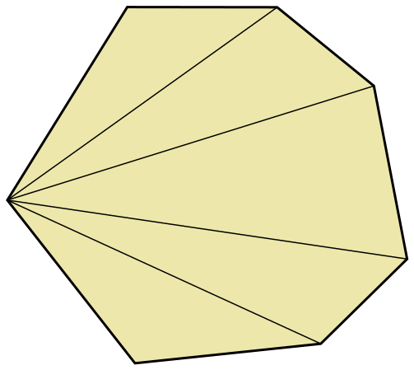
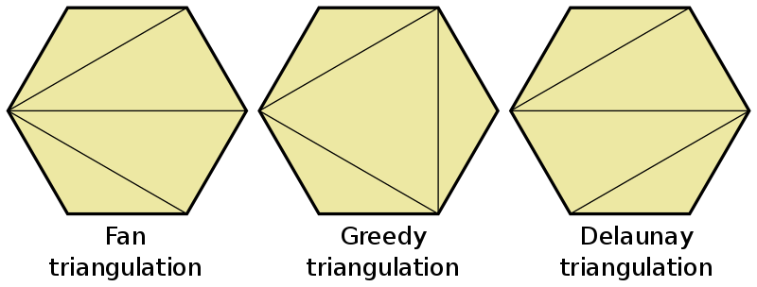
Problem: minimum length triangulation
$$q_{2}$$
$$q_{3}$$
$$q_{4}$$
Input: $n$ points $q_{1},…,q_{n}$ in 2D space that form a convex $n$-gon $P$
Assume points are sorted clockwise around the center of P
Find: a triangulation of $P$ such that the sum of the perimeters of the $n−2$ triangles is minimized
Output: the sum of the perimeters of the triangles in $P$
$$q_{1}$$
$$q_{5}$$
$$q_{7}$$
$$q_{6}$$

Slide 3
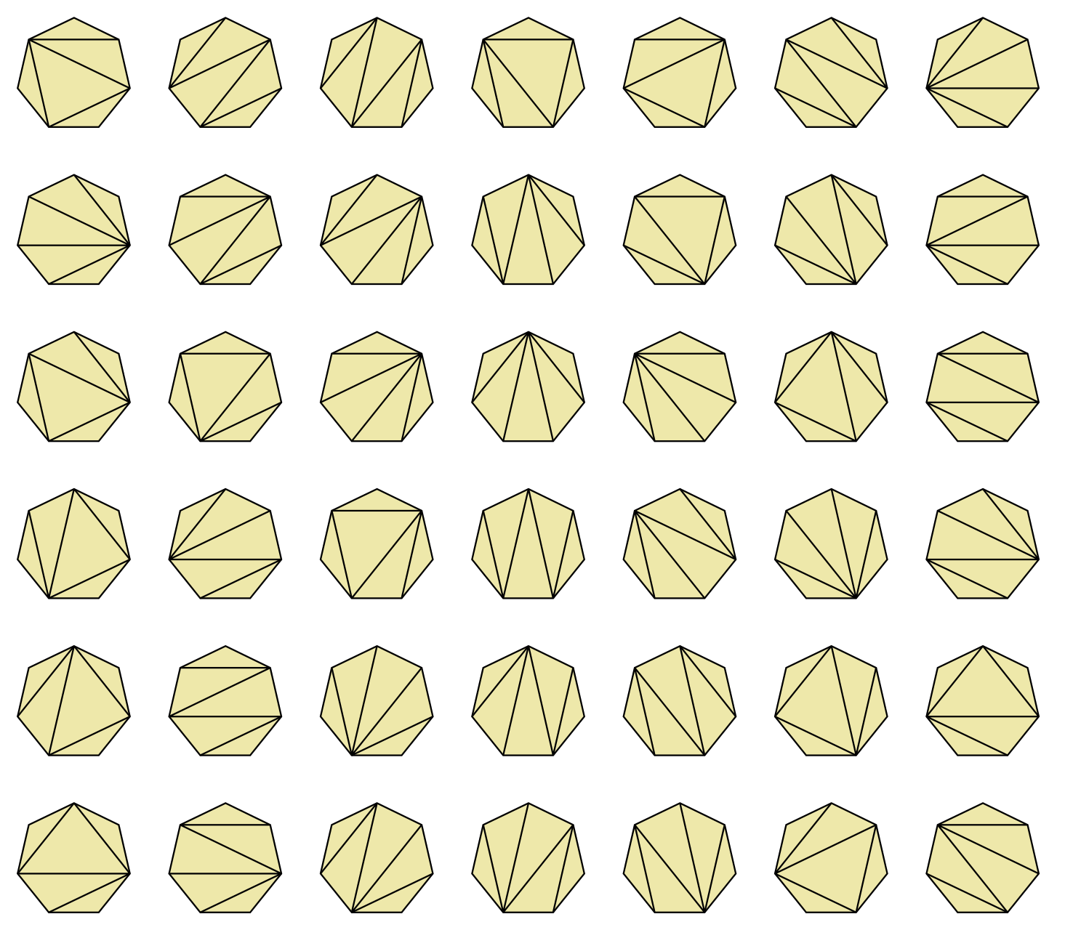
How hard is this Problem?
How many triangulations are there?
Number of triangulations of a convex $n$-gon = the $\left(n−2\right)$nd Catalan number
This is $C_{n−2}=\frac{1}{n−1}\left({2n−4 \atop n−2}\right)$
It can be shown that $C_{n−2}∈Θ(4^{n}/{\left(n−2\right)}^{3/2})$

Slide 4
Problem decomposition
$$q_{2}$$
$$q_{3}$$
$$q_{1}$$
…
$$q_{n−1}$$
$$q_{n}$$

Slide 5
Problem decomposition
$$q_{2}$$
$$q_{3}$$
$$q_{k}$$
(1)
$$q_{1}$$
…
$$q_{n−1}$$
$$q_{n}$$

Slide 6
Problem decomposition
$$q_{2}$$
$$q_{3}$$
(2)
$$q_{k}$$
(1)
$$q_{1}$$
…
$$q_{n−1}$$
$$q_{n}$$

Slide 7
Problem decomposition
$$q_{2}$$
$$q_{3}$$
(2)
$$q_{k}$$
(1)
(3)
$$q_{1}$$
…
$$q_{n−1}$$
$$q_{n}$$

Slide 8
Problem decomposition
$$q_{2}$$
$$q_{3}$$
(2)
$$q_{k}$$
(1)
(3)
$$q_{1}$$
…
$$q_{n−1}$$
$$q_{n}$$

Slide 9
Problem decomposition
$$q_{2}$$
$$q_{3}$$
(2)
$$q_{k}$$
$$q_{1}$$
$$q_{k}$$
(1)
$$q_{1}$$
$$q_{k}$$
(3)
$$q_{n}$$
…
$$q_{n−1}$$
$$q_{n}$$

Slide 10
Recurrence relation
Let $S(i,j)=$ optimal solution to the subproblem consisting of the polygon with vertices $q_{i}…q_{j}$
Let $Δ_{ijk}$ denote perimeter( )
If a given triangle $q_{i}$,$q_{j}\text{,}q_{k}$ is in the optimal solution, then $S(i,j)=S(i,k) +Δ_{ijk}+S(k,j)$
$$q_{k}$$
$$q_{i}$$
$$q_{j}$$
$$q_{i+1}$$
…
$$S(i,k)$$
$$q_{k}$$
$$Δ_{ijk}$$
$S(k,j)$
$$q_{i}$$
$$q_{k+1}$$
$$…$$
$$q_{j}$$

Slide 11
Recurrence relation
But we don’t know the optimal $k$
Minimize over all $k$ strictly between $i$ and $j$
$$S(i,j)=\left\{\begin{aligned}\underset{i<k<j}{m\text{in}}\left\{S(i,k)+Δ_{ijk}+S(k,j)\right\} if j≥i+2 \\ 0 otherwise\end{aligned}\right.$$
$$k=i+1$$
$$S(i,k)$$
$$k=i+2$$
$$…$$
$$S(i,k)=0$$
$$S(i,k)$$
$$q_{i}$$
$$S(k,j)$$
$$S(k,j)$$
$$q_{j}$$
$$k=j−1$$
$$S(k,j)=0$$

Slide 12
Filling in the table
$$S(i,j)=\left\{\begin{aligned}\min_{i<k<j}\left\{S(i,k)+Δ_{ijk}+S(k,j)\right\} if j≥i+2 \\ 0 otherwise\end{aligned}\right.$$
Table $S\left[1..n,1..n\right]$ of solutions to $S(i,j)$ for all $i,j∈\{1..n\}$
Dependencies:
$S[i,k]$ and $S[k,j]$
For $k=(i+1)…(j−1)$
$$+j$$
$$S[i,j]$$
$$S\left[k,j\right]:$$
$S[i,k]$:
$$S\left[i,i+1\right]…S[i,j−1]$$
$S[i+1,j]$ … $S[j−1,j]$
$$0…0$$
$$j≥i+2$$
$$+i$$
$$j=i+2$$
$$j=i$$
We depend on larger $i$
And same $i$ but smaller $j$
What’s a correct fill order?
for $i=n..1$, for $j=1..n$

Slide 13
Runtime Word RAM model
$$S(i,j)=\left\{\begin{aligned}\min_{i<k<j}\left\{S(i,k)+Δ_{ijk}+S(k,j)\right\} if j≥i+2 \\ 0 otherwise\end{aligned}\right.$$
Number of subproblems: $n^{2}$
Time to solve subproblem $S(i,j)$: $O\left(j−i\right)⊆O(n)$
So total runtime is in $O\left(n^{3}\right)$
Some effort needed to show $Ω\left(n^{3}\right)$, since so many subproblems are base cases, which take $Θ(1)$ steps
Incidentally, this is polynomial time (in the input size)
But basic runtime analysis does not require such an argument

Slide 14
Problem: Longest Common Subsequence (LCS)
Let’s first solve for the length of the LCS

Slide 15
Examples
X=aaaaa Y=bbbbb Z=LCS(X,Y)=?
Z=$ε$ (empty sequence)
X=abcde Y=bcd Z=LCS(X,Y)=?
Z=bcd
X=abcde Y=labef Z=LCS(X,Y)=?
Z=abe

Slide 16
Possible greedy solutions?
Alg: for each $x_{i}∈X$, try to choose a matching $y_{j}∈Y$ that is to the right of all previously chosen $y_{j}$ values
X=abcde Y=labef
X=abcde Y=labef
X=abcde Y=labef [no suitable $y_{j}$ found]
X=abcde Y=labef [no suitable $y_{j}$ found]
X=abcde Y=labef
Z=abe Optimal?

Slide 17
Possible greedy solutions?
Alg: for each $x_{i}∈X$, try to choose a matching $y_{j}∈Y$ that is to the right of all previously chosen $y_{j}$ values
X=azbracadabra Y=abracadabraz
X=azbracadabra Y=abracadabraz
X=azbracadabra Y=abracadabraz [no $y_{j}$ after z]
X=azbracadabra Y=abracadabraz [no $y_{j}$ after z]
…
Z=az Optimal?
Blindly taking z is bad.
How to decide whether to take or leave z?
Similar greedy alg that goes right-to-left works for this input, but fails for other inputs.
Try both possibilities! (Brute force / dynamic programming)

Slide 18
Defining subproblems
Full problem: $|LCS\left(X,Y\right)|$ (i.e., length of LCS)
Reduce size by taking prefixes of $X$ or $Y$
Let $X_{i}=(x_{1},…,x_{i})$ and $Y_{i}=(y_{1},…,y_{i})$
Note $X=X_{m}$ and $Y=Y_{n}$
Subproblem: $\left|LCS\left(X_{i},Y_{j}\right)\right|$
Shrinking the problem: remove the last letter of $X$ or $Y$
$$X_{m}$$ | $$x_{1}$$ | $$x_{2}$$ | $$x_{3}$$ | $$x_{4}$$ | … |  |  |  | $$x_{m−1}$$ | $$x_{m}$$
$$X_{4}$$ | $$x_{1}$$ | $$x_{2}$$ | $$x_{3}$$ | $$x_{4}$$
Notes:
Note to self: replace generic X, Y with actual strings you can grab onto…

Slide 19
Building solutions from subproblems Example #1 to build intuition
This cannot be the final a in $Z$
$$X$$ | a | b | r | a | c | a | z | z
 | $$x_{1}$$ | $$x_{2}$$ | $$x_{3}$$ | $$x_{4}$$ | … |  | $$x_{m−1}$$ | $$x_{m}$$
Neither of these is part of $Z$
Neither of these is part of $Z$
$$X_{m−1}$$
Since $Z$ is a subsequence of $X$, $z_{ℓ}=$ a must appear in $X_{m−1}$
This cannot be the final a in $Z$
$$Y$$ | a | z | b | r | a | c | a | d | a | b
 | $$y_{1}$$ | $$y_{2}$$ | $$y_{3}$$ | $$y_{4}$$ | … |  |  |  | $$y_{n−1}$$ | $$y_{n}$$
$$Y_{n−1}$$
$z_{ℓ}=$ a must be in $Y_{n−1}$
$$Z$$ | a | b | r | a | c | a
Consider optimal solution $Z=LCS(X,Y)$
 | $$z_{1}$$ | $$z_{2}$$ | $$z_{3}$$ | $$\text{…}$$ | $$z_{ℓ−1}$$ | $$z_{ℓ}$$
Since $x_{m},y_{n}∉Z$ we know $Z=LCS(X_{m−1},Y_{n−1})$

Slide 20
Building solutions from subproblems Example #2
Or maybe this is
This might be the final a in $Z$
$$X$$ | a | b | r | a | c | a | z | a
 | $$x_{1}$$ | $$x_{2}$$ | $$x_{3}$$ | $$x_{4}$$ | … |  | $$x_{m−1}$$ | $$x_{m}$$
But this certainly is not :)
$$Y$$ | a | z | b | r | a | c | a | d | a | b
 | $$y_{1}$$ | $$y_{2}$$ | $$y_{3}$$ | $$y_{4}$$ | … |  |  |  | $$y_{n−1}$$ | $$y_{n}$$
$$Y_{n−1}$$
Since $Z$ is a subsequence of $Y$, $z_{ℓ}=$ a must appear in $Y_{n−1}$
$$Z$$ | a | b | r | a | c | a
 | $$z_{1}$$ | $$z_{2}$$ | $$z_{3}$$ | $$\text{…}$$ | $$z_{ℓ−1}$$ | $$z_{ℓ}$$
Case $x_{m}∉Z,y_{n}∈Z$ is symmetric
Since $y_{n}∉Z$ we know $Z=LCS(X,Y_{n−1})$
$$Z=LCS(X_{m−1},Y)$$

Slide 21
Building solutions from subproblems Example #3
Or maybe this is…
This might be the final a in $Z$
$$X$$ | a | b | r | a | c | a | z | a
 | $$x_{1}$$ | $$x_{2}$$ | $$x_{3}$$ | $$x_{4}$$ | … |  | $$x_{m−1}$$ | $$x_{m}$$
This might be the final a in $Z$
$$Y$$ | a | z | b | r | a | c | a | d | a | a
 | $$y_{1}$$ | $$y_{2}$$ | $$y_{3}$$ | $$y_{4}$$ | … |  |  |  | $$y_{n−1}$$ | $$y_{n}$$
$$Z$$ | a | b | r | a | c | a | a
 | $$z_{1}$$ | $$z_{2}$$ | $$z_{3}$$ | $$z_{4}$$ | … | $$z_{ℓ−1}$$ | $$z_{ℓ}$$
Might as well match $x_{m}$ and $y_{n}$ with $z_{ℓ}$
Then we have $Z=LCS\left(X_{m−1},Y_{n−1}\right)+z_{ℓ}$

Slide 22
Summarizing cases
$z_{ℓ}$ matches neither $x_{m}$ nor $y_{n}$ $Z=LCS(X_{m−1},Y_{n−1})$
$z_{ℓ}$ matches $x_{m}$ but not $y_{n}$ $Z=LCS(X_{m},Y_{n−1})$
$z_{ℓ}$ matches $y_{n}$ but not $x_{m}$ $Z=LCS(X_{m−1},Y_{n})$
$z_{ℓ}$ matches both $Z=LCS(X_{m−1},Y_{n−1}) + z_{ℓ}$
… but we don’t know $z_{ℓ}$
Try all cases and maximize
Careful: last case is only valid if $x_{m}=y_{n}$
Also note $x_{m}=y_{n}$ only holds in the last case
Cases 2&3: trivial
Case 1: if $x_{m}=y_{n}≠z_{ℓ}$ then we can improve $Z$ (contra)

Slide 23
Deriving a recurrence
Recall $Z=LCS\left(X_{m},Y_{n}\right)$
$z_{ℓ}$ matches neither $x_{m}$ nor $y_{n}$ $(x_{m}≠y_{n})$ $Z=LCS(X_{m−1},Y_{n−1})$
$z_{ℓ}$ matches $x_{m}$ but not $y_{n}$ $(x_{m}≠y_{n})$ $Z=LCS(X_{m},Y_{n−1})$
$z_{ℓ}$ matches $y_{n}$ but not $x_{m}$ $(x_{m}≠y_{n})$ $Z=LCS(X_{m−1},Y_{n})$
$z_{ℓ}$ matches both $(x_{m}=y_{n})$ $Z=LCS(X_{m−1},Y_{n−1}) + z_{ℓ}$
Let $c\left(i,j\right)=\left|LCS\left(X_{i},Y_{j}\right)\right|$
Brainstorming sensible base cases
$i=0$ one string is empty, so $c\left(0,j\right)=0$ (similarly for $j=0$)
General cases
$c(i,j) =c\left(i−1,j−1\right)+1$
if $x_{m}=y_{n}$
$c(i,j)=max⁡\{c\left(i−1,j−1\right),c\left(i,j−1\right),c\left(i−1,j\right)\}$
if $x_{m}≠y_{n}$

Slide 24
Recurrence
Combining expressions
$$c(i,j)=\left\{\begin{matrix}0 & if i=0 or j=0 \\ c\left(i−1,j−1\right)+1 & if i,j≥1 and x_{i}=y_{j} \\ max\left\{c\left(i,j−1\right),c\left(i−1,j\right),c\left(i−1,j−1\right)\right\} & if i,j≥1 and x_{i}≠y_{j}\end{matrix}\right.$$
Can simplify!
Observe $c\left(i−1,j−1\right)≤c\left(i−1,j\right)$ (former is a subproblem of the latter)
$$c(i,j)=\left\{\begin{matrix}0 & if i=0 or j=0 \\ c\left(i−1,j−1\right)+1 & if i,j≥1 and x_{i}=y_{j} \\ max\left\{c\left(i,j−1\right),c\left(i−1,j\right)\right\} & if i,j≥1 and x_{i}≠y_{j}\end{matrix}\right.$$

Slide 25
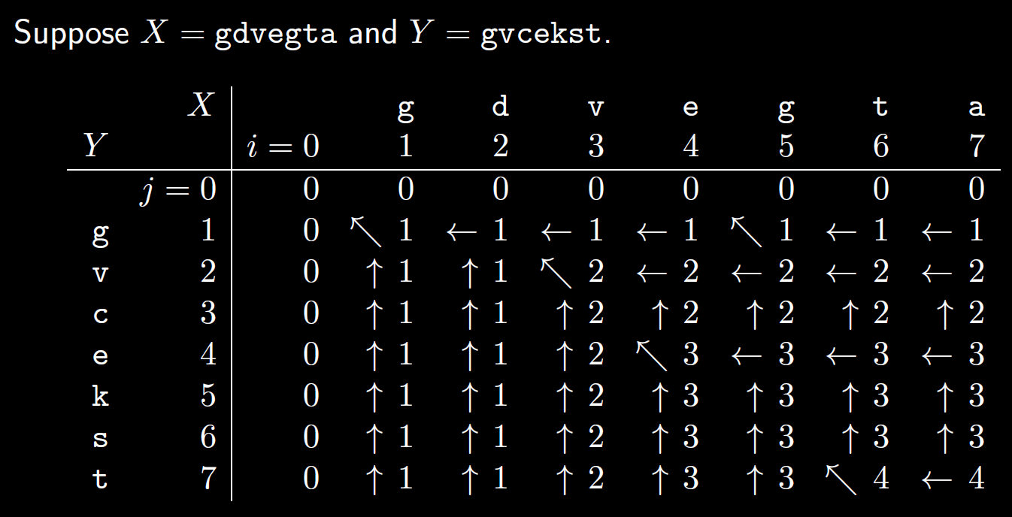
$$c(i,j)=\left\{\begin{matrix}0 & if i=0 or j=0 \\ c\left(i−1,j−1\right)+1 & if i,j≥1 and x_{i}=y_{j} \\ max\left\{c\left(i,j−1\right),c\left(i−1,j\right)\right\} & if i,j≥1 and x_{i}≠y_{j}\end{matrix}\right.$$
Suppose $X=$ gdvegta and $Y=$ gvcekst
Question 1
Q2
Q3
Q6
…
Q4
Q7
Q5
…
…
…

Slide 26
$$c(i,j)=\left\{\begin{matrix}0 & if i=0 or j=0 \\ c\left(i−1,j−1\right)+1 & if i,j≥1 and x_{i}=y_{j} \\ max\left\{c\left(i,j−1\right),c\left(i−1,j\right)\right\} & if i,j≥1 and x_{i}≠y_{j}\end{matrix}\right.$$
Suppose $X=$ gdvegta and $Y=$ gvcekst

Slide 27
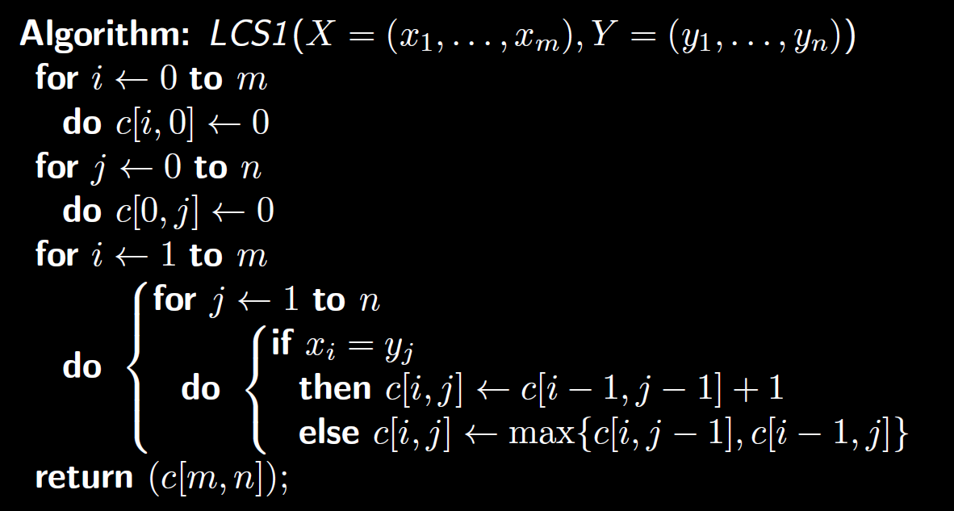
pseudocode
$$c(i,j)=\left\{\begin{matrix}0 & if i=0 or j=0 \\ c\left(i−1,j−1\right)+1 & if i,j≥1 and x_{i}=y_{j} \\ max\left\{c\left(i,j−1\right),c\left(i−1,j\right)\right\} & if i,j≥1 and x_{i}≠y_{j}\end{matrix}\right.$$
Complexity:
Space? Time? (word RAM model)
$Θ\left(nm\right)$ for both

Slide 28
Computing the LCS not just its length
Consider which table entry was used to calculate $c[i,j]$
$$c(i,j)=\left\{\begin{matrix}0 & if i=0 or j=0 \\ c\left(i−1,j−1\right)+1 & if i,j≥1 and x_{i}=y_{j} \\ max\left\{c\left(i,j−1\right),c\left(i−1,j\right)\right\} & if i,j≥1 and x_{i}≠y_{j}\end{matrix}\right.$$
We store the direction to that entry in an array $π[i,j]$
Case 1: $c\left(i,j\right)=c\left(i,j−1\right)$
Case 2: $c\left(i,j\right)=c\left(i−1,j\right)$
Case 3: $c\left(i,j\right)=c\left(i−1,j−1\right)+1$
We store “J” in $π[i,j]$ to indicate decrementing $j$ (to get $i,j−1$)
We store “I” in $π[i,j]$ to indicate decrementing $i$ (to get $i−1,j$)
We store “IJ” in $π[i,j]$ to indicate decrementing both $i$ and $j$
In our example table we just draw an arrow to the entry…
Recall in this case, $x_{i}=y_{j}$ so we include $x_{i}$ in the LCS

Slide 29
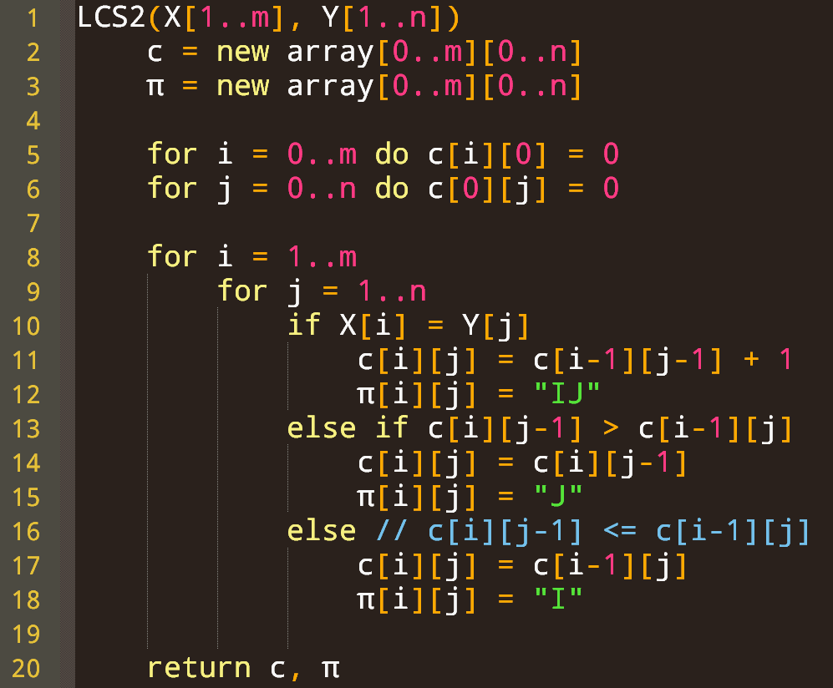
Saving the direction to the predecessor subproblem $π$
Case: $c\left(i,j\right)=c\left(i−1,j−1\right)+1$
We store “IJ” in $π[i,j]$ to indicate decrementing both $i$ and $j$
Recall in this case, $x_{i}=y_{j}$ so we include $x_{i}$ in the LCS
hidden
Case: $c\left(i,j\right)=c\left(i,j−1\right)$
We store “J” in $π[i,j]$ to indicate decrementing $j$ (to get $i,j−1$)
hidden
Case: $c\left(i,j\right)=c\left(i−1,j\right)$
hidden
We store “I” in $π[i,j]$ to indicate decrementing $i$ (to get $i−1,j$)

Slide 30
How to obtain LCS=gvet from this table?
LCS = ?
LCS = gvet
Example
seq=et
Done: seq=gvet
this is.
seq=t
seq=gvet
seq=vet
this “a” is not in

Slide 31
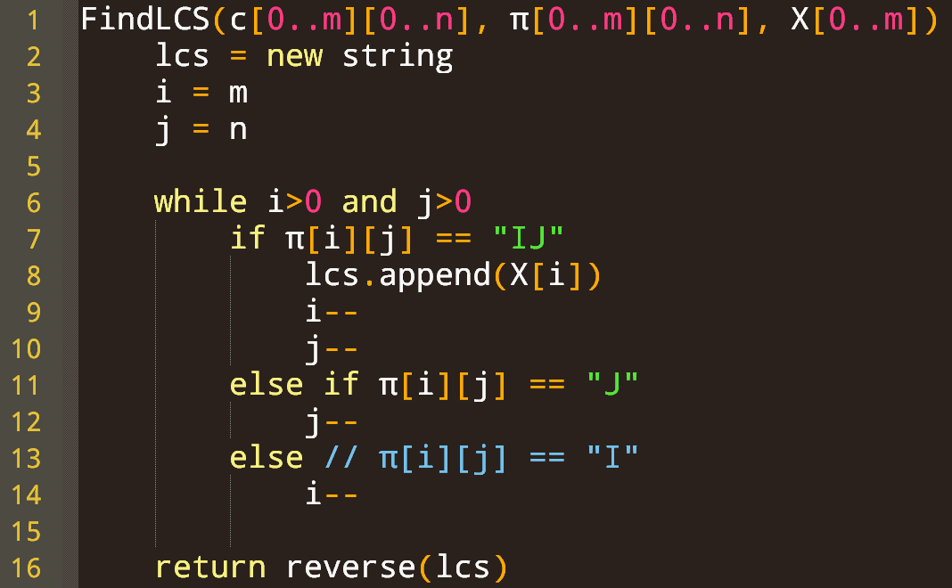
Following predecessors to compute the LCS
Complexities of this trace-back algo: Space? Time? (word RAM model)
space: O(n+m) words
time: O(n+m)

Slide 32
Unlikely to get this far
So this is likely just an exercise for you…

Slide 33
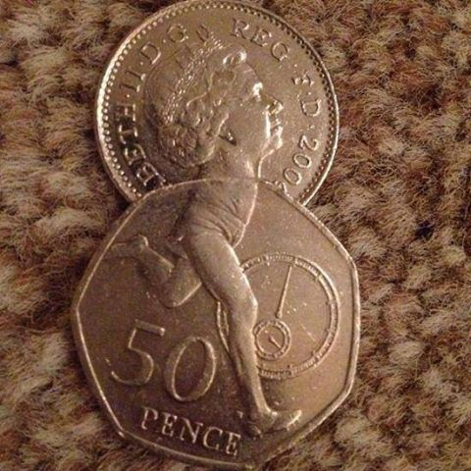
Coin changing

Slide 34
There is a denomination with unit value!
In 0-1 knapsack, we only considered two subproblems in our recurrence: taking an item, or not.
Here we can do more than use a coin denomination or not.

Slide 35
Exploring: some sensible base case(s)?
General case:
What are the different ways we could use coin denomination $di$?
What subproblems / solutions should we use?
Final recurrence relation
OR $t=0$

Slide 36
Also $N[i,0]=0$ for all $i$
General case:
What are the different ways we could use coin denomination $di$?
What subproblems / solutions should we use?
Final recurrence relation
OR $t=0$

Slide 37
Also $N[i,0]=0$ for all $i$
OR $t=0$

Slide 38
Filling the array $N[1…n,0…T]$:
OR $t=0$
No data dependencies on any other array cells.
$i$-axis
(coin type)
(recall: $N[i,t]$ uses coin types $1..i$)
…
1
3
5
n
…
0
2
4
T
$t$-axis (target sum remaining)
Notes:
Note to self for next time: make more concrete, with numbers I can fill in completely

Slide 39
Filling the array $N[1…n,0…T]$:
OR $t=0$
No data dependencies on any other array cells.
0 | 1 | 2 | 3 | 4 | 5 | 6 | … |  |  |  |  |  |  |  |  |  |  |  |  | T
0
0
0
0
…
0
$i$-axis
(coin type)
(recall: $N[i,t]$ uses coin types $1..i$)
…
1
3
5
n
…
0
2
4
T
$t$-axis (target sum remaining)

Slide 40
Filling the array $N[1…n,0…T]$:
OR $t=0$
0 | 1 | 2 | 3 | 4 | 5 | 6 | … |  |  |  |  |  |  |  |  |  |  |  |  | T
0
0
0
0
…
0
$$N[i−1,t−2⋅d_{i}]$$
$$N[i−1,t−1⋅d_{i}]$$
$$N[i−1,t−0⋅d_{i}]$$
$i$-axis
(coin type)
(recall: $N[i,t]$ uses coin types $1..i$)
…
…
1
3
5
n
Consider cell$N[i,t]$
$$di$$
It is sufficient to fill:
row i=1 (base case), then for ($i=2…n$), for ($t=0…T$)
We only look at the previous $i$-row!
…
0
2
4
T
$t$-axis (target sum remaining)

Slide 41
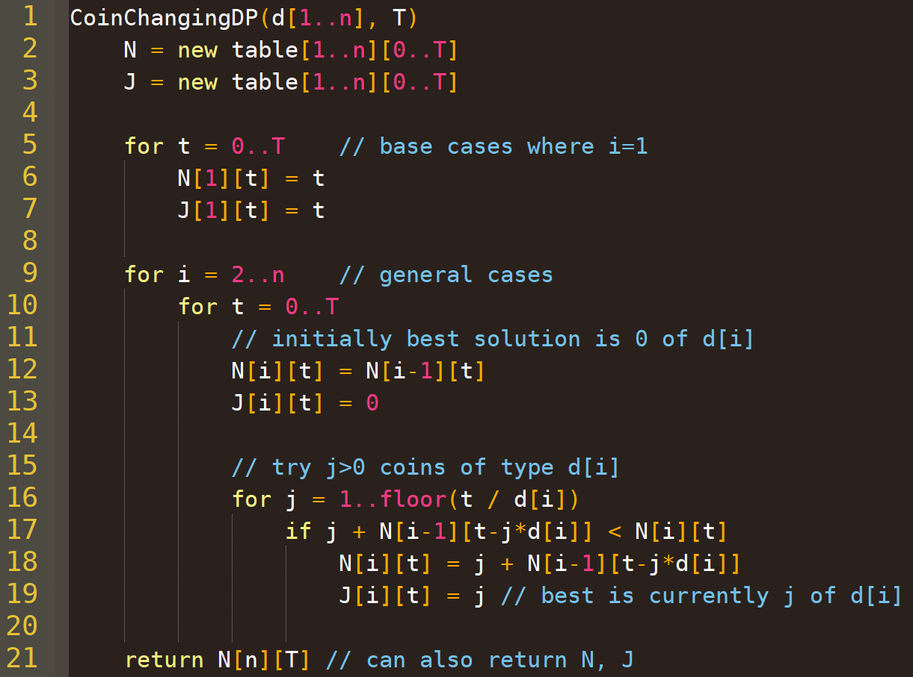
i.e., using coin $d_{1}=1$
$J\left[i,t\right]=$ # of coins of type $di$ used in $N[i,t]$
using other coin types
Compute min{…} over $j = 0 …\left\lfloor t/d_{i}\right\rfloor$

Slide 42
outputting Optimal Set of Coins
Recall $J\left[i,t\right]=$ # of coins of type $di$ used in $N[i,t]$
We start at $J\left[n\right]\left[T\right]=$ # of coins of type $d_{n}$ used in the optimal solution
Exercise for later:
compute the correct output without using $J\left[i,t\right]$ (i.e., using only $N$, $d$, $T$)

Slide 43
Time complexity?
Unit cost computational model is reasonable here
Consider instance $I=(d,T)$
Runtime $R\left(I\right)∈O\left(\sum_{i=2}^{n}{\sum_{t=0}^{T}{\left\lfloor \frac{t}{d_{i}}\right\rfloor }}\right)$
$$R\left(I\right)∈O\left(\sum_{i=2}^{n}{\frac{1}{d_{i}}}\sum_{t=0}^{T}{t}\right)$$
$$R\left(I\right)∈O\left(\sum_{i=2}^{n}{\frac{1}{d_{i}}}\left(\frac{T\left(T+1\right)}{2}\right)\right)$$
$$R\left(I\right)∈O\left(DT^{2}\right)$$
where $D=\sum_{i=2}^{n}{\frac{1}{d_{i}}}<n$.
If T is small, this is much better than brute force

Slide 44
Memoization: an alternative to DP

Slide 45
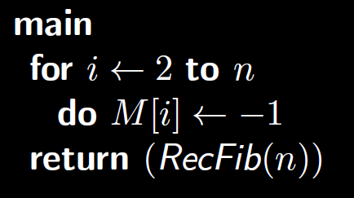
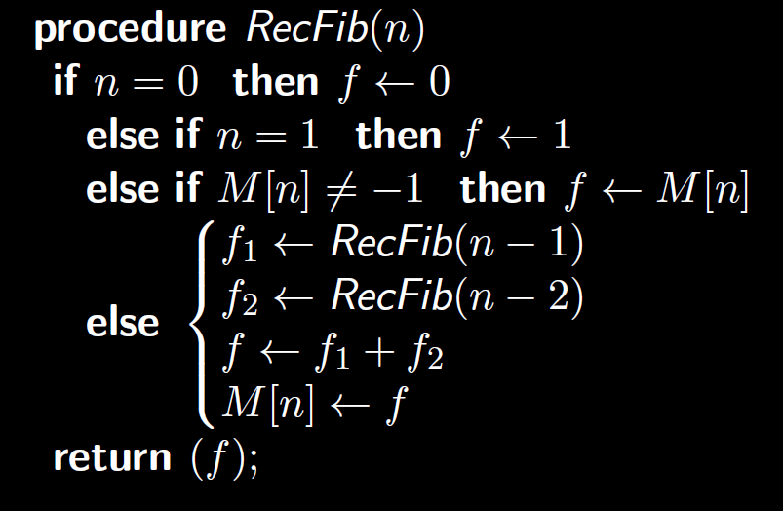
Example: using memoization to compute Fibonacci numbers efficiently
If M[n] is already computed, don’t recurse!

Slide 46
Visualizing memoization
Done!
If M[n] is already computed, don’t recurse!
Done!
Already done!
Done!
Already done!
Done!
Already done!
Done!
Done!

