Slide 1
CS341: Algorithms (F23)
Lecture 1
Trevor Brown
https://student.cs.uwaterloo.ca/~cs341
trevor.brown@uwaterloo.ca

Slide 2
Table of Contents
Course mechanics
Models of computation
Worked example: Bentley’s problem
  Multiple solutions,
  demonstrating different algorithm design techniques
  Analyzed in different models of computation

Slide 3

Course mechanics

Slide 4
Course mechanics
In person
  Lectures
  “Lab” section is for tutorials
Course website: https://student.cs.uwaterloo.ca/~cs341/
  Syllabus, calendar, policies, slides, assignments…
  Read this and mark important dates.
Keep up with the lectures: Material builds over time…
Piazza: For questions and announcements.

Slide 5
Assessments
All sections have same assignments, midterm and final
Sections are roughly synchronized to ensure necessary content is taught
Tentative plan is 5 assignments, midterm, final
See website for grading scheme, etc.

Slide 6
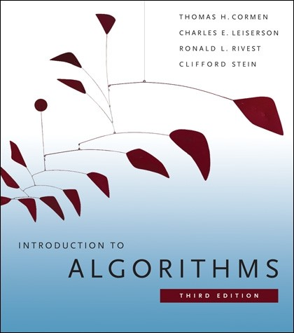
Textbook
Available for free via library website!
You are expected to know
  entire textbook sections,
  as listed on course website
  all the material presented in lectures
  (unless we explicitly say you aren’t
  responsible for it)
Some other textbooks cover some material better… see www

Slide 7

Academic offenses
Beware plagiarism
  High level discussion
  about solutions with individual students is OK
  Don’t take written notes away from such discussions
  Class-wide discussion of solutions is not OK (until deadline+2 days)

Slide 8

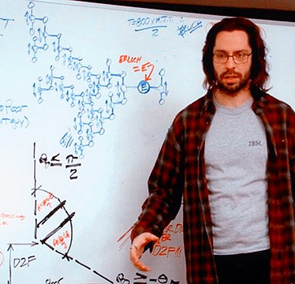
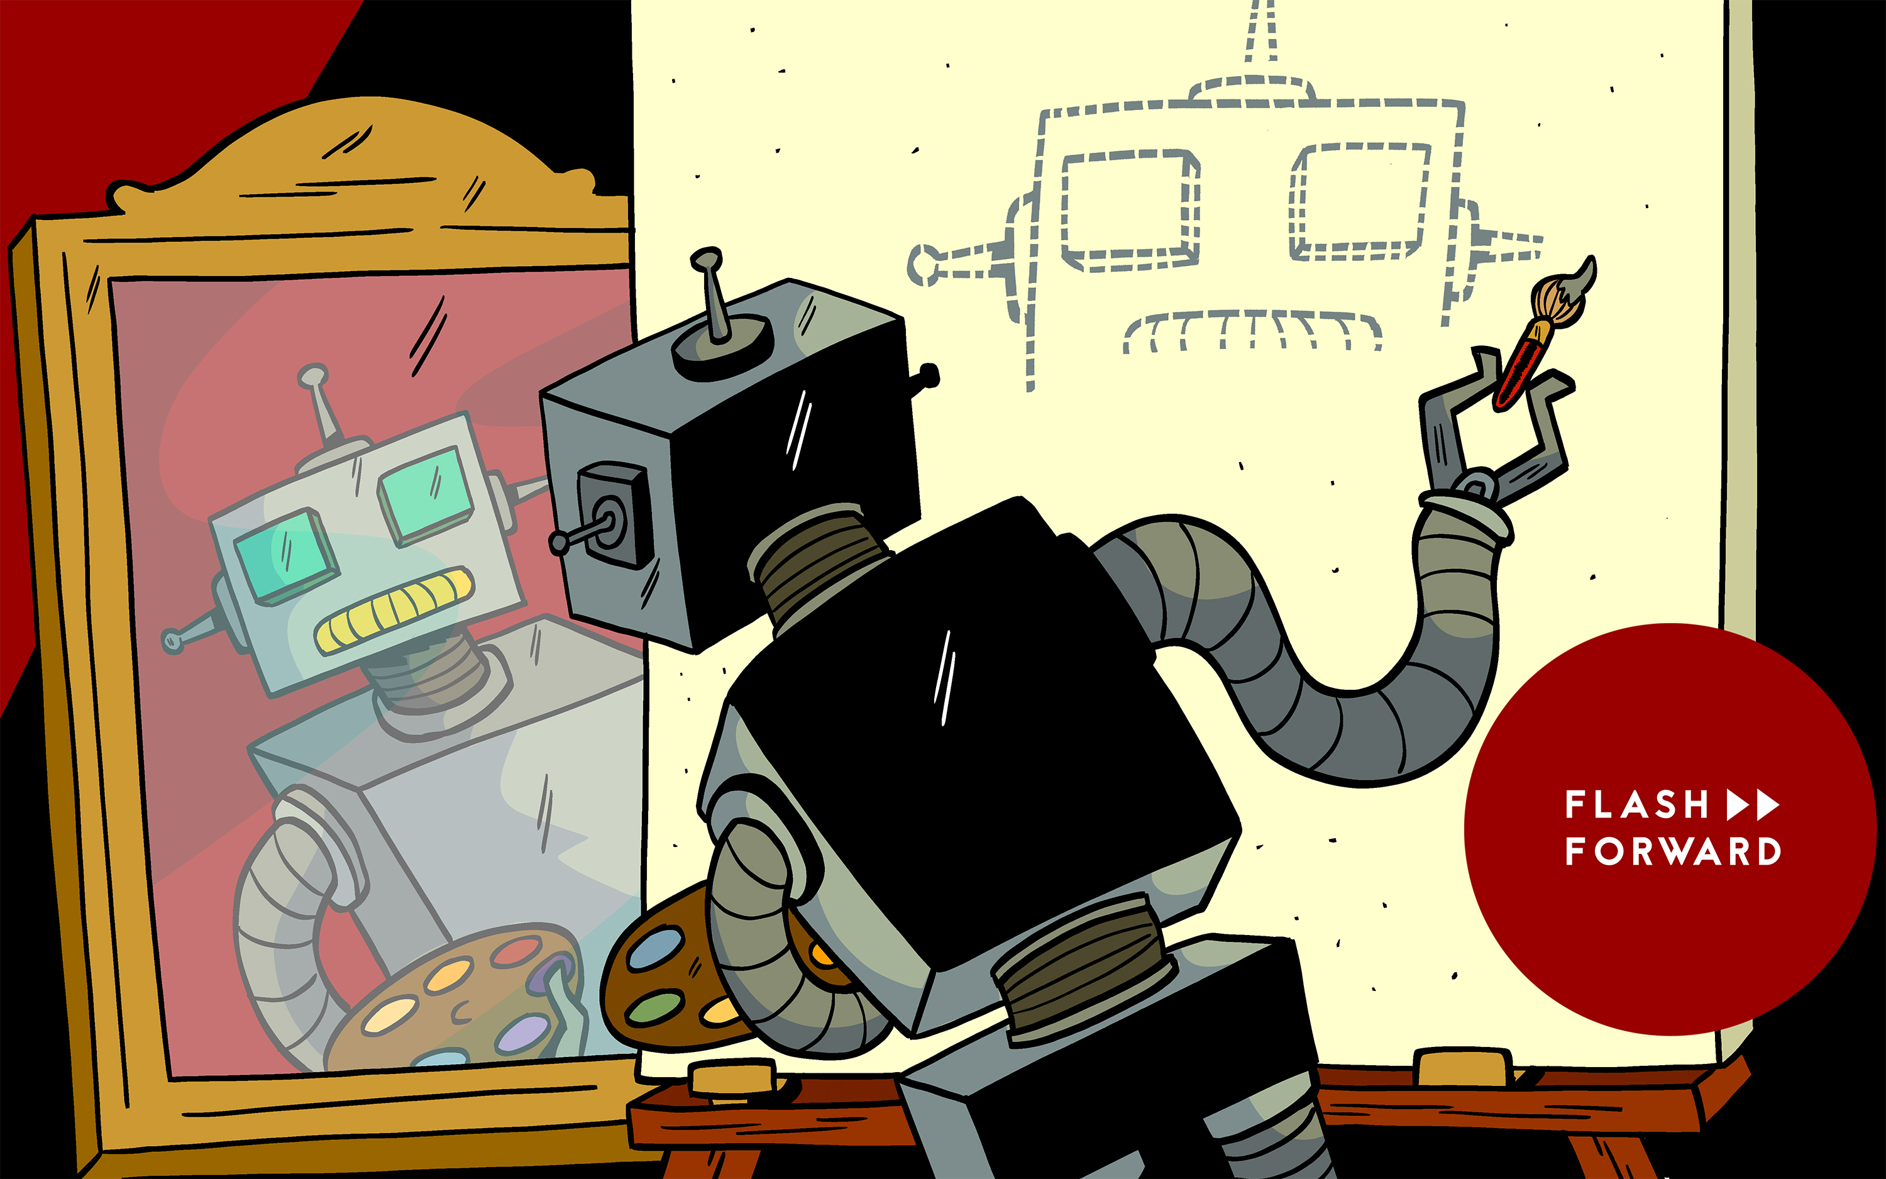

Why is CS341 Important For You?
Algorithms is the heart of CS
  It appears often in later courses
  It dominates technical interviews
    Master this material…
    make your interviews easy!
Designing algorithms is creative work
  Useful for some of the more interesting jobs out there
And, you want to graduate…

Slide 9
Models of computation

Slide 10
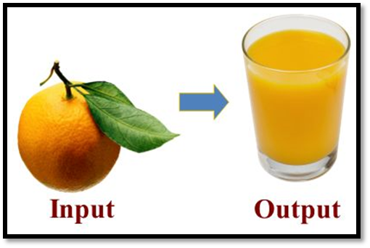
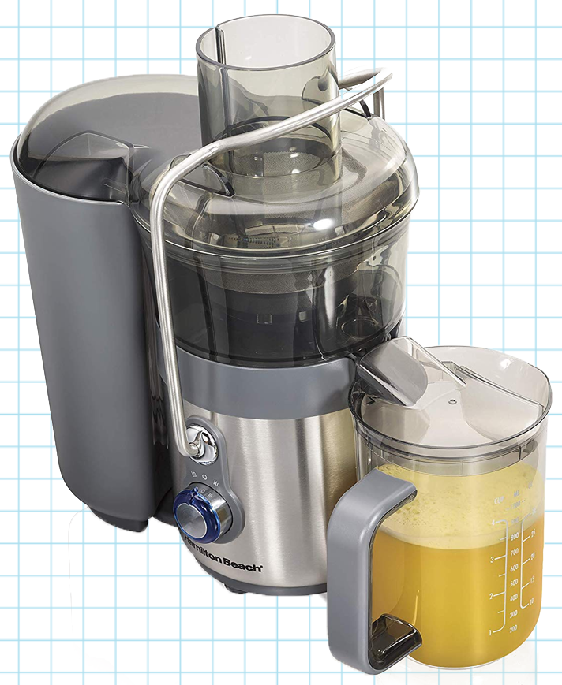
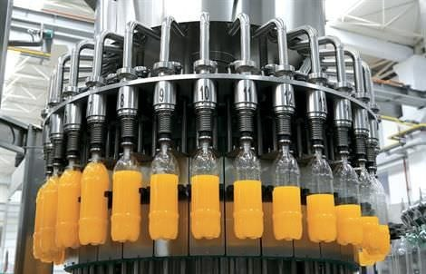

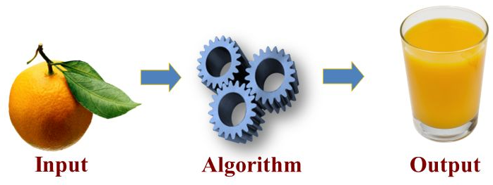

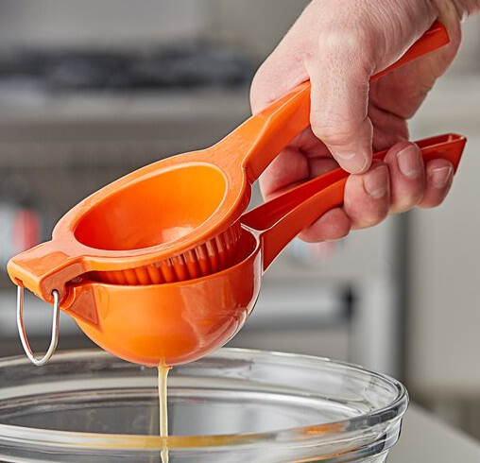
What is an Algorithm?
What is a Computational Problem?
Informally: A description of input,
and the desired output
Informally: A well-defined
procedure (sequence of steps)
to solve a computational problem
Correctness?

Slide 11

Analysis of algorithms
Every program uses resources
  CPU instructions / cycles → time
  Memory (RAM) → space
  Others: I/O, network bandwidth/messages, locks…
  (not covered in this course)
Analysis is the study of how many resources an algorithm uses
  Usually using big-O notation (to ignore constant factors)

Slide 12
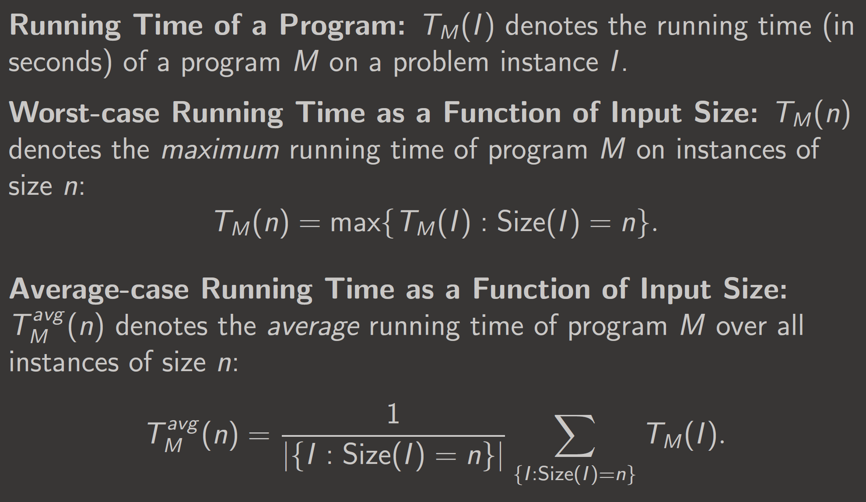
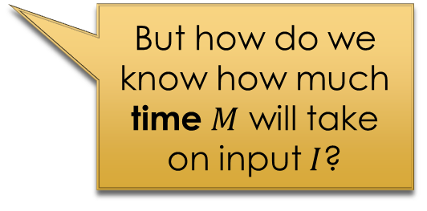
But how do we know how much time $M$ will take on input $I$?
Depends on the model of computation

Slide 13
Models of computation
Make analysis possible
Ones covered in this course
  Unit cost model
  Word RAM model
  Bit complexity model

Slide 14
Unit cost model
Each variable (or array entry) is a word
Words can contain unlimited bits
Basic operations on words take O(1) time
  Read/write a word in O(1)
  Add two words in O(1)
  Multiply two words in O(1)
Space complexity is the number of words used
(excluding the input)

Slide 15
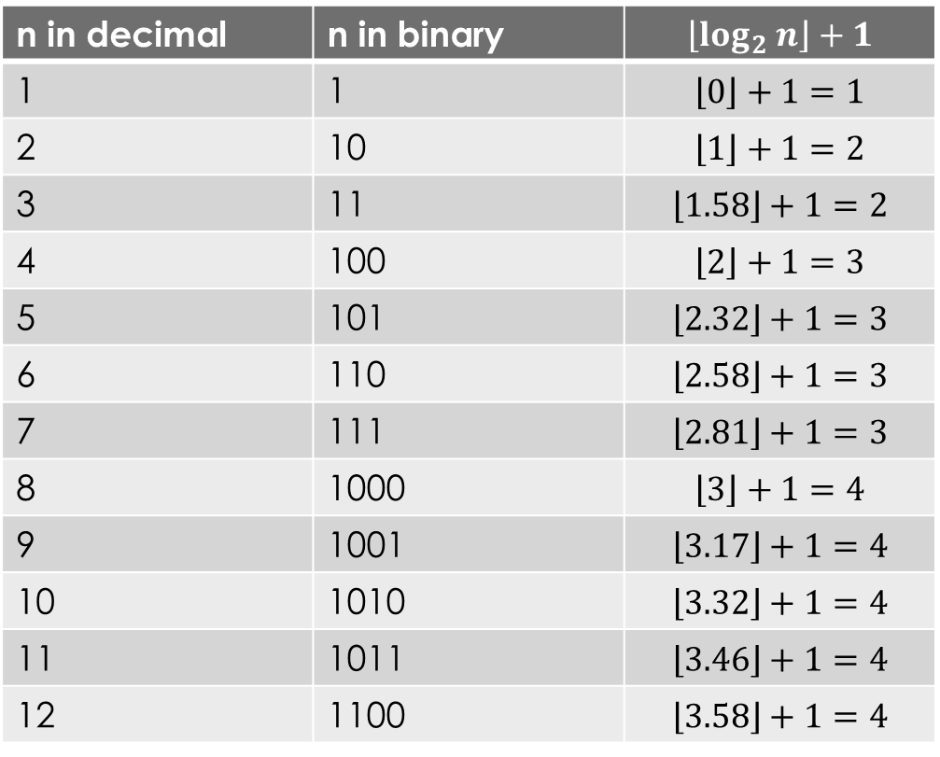
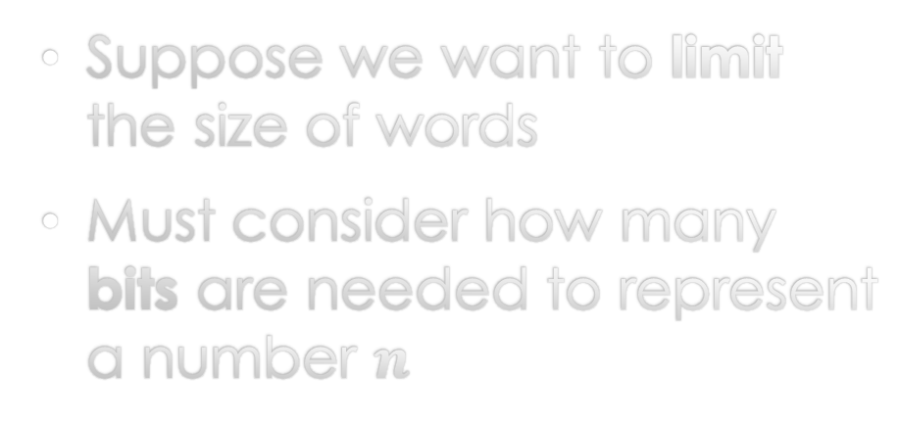

But sometimes we care about word size
Suppose we want to limit the size of words
Must consider how many bits are needed to represent a number $n$
n in decimal | n in binary | $$\left\lfloor log_{2} n\right\rfloor +1$$
1 | 1 | $$\left\lfloor 0\right\rfloor +1=1$$
2 | 10 | $$\left\lfloor 1\right\rfloor +1=2$$
3 | 11 | $$\left\lfloor 1.58\right\rfloor +1=2$$
4 | 100 | $$\left\lfloor 2\right\rfloor +1=3$$
5 | 101 | $$\left\lfloor 2.32\right\rfloor +1=3$$
6 | 110 | $$\left\lfloor 2.58\right\rfloor +1=3$$
7 | 111 | $$\left\lfloor 2.81\right\rfloor +1=3$$
8 | 1000 | $$\left\lfloor 3\right\rfloor +1=4$$
9 | 1001 | $$\left\lfloor 3.17\right\rfloor +1=4$$
10 | 1010 | $$\left\lfloor 3.32\right\rfloor +1=4$$
11 | 1011 | $$\left\lfloor 3.46\right\rfloor +1=4$$
12 | 1100 | $$\left\lfloor 3.58\right\rfloor +1=4$$
Need $\left\lfloor log_{2} n\right\rfloor +1$ bits to store $n$
i.e., $Θ(\log{n})$ bits

Slide 16
Word RAM model
Key difference: we care about the size of words
Words can contain O(lg n) bits,
where n is the number of words in the input
  Word size depends on input size!
  Intuition: if the input is an array of n words,
  a word is large enough to store an array index
Basic operations on words still take O(1) time
  (but the values they can contain are limited)

Slide 17
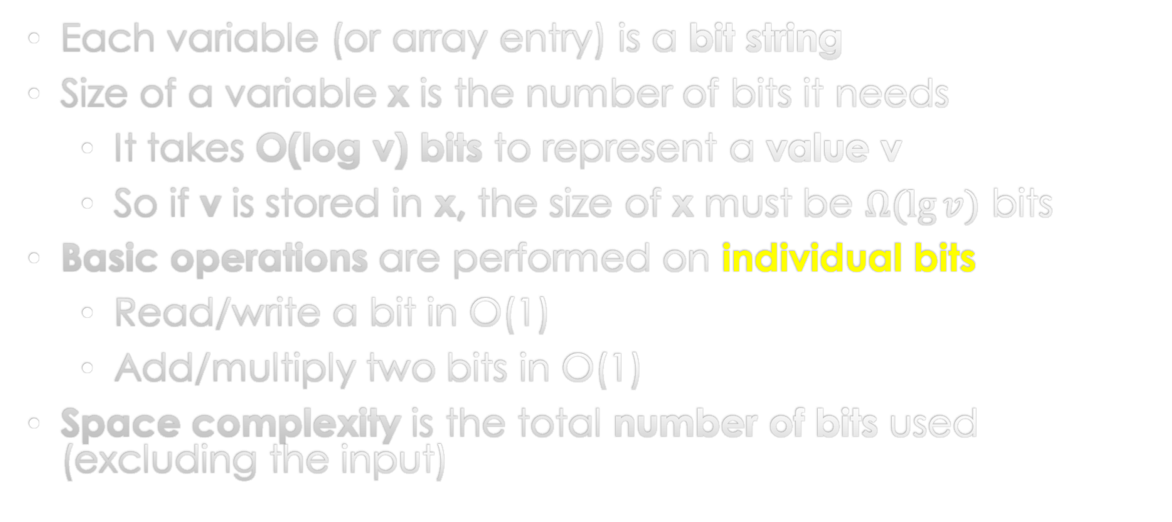
Bit complexity model
Each variable (or array entry) is a bit string
Size of a variable x is the number of bits it needs
  It takes O(log v) bits to represent a value v
  So if v is stored in x, the size of x must be $Ω(\lg{v})$ bits
Basic operations are performed on individual bits
  Read/write a bit in O(1)
  Add/multiply two bits in O(1)
Space complexity is the total number of bits used
(excluding the input)

Slide 18
Bentley’s Problem
A worked example to demonstrate algorithm design & analysis

Slide 19
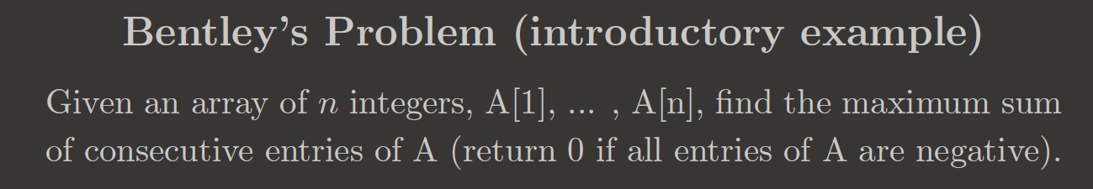
Example 1
1 | 7 | 4 | 0 | 2 | 1 | 3 | 1
Solution: 19
(take all of A[1..8])
Array index
1 | 2 | 3 | 4 | 5 | 6 | 7 | 8
Example 2
-1 | -7 | -4 | -1 | -2 | -1 | -3 | -1
Solution: 0
(take no elements of A)
Index
1 | 2 | 3 | 4 | 5 | 6 | 7 | 8
Example 3
1 | -7 | 4 | 0 | 2 | -1 | 3 | -1
Solution: 8
(take A[3..7])
Index
1 | 2 | 3 | 4 | 5 | 6 | 7 | 8

Slide 20
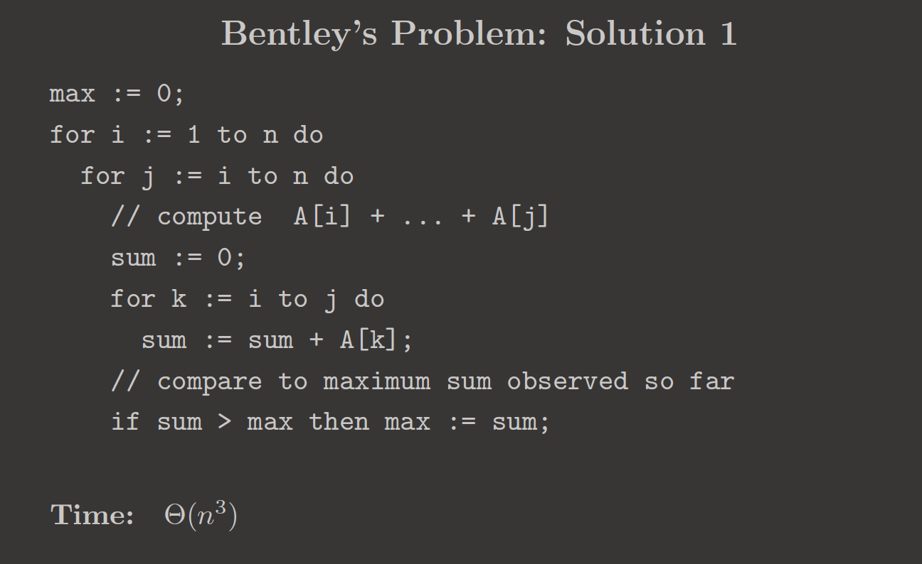




Design: brute force
Try all combinations of $i, j$
And for each combination,
sum over $k=i ..j$
$$k$$
$$i$$
$$j$$
1 | -7 | 4 | 0 | 2 | -1 | 3 | -1
in unit cost model?

Slide 21
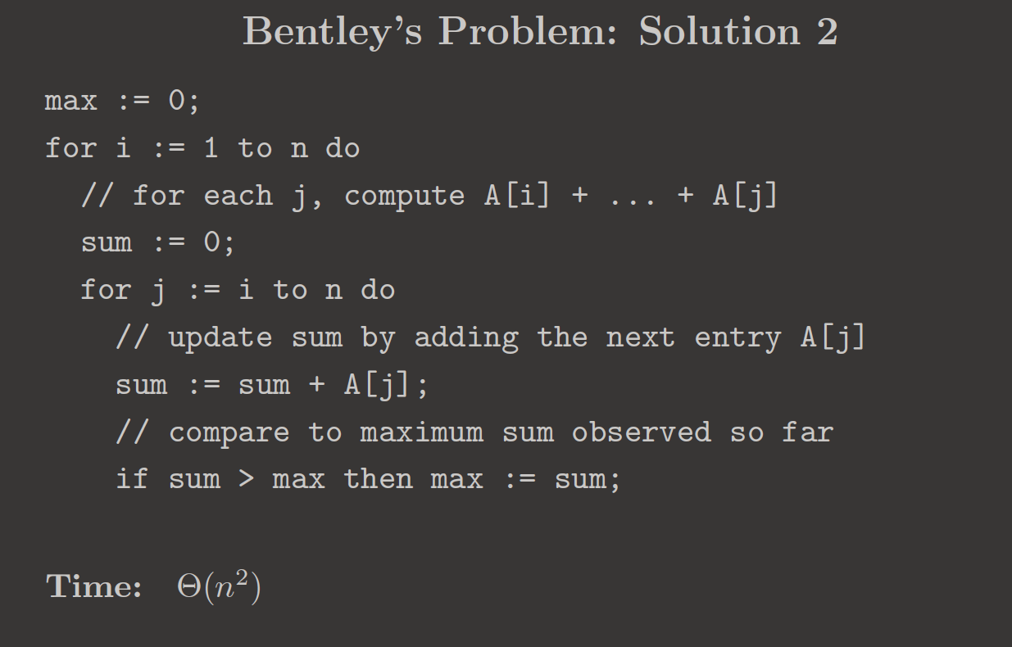





Design: slightly better brute force
Avoid repeatedly summing over $k=i ..j$
1 | -7 | 4 | 0 | 2 | -1 | 3 | -1
$$i=j$$
$$j$$
$$j$$
$$j$$
in unit cost model?

Slide 22
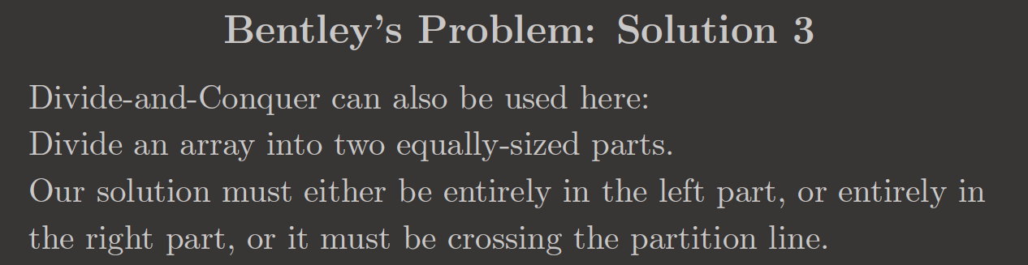
A
9 | -3 | 4 | -5 | -2 | -5 | 3 | -1
Case 1: optimal sol’n
is entirely in L
L
9 | -3 | 4 | -5
R
-2 | -5 | 3 | -1
Case 2: optimal sol’n
is entirely in R
A
1 | -7 | 4 | 0 | 2 | -1 | 3 | 0
Case 3: optimal sol’n
crosses the partition
L
1 | -7 | 4 | 0
R
2 | -1 | 3 | 0

Slide 23
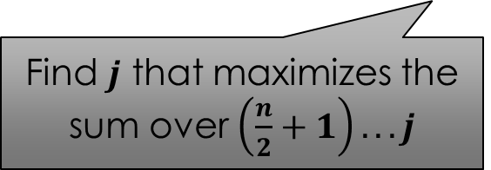

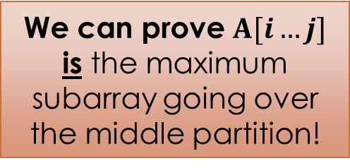


Find: maximum subarray going over the middle partition
A
1 | -7 | 4 | 0 | 2 | -1 | 3 | 0
Index
1 | 2 | … | n/2 | n/2+1 | … |  | n
$$i$$
$$j$$
Find $i$ that maximizes the sum over $i ...n/2$
We can prove $A[i…j]$ is the maximum subarray going over the middle partition!
Find $j$ that maximizes the sum over $\left(\frac{n}{2}+1\right)...j$

Slide 24











Why $A[i…j]$ is maximal
Suppose not for contradiction
Then some $A[i^{′}…j^{′}]$ that crosses the partition
has a larger sum
A
But both are impossible!
$$L$$
$$R$$
$$i$$
$$j$$
$$L^{′}$$
$$R^{′}$$
This sum is bigger
$$i′$$
$$j′$$
So either $∑L^{′}>∑L$
or $∑R^{′}>∑R$

Slide 25
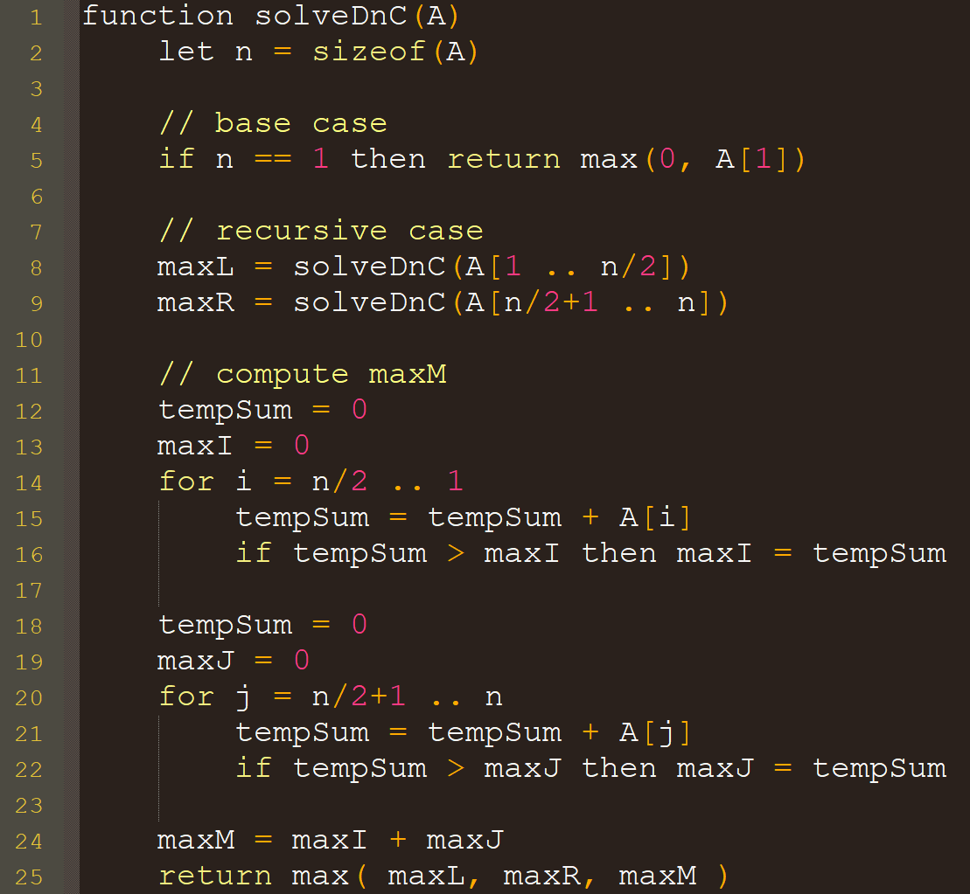

A
9 | -3 | 4 | -5 | -2 | -5 | 3 | -1
L
9 | -3 | 4 | -5
R
-2 | -5 | 3 | -1
maxL = 10
maxR = 3
maxM = maxI + maxJ = 5
A
9 | -3 | 4 | -5 | -2 | -5 | 3 | -1
Index
1 | 2 | … | n/2 | $$\frac{n}{2}+1$$ | … |  | n
maxI = 5
maxJ = 0
Return max( 10, 3, 5 ) = 10

Slide 26

A
1 | -7 | 4 | 0 | 2 | -1 | 3 | 0
L
1 | -7 | 4 | 0
R
2 | -1 | 3 | 0
maxL = 4
maxR = 4
maxM = maxI + maxJ = 8
A
1 | -7 | 4 | 0 | 2 | -1 | 3 | 0
Index
1 | 2 | … | n/2 | $$\frac{n}{2}+1$$ | … |  | n
maxI = 4
maxJ = 4
Return max( 4, 4, 8 ) = 8

Slide 27
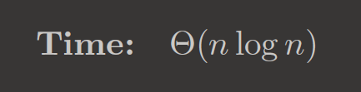
(in unit cost model)
How do we analyze this running time?
Need new mathematical techniques!
Recurrence relations, recursion tree methods, master theorem…
This result is really quite good…
but can we do asymptotically better?

Slide 28



Analysis in the bit complexity model
Can only add a pair of bits in O(1) time. How many bits are added here?
Revisiting Solution 1
$size\left(A\left[k\right]\right)∈O\left(log A\left[k\right]\right)$ bits.
$size\left(sum\right)∈$ ???
$$sum=A\left[i\right]+…+A[k−1]$$
so $size\left(sum\right)∈O\left(log\left(A\left[i\right]+…+A\left[k−1\right]\right)\right)$ bits
How to simplify?

Slide 29
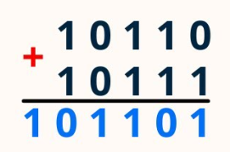

Complexity of Addition
Adding two numbers x+y takes O(max{size(x), size(y)}) bit operations
Fun fact: the size of x+y can be 1 bit larger than either x or y
(multiplication can double #bits)
This can be rewritten O(size(x)+size(y))
= O(lg x + lg y)
Let $M=max\{A\left[1\right],…,A\left[n\right]\}$
$$size\left(sum\right)∈O\left(log \left(A\left[i\right]+…+A\left[k−1\right]\right)\right)$$
$∈O\left(log\left(M+…+M\right)\right)$ bits
$∈O\left(log ((k−i)M\right)$ bits
Optional: simplify to $O\left(log kM\right)$

Slide 30

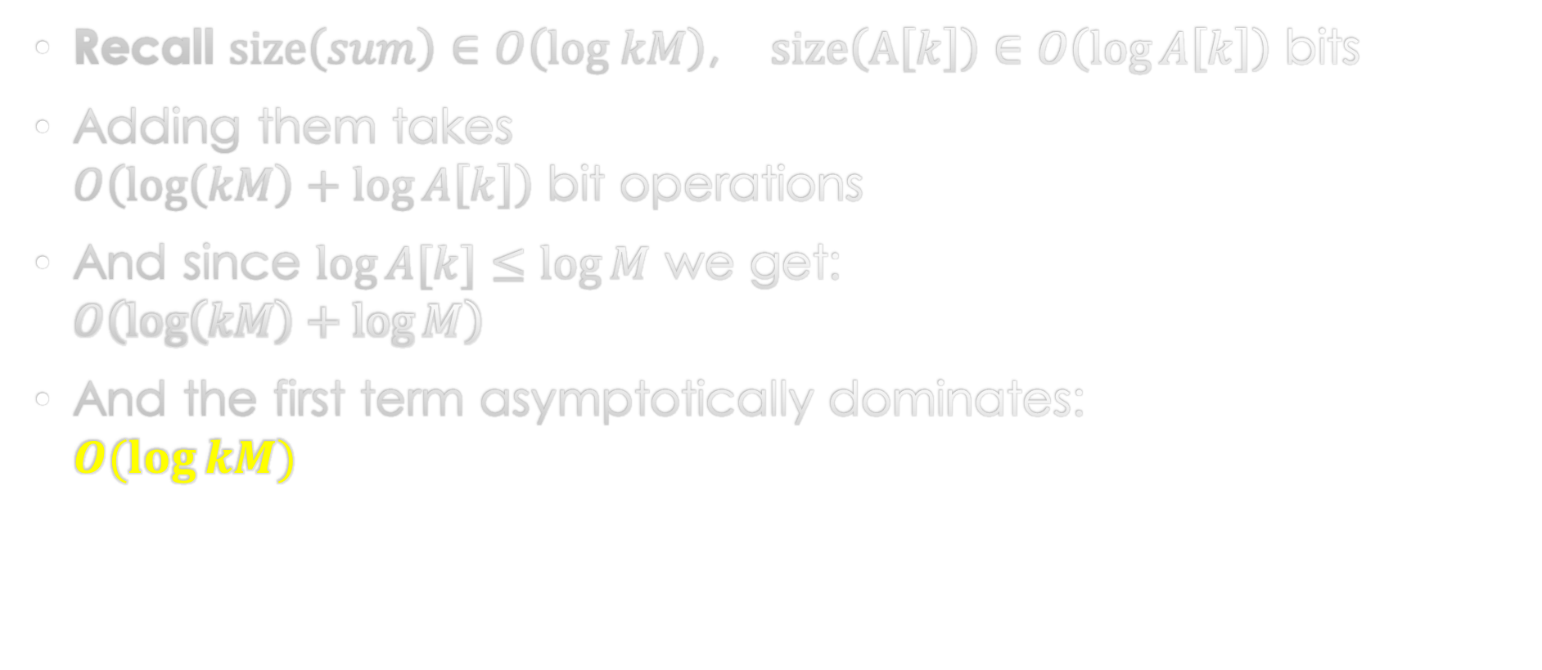
Adding sum and A[k]
Recall $size\left(sum\right)∈O\left(log kM\right)$, $size\left(A\left[k\right]\right)∈O\left(\log{A\left[k\right]}\right)$ bits
Adding them takes
$O\left(\log\left(kM\right)+\log{A\left[k\right]}\right)$ bit operations
And since $\log{A[k]}≤\log{M}$ we get:
$O\left(\log\left(kM\right)+\log{M}\right)$
And the first term asymptotically dominates:
$O(\log{kM)}$
Notes:
Analysis is a little sketchy because of negative numbers…

Slide 31
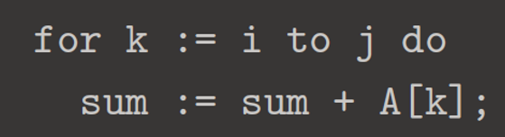
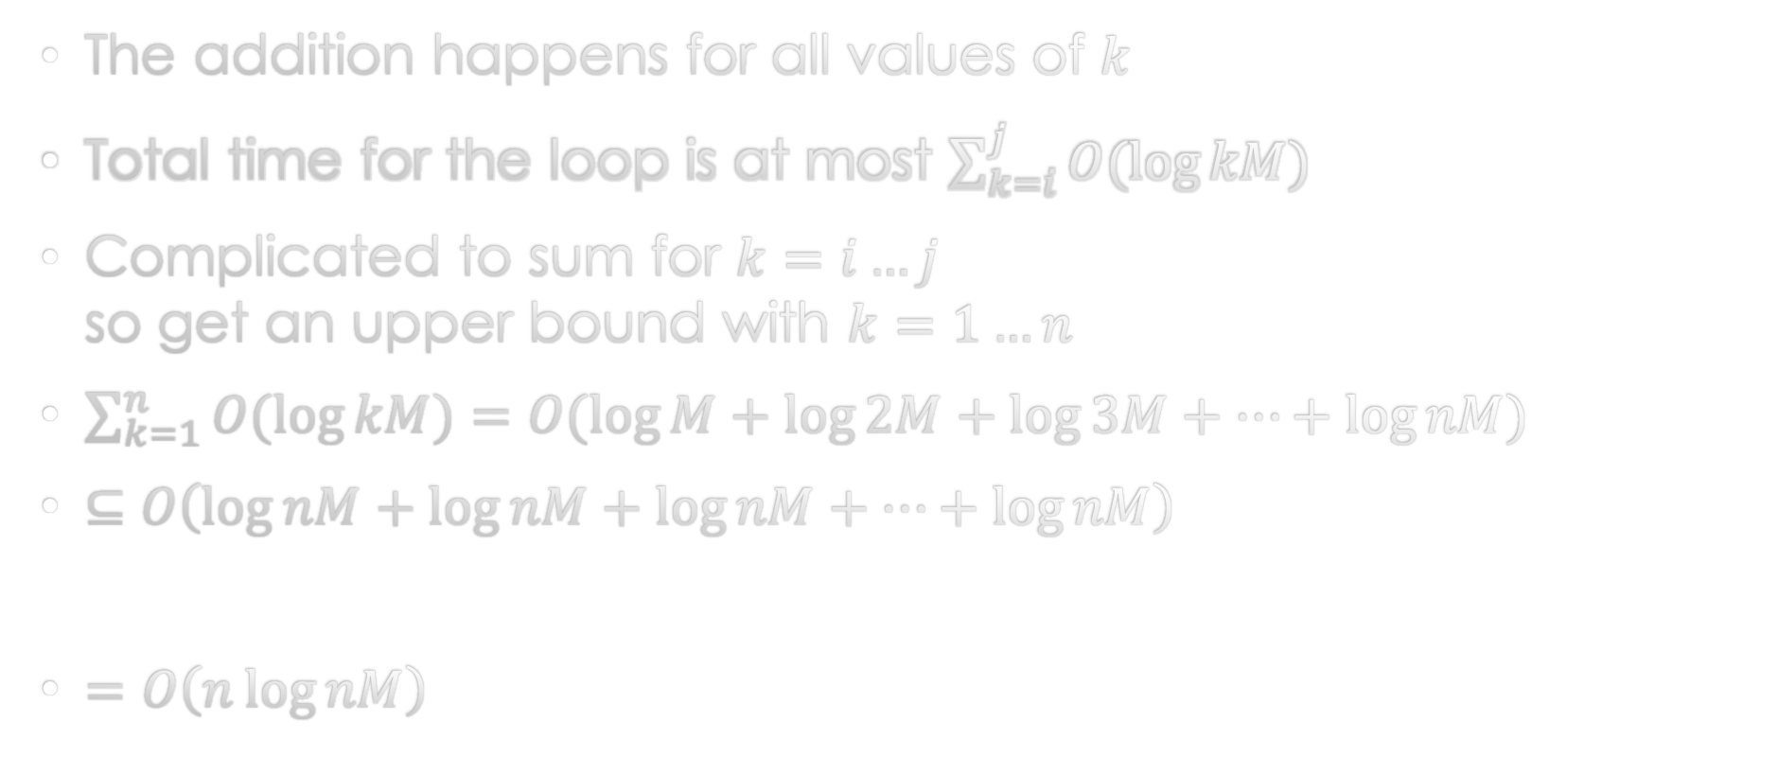
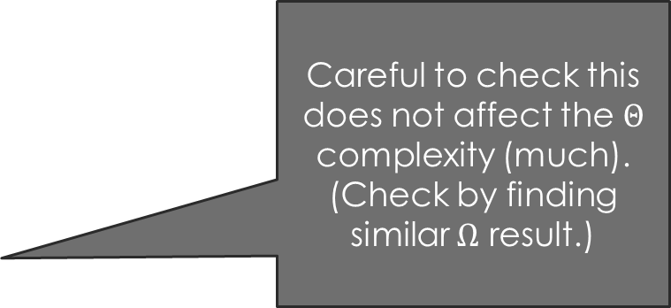
Zooming out to the k loop
The addition happens for all values of $k$
Total time for the loop is at most $\sum_{k=i}^{j}{O(\log{kM})}$
Complicated to sum for $k=i…j$
so get an upper bound with $k=1…n$
$\sum_{k=1}^{n}{O(\log{kM})}=O(\log{M}+\log{2M}+\log{3M}+…+\log{nM})$
$⊆$ $O\left(\log{nM}+\log{nM}+\log{nM}+…+\log{nM}\right)$
$=O\left(n\log{nM}\right)$
Careful to check this does not affect the $Θ$ complexity (much).
(Check by finding similar $Ω$ result.)
And similarly for this…
$$n$$

Slide 32


Accounting for the outer loops
$k$ loop is repeated
at most $n^{2}$ times
Each time taking at most
$O(n\log{nM})$ time
So total runtime is
$O(n^{3}\log{nM})$ time
Compare to unit cost model:
$O\left(n^{3}\right)$ time
Difference is due to
(1) growth in variable sizes and
(2) cost of bitwise addition
log-factor difference is common…

Slide 33
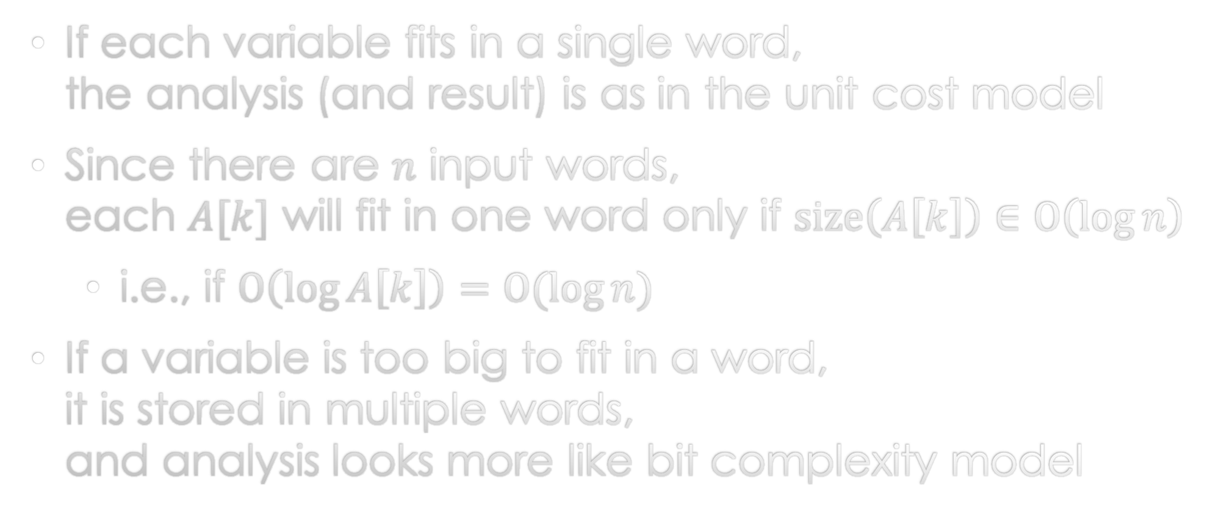
How about word RAM?
If each variable fits in a single word,
the analysis (and result) is as in the unit cost model
Since there are $n$ input words,
each $A[k]$ will fit in one word only if $size\left(A\left[k\right]\right)∈O\left(\log{n}\right)$
  i.e., if $O\left(\log{A\left[k\right]}\right)=O(\log{n})$
If a variable is too big to fit in a word,
it is stored in multiple words,
and analysis looks more like bit complexity model

Slide 34
Bentley’s solutions: runtime in practice
Consider solutions implemented in C
  Some values measured on a Threadripper 3970x
  Red values extrapolated from measurements
  0 represents time under 0.01s
n | Sol.4 O(n) | Sol.3 O(n lg n) | Sol.2 O(n²) | Sol.1 O(n³)
100 | 0 | 0 | 0 | 0
1,000 | 0 | 0 | 0 | 0.12
10,000 | 0 | 0 | 0.036 | 2 minutes
100,000 | 0 | 0.002 | 3.582 | 33 hours
1M | 0.001 | 0.017 | 6 minutes | 4 years
10M | 0.012 | 0.195 | 12 hours | 3700 years
100M | 0.112 | 2.168 | 50 days | 3.7M years
1 billion | 1.124 | 24.57 | 1.5 years | > age of life
10 billion | 19.15 | 5 minutes | 150 years | > age of universe

Slide 35
Homework: Big-O Review & exercises

Slide 36
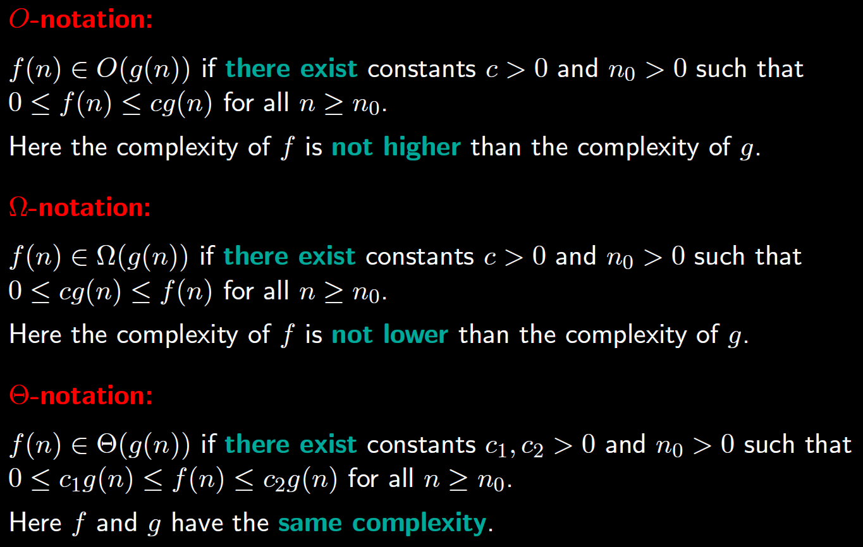
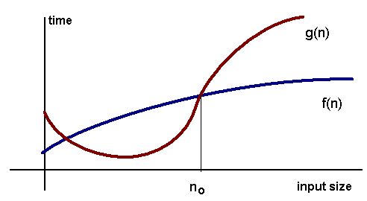
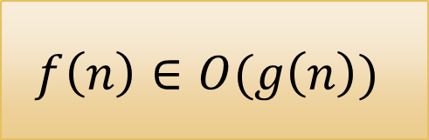
$$f\left(n\right)∈O(g\left(n\right))$$

Slide 37


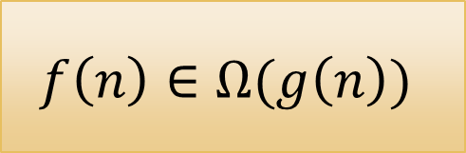
$$f\left(n\right)$$
$$f\left(n\right)∈Ω(g\left(n\right))$$
$$g\left(n\right)$$

Slide 38
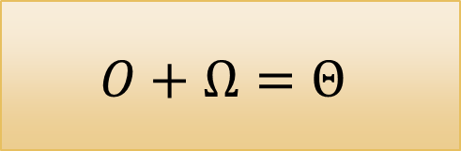


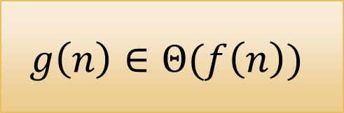

$$f\left(n\right)∈Θ(g\left(n\right))$$
$$f\left(n\right)∈O(g\left(n\right))$$
$$g\left(n\right)∈Θ(f\left(n\right))$$
$$f\left(n\right)∈Ω(g\left(n\right))$$
$$O+Ω=Θ$$

Slide 39
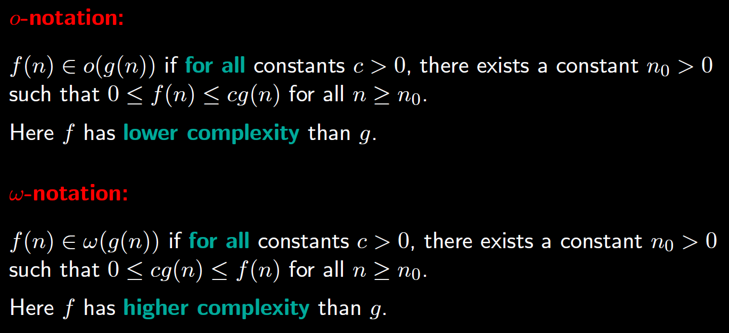
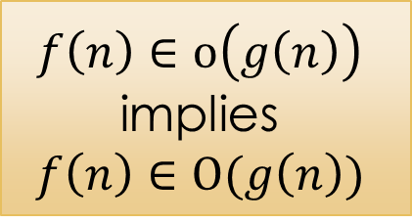
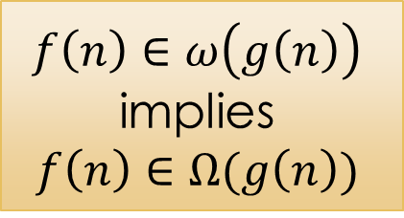
$f\left(n\right)∈o\left(g\left(n\right)\right)$
implies
$$f\left(n\right)∈O(g\left(n\right))$$
But NOT
vice versa
$f\left(n\right)∈ω\left(g\left(n\right)\right)$
implies
$$f\left(n\right)∈Ω(g\left(n\right))$$
But NOT
vice versa

Slide 40
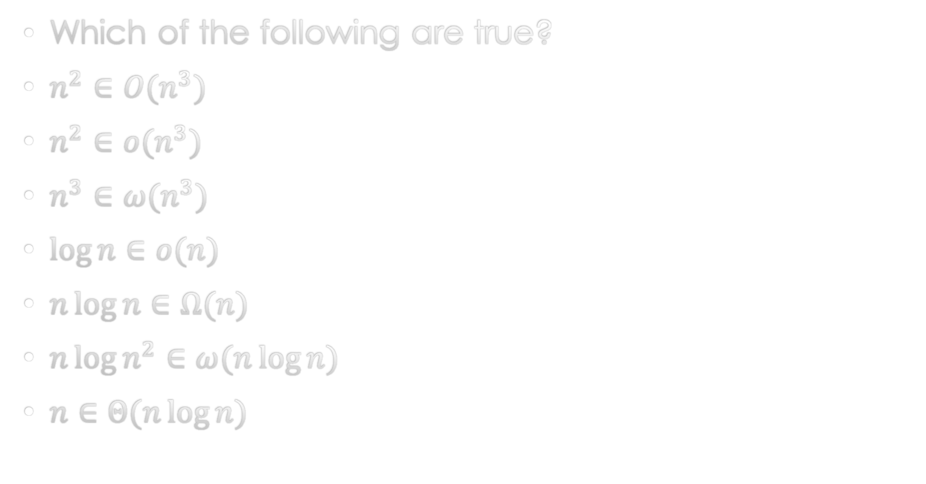
Exercise
Which of the following are true?
$n^{2}∈O(n^{3})$
$n^{2}∈o(n^{3})$
$n^{3}∈ω(n^{3})$
$\log{n}∈o(n)$
$n\log{n}∈Ω(n)$
$n\log{n^{2}}∈ω(n\log{n})$
$n∈Θ(n\log{n})$

Slide 41
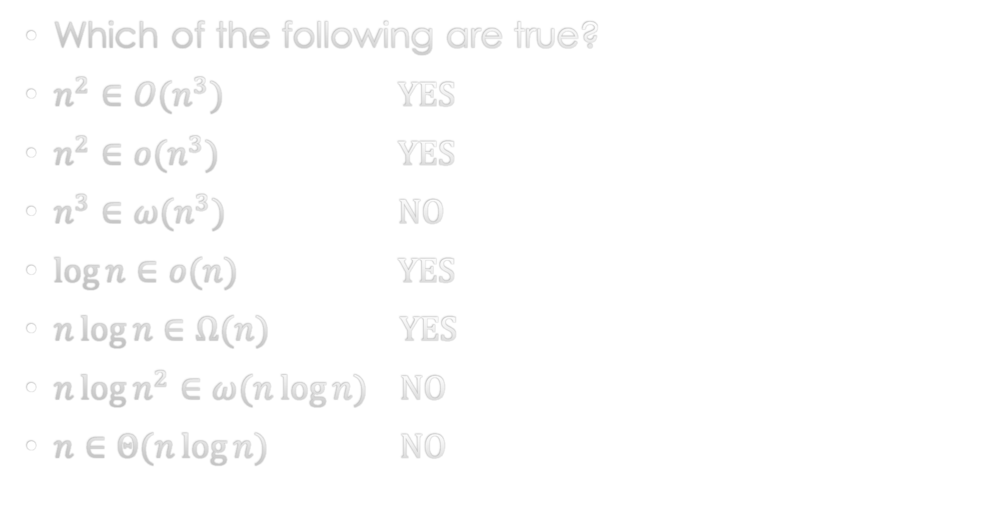
Exercise
Which of the following are true?
$n^{2}∈O(n^{3})$ YES
$n^{2}∈o(n^{3})$ YES
$n^{3}∈ω(n^{3})$ NO
$\log{n}∈o(n)$ YES
$n\log{n}∈Ω(n)$ YES
$n\log{n^{2}}∈ω(n\log{n})$ NO
$n∈Θ(n\log{n})$ NO

Slide 42
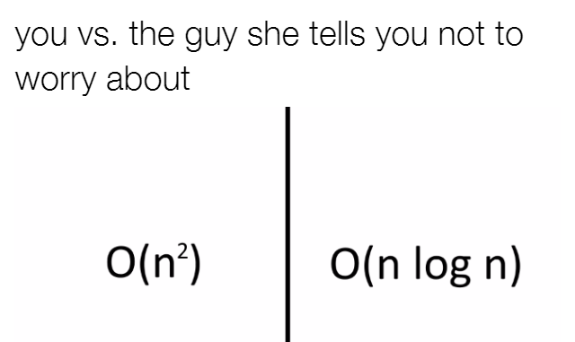
Comparing growth rates

Slide 43
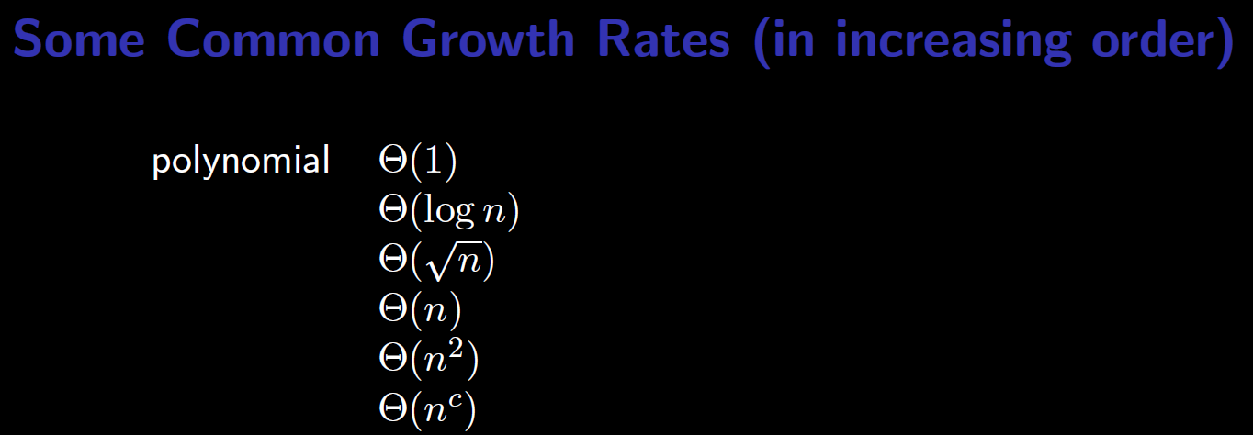
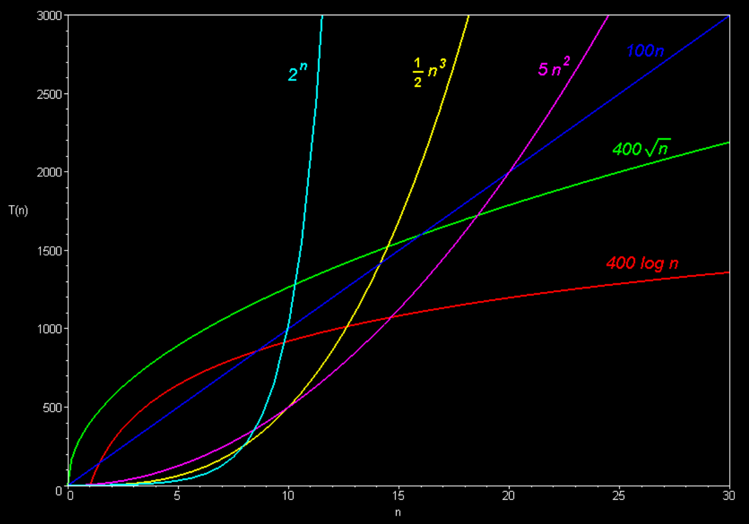
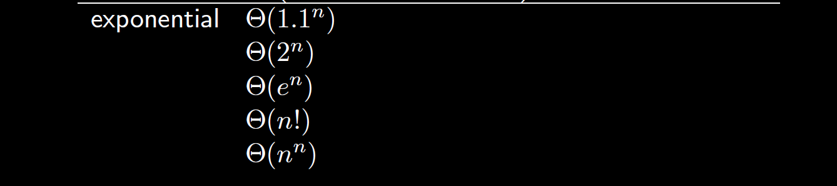

Slide 44
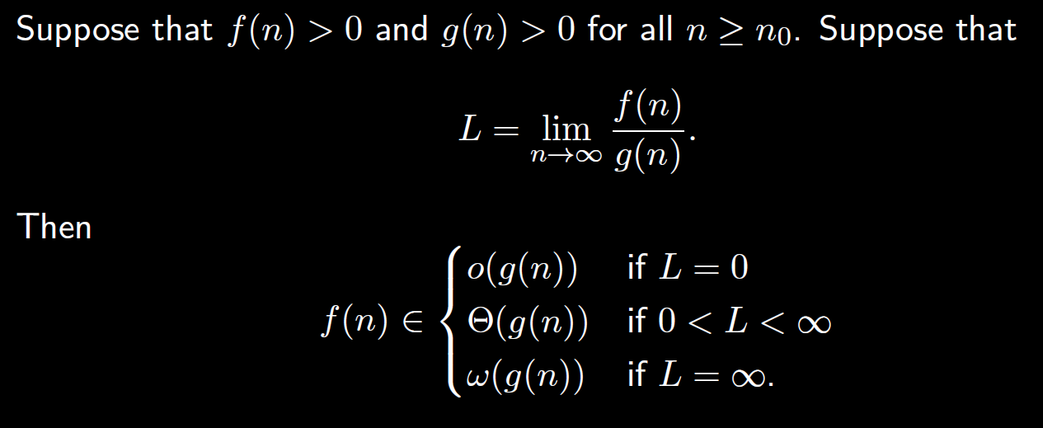
Limit technique for comparing growth rates

Slide 45
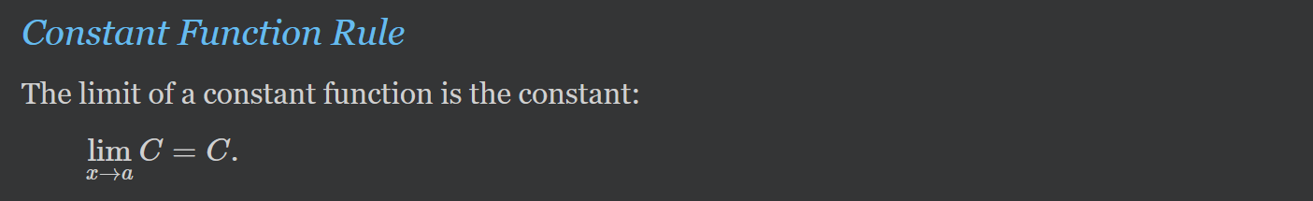
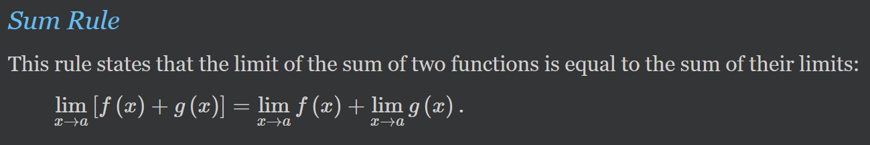
Limit rules 1/3
All of the identities shown hold only if the limits exist

Slide 46
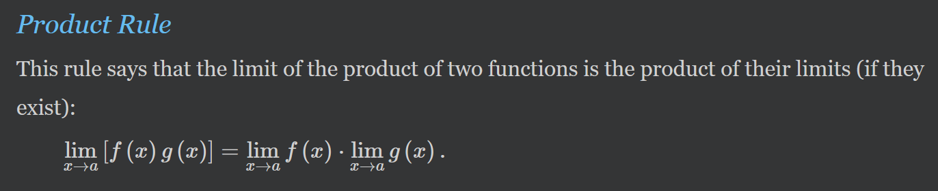
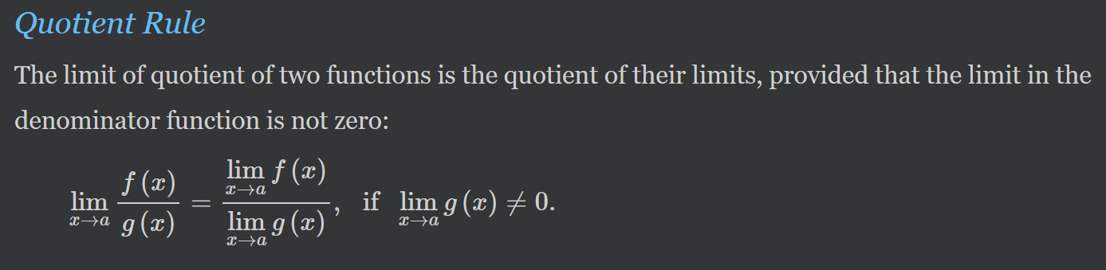
Limit rules 2/3

Slide 47


Limit rules 3/3
Limit of an Exponential Function
$$\lim_{x→a}{b^{f\left(x\right)}}=b^{\lim_{x→a}{f\left(x\right)}}$$
Limit of a Logarithm of a Function
$$\lim_{x→a}{\log_{b}{f(x)}}=\log_{b}{\lim_{x→a}{f\left(x\right)}}$$
(Where base $b>0$)

Slide 48

L’Hospital’s rule
Often we take the limit of $\frac{f\left(n\right)}{g\left(n\right)}$ where
both $f(n)$ and $g(n)$ tend to $∞$, or
both $f(n)$ and $g(n)$ tend to $0$
Such limits require L’Hospital’s rule
  This rule says the limit of $f(n)/g(n)$ in this case
  is the same as the limit of the derivative
  In other words, $\lim_{n→∞}{\frac{f\left(n\right)}{g\left(n\right)}}=\lim_{n→∞}\frac{\frac{d}{dn}f\left(n\right)}{\frac{d}{dn}g\left(n\right)}$

Slide 49

Using the limit method: Exercise 1
Compare growth rate of $n^{2}$ and $n^{2}−7n−30$
$\lim_{n→∞}{\frac{n^{2}−7n−30}{n^{2}}}$
$=\lim_{n→∞}{(1−\frac{7}{n}−\frac{30}{n^{2}}) }$
$=1$
So $n^{2}−7n−30∈Θ(n^{2})$

Slide 50



Using the limit method: Exercise 2
Compare growth rate of ${\left(\ln{n}\right)}^{2}$ and $n^{1/2}$
$\lim_{n→∞}{\frac{{\left(\ln{n}\right)}^{2}}{n^{1/2}}}=\lim_{n→∞}{\frac{{\frac{d}{dn}\left(\ln{n}\right)}^{2}}{\frac{d}{dn}n^{1/2}}}$

Slide 51


Using the limit method: Exercise 2
Compare growth rate of ${\left(\ln{n}\right)}^{2}$ and $n^{1/2}$
$\lim_{n→∞}{\frac{{\frac{d}{dn}\left(\ln{n}\right)}^{2}}{\frac{d}{dn}n^{1/2}}}$
$=\lim_{n→∞}{\frac{2\ln{n} (1/n)}{\frac{1}{2}n^{−1/2}}}$
$=\lim_{n→∞}{\frac{4\ln{n}}{n^{1/2}}}$
$=\lim_{n→∞}{\frac{\frac{d}{dn}4\ln{n}}{{\frac{d}{dn}n}^{1/2}}}$
$=\lim_{n→∞}{\frac{4/n}{{\frac{1}{2}n}^{−1/2}}}$
$=\lim_{n→∞}{\frac{8}{n^{1/2}}}$
$=0$
So, ${\left(\ln{n}\right)}^{2}∈o(n^{1/2})$
Notes:
a

Slide 52

Try these at home…

Slide 53

Summations and sequences

Slide 54

This is included for your notes

Slide 55


Slide 56



Sequences

Slide 57

Sequences continued
This is included for your notes

Slide 58

This is included for your notes

Slide 59
Logarithm Rules

Slide 60


Slide 61


Base of logarithm does not matter!
Big-O notation does not distinguish between log bases
Proof:
  Fix two constant logarithm bases b and c
  From log rules, we can change from $\log_{c}$ to $\log_{b}$
  by using formula: $\log_{b} x=\log_{c}{x}/\log_{c}{b}$
  But $\log_{c}{b}$ is a constant!
  So $\log_{c}{x}∈Θ(\log_{b}{x})$
  We typically omit the base, and just write $Θ\left(\log{x}\right)$
  for this reason

Slide 62
Loop analysis

Slide 63
Meta-algorithm for analyzing loops
Identify operations that require only constant time
The complexity of a loop is the sum of
the complexities of all iterations
Analyze independent loops separately and add the results
If loops are nested, it often helps to start at the innermost,
and proceed outward… but,
  sometimes you must express several nested loops together in a single equation (using nested summations),
  and actually evaluate the nested summations… (can be hard)

Slide 64

two big-O analysis strategies
Strategy 1
  Prove a O-bound and a matching $Ω$-bound
  separately to get a $Θ$-bound.
Strategy 2
  Use $Θ$-bounds throughout the analysis and thereby obtain a $Θ$-bound for the complexity of the algorithm
Often easier
(but not always)

Slide 65

Example 1

Slide 66

Strategy 1: big-O and big-$Ω$ bounds

Slide 67

Strategy 2: use $Θ$-bounds throughout the analysis

Slide 68












Example 2
$$O(1)$$
Consider this loop alone… number of loop iterations?
$$O(1)$$
$j$ starts at $i$ and is repeatedly divided by 2… this can happen only $Θ(\log{i})$ times
$$O(1)$$
So inner loop has runtime $Θ(\log{i})$
$$O(1)$$
And the entire inner loop is executed for $i=1,2,…,n$
$$O(1)$$
So, we have $T\left(n\right)∈Θ\left(\sum_{i=1}^{n}{\log{i}}\right)$
$$T\left(n\right)∈O\left(\sum_{i=1}^{n}{\log{i}}\right)⊆O\left(\sum_{i=1}^{n}{\log{n}}\right)⊆O(n\log{n})$$
$$T\left(n\right)∈Ω\left(\sum_{i=1}^{n}{\log{i}}\right)⊆Ω\left(\sum_{i=\frac{n}{2}}^{n}{\log{\frac{n}{2}}}\right)⊆Ω(n\log{n})$$

Slide 69

… Another exercise in Loop analysis?

Slide 70

Example 3 (Bentley’s problem, Solution 1)
Try to analyze this yourself!
One possible solution is given in these slides…

Slide 71






Strategy 1: big-O and big-$Ω$ bounds
$$O(1)$$
$$\sum_{i=1}^{n}{…}$$
$$T\left(n\right)∈Θ\left(1\right)+\sum_{i=1}^{n}{\sum_{j=i}^{n}{\left(Θ\left(1\right)+\sum_{k=i}^{j}{Θ\left(1\right)}+Θ(1)\right)}}$$
$$T\left(n\right)∈\sum_{i=1}^{n}{\sum_{j=i}^{n}{Θ\left(j−i\right)}}∈Θ\left(\sum_{i=1}^{n}{\sum_{j=i}^{n}{(j−i)}}\right)$$
$$T\left(n\right)∈O\left(\sum_{i=1}^{n}{\sum_{j=i}^{n}{(j−i)}}\right)≤O\left(\sum_{i=1}^{n}{\sum_{j=i}^{n}{n}}\right)$$
$$≤O\left(\sum_{i=1}^{n}{\sum_{j=1}^{n}{n}}\right)$$
$$T\left(n\right)∈O(n^{3})$$
$$O(1)$$
$$O(1)$$
$$O(1)$$
This is the maximum number of iterations that could be performed in this loop

Slide 72





Proving a big-$Ω$ bound…
$$T\left(n\right)∈Θ\left(\sum_{i=1}^{n}{\sum_{j=i}^{n}{(j−i)}}\right)$$
$$T\left(n\right)∈Ω\left(\sum_{i=1}^{n}{\sum_{j=i}^{n}{(j−i)}}\right)$$
$$≥Ω\left(\sum_{i=1}^{n/2}{\sum_{j=i}^{n}{(j−i)}}\right)$$
$$≥Ω\left(\sum_{i=1}^{n/2}{\sum_{j=3n/4}^{n}{(j−i)}}\right)$$
Recall:
Intuition: $j−i$ is $Ω(n)$ in some iterations. How many iterations? Lots?
To get a good $Ω$-bound, we ask questions like:
When do our loops have many iterations?
When is our dominant term large?
Many iterations: when our $j$ loop does $Ω(n)$ iterations! For example, when $i≤n/2$…
Large dominant term: when $j$ is much larger than $i$ (i.e., by a factor of n)

Slide 73


Proving a big-$Ω$ bound… continued
$$T\left(n\right)∈Ω\left(\sum_{i=1}^{n/2}{\sum_{j=3n/4}^{n}{(j−i)}}\right)$$
$$≥Ω\left(\sum_{i=1}^{n/2}{\sum_{j=3n/4}^{n}{\left(\frac{3n}{4}−\frac{n}{2}\right)}}\right)$$
$$=Ω\left(\sum_{i=1}^{n/2}{\sum_{j=3n/4}^{n}{n/4}}\right)$$
$$≥Ω\left(\frac{n}{2}⋅\frac{n}{4}⋅\frac{n}{4}\right)=Ω(n^{3})$$
Recall:
Smallest possible value of $j−i$
for these bounds on $i, j$
We will perform at least this much work in every iteration!
This term does not depend on the loop indexes, so just multiply by the total number of loop iterations…
Since we have $O\left(n^{3}\right)$ and $Ω\left(n^{3}\right)$, we have proved $Θ\left(n^{3}\right)$

Slide 75
Bonus
Study-song of the day
Tool - Descending
youtu.be/PcSoLwFisaw

