Slide 1
CS 341: Algorithms
Lecture 10: graph algorithms I
Readings: see website
Trevor Brown
https://student.cs.uwaterloo.ca/~cs341
trevor.brown@uwaterloo.ca
Notes:
14h so far… by may11 1145pm

Slide 2
Graphs

Slide 3
Graphs
7
8
Undirected
A graph is a pair $G = (V,E)$
$V$ contains vertices
$E$ contains edges
An edge $uv$ connects two distinct vertices $u, v$
Also denoted $(u,v)$
Graphs can be undirected
… or directed
meaning $\left(u,v\right)≠(v,u)$
3
5
6
1
2
4
7
8
Directed
3
5
6
1
2
4

Slide 4
Properties of graphs
3
4
Number of vertices $n=|V|$
Number of edges $m=\left|E\right|≤n(n−1)$
Note $m$ is in $O\left(n^{2}\right)$ but not necessarily $Ω\left(n^{2}\right)$
For undirected graphs, $m≤\frac{n\left(n−1\right)}{2}$
(Asymptotically, no different)
Other common terminology:
vertices = nodes edges = arcs
1
2
12 edges
$$n\left(n−1\right)=4⋅3$$
Head of the edge $(u,v)$
Tail of the edge
$$u$$
$$v$$
(or source & target)

Slide 5
A few more terms
The indegree of a node $u$, denoted $indeg(u)$, is the number of edges directed into $u$
The outdegree, denoted $outdeg(u)$, is the number of edges directed out from $u$
The neighbours of $u$ are the nodes $u$ points to
Also called the nodes adjacent to $u$, denoted $adj(u)$
or simply $deg⁡(u)$ in an undirected graph
6
$$indeg\left(u\right)=1$$
$$outdeg\left(u\right)=2$$
$$adj\left(u\right)=\{1,5\}$$
1
2
$$u$$
4
5
7

Slide 6
Data structures for graphs
Two main representations
Adjacency matrix
Adjacency list
Each has pros & cons

Slide 7
Adjacency matrix representation
$n×n$ matrix $A=(a_{uv})$
rows & columns indexed by $V$
$a_{uv}=1$ if $(u,v)$ is an edge
$a_{uv}=0$ if $\left(u,v\right)$ is a non-edge
Diagonal = 0 (no self edges)
Matrix $A$
tail
1 | 2 | 3 | 4 | 5 | 6 | 7
1
2
3
4
5
6
7
0 | 0 | 0 | 1 | 0 | 0 | 0
0 | 0 | 1 | 0 | 0 | 0 | 0
1 | 0 | 0 | 0 | 1 | 0 | 0
0 | 1 | 0 | 0 | 0 | 0 | 0
0 | 0 | 0 | 0 | 0 | 1 | 0
0 | 0 | 0 | 0 | 0 | 0 | 1
0 | 0 | 0 | 0 | 1 | 0 | 0
6
1
2
3
head
4
5
7

Slide 8
Adjacency matrix representation
For undirected graphs
$a_{uv}=1$ if $(u,v)$ or $(v,u)$ is an edge
Matrix is symmetric $A^{T}=A$
tail
1 | 2 | 3 | 4 | 5 | 6 | 7
1
2
3
4
5
6
7
0 | 0 | 1 | 1 | 0 | 0 | 0
0 | 0 | 1 | 1 | 0 | 0 | 0
1 | 1 | 0 | 0 | 1 | 0 | 0
1 | 1 | 0 | 0 | 0 | 0 | 0
0 | 0 | 1 | 0 | 0 | 1 | 1
0 | 0 | 0 | 0 | 1 | 0 | 1
0 | 0 | 0 | 0 | 1 | 1 | 0
6
1
2
3
head
4
5
7

Slide 9
Implementing an adjacency matrix
Suppose we are loading a graph from input
Assume nodes are labeled 0..n-1
2D array bool adj[n][n]
What if nodes are not labeled 0..n-1?
Rename them in a preprocessing step
What if you don’t have 2D arrays?
Transform 2D array index into 1D index
adj[u][v] → adj[u*n + v] (can simplify with macros in C)

Slide 10
Adjacency list representation
$n$ linked lists, one for each node
We write $adj[u]$ to denote the list for node $u$
$adj[u]$ contains the labels of nodes it has edges to
1
2
3
4
5
6
7
4
tail
3
6
1
2
3
1
5
head
2
4
6
5
7
7
5

Slide 11
Adjacency list representation
For undirected graphs
If $adj[u]$ contains $v$ then $adj[v]$ also contains $u$
tail
1
2
3
4
5
6
7
3
4
3
4
6
1
2
3
1
2
5
head
1
2
4
3
6
7
5
7
5
7
5
6

Slide 12
Implementing adjacency lists
Suppose we are loading a graph from input
Assume nodes are labeled 0..n-1
Array of lists adj[n]
(In C++, something like an array of vector<int> would work)

Slide 13
Pros and cons
Excellent when nodes have $O(1)$ neighbours
 | Adjacency matrix | Adjacency list
Time to test whether $(u,v)$ is an edge | $$O(1)$$ | $$O(outdeg\left(u\right))$$
Time to list neighbours of $u$ | $$O(n)$$ | $$O(outdeg\left(u\right))$$
Space complexity | $$O(n^{2})$$ | $$O(n+m)$$
Can be better for dense graphs
Better if $o(n^{2})$ edges
We call this a sparse graph

Slide 14
Breadth first search
A simple introduction to graph algorithms

Slide 15
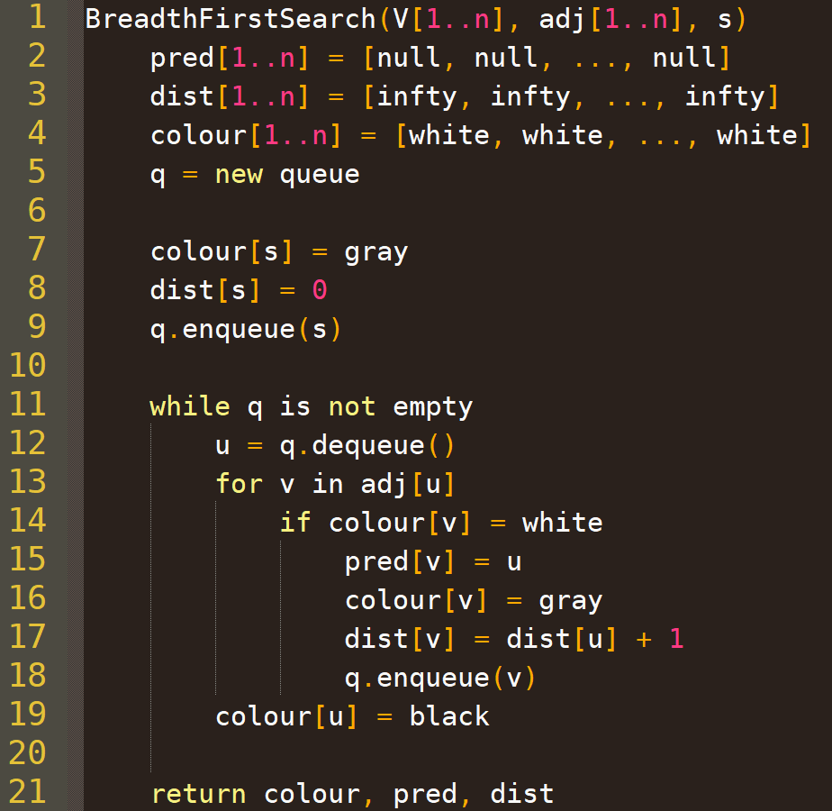
Assuming adjacency list representation
w
w
Discover (enqueue) starting node s
u
u
u
v
v
Undiscovered nodes are white
Discovered nodes are gray
Processing adjacent edges
Finished nodes are black
Adjacent nodes have been processed
Connected graph: each node is eventually black
Start processing node $u$’s edges
Discover (enqueue) neighbour $v$
Finish processing $u$

Slide 16
Example execution starting at node 1
7
7
7
8
8
8
2
2
3
3
3
5
5
5
6
6
6
1
2
3
1
1
1
2
2
2
4
4
4
0
1
2
q:
3
2
6
8
7
5
4
1
q tail
q head

Slide 17
Complexity
$$O(n)$$
(with adjacency lists)
$$O(n)$$
$$O(n)$$
$$O(1)$$
Naïve loop analysis:
$O(n)$ iterations * $O\left(\left|adj\left[u\right]\right|\right)$ iterations
$\left|adj\left[u\right]\right|≤n,$so $O(n^{2})$
$$O(1)$$
$$O(1)$$
$$O(1)$$
$O\left(n\right)$ iterations
$$O(1)$$
$O\left(\left|adj\left[u\right]\right|\right)$ iterations
$$O(1)$$
$$O(1)$$

Slide 18
Smarter loop analysis:
For each $u$, iterate over all neighbours
We touch each edge twice (doing $O(1)$ work each time)
Total contribution of the inner loop to the runtime: $O(m)$
7
x
x
7
8
8
x
x
x
x
3
x
x
x
x
3
5
5
6
6
x
x
x
x
x
x
1
1
2
2
4
4
x
x
x
x

Slide 19
Smarter loop analysis:
Initialization time: $O(n)$
Total contribution of the inner loop: $O(m)$
(Over all iterations of the outer loop)
Additional contribution of the outer loop: $O(n)$
Total runtime: $O(m+n)$
Analytic expression for loop complexity:
$$T_{LOOP}\left(n\right)∈O\left(\sum_{u=1}^{n}{\left(1+\deg\left(u\right)\right)}\right)$$
$$=O\left(n+\sum_{u=1}^{n}{\deg\left(u\right)}\right)=O\left(n+m\right)$$

Slide 20
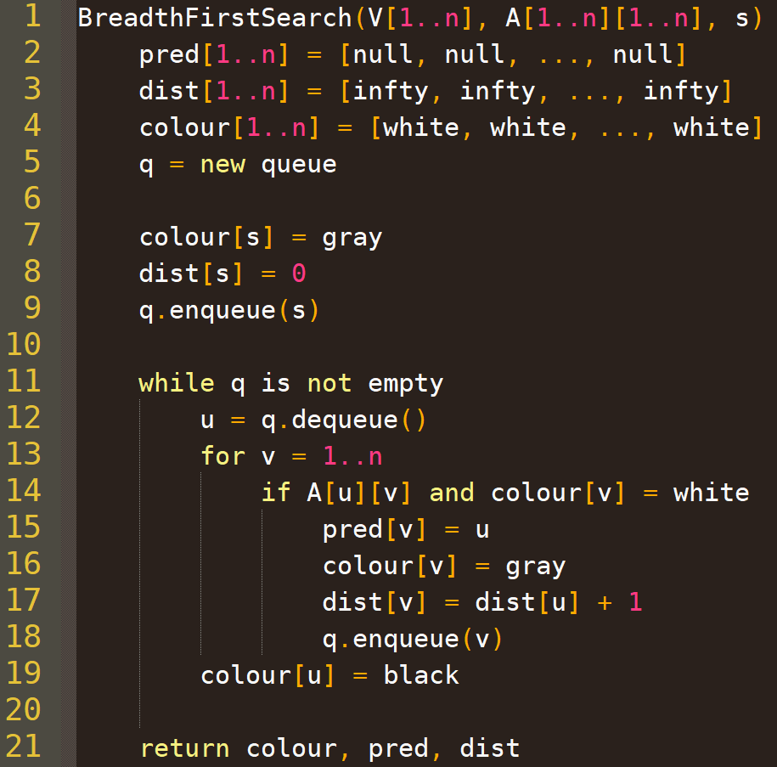
Differences with Adjacency matrices
Analysis is mostly similar
But, it takes $O(n)$ time to determine which nodes are adjacent to $u$!
This $O\left(n\right)$ cost is paid for each $u$, resulting in a total runtime $∈O\left(n^{2}\right)$

Slide 21
BFS Tree
Disconnected? Forest…
Connected graph: the $pred[]$ array induces a tree
The edges induced by $pred[]$ are called tree edges
Edges in the graph, but not in pred, are cross edges
BFS tree
Graph
1
7
Tree edge
7
7
8
8
8
2
3
3
3
3
5
5
5
6
6
6
4
5
7
8
1
1
1
2
2
2
4
4
4
Cross edge (not part of tree)
6
Careful: we will also see DFS trees, and cross edges will be defined differently

Slide 22
BFS: Proof of optimal distances

Slide 23
Distance in Graph $G$ and BFS tree $T$
Denote $d_{G}(v)$ as the (optimal) distance between $s$ and $v$ in $G$
Denote $d_{T}(v)$ as the distance between $s$ and $v$ in the BFS tree $T$
Recall: $dist\left[v\right]$ is a value set by BFS for each node $v$
$$G$$
$$T$$
7
$$s$$
7
7
8
8
8
$$d_{G}\left(v\right)=3$$
2
3
3
3
3
5
5
5
6
6
$$v$$
$$dist[3]=1$$
$$dist[5]=2$$
$$dist[v]=3$$
4
5
7
8
1
1
$$s$$
2
2
2
4
4
4
$$dist[s]=0$$
$$v$$
$$d_{T}\left(v\right)=3$$

Slide 24
Proof idea
$$s$$
7
7
7
8
8
8
2
3
$$d_{G}\left(v\right)=3$$
3
3
3
5
5
5
6
6
$$v$$
4
5
7
8
$$dist[3]=1$$
$$dist[5]=2$$
$$dist[v]=3$$
1
1
$$s$$
2
2
2
4
4
4
$$v$$
$$d_{T}\left(v\right)=3$$
$$dist[s]=0$$
Want to show: at the end of BFS, $dist\left[v\right]=d_{G}\left(v\right)$ for all $v$
Plan: prove this in two parts
Claim 1: $dist\left[v\right]=d_{T}\left(v\right)$
Claim 2: $d_{T}\left(v\right)=d_{G}\left(v\right)$

Slide 25
Sketch of Claim 1: $dist\left[v\right]=d_{T}\left(v\right), ∀v∈V$
Key observation: whenever we set
$$dist\left[v\right]←dist\left[u\right]+1,$$
$u$ is the parent of $v$ in the BFS tree.
Based on this observation, a simple inductive proof shows $$dist\left[v\right]=d_{T}\left(v\right)$$
(for example, by strong induction on the nodes in the order their $dist$ values are set---left as an exercise)

Slide 26
Sketch of claim 2: $d_{T}\left(v\right)=d_{G}\left(v\right)$
Part 1: $∀v, d_{G}\left(v\right)≤d_{T}\left(v\right)$
There is a unique path $v→…→s$ in $T$
And $T$ is a subgraph of $G$
So that same path also exists in $G$ (technically reversed)
To prove $=$ we show $≤$ and $≥$
$$s$$
7
7
7
8
8
8
So $d_{G}\left(v\right)$ is 3 or better
2
3
3
3
3
5
5
5
6
6
$$v$$
4
5
7
8
1
1
$$s$$
2
2
2
4
4
4
$$v$$
$$d_{T}\left(v\right)=3$$

Slide 27
Sketch of claim 2: $d_{T}\left(v\right)=d_{G}\left(v\right)$
What are the consequences of “skipping” a level in $T$?
$$s$$
Part 2: $∀v,d_{G}\left(v\right)≥d_{T}\left(v\right)$
Partition $T$ into levels $V_{i}=\{v:d_{T}\left(v\right)=i\}$ by distance from $s$
Claim: there is no “forward” edge in $G$ that “skips” a level from $V_{i}$ to $V_{j},j≥i+2$
Suppose there is, for contradiction…
$$V_{0}$$
$$V_{1}$$
2
3
$$V_{2}$$
4
5
7
8
$$V_{3}$$
$$v$$
7
7
7
8
8
8
But that edge in $G$ would cause 7 to have $s$ as its parent, so $dist[7]$ would be only 1 greater than its parent…
That “skip” edge in $T$ looks like this in $G$
3
3
3
5
5
5
6
6
$$v$$
Contradicts(!) the assumption that the edge points to a node with greater distance by at least 2
1
1
$$s$$
2
2
2
4
4
4

Slide 28
sketch of claim 2: $d_{T}\left(v\right)=d_{G}\left(v\right)$
$$s$$
Part 2: $∀v,d_{G}\left(v\right)≥d_{T}\left(v\right)$
We’ve just argued that there is no “forward” edge in $G$ that “skips” a level in $T$ from $V_{i}$ to $V_{j},j≥i+2$
Since no edge in $G$ “skips” a level in $T$, we know at least one edge in $G$ is needed to traverse each level between $s∈V_{0}$ and $v∈V_{d_{T}\left(v\right)}$
There are $d_{T\left(v\right)}$ such levels, so $d_{G}\left(v\right)≥d_{T}(v)$
$$V_{0}$$
$$V_{1}$$
2
3
$$V_{2}$$
4
5
7
8
$$V_{3}$$
$$v$$

Slide 29
BFS Tree properties
1
Level 0
7
7
7
8
8
8
2
3
Level 1
3
3
3
5
5
5
6
6
6
4
5
7
8
Level 2
1
1
1
2
2
2
4
4
4
6
Level 3
Fact: there are no “back” edges in undirected graphs that “skip” a level going up in the BFS tree.
Exercise: what about directed graphs?
Answer in bonus slides…

Slide 30
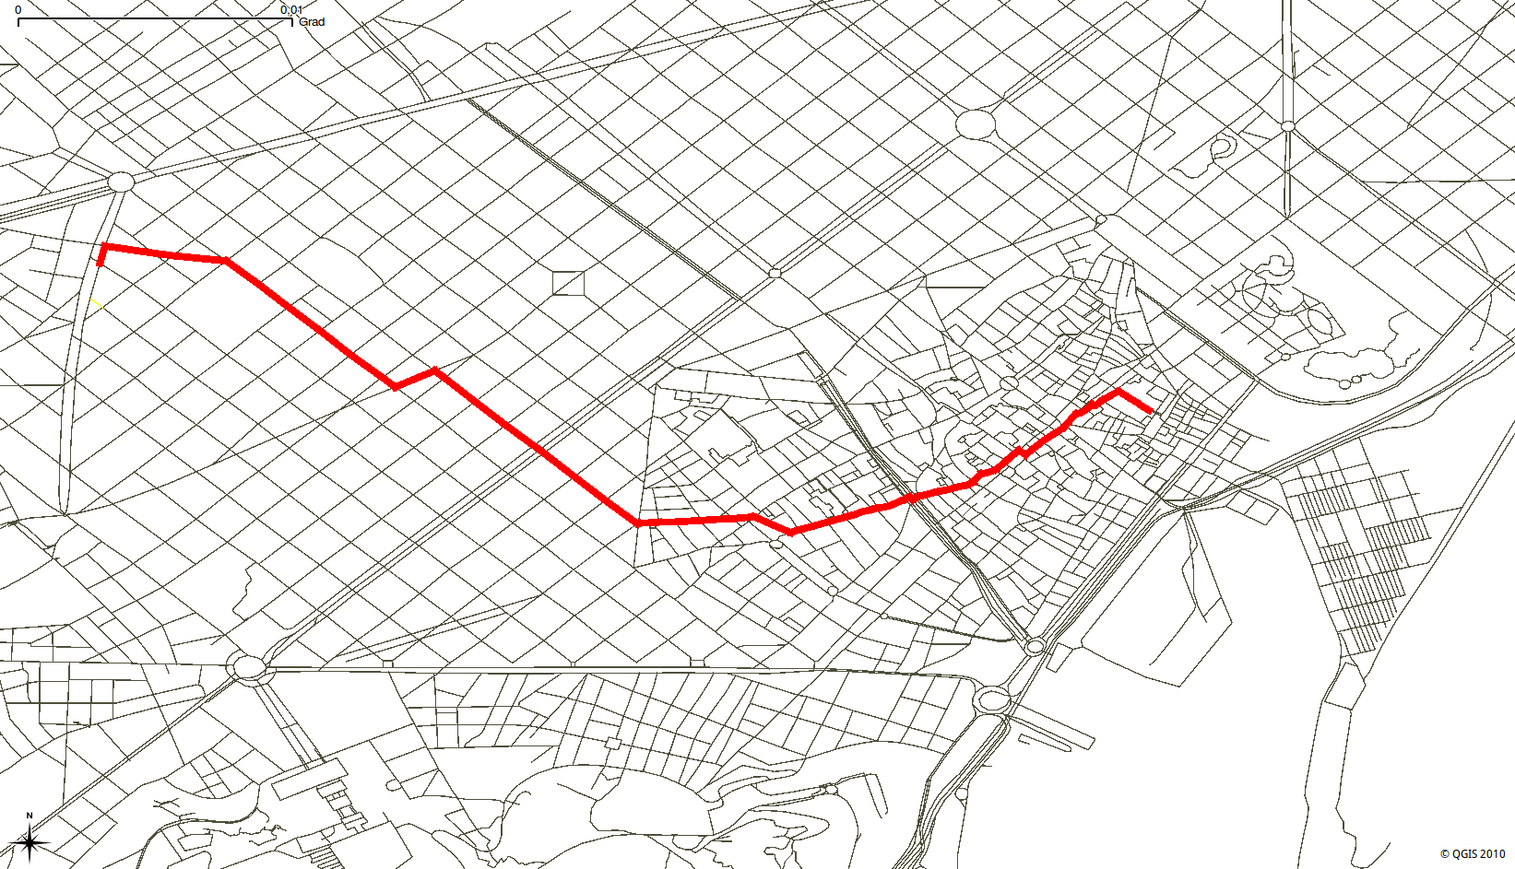
Application: Finding shortest paths

Slide 31
User interfaces:
rubber-banding a mouse cursor around obstacles

Slide 32
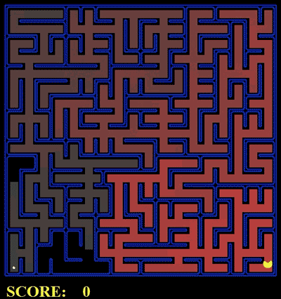
How to represent a grid graph?
Starting to get into the details
Game AI: path finding in a grid-graph
BFS from here

Slide 33
How to Output an actual path
Suppose you want to output a path from $s$ to $v$ with minimum distance (not just the distance to $v$)
Algorithm (what do you think?)
Similar to extracting an answer from a DP array!
Work backwards through the predecessors
Note: this will print the path in reverse! Solution?

Slide 34
Shortest path to here?
5
4
3
Destination $v$
5
BFS from here
4
3
2
Predecessor $pred\left[v\right]$
4
3
2
Each time you visit a predecessor, push it into a stack
Predecessor $pred\left[pred\left[v\right]\right]$
5
0
1
0
1
I.e., push $v=5$, then push $pred\left[v\right]=4$, then push $pred\left[pred\left[v\right]\right]=3$, then 2, …
At the end, pop all off the stack.
This gives 0, 1, 2, …, 5 = the path!

Slide 35
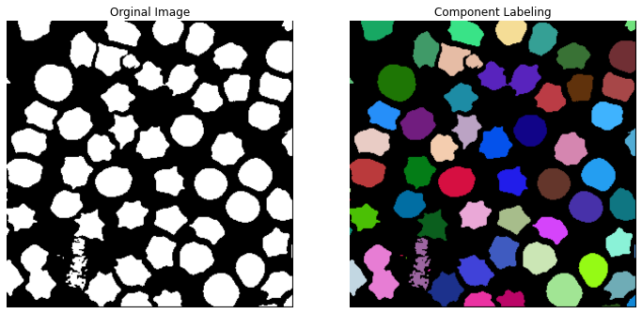
Application: undirected connected components

Slide 36
Connected components
Example: undirected graph with three components
Can you think of a way to use BFS to count how many connected components there are?

Slide 37
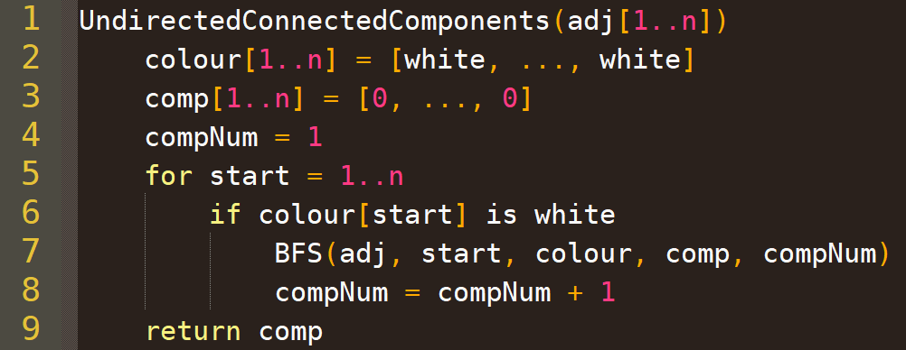
Connected components
4
6
4
5
6
5
10
10
3
3
7
7
1
1
9
Can be done in $O(n+m)$ time
2
9
2
Complexity?
8
BreadthFirstSearch(V, adj, 1)
8
BreadthFirstSearch(V, adj, 3)
BreadthFirstSearch(V, adj, 4)
Modified BFS that (1) reuses the same colour array for consecutive calls and (2) sets comp[u] = compNum for each node u it visits

Slide 38
Bonus slides

Slide 39
Answer to BFS tree property exercise…
Bfs tree
graph
Bfs tree
graph
Dotted = back edge

