Slide 1
CS 341: Algorithms
Lecture 12: graph algorithms III – DAG testing, topsort, SCC
Readings: see website
Trevor Brown
https://student.cs.uwaterloo.ca/~cs341
trevor.brown@uwaterloo.ca

Slide 2
DFS Application: Testing whether a graph is a DAG

Slide 3
Back edge: points to an ancestor in the DFS forest

Slide 4
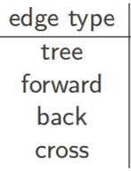
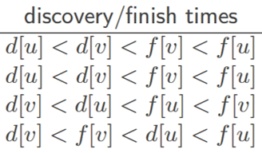
Case $\left(⇐\right)$: Suppose $∃$ directed cycle. Show $∃$ back edge.
Let $v_{1},v_{2},…,v_{k},v_{1}$ be a directed cycle
WLOG let $v_{1}$ be earliest discovered node in the cycle
$$v_{k}$$
$$v_{1}$$
$$d[v_{k}]$$
$$d[v_{1}]$$
$$f[v_{1}]$$
$$f[v_{k}]$$
$$d[v_{k}]$$
$$d[v_{1}]$$
$$f[v_{1}]$$
$$f[v_{k}]$$
$$d[v_{1}]$$
$$d[v_{k}]$$
$$f[v_{k}]$$
$$f[v_{1}]$$
$$d[v_{1}]$$
$$f[v_{1}]$$
$$d[v_{k}]$$
$$f[v_{k}]$$
Discovered before $v_{2},…, v_{k}$
$$v_{2}$$
$$v_{3}$$
$$v_{2}$$
$$v_{3}$$
$$v_{1}$$
Recall: every node $v_{i}$ that is white-reachable from $v_{1}$ when we discover $v_{1}$ (call $DFSVisit(v_{1})$) turns black before $v_{1}$ ($f\left[v_{i}\right]<f[v_{1}]$)
$$v_{1}$$
$$v_{4}$$
Consider edge $\{v_{k},v_{1}\}$
$$v_{4}$$
Recall: nodes become gray when discovered
Since $d\left[v_{1}\right]<d\left[v_{k}\right]$, $\{v_{k},v_{1}\}$ must be a back or cross edge. Why?
$$v_{k}$$
$$v_{k}$$
$$v_{5}$$
So $v_{k}$ must turn black before $v_{1}$, and we have $f\left[v_{k}\right]<f[v_{1}]$.
$$v_{5}$$
…
$$v_{6}$$
$$v_{6}$$
So when $v_{1}$ is discovered, $v_{2},…,v_{k}$ are all white
Thus, $\{v_{k},v_{1}\}$ must be a back edge. QED

Slide 5
Turning the lemma into an algorithm
Search for back edges
How to identify a back-edge?
Back edge
When we observe an edge from $u$ to $v$, check if $v$ is gray
$$u$$
$$v$$
$$v$$

Slide 6
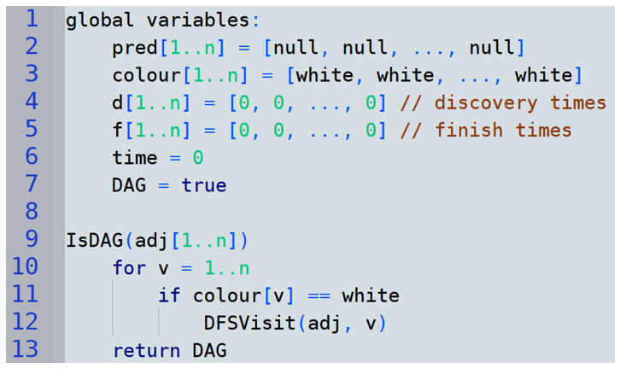
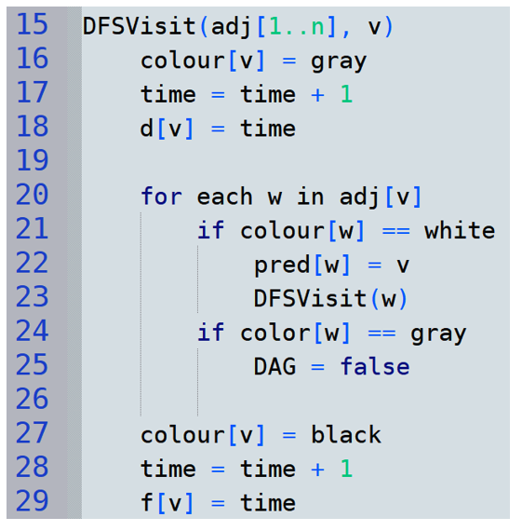
DFS: Testing whether a graph is a DAG

Slide 7
example
Back edge found!
So we set DAG = false
3
3
2
2
1
1
1
4
4
4
5
5
6
6
6

Slide 8
Topological sort
Finding node orderings that satisfy given constraints

Slide 9
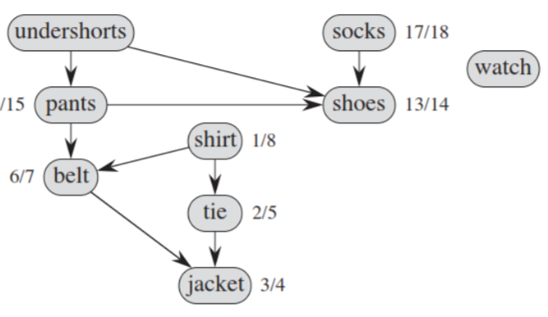
Dependency graph
Edge $\{u,v\}$ means $u$ must be completed before $v$
Example problem: getting dressed in the morning
Watch any time
Pants before belt
Socks before shoes
Could do various things first. Which ones are possible? What do they have in common?

Slide 10
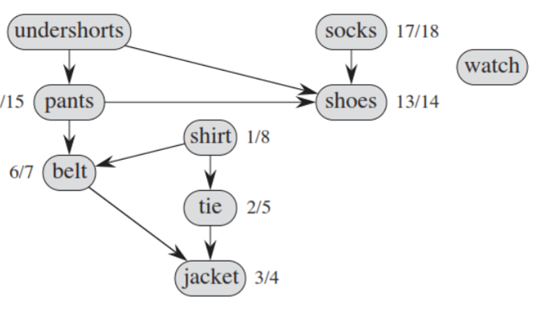
Try to order nodes linearly so there are only pointers from left to right!
Possible IFF graph is a DAG
Topological sort

Slide 11
Formal definition
3
2
1
Graph G
4
5
6
Topological sort of G
3
2
5
4
1
6
v₃ < v₂ < v₅ < v₄ < v₁ < v₆
Edges are directed only left-to-right in this ordering

Slide 12
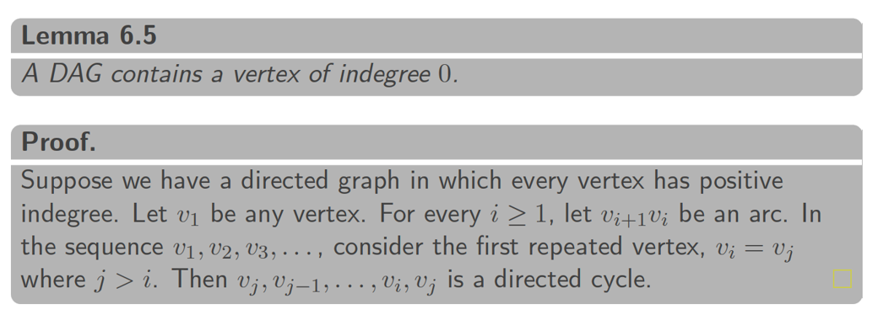
Useful fact
One of these must be repeated. So there is a cycle!
…
$$v_{n+1}$$
$$v_{n}$$
$$v_{3}$$
$$v_{2}$$
$$v_{1}$$

Slide 13
Topological sort via DFS
We can implement topological sort by using DFS!
The finishing times of nodes help us
Understanding this algo will be key for understanding strongly connected components

Slide 14
Recall from DAG-testing: there are no back edges in a DAG
$$u$$
$$v$$

Slide 15
Theorem: if D is a DAG, and we order vertices in reverse order of finishing time, (i.e., by largest to smallest finish time) then we get a topological ordering!
To see why, suppose D is a DAG and we order nodes in this way, so $f_{v_{1}}>f_{v_{2}}>…>f_{v_{n−1}}>f_{v_{n}}$
$$v_{1}$$
$$v_{2}$$
…
$$v$$
…
$$u$$
…
$$v_{n}$$
For contradiction, suppose a right-to-left edge $\{u,v\}$ exists
By our node ordering, $f_{v}>f_{u}$
But the lemma says for every edge $\{u,v\}$, we must have $f_{v}<f_{u}$
Contradiction! Right-to-left edge cannot exist. So is is a topological ordering.

Slide 16
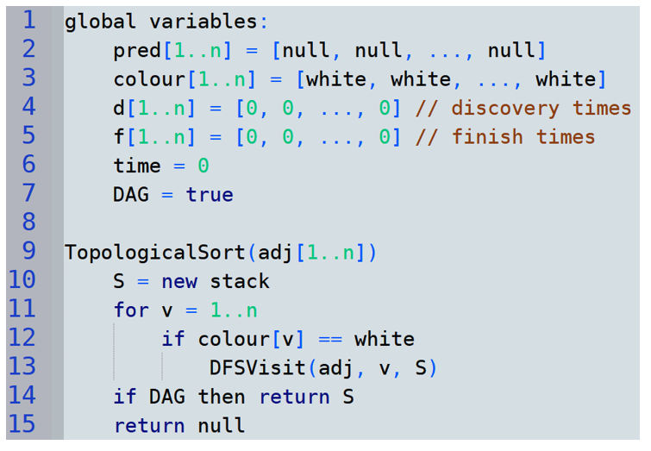
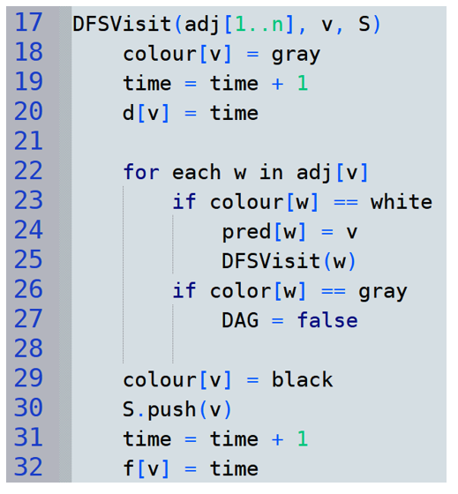
Topological ordering via DFS
$O(n+m)$ w/adj. lists
Save each node when it finishes
Push smallest finishing time first → pop largest first

Slide 17
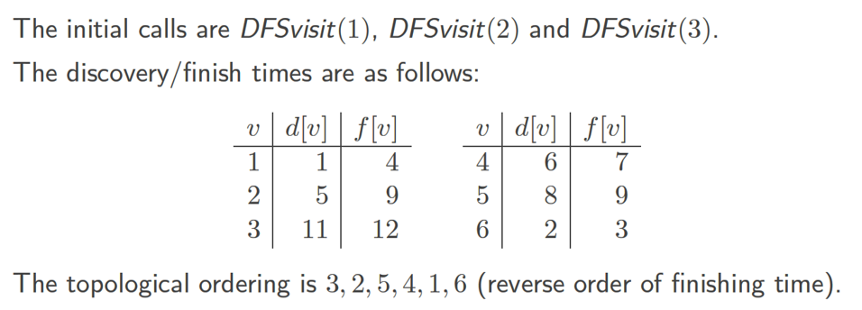
Home exercise: run on this graph
3
2
1
4
5
6
$$10$$

Slide 18
Strongly Connected Components

Slide 19
Strongly connected components
This graph could be divided into two graphs that are each strongly connected
f
a
b
c
h
d
e
i
g
These are called strongly connected components (SCCs)

Slide 20
Strongly connected components
Not maximal
It could also be divided into three graphs…
But we want our SCCs to be maximal (as large as possible)
f
a
b
c
h
d
e
i
g
Maximal SCC
Not maximal

Slide 21
Strongly connected components
So, the goal is to find these (maximal) SCCs:
f
a
b
c
h
d
e
i
g

Slide 22
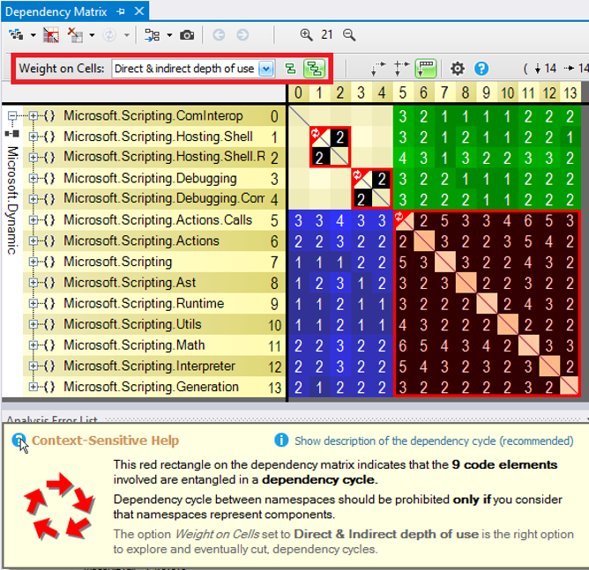
Applications of SCCs and component graphs
Finding all cyclic dependencies in code
Can find single cycle with an easier DFS-based algorithm
But it is nicer to find all cycles at once, so you don’t have to fix one to expose another

Slide 23
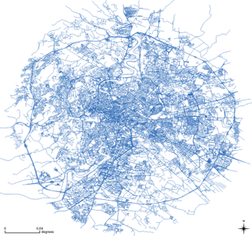
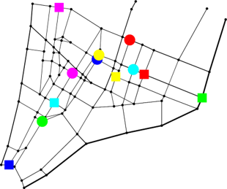
Applications of SCCs and component graphs
Data filtering before running other algorithms
maps; nodes = intersections, edges = roads
Don’t want to run path finding algorithm on the entire global graph!
Throw away everything except the (maximal) SCC containing source & target
Crop & find SCCs

Slide 24
Component graph
l
Consider this graph
These are its SCCs
j
k
f
a
b
c
h
d
e
i
g
And an edge between two nodes IFF there is an edge between the corresponding SCCs
It has one node for each SCC
Can there be a cycle in the component graph?
The following is its component graph
l,j,k
No! If there are paths both ways between components, they are actually the same SCC
a,b,c,d
f,e,g
h,i
Component graph is a DAG!

Slide 25
Brainstorming an algorithm
What if we run DFS, then reverse all edges, then run DFS (like checking whether an entire graph is strongly connected?)
This will definitely visit every node in $a$’s SCC
And in fact it might visit other SCCs as well…
l,23
l,20
l
$$DFSVisit(a)$$
$$DFSVisit(h)$$
$$DFSVisit(j)$$
j,24
j,19
f
j
f,9
f,6
k,22
c,11
k,21
c,4
k
c
h,18
h,15
b
h
b,3
a
b,12
a,1
a,14
i,17
i,16
d
i
d,13
d,2
e
e,5
e,10
g,8
g
g,7
Showing discovery times
Showing finish times

Slide 26
What if we run DFS, then reverse all edges, then run DFS?
l,23
l
$$DFSVisit(a)$$
$$DFSVisit(h)$$
$$DFSVisit(j)$$
l
j,24
j
f
j
f,9
f
k,22
c,11
k
c
k
c
h,18
h
b
h
b
a
b,12
a
a,14
i,17
i
d
i
d,13
d
e
e
e,10
g,8
g
g
We fail to identify SCC { h, i }
$$DFSVisit(a)$$
$$DFSVisit(e)$$
$$DFSVisit(h)$$
reverse edges
Problem: from $h$, we can reach other SCCs
l
l
l
j
j
f
j
f
f
k
c
k
c
k
c
h
h
b
h
b
a
b
a
a
What if we perform DFSVisit calls in a different order in the reverse graph?
i
i
d
i
d
d
e
e
e
g
g
g
Other reachable SCCs should be visited first
Then, each DFSVisit will visit exactly one SCC
(So we don’t visit them again)

Slide 27
Consider component graph $C_{G}$ of $G$ (which we want to compute)
If we call DFSVisit in $G$ from largest to smallest finish times, we can reach other SCCs.
DFSVisit(j)
l,23
l
l
f
f,9
f
c,11
c
c
h,18
h
b
h
b
a
b,12
a
a,14
j,24
j
j
k,22
k
k
graph $G$
i,17
i
d
i
d,13
d
e
e
DFSVisit(a)
e,10
g,8
g
g
Recall lemma: edge uv in DAG implies f(u)>f(v)
However, when we reverse the edges to get graph $H$ other SCCs can no longer be reached…
l
f
l
f
l
f
c
c
b
c
b
a
b
a
a
h
h
h
j
j
reversed graph $H$
j
k
k
d
k
d
d
e
e
e
i
i
g
i
g
g

Slide 28
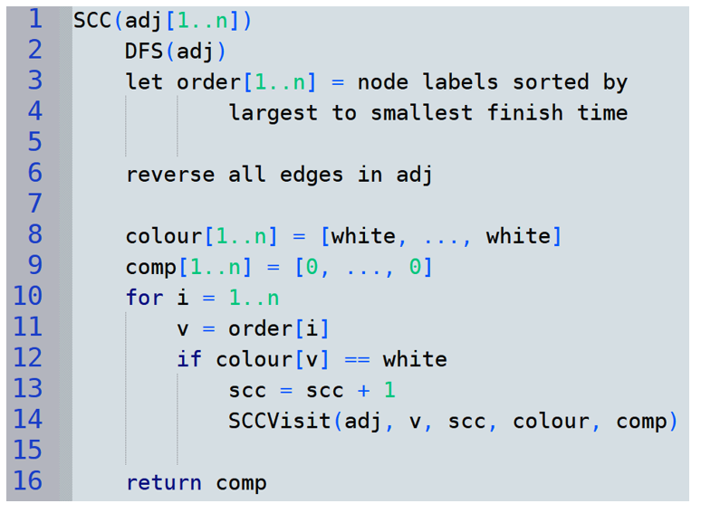
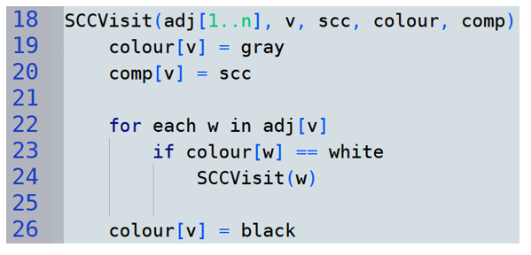
SCC Algorithm
This is called Sharir’s algorithm (sometimes Kosaraju’s algorithm).
This paper first introduced it.

Slide 29
Running Sharir’s Algorithm
Phase 1: DFS to get finish times
l,23
l
l
f
f,9
f
c,11
c
b
c
b
a
b,12
a
a,14
j,24
j
j
k,22
k
h,18
k
h
h
d
d,13
d
e
e
e,10
g,8
g
g
i,17
i
i
Phase 2: DFSVisit reverse graph by reverse finish times
$scc$ is shown
$$DFSVisit(j)$$
$$DFSVisit(h)$$
$$DFSVisit(a)$$
$$DFSVisit(e)$$
$$scc=1$$
$$scc=2$$
$$scc=3$$
$$scc=4$$
l,1
l
l
j,1
j
f
j
f
f,3
k,1
c,4
k
c
k
c
h
h,2
b
h
b
a
b,4
a
a,4
i,2
i
d,4
i
d
d
e,3
e
e
g,3
g
g

Slide 30
Time complexity?
Can be returned as part of the DFS with no added runtime
$$O(n+m)$$
Finish times increase as we set them, so just use a stack…
$$O(n+m)$$
$$O(n)$$
$$O(n)$$
Total of $O(n+m)$ work over all n iterations of the $i$ loop
(each edge is inspected once, each node is visited once, constant work per visited node/inspected edge)
Total $O(n+m)$

Slide 31
Correctness
Want to prove that each top-level call to SCCVisit explores exactly the nodes in one SCC
Proof hinges on a key lemma that talks about the finish times of SCCs in the component graph
To talk about finish times of SCCs, we need a definition…

Slide 32
A key definition
$$d\left[C_{1}\right]=19$$
$$=\min\left\{d\left[j\right],d\left[k\right],d[l] \right\}$$
For a strongly connected component $C$, let $d\left[C\right]=min⁡\{d\left[v\right] :v∈C\}$ and $f\left[C\right]=max⁡\{f\left[v\right] :v∈C\}$
l,20
l
$$d\left[C_{4}\right]=1$$
$$d\left[C_{3}\right]=5$$
$$d\left[C_{2}\right]=15$$
j,19
f
j
f,6
k,21
c,4
k
c
h,15
b
h
a
b,3
a,1
$$C_{1}$$
i,16
d
i
d,2
e
$$C_{4}$$
e,5
g
g,7
$$C_{2}$$
$$C_{3}$$
l,23
l
l
$$f\left[C_{4}\right]=14$$
$$f\left[C_{2}\right]=18$$
j,24
j
f
j
f,9
f
k,22
c,11
k
c
k
c
h,18
h
b
h
b
a
b,12
a
a,14
$$f\left[C_{3}\right]=10$$
$$C_{1}$$
i,17
i
d
i
d,13
d
e
e
$$C_{4}$$
e,10
$$f\left[C_{1}\right]=24$$
$$=\max\left\{f\left[j\right],f\left[k\right],f[l] \right\}$$
g,8
g
g
$$C_{2}$$
$$C_{3}$$

Slide 33
A Key Lemma
Lemma: if $C_{i},C_{j}$ are SCCs and there is an edge $C_{i}→C_{j}$ in $G$, then $f\left[C_{i}\right]>f[C_{j}]$
Proof. Case 1 ($d\left[C_{i}\right]<d[C_{j}]$):
Let $u$ be the earliest discovered node in $C_{i}$
All nodes in $C_{i}∪C_{j}$ are white-reachable from $u$, so they are descendants in the DFS forest and finish before $u$
So $f\left[C_{i}\right]=f[u]>f[C_{j}]$
Component graph for $G$
$C_{i}$ discovered first
$$C_{j}$$
$$C_{i}$$
$u$ = earliest discovered node in here

Slide 34
A Key Lemma
Lemma: if $C_{i},C_{j}$ are SCCs and there is an edge $C_{i}→C_{j}$ in $G$, then $f\left[C_{i}\right]>f[C_{j}]$
Proof. Case 2 ($d\left[C_{j}\right]<d[C_{i}]$):
Since component graph is a DAG, there is no path $C_{j}→C_{i}$
Thus, no nodes in $C_{i}$ are reachable from $C_{j}$
So we discover $C_{j}$ and finish $C_{j}$ without discovering $C_{i}$
Therefore $d[C_{j}]<f[C_{j}]<d\left[C_{i}\right]<f\left[C_{i}\right]$. QED
Component graph for $G$
$C_{j}$ discovered first
$$C_{j}$$
$$C_{i}$$

Slide 35
Completing the Proof
Suppose we have performed DFS to get our finish times, and we are about to perform SCCVisits on the reverse graph
We prove each top-level SCCVisit call visits precisely one SCC
Consider the first top-level SCCVisit($u$)
Let $C$ be the SCC containing $u$ and $C′$ be any other SCC
Since we call SCCVisit on nodes starting from the largest finish time,
We know $f\left(C\right)>f(C^{′})$
$u$ in here
$$C′$$
$$C$$
component graph $C_{G}$ of $G$

Slide 36
Completing the Proof
… and sets comp[v] = scc for all nodes in the SCC
We know $f\left(C\right)>f(C^{′})$
By Lemma: if there were an edge $C^{′}→C$ in $G$, then we would have $f\left(C^{′}\right)>f(C)$
So there is no edge $C^{′}→C$in $G$
and hence no edge $C→C^{′}$ in $H$
So, SCCVisit($u$) in $H$ cannot visit $C′$
So each top-level call explores one SCC…
and larger finish time means already explored!
In $G$, edges go from larger to smaller finish times. In $H$, edges go from smaller to larger.
Similar argument for subsequent top-level calls to SCCVisit.
So SCCVisit($u$) visits exactly the nodes in $C$
component graph $C_{G}$ of $G$
component graph $C_{H}$ of $H$
$$C′$$
$$C′$$
$$C$$
$$C$$
?
$u$ in here

Slide 37
If we have time
topological sort without relying on DFS

Slide 38
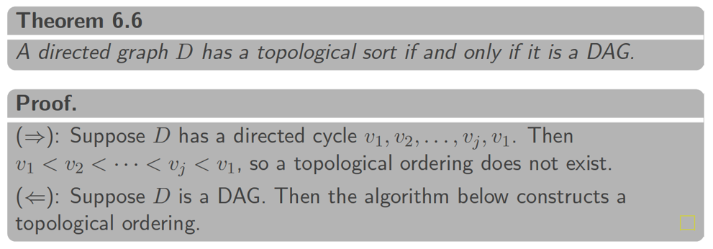
Existence of a topological Sort Order

Slide 39
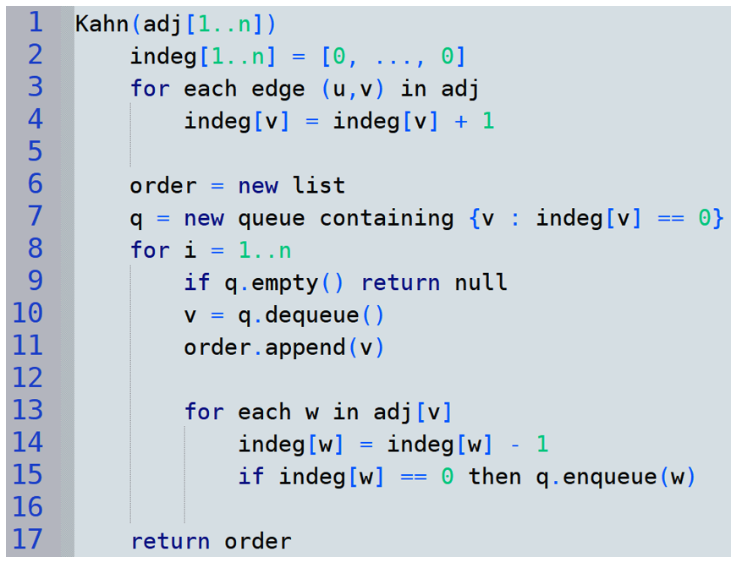
$indeg\left[v\right]=$ # of edges pointing into node $v$
= number of unsatisfied constraints on $v$
Nodes with $indeg$ 0 have no unsatisfied dependencies
So this step is enqueuing nodes whose dependencies are already satisfied
$q$ always contains nodes with no unsatisfied dependencies (indeg 0)
No such order!
Add $v$ to the topological order
Remove $v$’s out edges. If we have now satisfied all dependencies for some $w$, add $w$ to the queue also.

Slide 40
Example (Kahn’s algorithm)
Queue Q
Compute indegree for all vertices
1
0
1
2
1
0
3
2
5
4
1
6
3
2
1
For each node u
For each w in adj(u)
w.deg = w.deg+1
1
1
2
1
0
4
Output
vertices with indeg 0 go into the queue
5
6
Until Q is empty: pop, output that element, decrement its neighbours, enqueue new indeg 0’s
1
0
1
1
2
1
0

Slide 41
Running time with adjacency lists?
$$O(n)$$
$O(n+m)$ total work over all iterations
$O(n)$ iterations
$O(1)$ per check
$$O\left(1\right)$$
$$\sum_{v∈V}{deg⁡(v)}∈O(n+m)$$ total work over all nodes $v$
$O\left(deg⁡(v)\right)$ per iteration $i$
Total $O(n+m)$

Slide 42
Bonus slides

Slide 43
SCC: How about a different ordering?
Rather than doing DFS in the reverse graph in order of decreasing finish times
Why not do DFS in the original graph in order of increasing finish times?
Exercise: does this work?

Slide 44
SCC: How about a different ordering?
Why not do DFS in the original graph in order of increasing finish times?
f,12
e
Doesn’t work!
Output depends where first DFS starts…
f,9
c,14
a,1
b,5
c
b
a,7
b,4
a
c,2
If first DFS starts at c, then…
e,13
e
e,8
d
d,6
d,3
g,11
g
g,10
DFSVisit(b) would reach two SCCs.

