Slide 1
CS 341: Algorithms
Lecture 20: intractability II – complexity class NP
Readings: see website
Trevor Brown
https://student.cs.uwaterloo.ca/~cs341
trevor.brown@uwaterloo.ca

Slide 2
This time
Finishing TSP reductions
Complexity class NP
Oracles, certificates, polytime verification algorithms

Slide 3
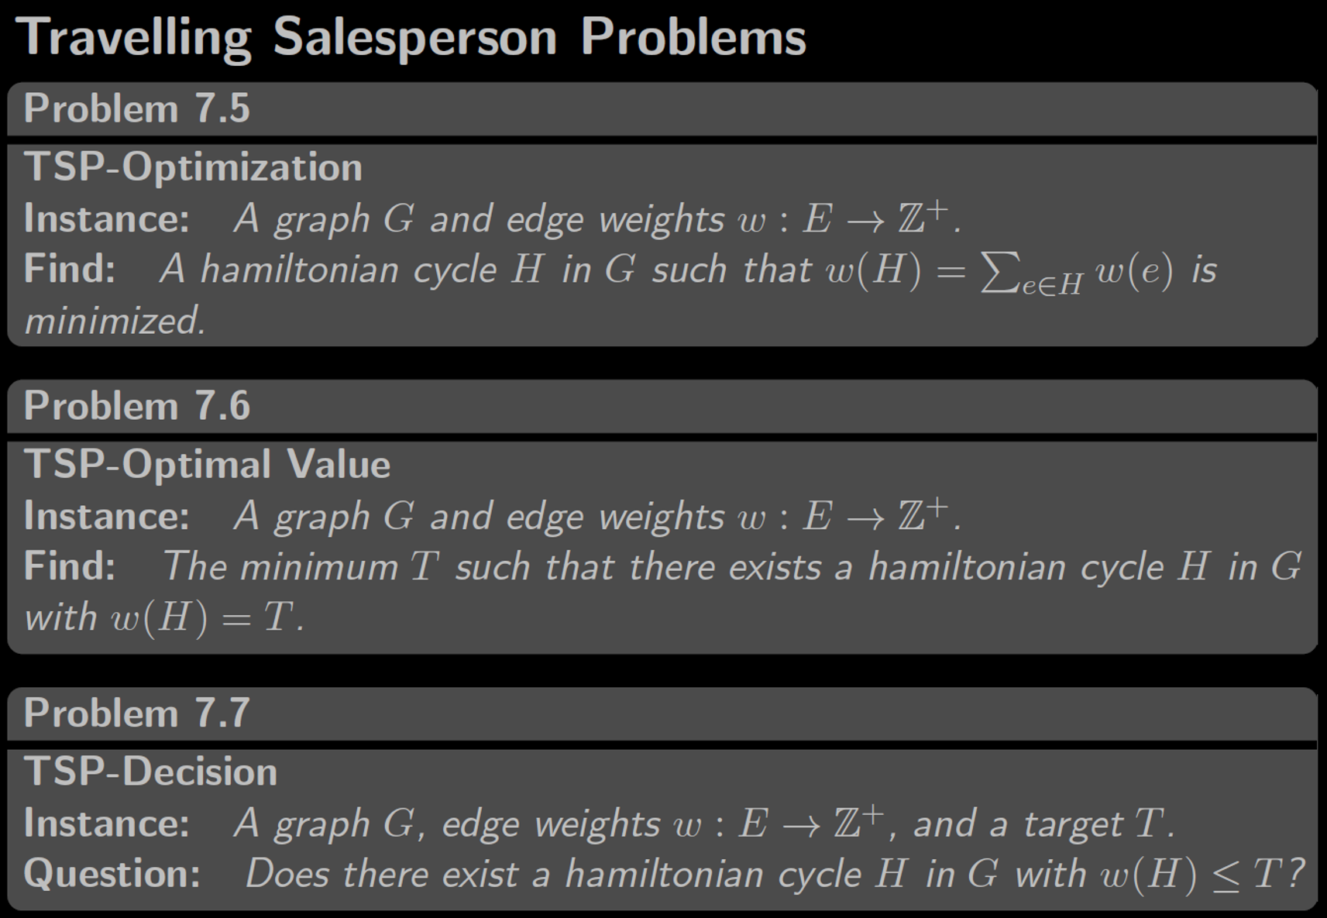
Recall
So far we know
TSP-Dec $≤_{P}^{T}$ TSP-Optimal Value
TSP-Dec $≤_{P}^{T}$ TSP-Optimization
In progress
TSP-Optimal Value $≤_{P}^{T}$ TSP-Dec

Slide 4
What’s the size of the input $I=(G,w)$?
$$Size\left(I\right)=Size\left(G\right)+Size\left(w\right)$$
So, suppose $G$ is represented as an array of adjacency lists (one list for each vertex), with each list containing edges to neighbouring vertices, and an edge is represented by a weight and the name of the target vertex
Bits to store weight of the edge (storing $w(e)$ takes $\log{w\left(e\right)}+1$ bits)
Bits to store the name of the target vertex (in 1..|V|)
$$Size\left(I\right)=|V|+\sum_{e∈E}{\left(log w\left(e\right)+1+log\left|V\right|+1\right)}$$
Array of empty lists for all vertices $v$
For all edges
Let’s relate this to runtime… what’s the runtime?

Slide 5
Let’s assume $O(1)$ time for operations on weights
Technically not needed to show polytime.. But simplifies
$$O(\left|E\right|)$$
$$O(1)$$
$O(1)$ for the oracle
# iterations: $O\left(\log\left(hi−lo\right)\right)$
Runtime $T\left(I\right)∈O\left(\left|E\right|+\log{\sum_{e∈E}{w(e)}}\right)$
$=\log{\sum_{e∈E}{w\left(e\right)}}$
$$O(1)$$

Slide 6
Comparing $T(I)$ and $Size(I)$
$T\left(I\right)$ $∈O\left(\left|E\right|+\log{\sum_{e∈E}{w(e)}}\right)$
$Size\left(I\right)$ $=|V|+\sum_{e∈E}{\left(log w\left(e\right)+1+log\left|V\right|+1\right)}$
$=\left|V\right|+Σ_{e∈E}\left(\log{w\left(e\right)}+1\right)+Σ_{e∈E}\left(\log\left|V\right|+1\right)$
$=\left|V\right|+Σ_{e∈E}\left(\log{w\left(e\right)}+1\right)+Σ_{e∈E}\left(\log\left|V\right|\right)+|E|$
Want to show $T\left(I\right)∈O\left(Size{\left(I\right)}^{c}\right)$ for some constant $c$ (we show c=1)
$O\left(\left|E\right|+\log{\sum_{e∈E}{w\left(e\right)}}\right)$ $⊆^{?}$ $O\left(\left|V\right|+Σ_{e∈E}(\log{w\left(e\right)+1)}+Σ_{e∈E}\log\left|V\right|+\left|E\right|\right)$
$⇔$ $O\left(\log{\sum_{e∈E}{w\left(e\right)}}\right)$ $⊆^{?}$ $O\left(\left|V\right|+Σ_{e∈E}\left(\log{w\left(e\right)}+1\right)+Σ_{e∈E}\log\left|V\right|\right)$
How to compare $\log{\sum_{e∈E}{w(e)}}$ and $Σ_{e∈E}\left(\log{w\left(e\right)}+1\right)$?

Slide 7
Comparing $T(I)$ and $Size(I)$
How to compare $\log{\sum_{e∈E}{w(e)}}$ and $Σ_{e∈E}\left(\log{w\left(e\right)}+1\right)$?
$Σ_{e∈E}\left(\log{w\left(e\right)}+1\right)=\left(\log{w\left(e_{1}\right)}+1\right)+\left(\log{w\left(e_{2}\right)}+1\right)+…+\left(\log\left(w\left(e_{\left|E\right|}\right)\right)+1\right)$
Can we combine these terms into one log using $\log{x}+\log{y}=\log{xy}$?
$Σ_{e∈E}\left(\log{w\left(e\right)}+1\right) =\left(\log{w\left(e_{1}\right)}+\log{2}\right)++…+\left(\log\left(w\left(e_{\left|E\right|}\right)\right)+\log{2}\right)$
$Σ_{e∈E}\left(\log{w\left(e\right)}+1\right) =\log{2w\left(e_{1}\right) 2w\left(e_{2}\right) … 2w\left(e_{\left|E\right|}\right)}=\log{\prod_{e∈E}{2w\left(e\right)}}$
So how to compare $\log{\prod_{e∈E}{2w\left(e\right)}}$ and $\log{\sum_{e∈E}{w(e)}}$?
All $w\left(e\right)$ are positive integers, so $\prod_{e∈E}{2w\left(e\right)}≥$ $\sum_{e∈E}{w(e)}$
Since log is increasing on ℤ⁺, $\log{\prod_{e∈E}{2w\left(e\right)}}≥$ $\log{\sum_{e∈E}{w(e)}}$

Slide 8
Comparing $T(I)$ and $Size(I)$
We in fact show $T\left(I\right)∈O(Size\left(I\right))$
$O\left(\log{\sum_{e∈E}{w\left(e\right)}}\right)$ $⊆^{?}$ $O\left(\left|V\right|+Σ_{e∈E}\left(\log{w\left(e\right)}+1\right)+Σ_{e∈E}\log\left|V\right|\right)$
How to compare $\log{\sum_{e∈E}{w(e)}}$ and $Σ_{e∈E}\left(\log{w\left(e\right)}+1\right)$?
We just saw $Σ_{e∈E}\left(\log{w\left(e\right)}+1\right)=\log{\prod_{e∈E}{2w\left(e\right)}}≥\log{\sum_{e∈E}{w(e)}}$
So $T\left(I\right)∈O\left(Size{\left(I\right)}^{c}\right)$ where $c=1$
So this reduction has runtime that is polynomial in the input size!

Slide 9
So TSP-OptimalValue-Solver is polytime… But is it a correct reduction from TSP-Optimal Value to TSP-Dec?
Need to prove: TSP-OptimalValue-Solver(G,w) returns the weight $W$ of the shortest Hamiltonian Cycle (HC) in G
Sketch: We return $∞$ iff there is no HC.
Key loop invariant: $W∈[lo,hi]$.
So, at termination when $hi=lo$, we return exactly $hi=W$.

Slide 10
So, TSP-OptimalValue-Solver is polytime, and is a correct reduction.
We have therefore shown:
TSP-Optimal Value is polytime reducible to TSP-Dec
So, if an $O\left(1\right)$ implementation of TSP-Dec-Solver exists, then we have a polytime implementation of TSP-Optimal-Value-Solver!
In fact, TSP-OptimalValue-Solver remains polytime even if the implementation of the oracle runs in polytime instead of O(1)! (bonus slides)

Slide 11
Proving reductions correct
In more complex reductions where we transform the input before calling the oracle, we will need a more complex proof:
(A) If there is a(n optimal) solution in the input, our transformation will preserve that solution so the oracle can find it, and
(B) Our transformation doesn’t introduce new solutions that are not present in the original input
(i.e., if we find a solution in the transformed input, there was a corresponding solution in the original input)
More on this later…

Slide 12
Input size cheat sheet
Exponentially larger than optimal representation!
Input $I$ | Perfectly fine choices of $Size(I)$
int $x$ | $1$ or $⌊\log\left(x\right)⌋+1$ (can simplify to $\log\left(x\right)+1$ or $\log{x}$)
Graph $\left(V,E\right)$ with weights $W$: | $|V|$ or $|E|$ or ${\left|V\right|}^{2}$ or $\left|V\right|+|E|$ or $\sum_{e∈E}{(\log\left(w\left(e\right)\right)+1)}$ or $\sum_{u,v∈V}{(log\left(w\left(u,v\right)\right)+1)}$ or any sum of terms above
$A[1..n]$ of int | $n$ or $\sum_{i}{(\log\left(A\left[i\right]\right)+1})$
$n$ x $n$ matrix $m$ | $n^{2}$ or $\sum_{i,j}{(log\left(m_{ij}\right)+1})$
Input $I$ | Examples of BAD choices of $Size(I)$
int $x$ | $x$
Graph $\left(V,E\right)$ | $2^{|V|}$ or ${\left|V\right|}^{|E|}$ or $\sum_{e∈E}{w(e)}$
$A[1..n]$ of int | $2^{n}$ or $\sum_{i}{A[i]}$
To write down x=1, need log(1)+1=1 bit.
For x=2 this is 2 bits.
For x=4, 3 bits.
Pick any expression that makes your analysis easy
Pseudo-polynomial ~= no exponentiation of non-constant terms
Technically any pseudo-polynomial combination of these terms is fine. For example, the following is fine: $\left({\left|E\right|}^{100}+{\left|V\right|}^{2}\right)⋅\sum_{e∈E}{(\log\left(w\left(e\right)\right)+1)}$

Slide 13
So far we know
TSP-Dec $≤_{P}^{T}$ TSP-Optimal Value
TSP-Dec $≤_{P}^{T}$ TSP-Optimization
TSP-Optimal Value $≤_{P}^{T}$ TSP-Dec
Let’s show
TSP-Optimization $≤_{P}^{T}$ TSP-Dec

Slide 14
What about reducing TSP-Optimization to TSP-Dec?
Need to return the actual minimum Hamiltonian Cycle!
We already know how to get the weight $T^{∗}$ of the minimum HC…
Idea: Use $T^{∗}$ along with calls to the oracle to somehow figure out which edges are involved in the minimum HC?
Given only a single bit of information per call to the oracle

Slide 15
To remove any dependence on this “other oracle,” simply replace this call with the reduction code we showed
Already know this call is poly-time reducible to TSP-Dec!
If removing edge $e$ removes every Hamiltonian cycle of minimum weight
then $e$ is part of every minimum Hamiltonian cycle, and we add it to $H$ (and add it back into the graph)
At the end, the graph contains precisely the edges that are needed to produce a minimum HC
[Correctness] Loop invariant: there exists a HC of weight $T^{∗}$ in $w_{0}$
By the end of the loop, $H$ contains all finite edges in $w_{0}$
So some HC $C$ of weight $T^{∗}$ is contained in $H$

Slide 16
At the end of the algorithm, there is a Hamiltonian Cycle $C$ of optimal weight $T^{∗}$ contained in $H$
If $H$ is precisely $C$, then we are done.
Suppose not to obtain a contradiction.
Graph $H$
3
3
In this case, there are some other edges in $H$ as well.
1
Let $e$ be one such edge.
Edge $e$
4
2
Consider the iteration when $e$ was processed. Note $e$ was not removed in this iteration!
1
5
1
Doing so would remove all Hamiltonian Cycles of weight $T^{∗}$, including $C$.
Hamiltonian cycle
$C$ of weight $T^{∗}$
This means the edge must be part of $C$---contradiction!

Slide 17
So this is a correct reduction.
Is it a polytime reduction?
What’s the runtime?
Let’s assume unit costs for simplicity
Runtime = $poly\left(Size\left(I\right)\right)+O\left(m\right)$
$poly\left(Size\left(I\right)\right)$
What’s $Size(I)$? (What’s a “useful” lower bound?)
$O(m)$ to copy matrix
$$O(1)$$
$Size\left(I\right)=Ω\left(|E|\right)=Ω(m)$
$O(1)$ to create list
Clearly $O\left(m\right)∈O\left(Size{\left(I\right)}^{1}\right)$
So runtime is in $poly\left(Size\left(I\right)\right)$
$O(m)$ iterations
$O(1)$ per iteration
So yes, this is a polytime reduction
What would change if we precisely counted the number of bits in each edge, weight, etc., in $Size(I)$?
What if operations on weight $w$ took $O(\log{w})$ time? (bonus slides)

Slide 18
Recap
Showed three flavours of TSP are polytime-equivalent (i.e., if you can solve one flavour in polytime, you can solve all three flavours in polytime)
One of these was a decision problem (yes/no), and the other two were not (total weight, actual cycle)
Decision and non-decision flavours of a problem are often polytime-equivalent
Proofs for a polytime Turing reduction
Correctness (return value is correct for every possible input)
Polytime (runtime is polynomial in the input size) [or poly(some lower bound on the input size)]

Slide 19
Complexity class NP
Note: only one of my sections got here
NP: Non-deterministic polynomial time

Slide 20
Example: subset-sum problem
Suppose we are given some integers, -7, -3, -2, 5, 8
Does some subset of these sum to zero?
In this case, yes: (-3) + (-2) + 5 = 0
Finding such a subset can be extremely difficult
Suppose I give you a certificate consisting of an array of numbers, and claim it represents such a subset
Of course, I might lie and give you a subset that does not sum to zero…
I could even give you numbers that are not in the input…
If I’m telling the truth, then we call this a yes-certificate. It is is essentially a proof that “yes” is the correct output.
Can you determine whether I am lying in polynomial time?
Can you use a yes-certificate to solve the problem efficiently?

Slide 21
Subset-sum via non-deterministic oracle
Suppose there is a non-deterministic oracle, which returns a subset that sums to 0 if one exists and otherwise can return anything (even garbage)
We call the oracle’s output a certificate
Given a certificate, can you verify in polytime whether it describes a solution to the problem?
Otherwise, either C is not a subset of the input (return false), or C sums to a non-zero value (return false)
If there exists a subset that sums to 0, then C is one such subset, and we return true
Given such an oracle, this algorithm would solve subset-sum
“Non-deterministic” is the N in NP, and it is so named because of oracles
Here “non-deterministic” just means the oracle is magically guaranteed to return a yes-certificate if one exists

Slide 22
Bonus slides

Slide 23
TSP-OptimalValue-Solver remains polytime even if the oracle runs in polytime instead of O(1)!
The key idea is: Consider polynomials $P_{R}(s)$ and $P_{O}\left(s\right)$ representing the runtime of a reduction and its oracle, respectively, on an input of size $s$.
Worst possible runtime happens if every step in the reduction is a call to the oracle. This is $P_{R}\left(s\right)P_{O}(s)$ --- multiplication of polynomials.
But multiplying polynomials of degrees $d_{1},d_{2}$ results in a polynomial of degree $≤d_{1}+d_{2}$. Example:
$$P_{1}\left(x\right)=5x^{2}+10x+100$$
$$P_{2}\left(x\right)=20x^{3}+20$$
$$P_{1}\left(x\right)P_{2}(x)=(5x^{2}+10x+100)(20x^{3}+20)$$
$$=100x^{5}+200x^{4}+2000x^{3}+100x^{2}+200x+2000$$

Slide 24
Let’s assume $O(\log{w})$ time for reading/writing/arithmetic operations on each weight w (and $O\left(\log{w}\right)$ space).
So this is a correct reduction.
Is it a polytime reduction?
What’s the runtime on such an input?
Runtime = $poly\left(Size\left(I\right)\right)$ $+O\left(m+\sum_{u,v∈V}{\log{w\left(u,v\right)}}\right)$
Suppose we show this is $poly\left(Size\left(I\right)\right)$
What’s $Size(I)$?
(or a useful lower bound on it)
$O(\sum_{u,v∈V}{\log{w\left(u,v\right)}})$ to copy matrix
$$O(1)$$
$Size\left(I\right)=O\left(|E|+\sum_{u,v∈V}{\log{w\left(u,v\right)}}\right)$
$O(1)$ to create list
$O(m)$ iterations: for all $u,v$
Clearly $O\left(m+\sum_{u,v∈V}{\log{w\left(u,v\right)}}\right)∈poly\left(Size\left(I\right)\right)$
$$O\left(\log{w\left(u,v\right)}\right)$$
$$O(1)$$
So, this is still a polytime reduction
$$O\left(\log{w\left(u,v\right)}\right)$$
Unit cost vs non-unit cost assumptions usually do not usually make a difference…
$$O(1)$$
This should not be surprising, since the same $O(\log{w})$ terms are introduced into both space and time complexities…

